Slide 1

Welcome Presentation
Year 6

Slide 2

Agenda
Staff
Punctuality
Attendance
Year group routines
Lunch Times
Uniform
PE
Reading
Homework
Reminders
SATs
Secondary Applications

Slide 3
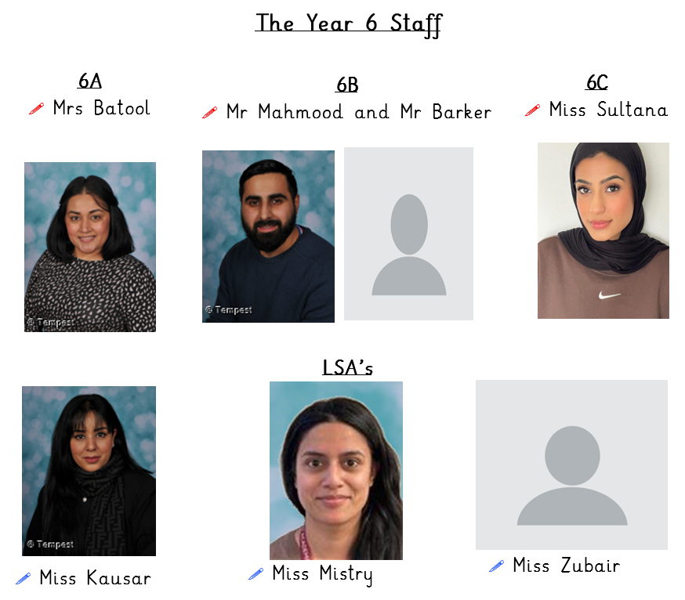
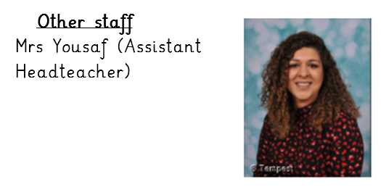
Year 6 Staff

Slide 4
Punctuality
Children are expected to line up outside 6A entrance at 8:30am every morning in line order.
Children will be led inside by their class teacher to start school at 8:35am.
If you arrive after 8:45am, your child will receive a late mark from the office which can mean missing out on exciting attendance rewards.
When school visits occur, you must ensure that your child arrives at the specified time.

Slide 5
Attendance
It is important to attend school every day. 96% attendance is only 'average'.
To optimise learning opportunities, your child must aim for above 96%
Please inform school if your child is sick.
Wherever possible arrange medical appointments before or after school, or during the weekends.
If your child comes to school on time every day, in the half-term, they will receive an attendance sticker. If they receive all stickers for the half-term, they will take part in a lucky prize dip. If your child comes to school every day on time for the whole year, they have a chance to win a bike!

Slide 6
Year Group Routines
The day begins at 8:35am. The Year 6 teachers will be waiting on the Lower Key Stage 2 playground from 8:30am. The Year 6 teachers will then lead the children into school at 8:35am through the 6A classroom entrance. It is important that your child is on time.
Please note: The Year 6 teachers will go inside with the children at 8:35am and school gates will close at 8:45am. If your child arrives after this time, you must take them to the school office. Any child that is late will be signed in and issued with a late slip.
The school day finishes at 3:05pm. Please collect your child from the class’s designated collection area. 6A, 6B and 6C will leave through the 6A entrance. We politely ask that parents stand in their allocated area and wait until children are sent to you. If you have not collected your child by 3:15 pm they will be taken to the school office.
It is vital that these timings at the beginning and end of day are strictly adhered to maintain the safety of our pupils, staff, and yourselves. Please feel free to approach staff in the playground with any queries or information before the day begins.

Slide 7
Lunch Times
Lunch time will start at 12:15pm for Year 6 and will finish at 1:00pm.
Our school canteen is HMC registered, and the food is halal. The canteen offers a variety of choice, and a menu is also available for you to see what your child is eating.
In Year 6 we expect all children to eat lunch at school and not at home, so that they can socialise with their peers. If there are any concerns around this, please speak to your child’s class teacher.

Slide 8
Uniform
Your child must wear a ‘Horton Grange’ uniform.
This consists of:
A maroon jumper/cardigan.
A white polo shirt or long-sleeved shirt for the winter.
Grey skirt, trousers, dress or shalwar kameez.
Black hijab with school logo on it (optional for girls)
Grey tights.
Sensible black shoes. Please, no open toed shoes, sandals or high heels or trainers.
In winter, please provide a waterproof coat, hat and gloves and in Summer it can get hot, so a sun hat and cream is essential. Please apply the cream yourself before coming to school. It would be useful if your child wore wellies in the rainy/snowy weather, but they should bring a change of shoes for when they are inside.
Children should look presentable. Children should not have any lines shaved into their hair, wear trainers (on non-PE days) or jewellery, such as hooped earrings.

Slide 9
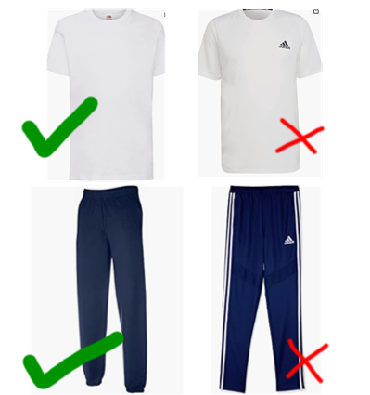
PE
Year 6 have PE on Tuesdays and Thursdays in the Khidmat Centre.
Children should arrive to school on these
days in their school PE kit.
This consists of:
A white polo shirt / T-shirt.
A maroon Horton Grange hoodie.
Blue/black jogging bottoms.
Black pumps or trainers.
Uniform must not have lines or patterns on them.

Slide 10
Reading
Please help your child to read their book every night and sign off their Raving Readers. We check every Wednesday during class assembly.
We encourage family members to ask children questions about the text to check their understanding of what they have read.
Children will be able to change their fluency book at least once a week.
Children will visit the library every week. Library books need to be returned each week. If books are lost or damaged, there will be a charge. This is so that we can replace the book.

Slide 11
Homework
Spellings
Given out: Wednesday
Collected in: Monday
English and Maths
Children should complete their homework and hand it in by Monday. You will receive a message via Marvellous Me to tell you about your child's homework each week. Children will also be informed.
Parents and older siblings are encouraged to work with children on homework but please do not allow older siblings to complete set homework for children.
We encourage all children to look at their homework on Wednesday evening so that they have time to approach a teacher for help if they are unsure of how to complete it.
Every half term, the children will be given a project to complete over the holidays for their new topic. We encourage parents to support with this.

Slide 12
Reminders
The doors and gates will be closed at 8.45am, after which time you must take your child to the school office where they will be marked as late arrivals.
We encourage children to eat their lunch at school, but if they do go home for lunch, they must be dropped off at the school gates at 12.55pm and you must wait with them until their class teacher collects them.
The school day finishes at 3.05pm. All year 6 children will leave from the 6A fire door. If you have not collected your child by 3:15pm they will be taken to the school office for collection.
Let a member of staff know if someone other than yourself is collecting your child. For safety reasons we will not allow a child to go home with someone unless their main carer has informed school and have provided us with a password.

Slide 13
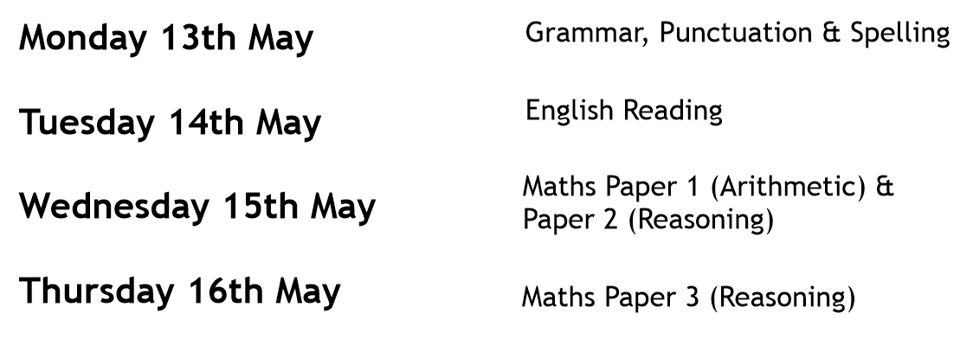
SATS
To further support our pupils, it is important that they are confident with their Year 5 and 6 Spellings which you received in your Welcome Pack to Year 6.

Slide 14
Secondary School Applications
Application forms can be found on the Bradford Council website. These applications must be completed between the 12th September 2023 and 31st October 2023. School allocations will then be announced at the beginning of March 2024.
Easy to apply online.
Secondary schools are having open evenings specified in the letter in which the council sent out.
www.bradford.gov.uk/admissions

