Slide 1


Welcome Presentation
Year 5

Slide 2
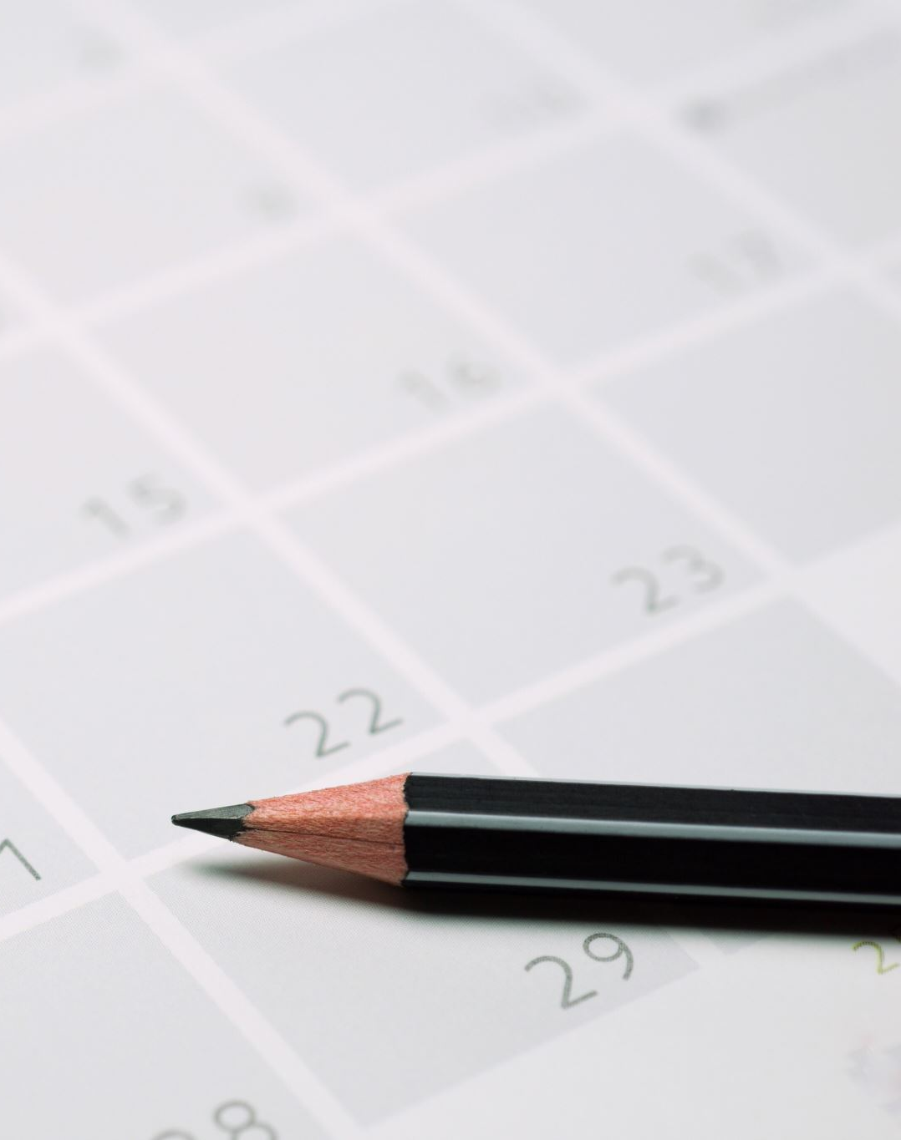
Agenda
Staff
Attendance and punctuality
Year group routines
Uniform
PE
Reading
Homework
Music
Ingleborough Hall Residential

Slide 3
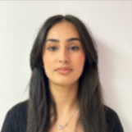
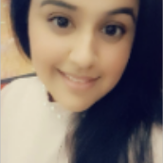
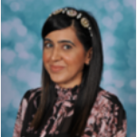
Staff
Class Teachers
Miss Khalid 5A
Miss Zaeeb 5B
Miss Afzal 5C
Support Staff
Mrs Begum
Miss Haq

Slide 4

Attendance and Punctuality
At Horton Grange we aspire for our children to aim at 100% attendance and for them to come into school, on time, every day!
A lack in this, will fundamentally impact their learning and their performance in class.
At our school we celebrate attendance and punctuality by holding weekly assemblies which allows children to win a trophy, a book and a certificate for their class.
We hope you will support us in ensuring your children attend school every day. This is only possible with YOUR support!

Slide 5

Year Group Routines
Morning – Registration and morning work.
Morning – Maths, break time, English and a Curriculum Lesson.
(Curriculum lessons comprise of, history, geography, art, DT, music, spanish, PSHE, PE)
Lunch time
Afternoon - Registration
Afternoon – Curriculum lessons

Slide 6
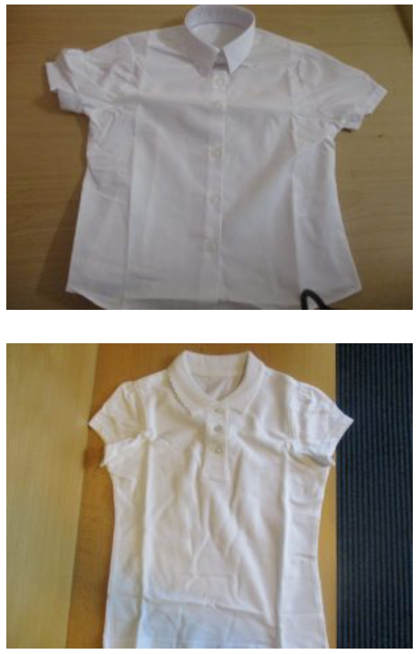
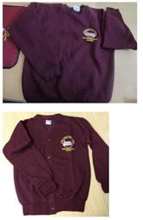
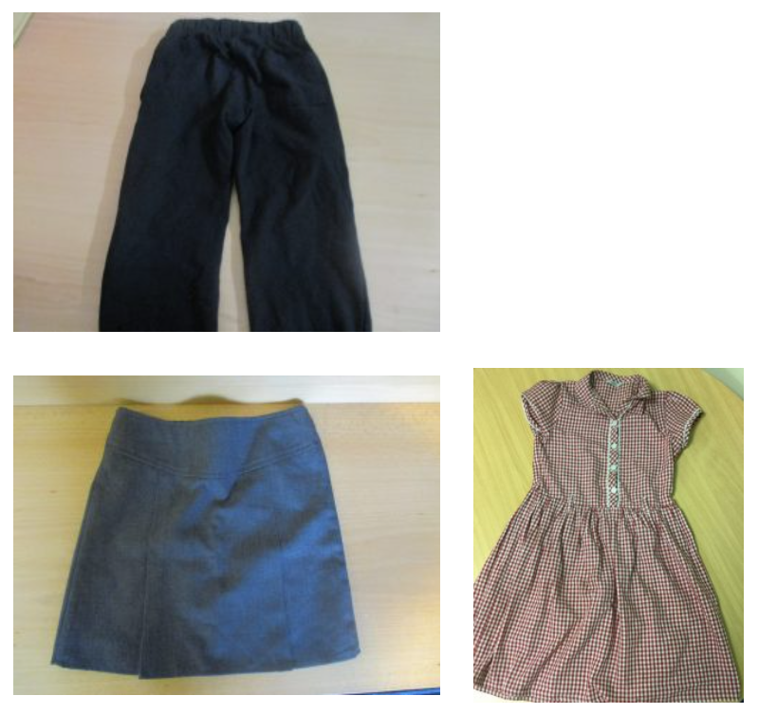
Uniform
We expect children to be dressed in the complete uniform for Horton Grange. Here is what we accept as uniform worn by boys and girls.
Please ensure children are ONLY wearing their Horton Grange hoodies on their allocated PE days.
In the event, of correct uniform not being worn, parents will be informed, and the correct uniform will have to be brought in for your children to wear.

Slide 7

PE
5A children have PE on Tuesday and Wednesday.
5B and 5C have PE on Wednesday and Thursday.
We expect children to come into school wearing their PE kit.
This must comprise of the following;
White polo shirt
Horton Grange Jumper/Hoody
Black or navy joggers/leggings/shorts
Trainers

Slide 8

Reading
“Regularly reading stories or novels outside of school is associated with higher scores in reading assessments”
“Reading enjoyment has been reported as more important for children’s educational success than their family’s socio-economic status.”
Department for Education
(2012)

Slide 9

Reading
Children have been sent their Raving Readers with their reading books which we EXPECT them to have signed and read at home at least once, on an evening with an adult at home.
Children are expected to bring their Raving Reader to school every day and hand them in on a Monday with their homework for the teacher to mark.
The children will bring home a fluency book which is in accordance with their reading level and a book to read for pleasure.
We urge you to support their reading at home and reach out if you are having trouble with this at home.

Slide 10

Homework
In Year 5 children will receive a Maths and English workbook which they will use for their homework weekly.
We set the children homework from these books in accordance with what they are learning in school. This is so you are aware of the children’s learning in school therefore giving you the opportunity to support them at home.
Homework is set on a Wednesday and due back in on a Monday morning.
Spellings get given on a Tuesday and children are tested the Tuesday after, every week.

Slide 11

Music
The children have been given the chance to take part in a concert at St George’s Hall on the 16th October.
We will be sending letters out nearer the time to inform you of this, in more detail.
Later in the Year, children have the fantastic opportunity to practice playing the guitars by a professional musician.
They are really excited about this!

Slide 12
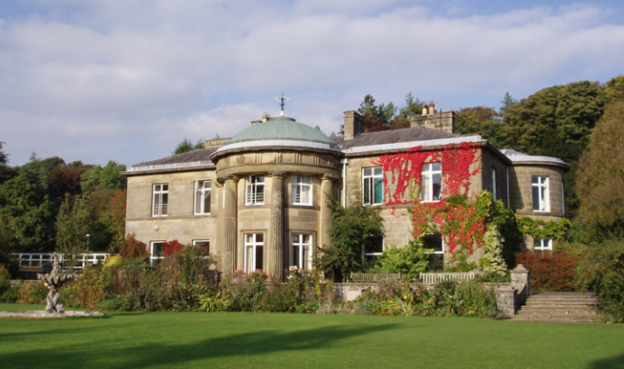
Ingleborough Residential
January 3rd – 5th 2024

Slide 13
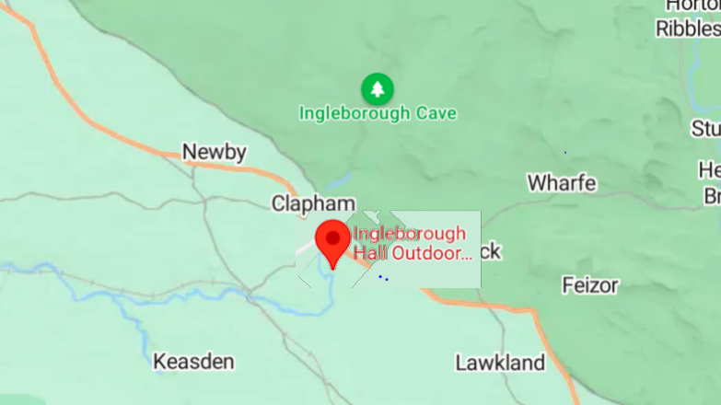
Ingleborough Hall lies on the Southern Flanks of Ingleborough Hill in the Yorkshire Dales village of Clapham.
The journey comprises of 1 hour and 10 minutes approximately.

Slide 14

Timetable and Activities
4 main activities: caving, gorge scramble, village study, orienteering/tree climb.
Evenings: relax, reading, watching films and board games.

Slide 15
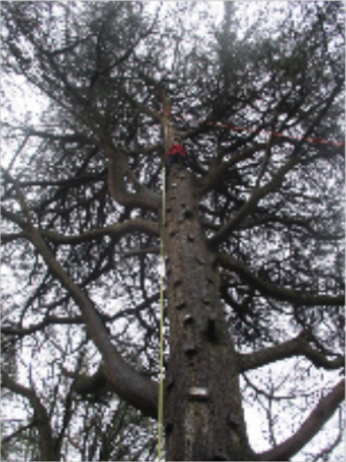
Last Year 2023

Slide 16
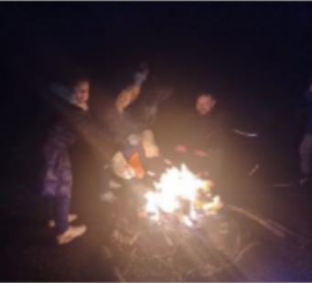
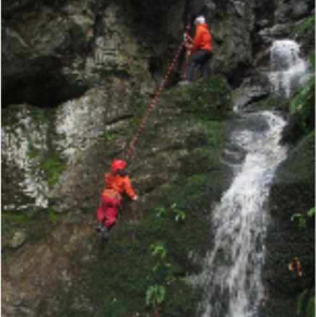
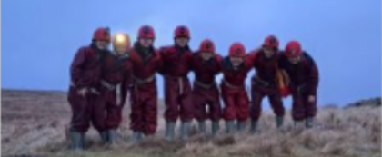
Last Year 2023

Slide 17

Thank you for Listening
If you have any questions regarding this, please do not hesitate to contact the class teacher and we will be happy to give further information.
There is also a detailed session taking place on Friday 15th September 2023 at 9am at the school, which we would like you to attend so you can ask any questions you might have.

