Slide 1

Welcome Presentation
Year 3

Slide 2

Agenda
Staff
Attendance and punctuality
Year group routines
Uniform
PE
Reading
Homework

Slide 3
Teachers
Mrs Bowker 3A
Mr Taylor 3C

Slide 4
Teachers & Support Staff
Support Staff:
Miss Tempest 3A
Mrs Afzal 3B
Miss Ilyas 3C

Slide 5
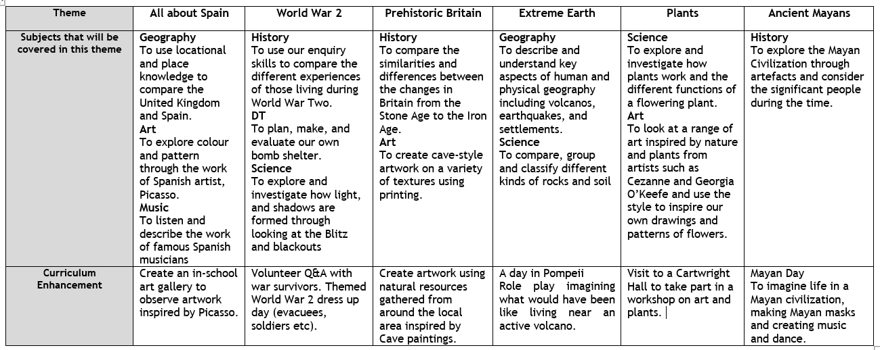
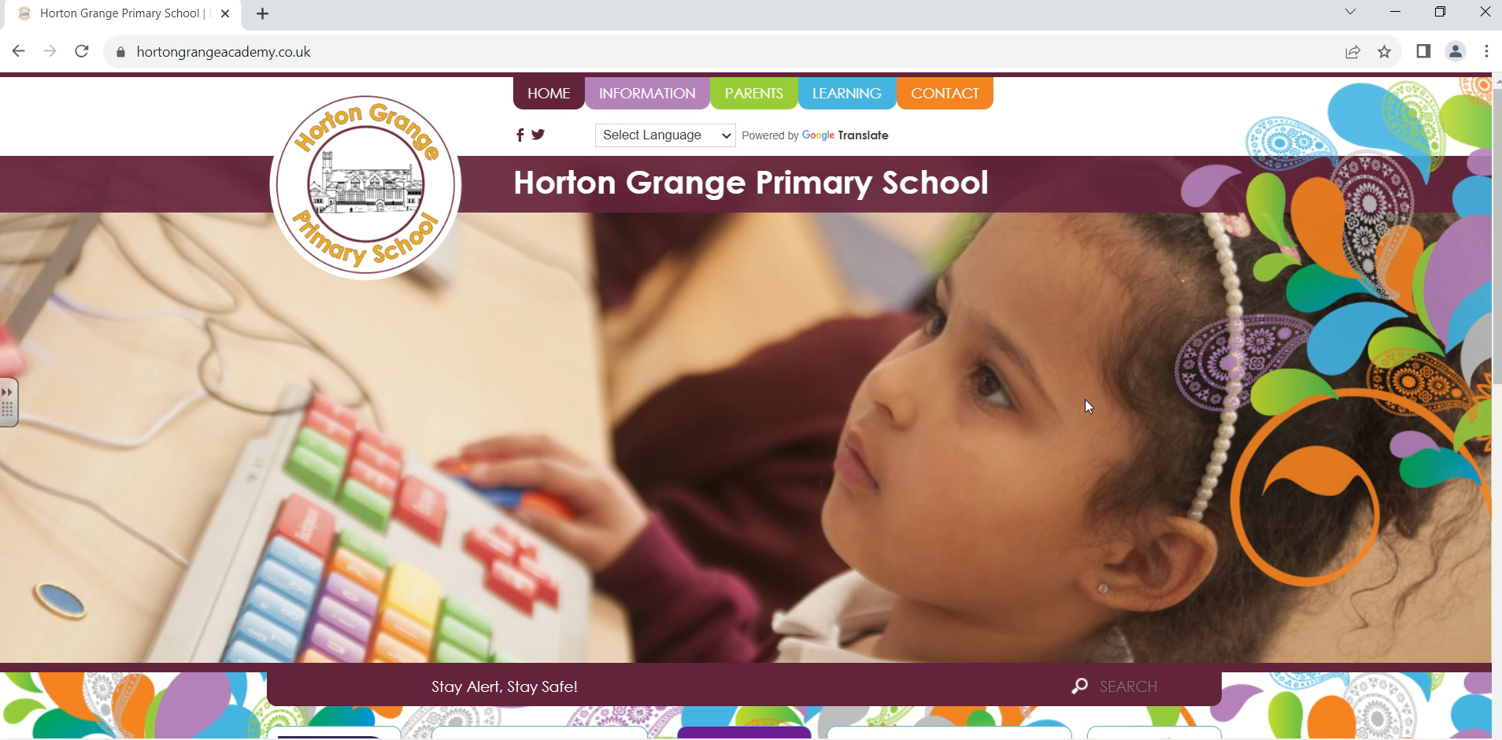
Long Term Plan- Can be found on the school website.

Slide 6
Attendance
Important to attend school everyday.
Important to arrive on time.
Children receive a badge on marvellous me each week for attending school.
Please inform school if your child is sick.
100% attendance – chance to win a bike.

Slide 7
Routines
Year 3 will enter, and exit, from 3A’s classroom door.
Raving Readers- Ensure you read with your child everyday and record this in their raving reader journal.
Homework (Spellings, English and Maths) – given on Wednesday, due in Monday. Children will be tested on these spellings on Wednesday.
Homework books- You will be told which pages to complete.
Children have a morning break and will have an afternoon break until Christmas to help with transition.
We encourage all children to stay in school for their lunch break. This helps form friendships and build independence.

Slide 8
Reading
Reading is very important for our children. It is necessary for them to read at home everyday and get their Raving Reader journal signed.
It helps children to:
Develop their comprehension skills
Interpret what they have read
Respond to texts and discuss them
Adopt richer vocabulary

Slide 9
Uniform
School jumper, white shirt, grey trousers, skirt or dress, school book bag.
Black shoes or black trainers. No boots!
Headscarves should be plain and black. Short styles only. School headscarves are available.
Haircuts for boys should be plain – no shaved lines or patterns.
No jewellery except studs in ears.

Slide 10
PE
3A PE days – Tuesday and Wednesday
3B PE days – Wednesday and Friday
3C PE days – Wednesday and Thursday
Children will need a plain white t-shirt, shorts or jogging bottoms.
Pumps or trainers must be worn for PE.
One of these sessions will be in the Khidmat Centre.

Slide 11
Lunchtimes
We encourage all children to stay in school for lunch.
12.15-1.00pm
Home dinners must be collected at 12.15 and will not be allowed through the gate any earlier than 1pm.
Please ensure all children bring a coat to school.
Packed lunches need to be healthy – no fizzy drinks, sweets or chocolate. No nuts!

Slide 12
Homework
Homework and spellings will be handed out every Wednesday.
Your child will receive Maths and English homework as well as spellings to learn each week.
The pages that need completing for Maths and English homework will be written in the inside cover.
This needs to be completed and handed back in by the following Monday.
Homework books are an expensive resource and belong to the school. Any damaged or lost books will be charged for.

