Slide 1
Welcome Presentation
Year 2

Slide 2
Agenda
Staff
Attendance and punctuality
Year group routines
Uniform
PE
Reading
Homework

Slide 3
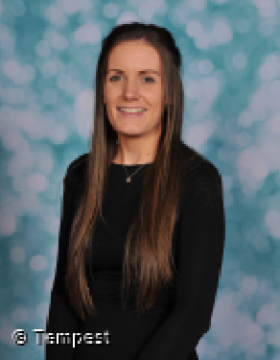
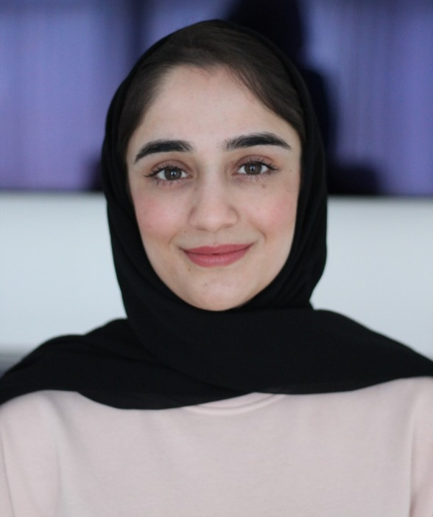
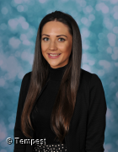
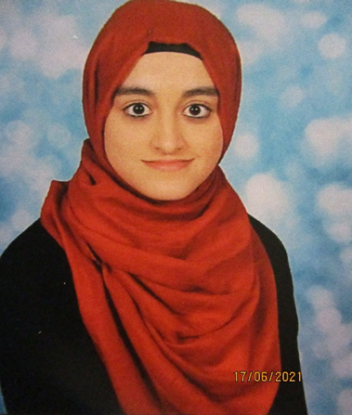
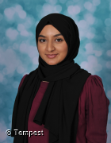
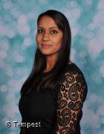
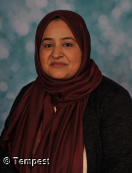
Year 2 Staff
2A 2B 2C
Miss Matthews
Miss Hanif
Mrs Whitehead
Mrs Bibi
Miss Ali
Miss Yasmin
Miss Lawson
Mrs Baidya
Mrs Qadir

Slide 4
Attendance and Punctuality
The day begins at 8:35am. The Year 2 teachers will be waiting on the Year 2 playground from 8:30am. The Year 2 teachers will then lead the children into school at 8:35am through the Year 2 entrance. It is important that your child is on time.
Please note: The Year 2 teachers will go inside with the children at 8:35am and school gates will close at 8:45am. If your child arrives after this time, you must take them to the school office. Any child that is late will be signed in and issued with a late slip.
The school day finishes at 3:05pm. Please collect your child from the class’ designated collection area in the Year 2 playground. We politely ask that parents stand in their allocated area and wait until children are sent to you. If you have not collected your child by 3:15 pm they will be taken to the school office.

Slide 5
Year group routines
Break Times
Your child will have a morning break at 10:15-10:30 and an afternoon break from 1:45-2:00. Milk and a snack will be given to the children during these breaks.
Lunch times
Lunch time will start at 12:00pm for Year 2 and will finish at 12:45pm.
Our school canteen is HMC registered, and the food is halal. The canteen offers a variety of choice and a 3-week menu is also available for you to see what your child is eating.
In Year 6 we expect all children to eat lunch at school and not at home, so that they can socialise with their peers. If there are any concerns around this, please speak to your child’s class teacher.

Slide 6
Uniform
School Uniform
All children in Year 2 must wear ‘Horton Grange’ uniform.
This consists of:
A maroon jumper/cardigan.
A white polo shirt or long-sleeved shirt for the winter.
Grey or black skirt, trousers, dress or shalwar kameez.
Grey or black tights.
Sensible black shoes. Please, no open-toed shoes, sandals, high heels, or trainers.
Haircuts should be smart with no shaved designs. If your child comes to school with a design shaved into their hair, a phone call will be made home. Long hair must be tied up.
You can purchase a jumper/cardigan with the school logo from:
Natasha’s Schoolwear and Uniform Shop
37 Westgate, Bradford, BD1 2QT
01274 724676
In winter, please provide a coat, hat, gloves, and scarf; in summer, a sun hat and cream are essential. Please apply suncream at home to your child, before coming to school. It would be useful if your child wore wellies in the rainy weather and they can then change into their school shoes once in the classroom.
Remember to put your child’s name and class in all clothing. It is not uncommon for children to get their clothes mixed up.
Book Bags
Every child in school should have a book bag. They need it for their reading book and homework. Please ensure that your child’s book bag is clearly labelled with their name and class.
Jewellery
For safety reasons only stud earrings can be worn in school. These should not be worn on P.E days. No other jewellery or items on a string are permitted.

Slide 7
PE
PE lessons will take place every Tuesday and Thursday.
Please ensure your child has a white polo shirt, black/blue shorts or jogging trousers and trainers.
Children need to come to school in their P.E. uniform on P.E. days, including their PE hoodie.

Slide 8
Reading
Please support your child’s learning by listening to them read daily at home. Encourage your child to talk about the book and what is happening in the story by asking questions. Each time your child reads at home, make a note of this in their Raving Reader book and sign it to say that an adult has heard them read. Your child will receive a “reading fluency book” that they will keep and read all week until they are fluent in that book. They can also choose a “reading for enjoyment book” from a selection in class.
Please note: If these books are lost or damaged there will be a charge to replace the book.

Slide 9
Homework
English and Maths
Given out: Friday
Collected in: Wednesday
Please make sure that your child completes their homework every week. Parents, Carers and older siblings are encouraged to support children with their homework. We respectfully ask that children complete their homework independently. If your child is struggling to complete tasks set, please speak with their class teacher.
Spellings
Spellings will be tested in class on a Monday. New spellings that need to be learnt will be given to children on a Monday to learn at home for a test the following week.

