Slide 1

Welcome Presentation
Reception

Slide 2
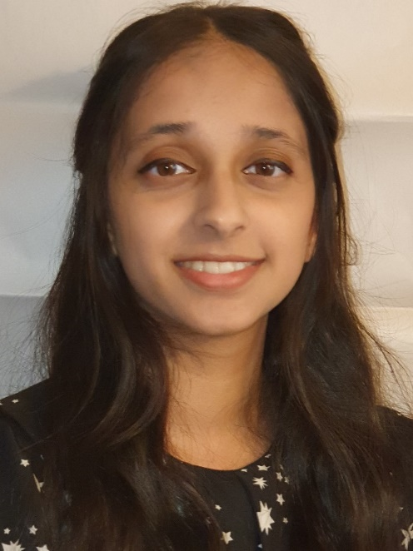
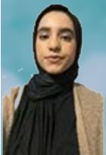
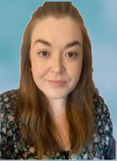
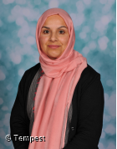
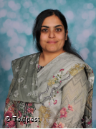
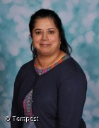
Staff in Reception
RA RB RC
Miss Khalifa
Miss Arshad
Miss Howard
Mrs Baig
Mrs Ashraf
Mrs Hussain

Slide 3

Attendance
Children should arrive at school between 8.30 and 8.45 every morning and can be collected from school between 3.05pm and 3.15pm.
Children should come to school every day, however if they are poorly, please make sure that you inform the office before 8.45am.
If your child attends school every day, they will receive a prize termly and be entered in a draw to win a bike at the end of the year.

Slide 4
Collecting at home time
Please make sure that if you are unable to collect your child at the end of day, that you let the Class Teacher know as soon as possible, or ring the office and they will pass on a message to your child’s teacher.
If a different adult is collecting your child, inform the office and provide a password so that we can ensure your child is dismissed safely.

Slide 5
Uniform
Maroon school jumper or cardigan
Grey trousers, shorts, skirt or summer dress
White polo shirt
Plain black shoes – not trainers
Plain black slip- on headscarf
Stud earrings – no hoops
No extra haircuts with shaved designs
Book bag (can be bought from Natasha’s)
During warm weather and PE sessions, children will be removing their jumpers.
Please make sure that all uniform is clearly labelled with your child’s FULL name and class.

Slide 6
PE
PE for Reception is on a Monday.
Children come to school in their PE kit which consists of:
White polo shirt or plain white t-shirt.
Black jogging bottoms or leggings
Trainers
School hoodie

Slide 7
Spare clothes
Please could all children bring a spare set of clothes in a drawstring bag, which will stay in school. This will need to be clearly labelled with your child’s name and class.
This is in case of spillages or children getting their clothes wet when playing.

Slide 8
School dinners
All children will receive a warm, free school meal in Early Years and KS1.
Teachers go up to the canteen with the children and then support staff will stay with the children until the end of lunch time.
All meals are halal and if your child has an allergy, they will receive an individual meal.

Slide 9

Raving Readers
We ask that all children read every night at home and this is then recorded into their Raving Reader Book.
This will need to include the book title and the date that it was read, along with your initials.
All children will be given a home reading book which will be changed weekly.
Children will also access the school library on a weekly basis.
There are prizes for children who achieve certain milestones with their daily reading as in an incentive.

Slide 10
Homework
All children have a purple homework book.
Children will receive homework on a Friday and this will need to be handed back to the Class Teacher by Wednesday.

Slide 11

Milk and snack
Milk and different types of fruit will be provided for all children every day. Milk is free for children in Reception until the end of the year.
All children will also be provided with a school water bottle and this will be refilled every morning.
Please do not send children into school with juice/ their own water bottles or snacks as this is provided by school.

Slide 12

Marvellous Me
Marvellous Me is a communication app on your phone.
Everyone will receive a join code that you can use when you download the app.
Letters, information and badges will be sent through this app so please make sure that you have access.
If you have any issues, please speak to a member of staff in the office.

Slide 13
Reception Baselines
All children will be completing a Reception baseline in the next few weeks.
This is a Government assessment to support the progress between Reception and Year 6.
A parent guide has been sent out on Marvellous Me.

Slide 14
Toothbrushing
All children in Reception will take part in brushing their teeth every day after lunch.
School will provide all resources needed to brush teeth.

Slide 15
Evidence Me
This is an observational platform, where you will receive observations of your child in the classroom.
You will need to download the app and you will receive log in details via email. Please log in using the app.
See your child’s class teacher if you need any help.

Slide 16
What can you do to support your child at home?
Name writing in lower case with a capital letter.
Numbers 0-20
Book behaviours
Letter recognition – letter sounds
Speaking in full sentences
Using a knife and fork and zipping up coats

Slide 17
Any questions?

