Slide 1
Year 1 Home Learning
10th March 2023
Lesson 1: Phonics: Slides 2-3
Lesson 2: Maths: Slides 4-13
Lesson 3: English: Slides 14-18
Lesson 4: PSHE: Slides 19-24
Lesson 5: PE: Slide 25

Slide 2
Phonics
Let’s watch this Alphablocks about the long ‘u’ sounds
(1) Learn to Read | Phonics for Kids | Long U Vowels - YouTube
https://www.youtube.com/watch?v=TfOiC3AkdrY

Slide 3
Mr T’s Phonics lesson ‘ue’.
(1) Mr Thorne Does Phonics - Episode UE - YouTube
https://www.youtube.com/watch?v=7BOih-iw1u4
Can you work with your adult to write down some words and sentences using the ‘ue’ sound?

Slide 4
Maths
Multiplication Word Problems

Slide 5
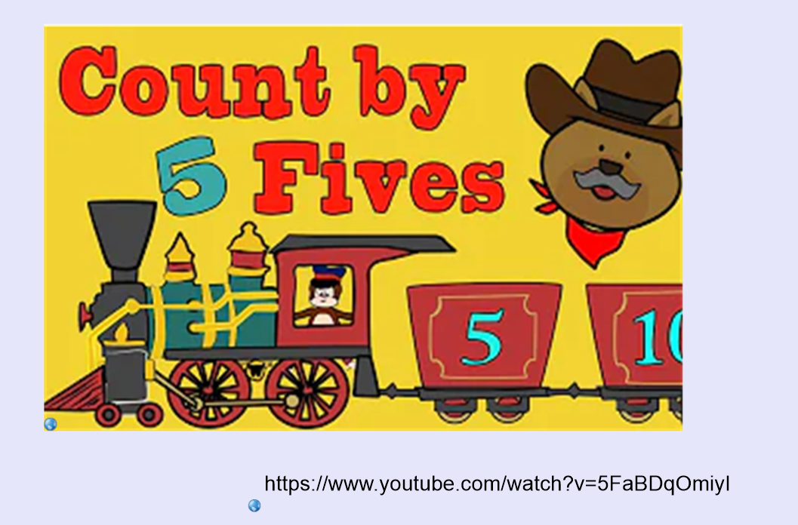

Slide 6
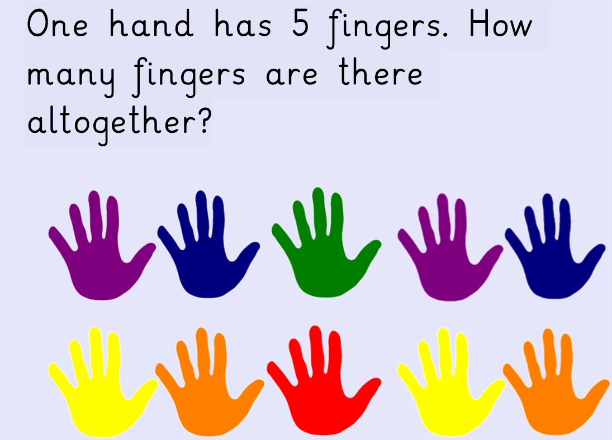

Slide 7
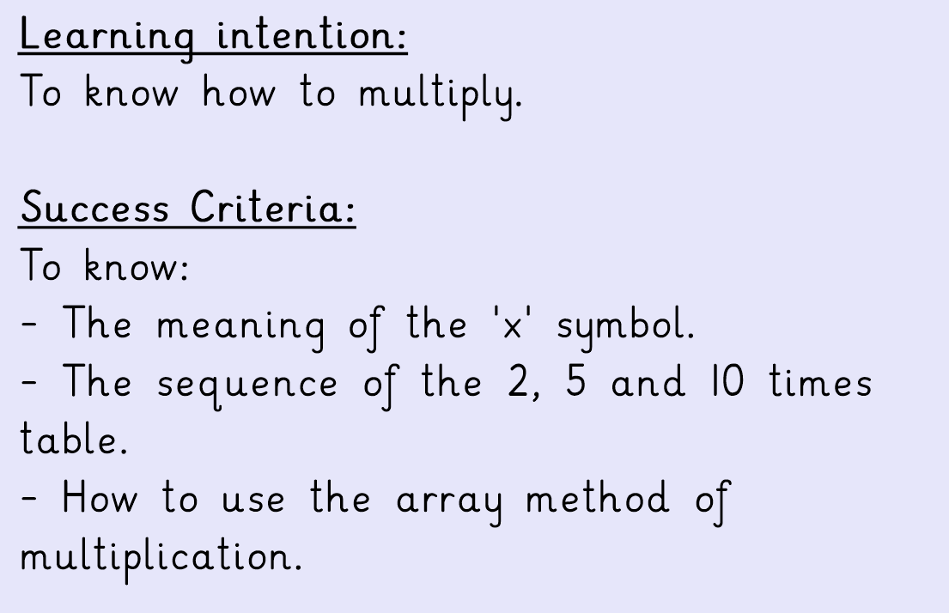

Slide 8
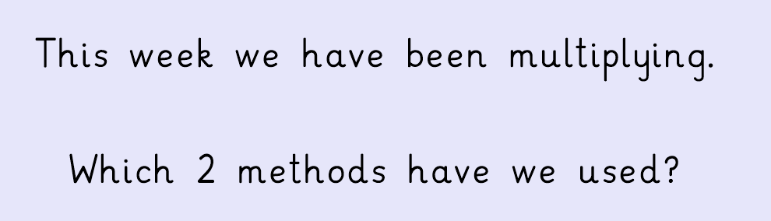

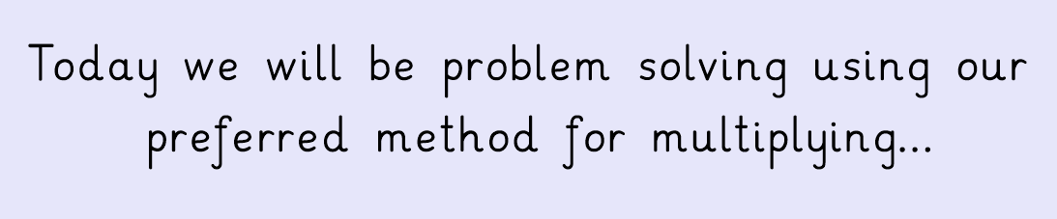

Slide 9
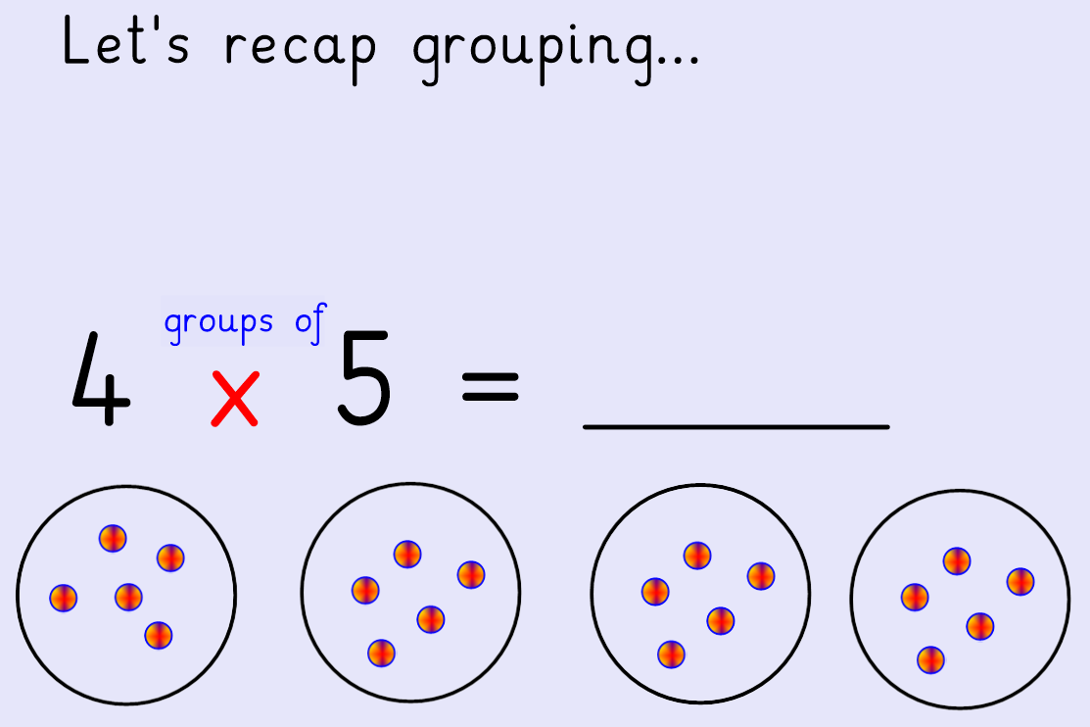

Slide 10
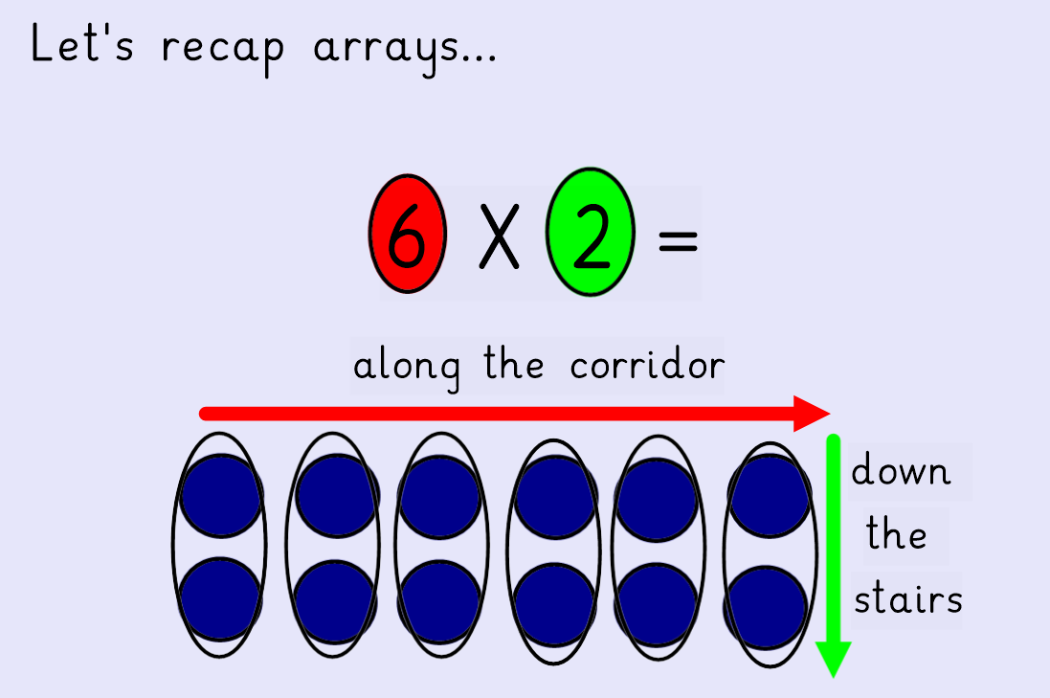

Slide 11
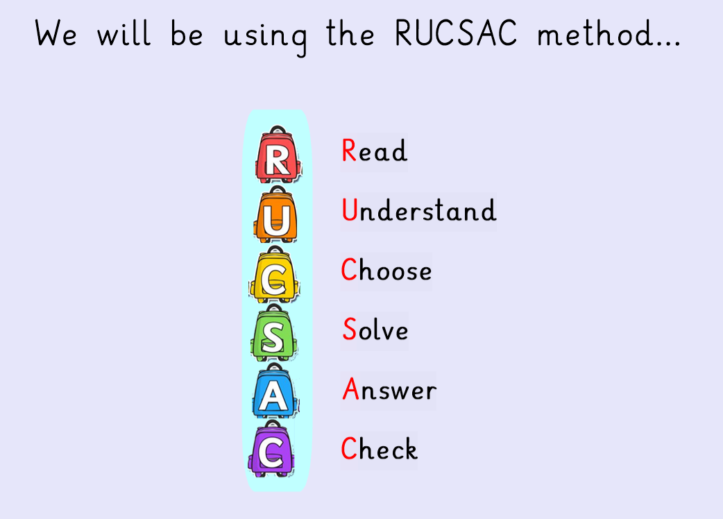

Slide 12
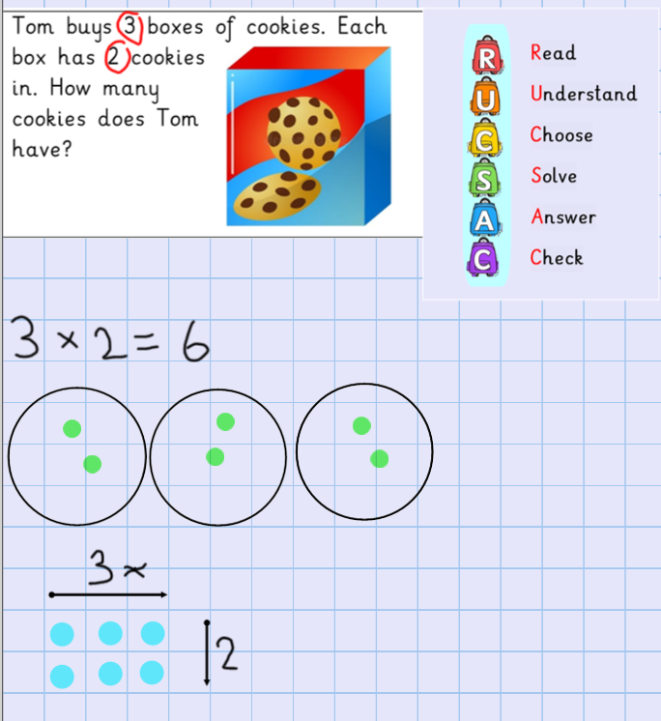

Slide 13
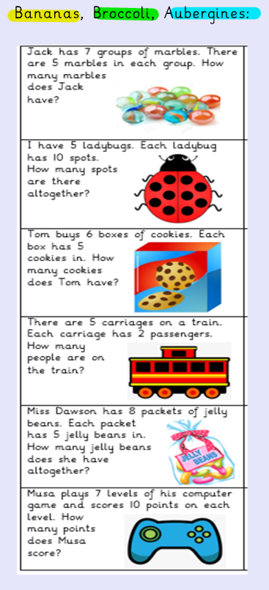
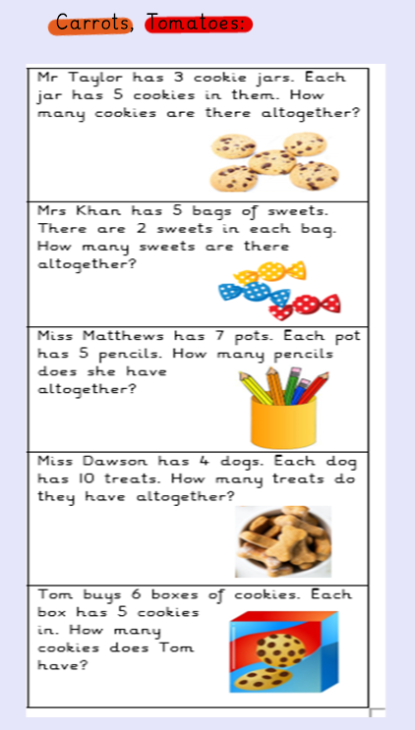
Use either the
grouping method
or arrays to
solve these
multiplication
problems.

Slide 14
English
Information texts

Slide 15
Learning Intention: To write with purpose.
Success criteria:
To know:
- What a fact is.
- How to use subheadings.
- When to use conjunctions to join sentences together.

Slide 16
This week, we have been learning about information texts.
Is an information text fiction or non– fiction?
Where might you see an information text?

Slide 17
Can you remember all the features of an information text? There are 6 in total.

Slide 18
Task
Your task is to create an information text on your own topic. Remember to include all of the features of an information text we have looked at in class. Try to include 3 sub headings that separate your facts into paragraphs.
Example
Heading: All about dogs
Subheading 1: The different breeds of dogs
Subheading 2: What dogs like to eat
Subheading 3: The 5 happy dog rules

Slide 19
PSHE
What goes onto the body?

Slide 20
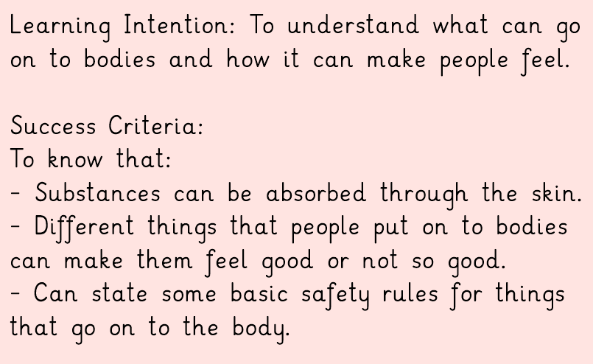

Slide 21
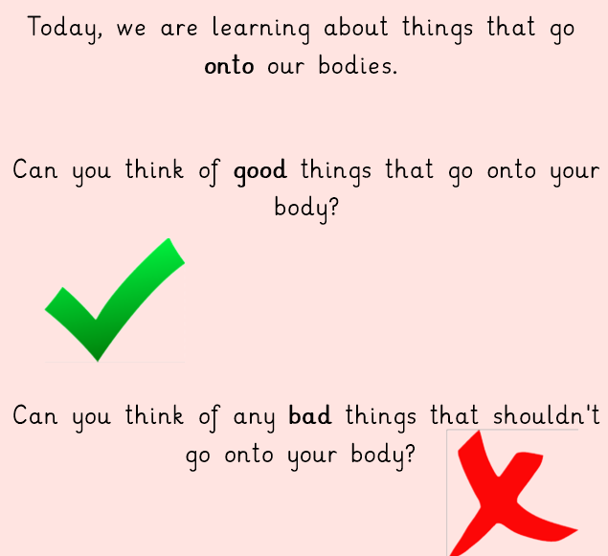

Slide 22
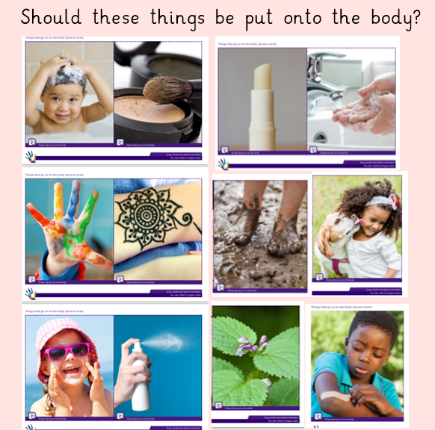

Slide 23
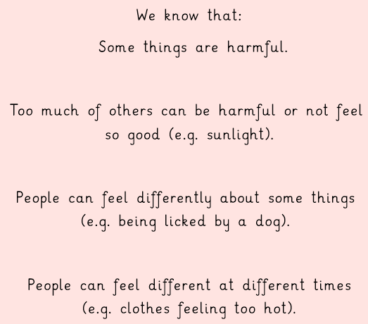

Slide 24
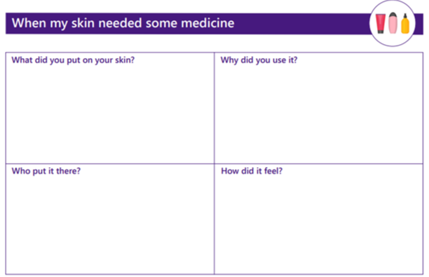
Task
Split you’re a piece of paper into 4 sections. Write these questions in each box:
What medicine have you put on your skin?
Who put it there?
Why did you use it?
How did it feel?
Have a go at answering these questions.

Slide 25
PE
Today’s PE lesson is taking advantage of the snowy weather to do some Outdoor Adventurous Learning!
You can choose any (or all) of the ideas from the following website to do with your adult and family!
Enjoy!
18 Fun Winter Activities for Kids (parents.com)
https://www.parents.com/fun/activities/outdoor/snow-activities-kids/

