Slide 1
2sCan Home Learning
Friday 10th March

Slide 2
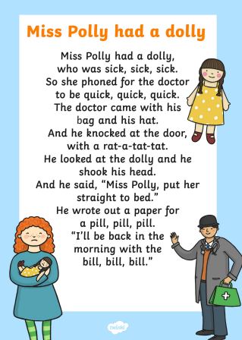
Nursery Rhymes
Can you practise singing this nursery rhyme with an adult?

Slide 3
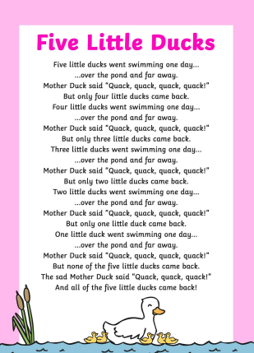
Nursery Rhymes
Can you practise singing this nursery rhyme with an adult?

Slide 4
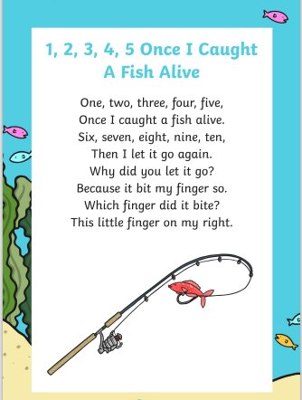
Nursery Rhymes
Can you practise singing this nursery rhyme with an adult?

Slide 5
ERIC- Story time
Click on the link below and watch the story ‘The Snow Storm’.
https://www.youtube.com/watch?v=6uqU_AcqpaA
Now wrap up warm and go enjoy the snow!

