Slide 1


Slide 2
Why is reading so important?
Helps your child to learn and make academic progress in all areas of the curriculum
Reading supports:
  social development – empathising with characters from stories read and transferring that empathy to our own relationships with others
  cognitive development – reading fills minds with information that your child can use to make sense of the world around them
  Well-being and mental health

Slide 3
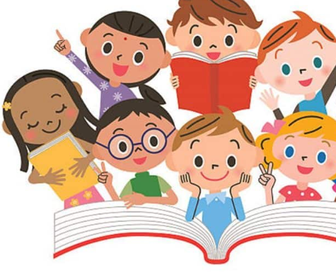
When do we read at school?
Where else do we read?
Will you ever stop needing your reading skills?

Slide 4
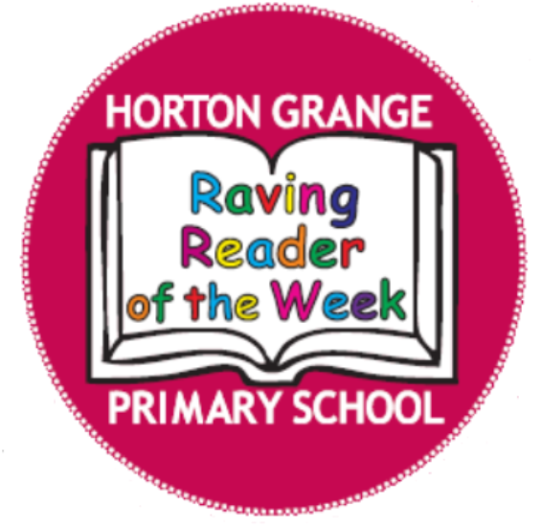
Reading at Horton Grange Primary School
Reading Fluency
Reading a text accurately, quickly and with expression.
How does a child achieve this?
Repeated reading, having good phonetic knowledge and sight reading of words.
What does it look and sound like?
No breaks in their reading, it flows when a child reads aloud to you.
Why is it important?
Creates a bridge between word recognition and comprehension (reading a text and understanding what has been read).

Slide 5
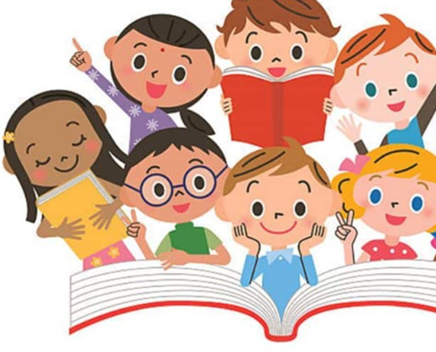
Reading at Horton Grange Primary School
Reading for Pleasure
Reading texts chosen by your child, relating to their interests.
Develops imagination, vocabulary development, well-being and empathy.
Supports academic success!

Slide 6

What is it?
Raving Readers is an exciting initiative at Horton Grange to encourage all children to read regularly.
Every child in school has the opportunity to change their reading for pleasure book frequently.
When a child brings back their home reading record, signed and dated, they get one mark (/) on the Raving Reader class chart.

Slide 7
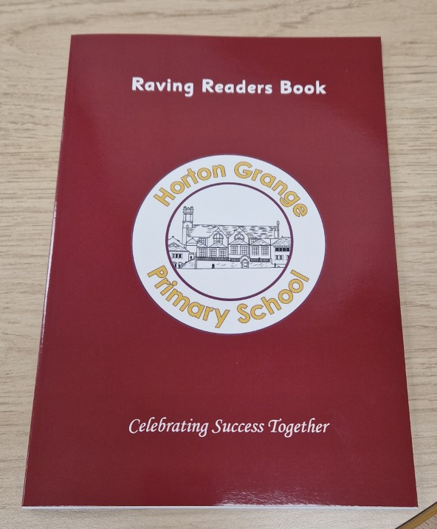
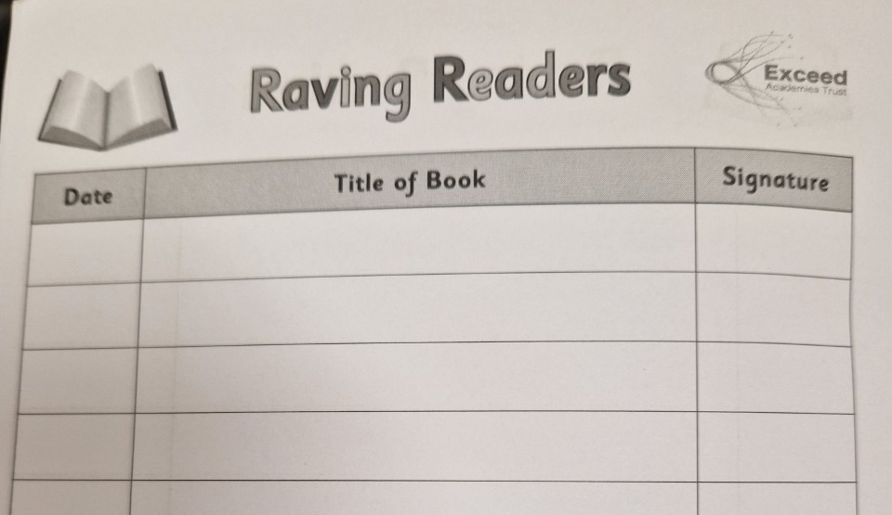
Raving Readers Journal

Slide 8
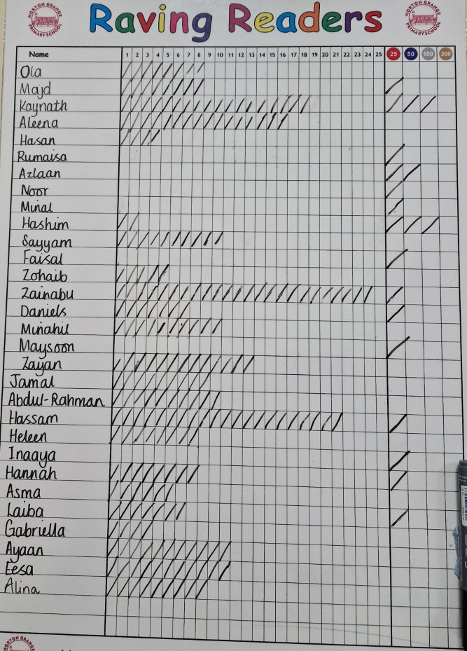
If your child reads at home they will be awarded a tick on their class Raving Reader chart!

Slide 9
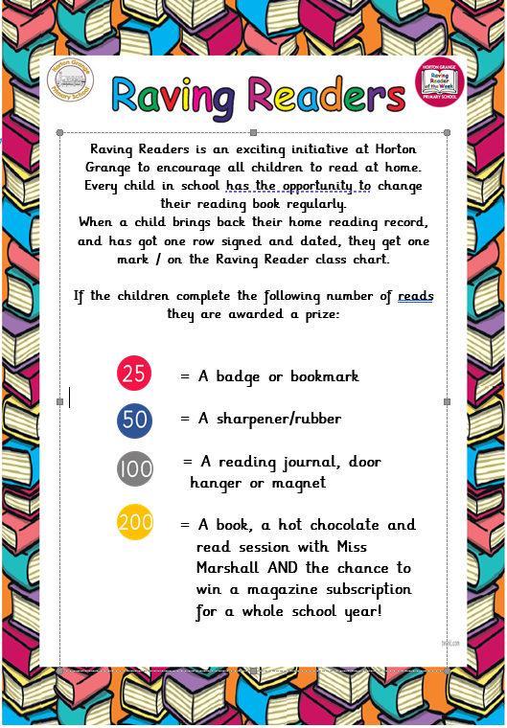
Raving Reader ticks make prizes!

Slide 10
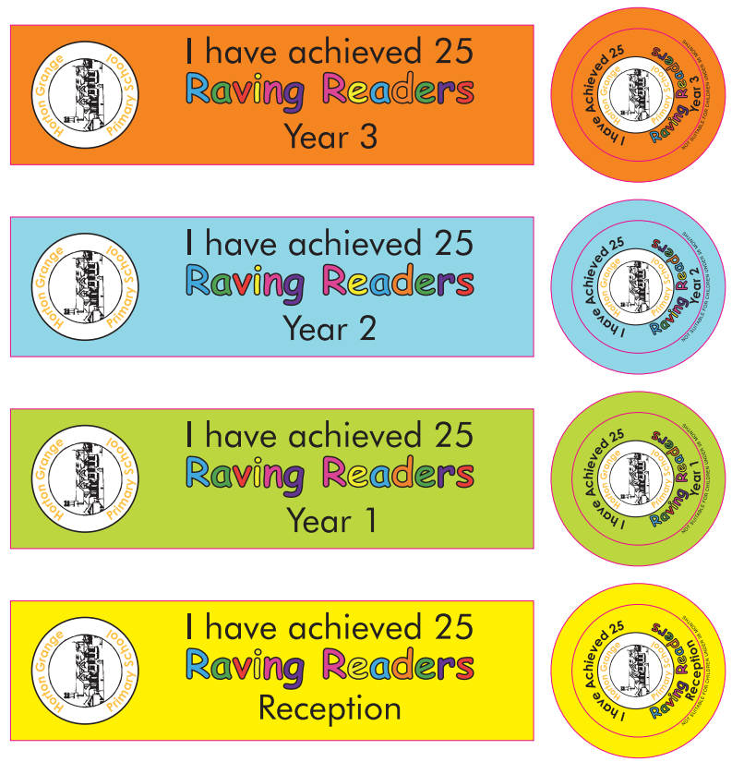
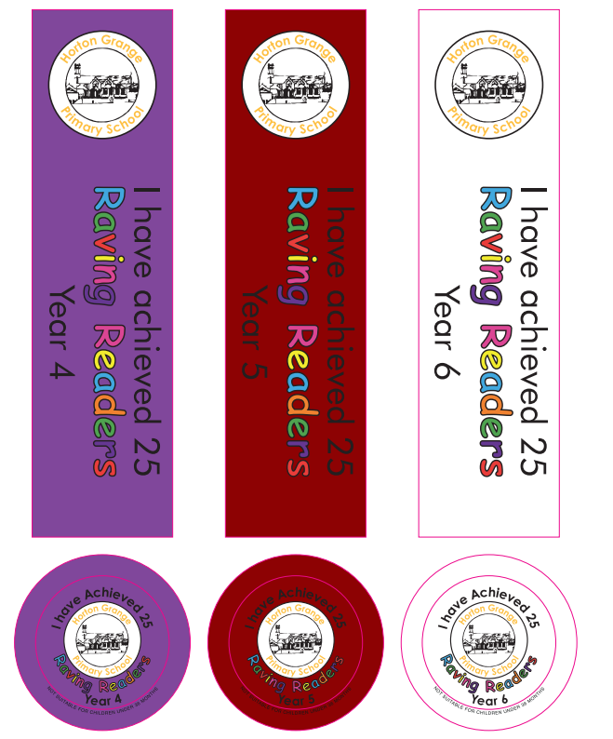
25 Raving Reader ticks
=
A Badge or a bookmark!

Slide 11
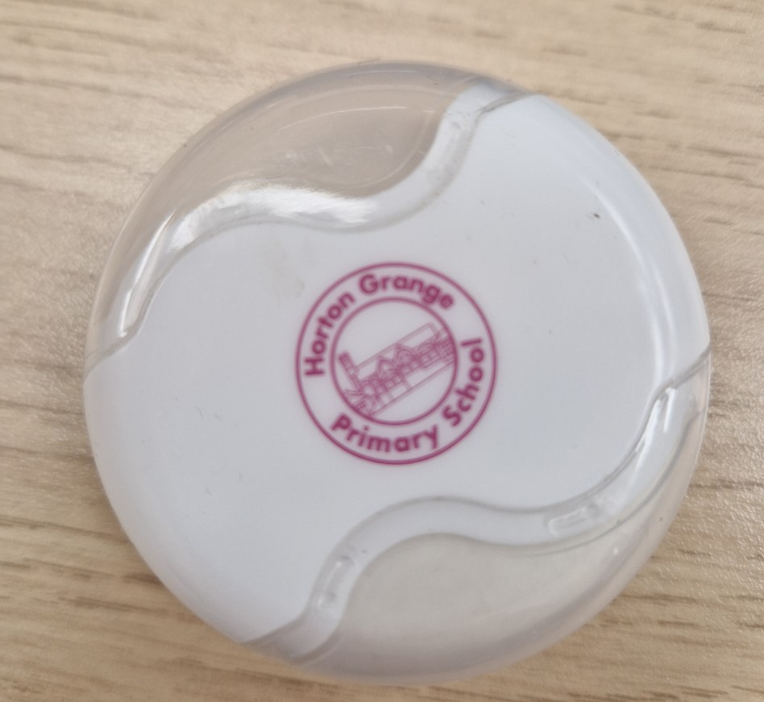
50 Raving Reader ticks
=
A pencil sharpener/rubber!
Pencil sharpener
Rubber

Slide 12
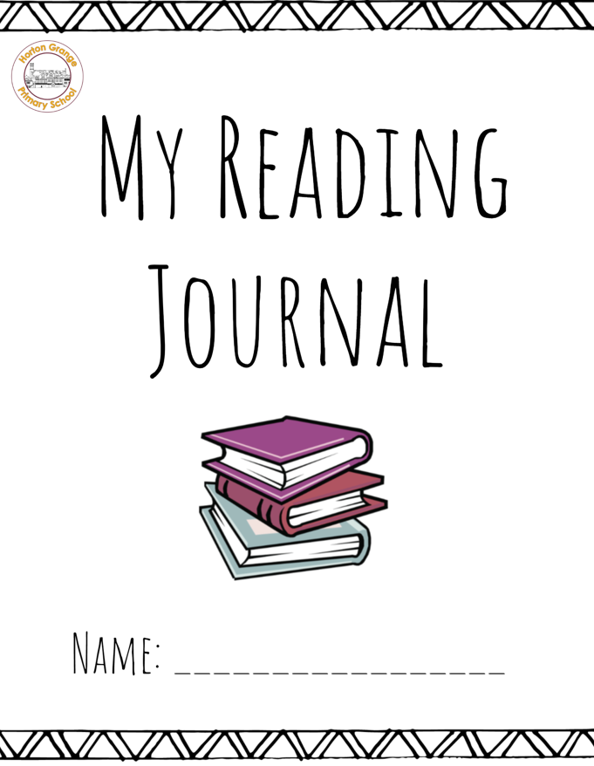
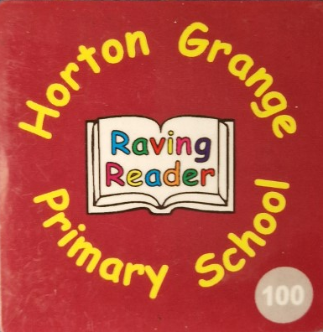
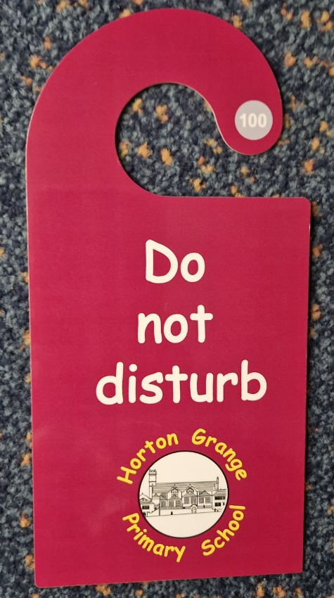
100 Raving Reader ticks
=
A reading journal, door hanger or magnet

Slide 13
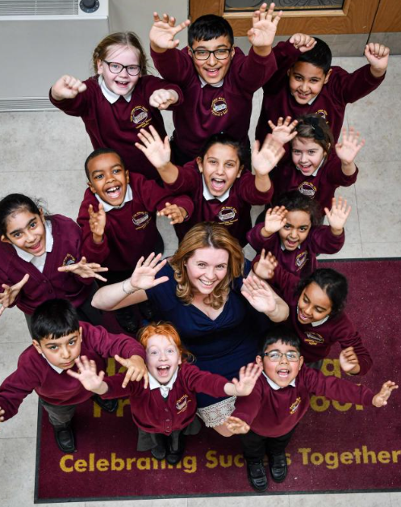

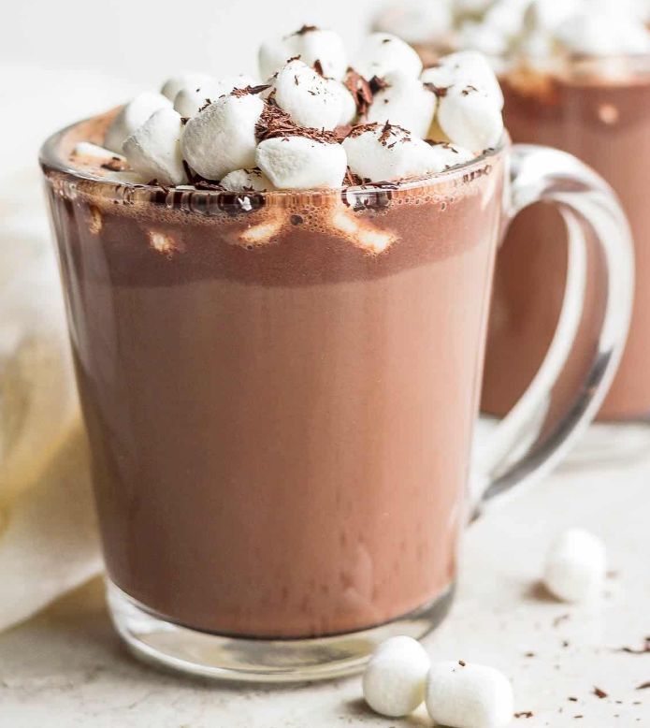
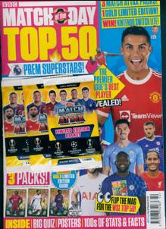
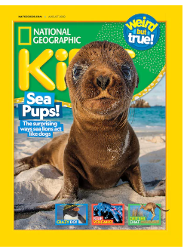
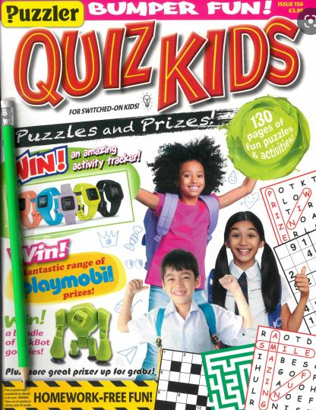
200 Raving Reader ticks =
PLUS…entry into a prize draw to win a magazine subscription for a year!
A book and a Hot chocolate and read session
with Miss Marshall

Slide 14

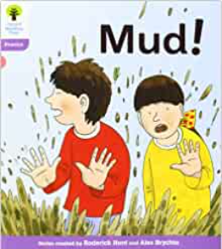
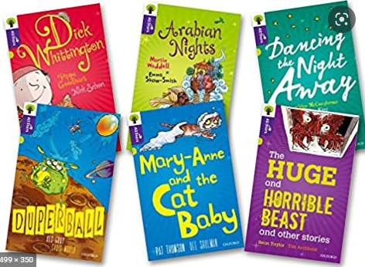
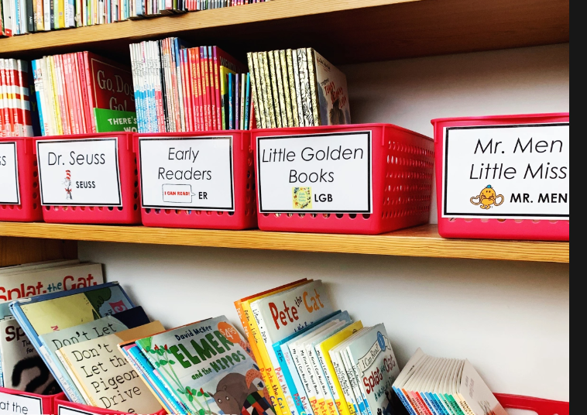
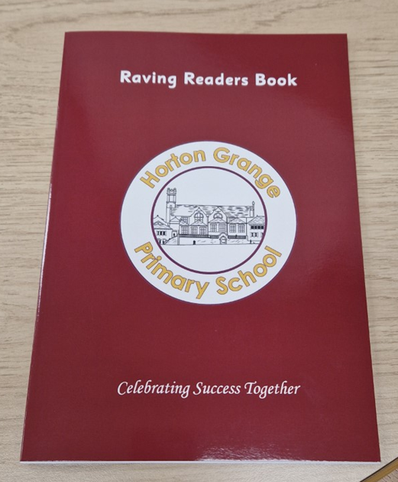
What should my child come home with each day?
Reading Fluency book
Reading for Pleasure book
Raving Readers Book

Slide 15
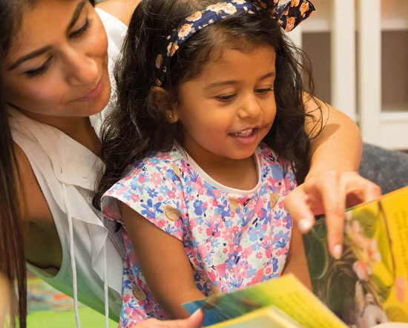

Please read with your child as much as possible!
Sign your child’s Raving Readers Book
once they have read.
Younger children can read to an older
sibling or family member.
Ask your child questions about
what they have read.
Fluent readers in Key Stage 2 can read
alone and parents/carers can sign to
say that they have see their child read.
Each half term parents/carers will be invited to join their child’s
year group Raving Reader assembly to share in their child’s achievements.

Slide 16

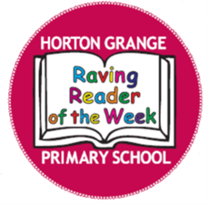
Thank you for coming to our Raving Readers assembly!

