Slide 1
EYFS Parent Workshop Supporting your child in their learning journey
Annabel Naylor (Deputy Headteacher)
Saira Yousaf (Assistant Headteacher)
Hannah Beaumont (EYFS Lead)

Slide 3
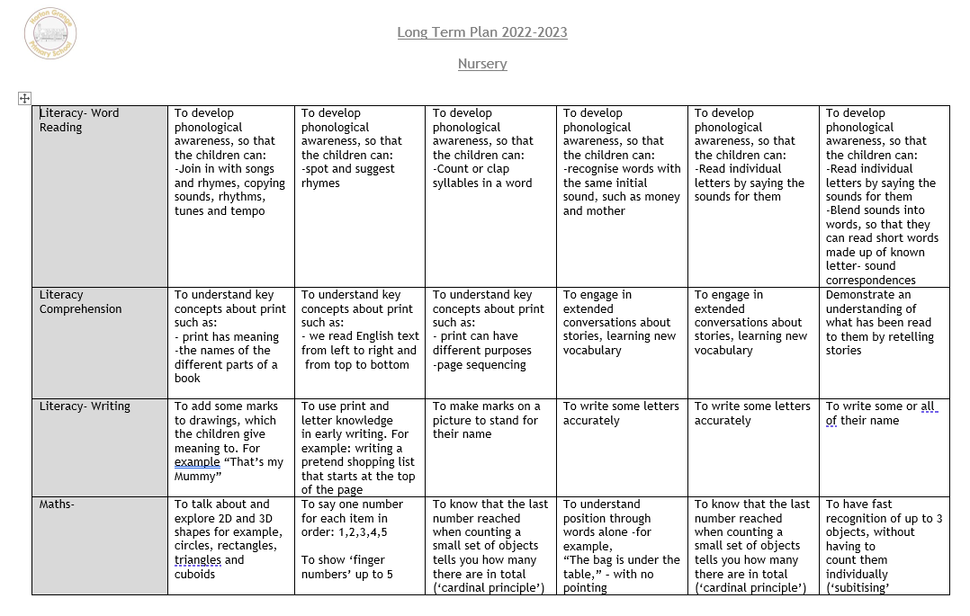

Slide 4
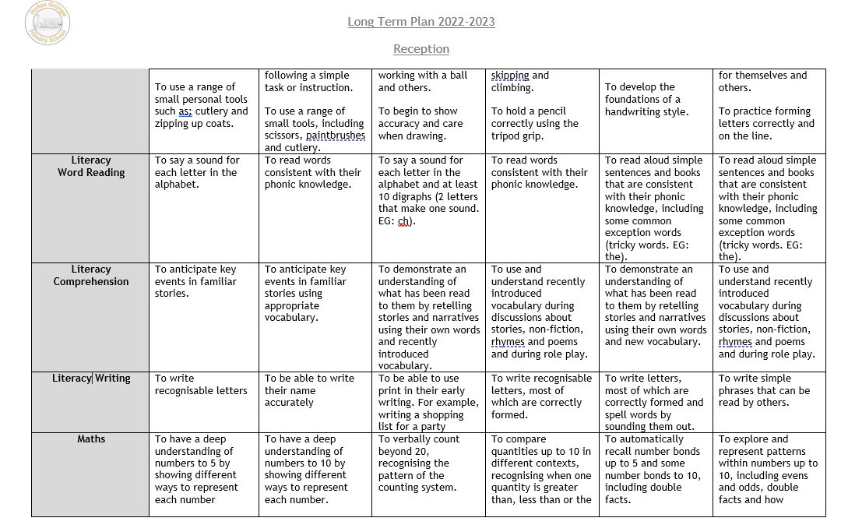
What are pupils learning about?

Slide 6
2sCan
Maths and English provision set up around the classroom
Teaching of the week
Number rhymes
Identifying numbers
English- mark making
Book behaviour- holding books, reading left to right, front cover (ERIC)
Phonics- listening for rhymes
Eric- story time daily- 1 book in the week
Library

Slide 7
Nursery
Numbers 1 to 5 in different formats
Physically count patterns, see capacity and feel weight
Look at different 2D shapes
Measure length
Groups are taught for Maths so that each child receives targeted support
Communication and Language – Speaking and listening, reading together and discussing
Daily Enjoying Reading, Improving Comprehension

Slide 8
Reception
Maths and English focus each week
Daily phonics
Guided reading
Daily Eric time
Daily Readers
Practical maths
Challenges set up in the classroom

Slide 9
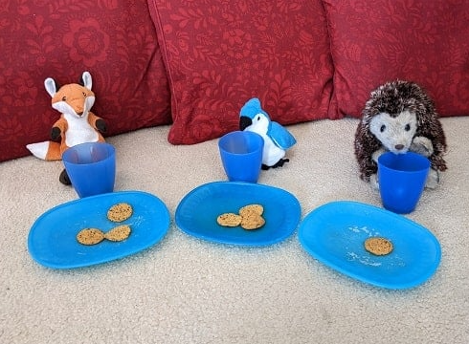
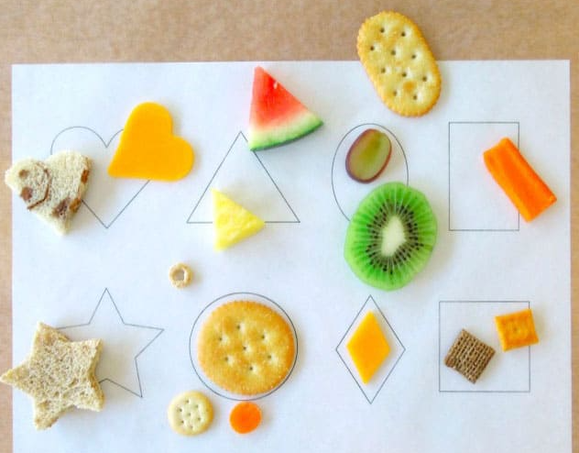
How can you support your child at home?
Maths
Number formation sheets
Numbots- EYFS only
Counting (stairs, cars, and looking at shapes)

Slide 10
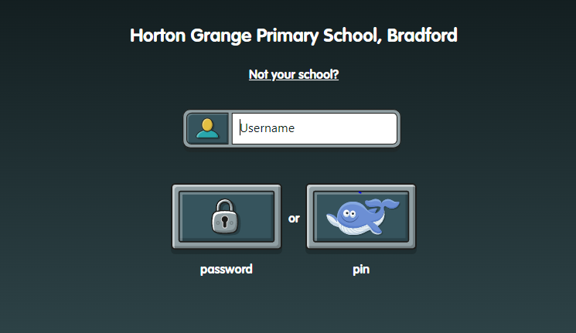
https://play.numbots.com/#/intro

Slide 11
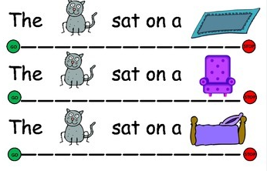
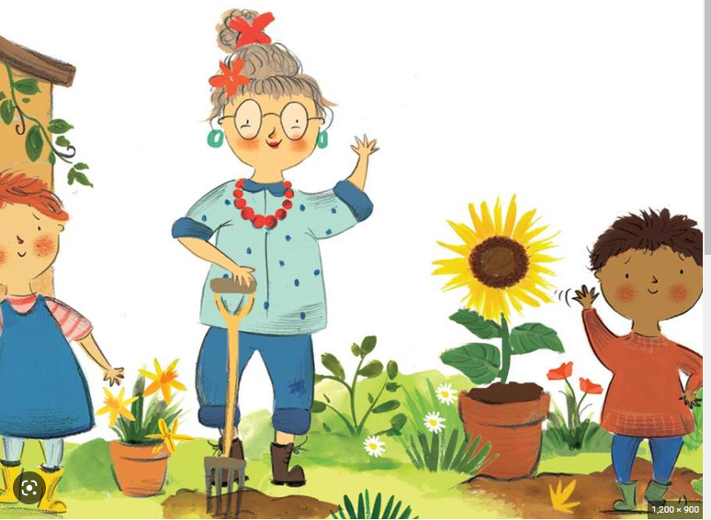
How can you support your child at home?
English
Reading at home
Modelling full sentences
Using finger to follow words
Front cover and back
Reading left to right
Talking about characters
Finding letters
Not to teach pupils to write in capital letters
Raving Readers –Nursery to Year 6 only

Slide 12
Bug Club
www.activelearnprimary.co.uk

Slide 13
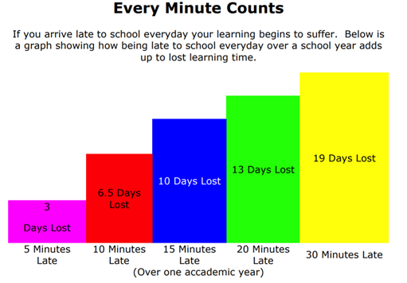
Other things that really help your child…
Attendance and Punctuality
Completion of Homework
Reading at home with your child
Communicating with school
Talking and asking questions to develop
vocabulary and communication skills
Accessing online learning platforms
Numbots
Bug Club
Alphablocks/Numberblocks (Cbeebies)

