Slide 1
English Home Learning
Week Beginning 17.1.22

Slide 2
Weekly Introduction
Please click the link below to take you to the weekly introduction to English this week.
This will explain the English learning and tasks for each day:
https://youtu.be/jW474afBQ5w

Slide 3
This week…
Day 1 – Grammar – Question marks
Day 2 – Handwriting 1
Day 2 – Guided Reading – Star of the Air
Day 3 – Describing what Robert looks like
Day 4 – Handwriting 2
Day 4 – What did Robert do?
Day 5 – Sending a letter to Robert

Slide 4
Day 1

Slide 5
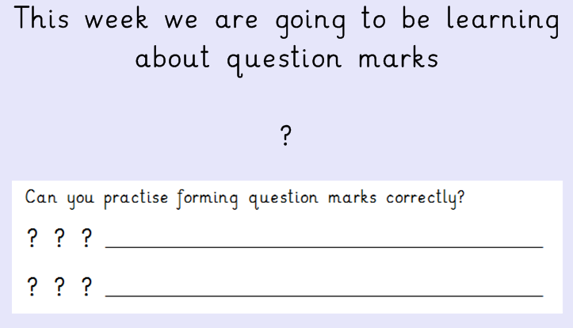
Day 1 – Question marks

Slide 6
Click below to watch the video: https://www.bbc.co.uk/bitesize/topics/z8x6cj6/articles/zcm3qhv

Slide 7
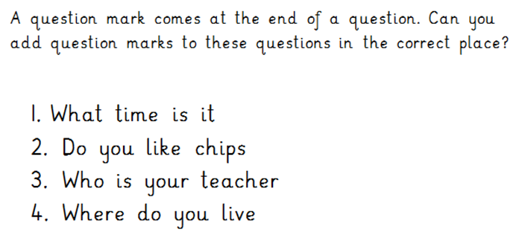
Day 1

Slide 8
Day 1- Grammar challenge:

Slide 9
Day 1- Grammar challenge:

Slide 10
Day 2 - Handwriting 1
Today you will be practising your letter formation.
Let’s warm up our hands and fingers ready to write first:
https://www.youtube.com/watch?v=o9D5lfqZF3o

Slide 11
Day 2 - Handwriting 1
Today you will be practising your letter formation of the following two letters: l and t
Let’s look at how we form each of these letters…

Slide 12
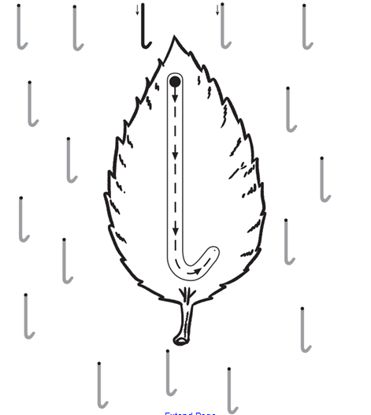
Day 2 - Handwriting 1
Look carefully at where you will start and which way the arrows point as this shows you how to form each letter:
Practise forming the letter l in the air with your finger.

Slide 13
Day 2 - Handwriting 1
Look carefully at where you will start and which way the arrows point as this shows you how to form each letter:
Practise forming the letter t in the air with your finger.

Slide 14
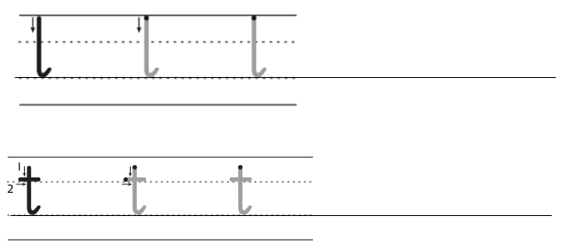
Day 2
Can you now practise writing the letters l and t in your home learning book…
Once you have done 2 lines of each letter can you write the following words with these letters in. Think really carefully about how you form each letter.

Slide 15
Day 2 - Guided Reading

Slide 16
Day 2 - Guided Reading
Read this book on Bug club.
Make sure you read the book carefully because you will be using this book for your English lessons this week!
Use your log in details to log into Bug club. The book will be at the very end of your allocated books in the ‘my stuff’ section.
https://www.activelearnprimary.co.uk/login?c=0

Slide 17
Questions to ask and answer:
Talk about these questions with an adult at home. Once you have talked about the answers you could write your answers into your home learning book.
Who are the characters in the story?
What does Robert do?
Who is Marvin?
How does Marvin help?
How does the story end?

Slide 18
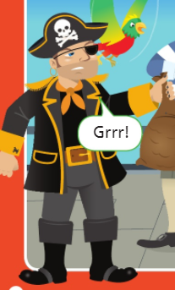
Day 3
Today you will be looking at one of the characters from the story you read for Guided Reading yesterday.
Click here to see a video of this lesson being taught:
https://youtu.be/crl4fUiS8zw

Slide 19
Who is this? What type of character was he? How could you describe him? What did he do in the story?

Slide 20
Day 3 Using the picture on the next slide you are going to label Robert. You can label his appearance (what he looks like) using adjectives (to describe). Remember to add as many labels as you can as you will be using these to help you to write sentences soon.

Slide 21
round earring
black hat
black and gold jacket
big black boots

Slide 22
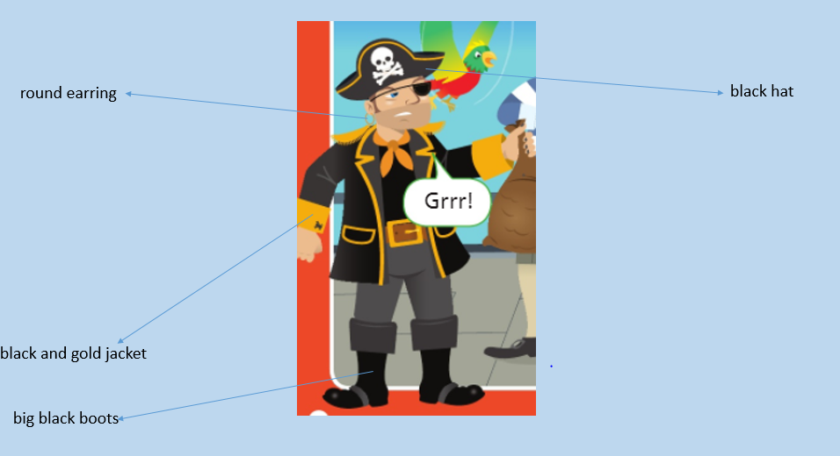
Day 3 Now you are going to use these labels to help you write sentences to describe what Robert looks like. Can you use and in your sentences? e.g. Robert is wearing black boots and a black hat.

Slide 23
Day 4 - Handwriting 2
Today you will be practising your letter formation of the following two letters: h and g
Let’s look at how we form each of these letters…

Slide 24
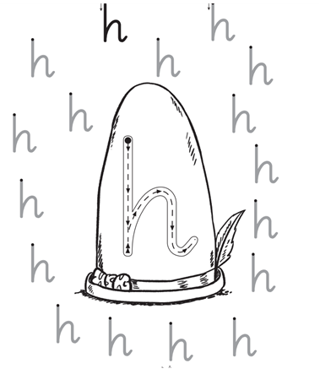
Day 4 - Handwriting 2
Look carefully at where you will start and which way the arrows point as this shows you how to form each letter:
Practise forming the letter h in the air with your finger.

Slide 25
Day 4
Can you now practise writing the letter h in your home learning book…
Once you have done 2 lines of the letter h can you write the following words with these letters in. Think really carefully about how you form each letter.

Slide 26
Day 4
Today you will be looking at what Robert did in the story you read for Guided Reading this week.

Slide 27
What did Robert do at the beginning of the story? Was he being kind or not? What adjectives could we use to describe him as a character?

Slide 28
Day 4 Today you will write sentences to tell me what Robert did in the story. e.g. Robert went on the ship. You can also use adjectives in your sentences which describe the type of character Robert is. e.g. Robert took the coins because he is greedy. Remember to use capital letters, finger spaces and full stops.

Slide 29
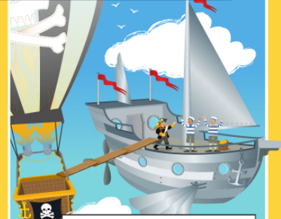
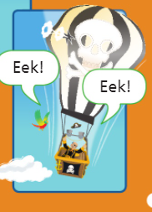
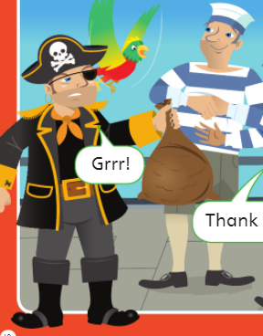
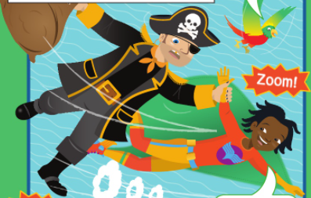
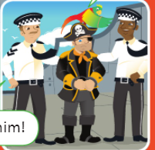
Day 4 Use the pictures below to remind you of the things Robert did in the story. Can you try to add and or because to your sentences to make them more interesting? Remember to write in full sentences if you can.

Slide 30
Day 5 Today you will be thinking about the story you have read. You will be writing a letter to Robert to tell him what he did wrong. I will help you to put your letter in to the right order. Then you will write some sentences for the main body of your letter to explain to Robert what he did wrong.

Slide 31
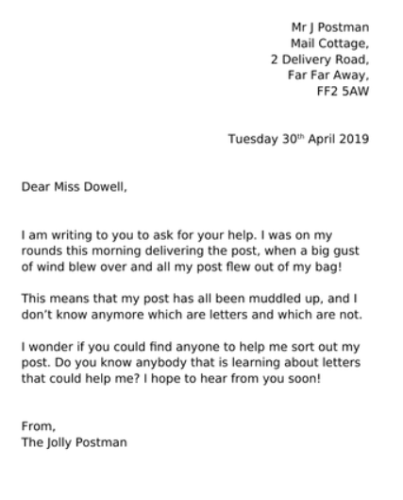
Look at these features of a letter:
Address (the person who is writing
the letter)
Date (when the letter was written)
Dear… (who the letter is to)
main body of the letter
(what the letter is about)
From… (who the letter is from)

Slide 32
Day 5 On the next page we have created a letter which you can use to help you. You need to write the main body of the letter to tell Robert what he did wrong. Remember to write in full sentences. Use capital letters, finger spaces and full stops. Also remember to use your Phonics to help you to sound out the words in your sentences.

Slide 33
your name Horton Grange Primary School Spencer Road Bradford BD7 2EU Friday 21st January
Dear Robert
I am writing to tell you about what you did wrong.
____________________________________________________________________
____________________________________________________________________
____________________________________________________________________
____________________________________________________________________
____________________________________________________________________
From
______________________________

