Slide 1
English Home Learning
Week Beginning 13.12.2021

Slide 2
Lesson 1 – WOTW
Lesson 2 – Guided Reading

Slide 3
Lesson 1 – WOTW

Slide 5
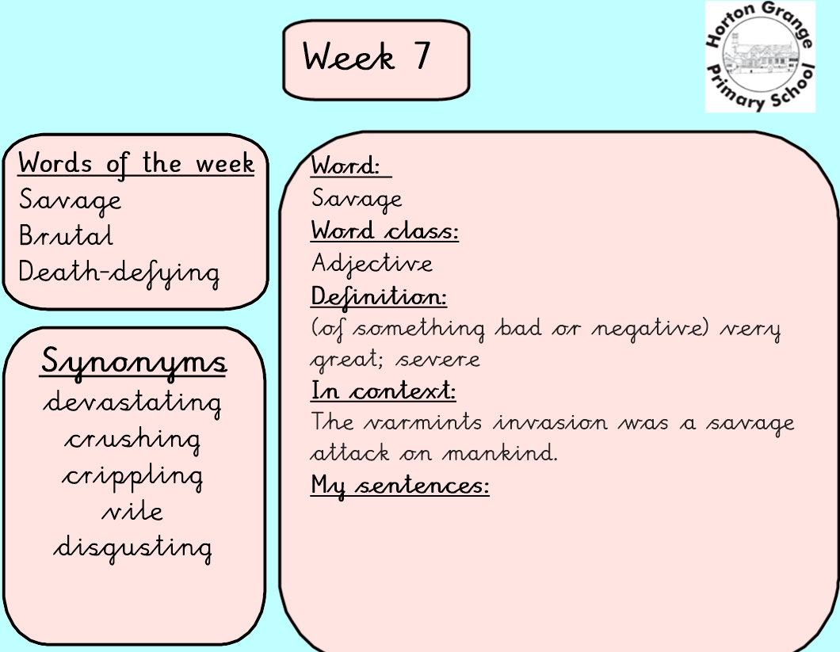

Slide 6
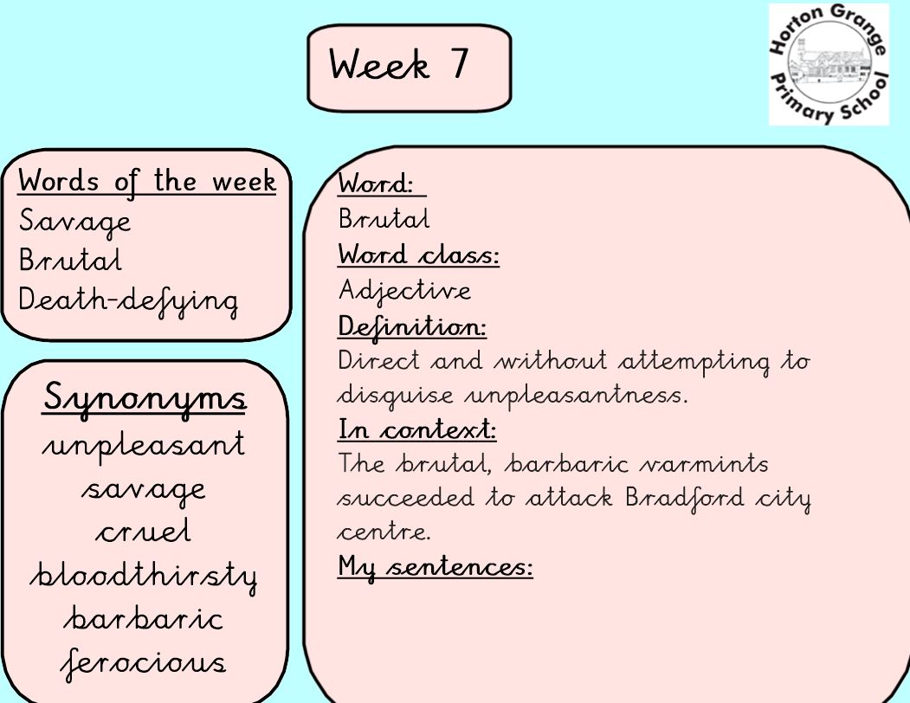

Slide 9
Lesson 2: Guided Reading

Slide 13
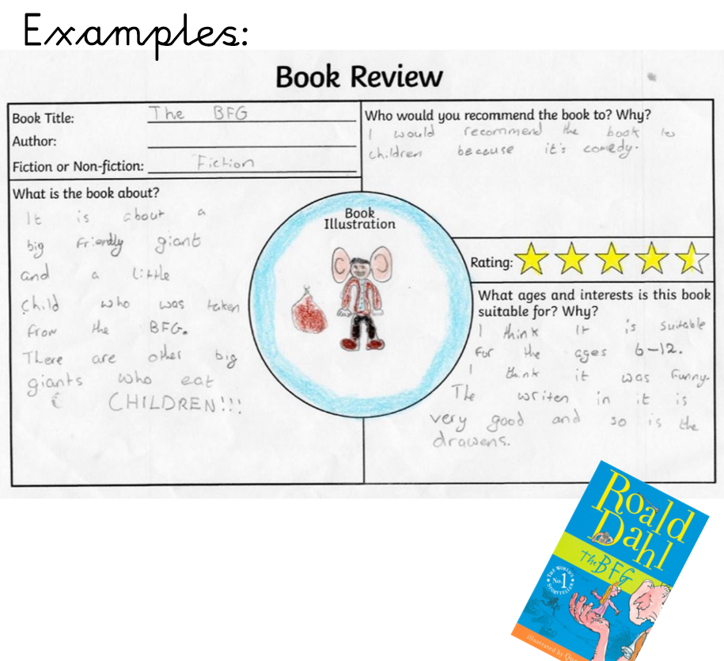

Slide 15
