Slide 1
English Home Learning
Week Beginning 15.11.2021

Slide 2
Day 1 – What is a Varmint?
Day 2 – Features of a Newspaper Report
Day 3 – Summarising a Newspaper Report
Day 4 – WOTW
Day 5 – Guided Reading

Slide 3
Day 1 – What is a Varmint?

Slide 15
Day 2 – Features of a Newspaper Report

Slide 20
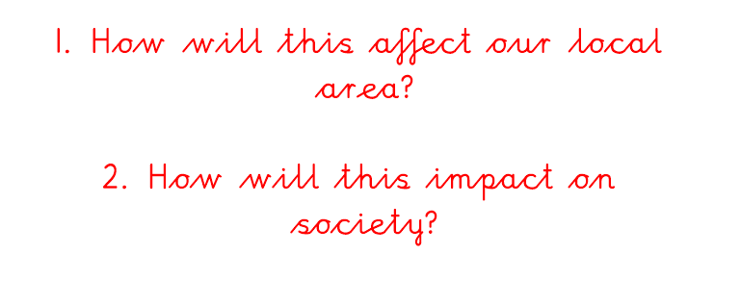

Slide 21
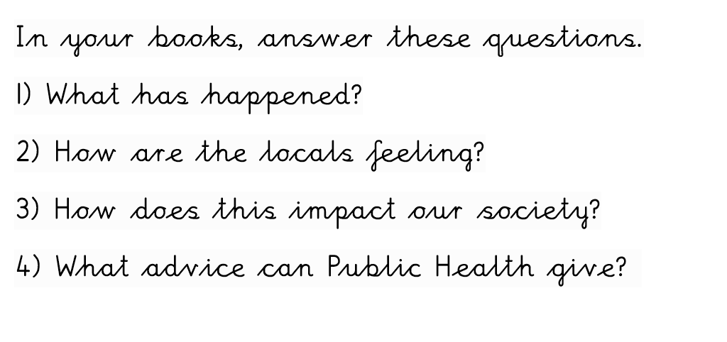

Slide 22
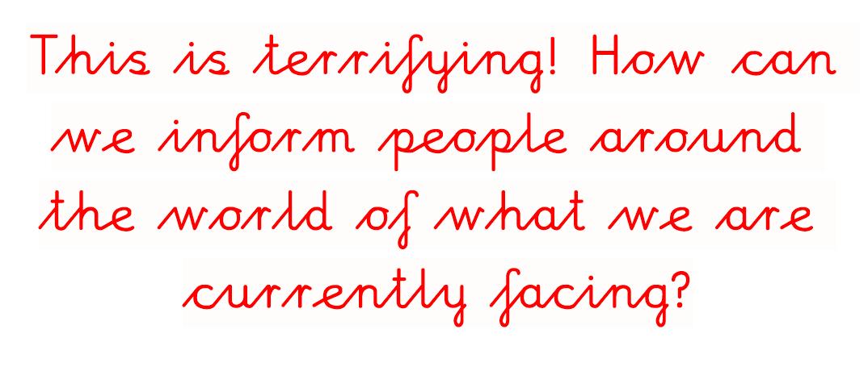

Slide 38
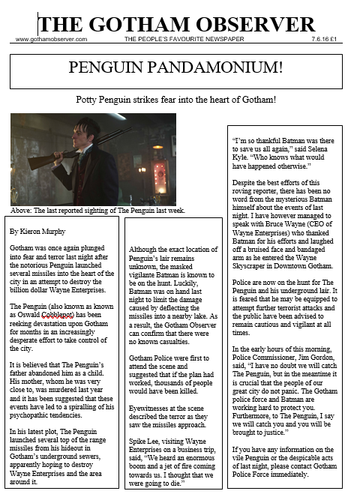

Slide 39
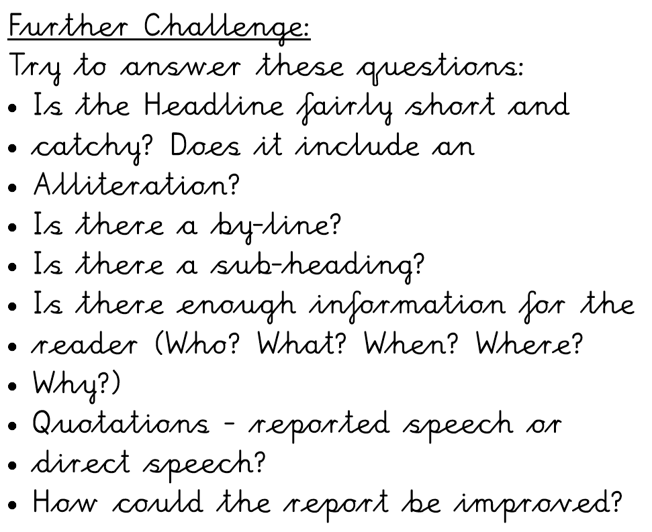

Slide 41
Day 3 – Summarising a Newspaper Report

Slide 50
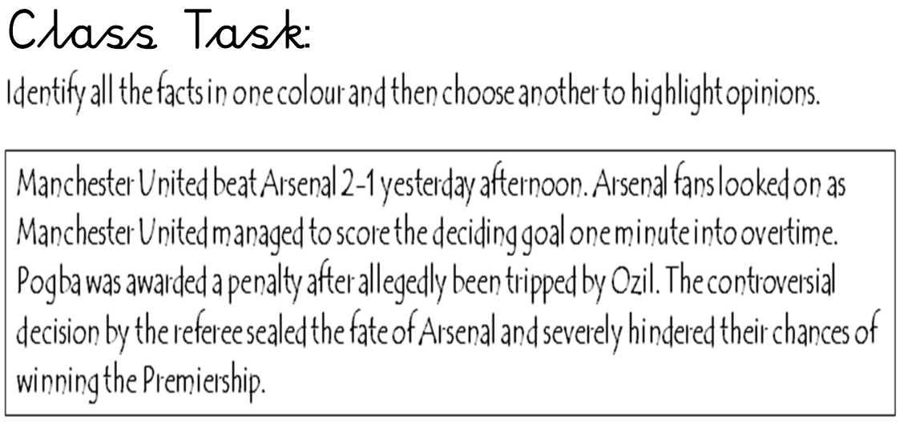

Slide 54
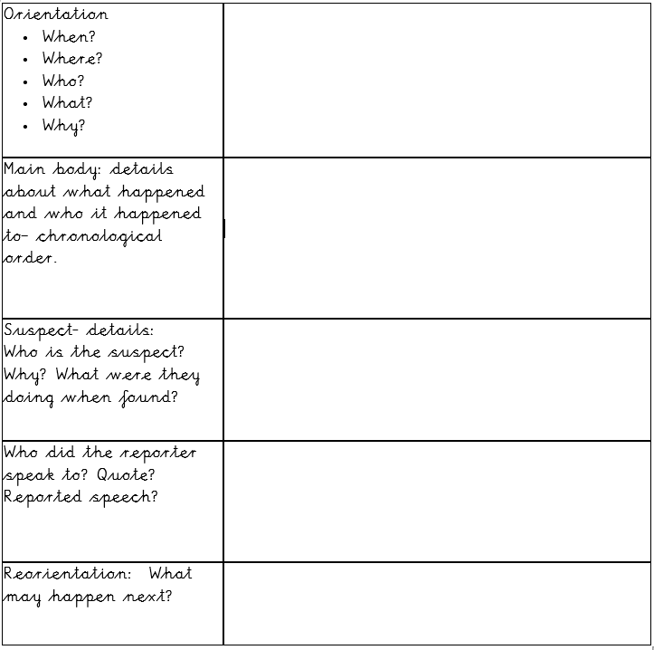

Slide 56
Day 4 – WOTW

Slide 59
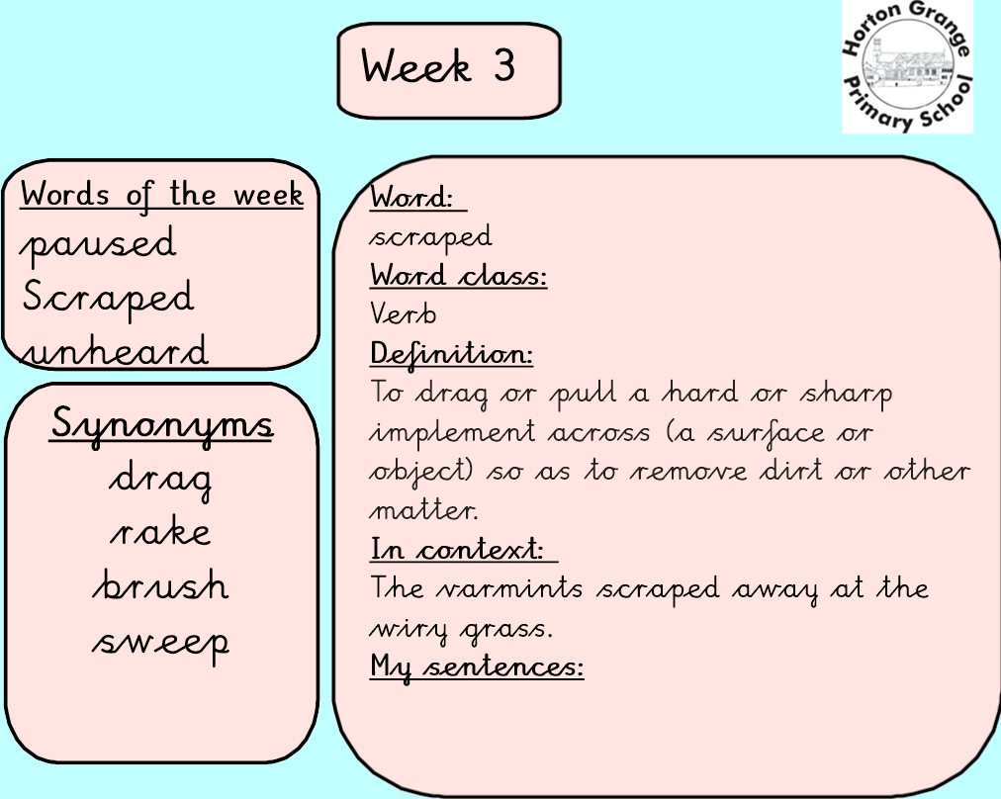

Slide 60
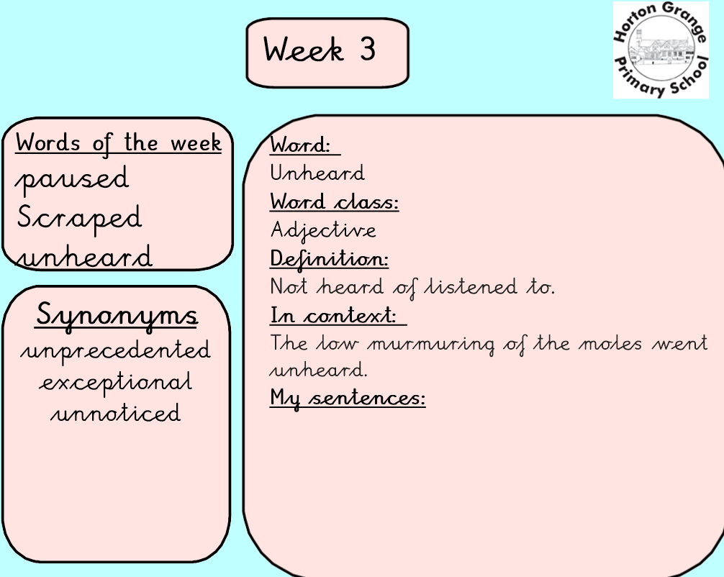

Slide 62
Day 5: Guided Reading

Slide 68
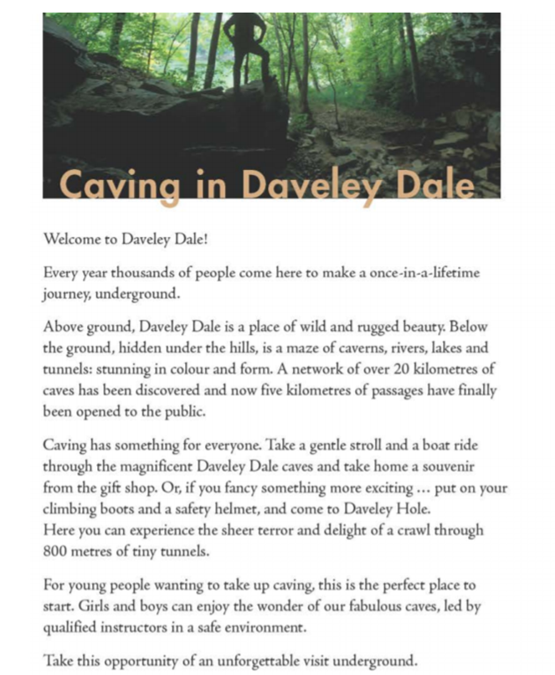

Slide 72
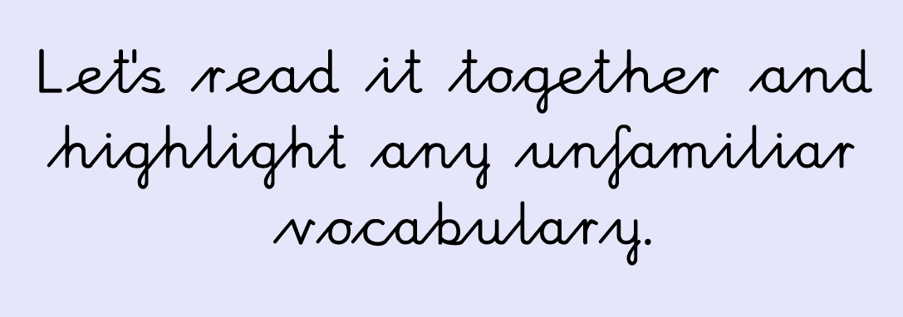

Slide 74
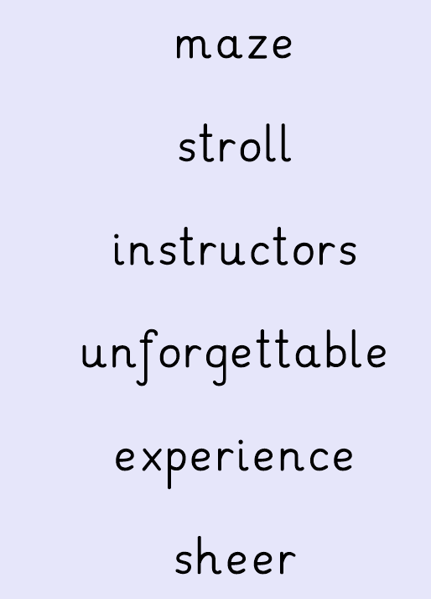

Slide 77
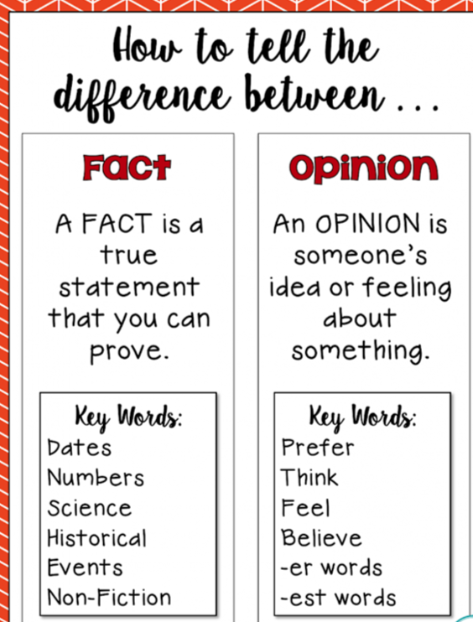

Slide 78
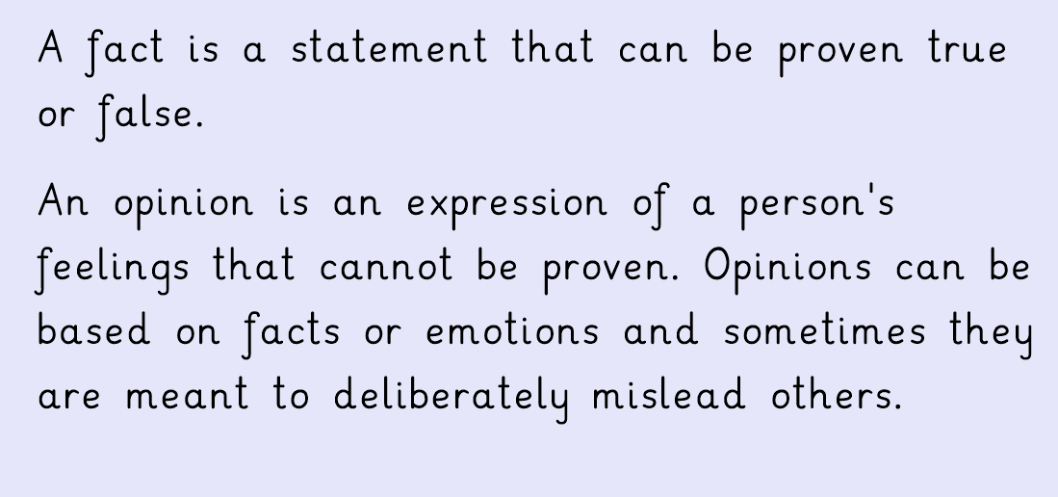

Slide 79
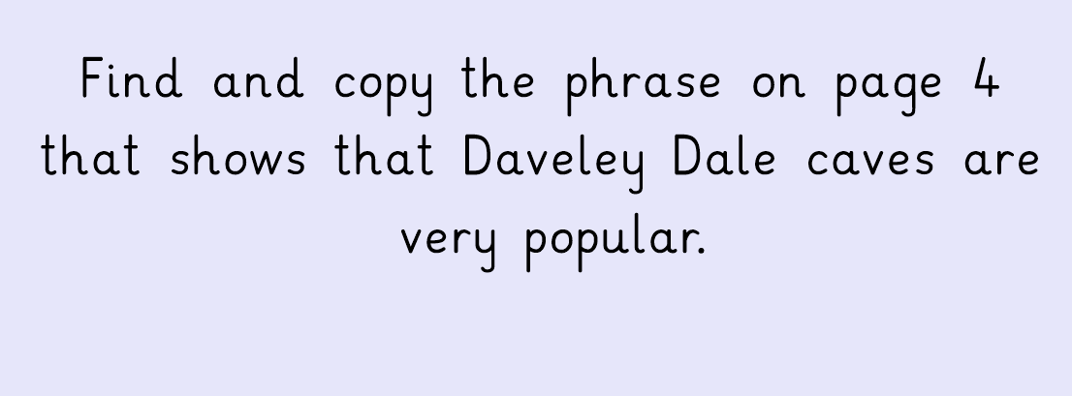

Slide 80
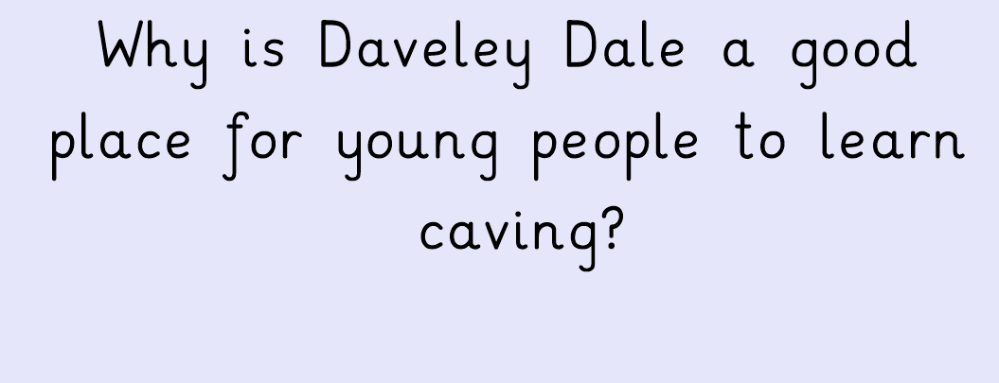

Slide 83
