Slide 1
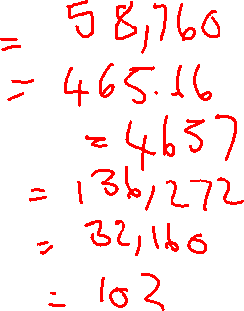
Monday 1st November 2021
Fractions
Starter
7345 x 8
2794 ÷ 6
3457 + 1200
5678 x 24
3216 x 10
4386 ÷ 43

Slide 2
Vocabulary
Fraction – A numerical quantity that is not a whole number
Numerator – The number at the top of a fraction that shows how many parts are being taken from the denominator
Denominator – The number at the bottom of a fraction which indicates how many equal parts something is divided into

Slide 3
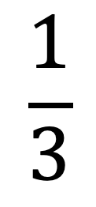
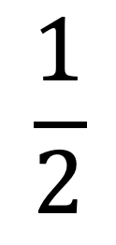
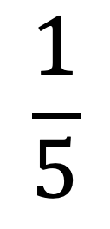
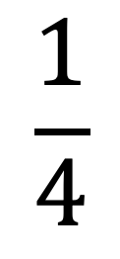
$$\frac{1}{2}$$
$$\frac{1}{3}$$
$$\frac{1}{4}$$
$$\frac{1}{5}$$
What’s the same?
What’s different?
What do you know about these

Slide 4
When dividing, you divide in to equal parts.
For example, 1/4 of 560 means we are dividing 560 in to 4 equal parts.
560
1
4
0
How can we use this information to work out 3/4 of 560?
4
5 6 0
1

Slide 5
If we were working out 1/5 of 670, what would we need to do?
Why?
How can we use this information to work out 4/5 of 670?

Slide 6
1/5 of 670
670
134
134
134
134
134
1
3
4
What does the denominator tell us?
What does the numerator tell us?
5
6 7 0
1
2

Slide 7
Practice:
Find 1/4 of 984
What is 3/4 of 984? How do you know?
Use the bar model/ written division method to support you

Slide 8
Practice 2:
Find 1/3 of 291
Find 2/3 of 291
What is the mathematical rule for finding a fraction of an amount?
Use the bar model/ written division method to support you

Slide 9
Practice 3:
Find 1/7 of 644
Find 6/7 of 644
How else can you find 6/7? Which is more efficient?
Use the bar model/ written division method to support you

Slide 10
Independent tasks

Slide 11
Tuesday 2nd November 2021
Fractions
Starter
3/5 – 1/5
4737 ÷ 16
40000 + 56000
235 x 15
3200 ÷ 100

Slide 12
Vocabulary
Fraction – A numerical quantity that is not a whole number
Numerator – The number at the top of a fraction that shows how many parts are being taken from the denominator
Denominator – The number at the bottom of a fraction which indicates how many equal parts something is divided into

Slide 13
When dividing, you divide in to equal parts.
For example, 1/4 of 560 means we are dividing 560 in to 4 equal parts.
560
1
4
0
How can we use this information to work out 3/4 of 560?
4
5 6 0
1

Slide 14
1/5 of 670
670
134
134
134
134
134
1
3
4
What does the denominator tell us?
What does the numerator tell us?
5
6 7 0
1
2

Slide 15
Practice:
Find 1/4 of 456
Find 3/4 of 456
What is the mathematical rule for finding a fraction of an amount?
Use the bar model/ written division method to support you

Slide 16
Practice 2:
Find 1/10 of 640
Find 7/10 of 640
Is there a more efficient method for finding 1/10? If so, what is it?
Use the bar model/ written division method to support you

Slide 17
Variation
Sarah is given the following question:
Find 3/5 of 560.
She says, “The answer is 112.”
Explain her mistake.
Complete the calculation to try and help you
How could you help show Sarah how to solve the question?

Slide 18
Independent tasks

