Slide 1
Year 1
Maths Home Learning
Week Beginning 16.11.2020

Slide 2
This Week………
Day 1: Slides 3-10: Maths Practical : Subtraction.
Day 2: Slides 11-20: Maths Practical : Subtraction.
Day 3: Slides 21-33: Maths Pictorial: Subtraction.
Day 4: Slides 34-45: Maths Pictorial: Subtraction.
Day 5: Holiday!!

Slide 3
Day 1

Slide 4
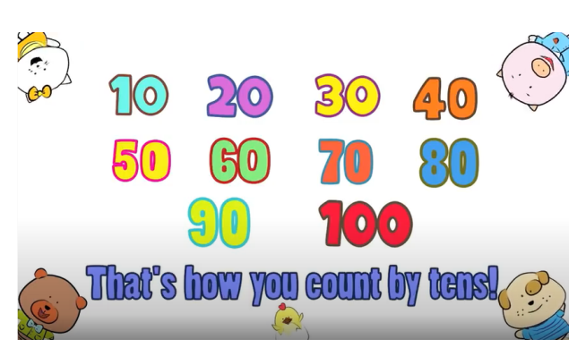
Watch the counting in 10s video and see if you can write the numbers from 10-100 in order!
https://www.youtube.com/watch?v=-gmEe0-_ex8

Slide 5
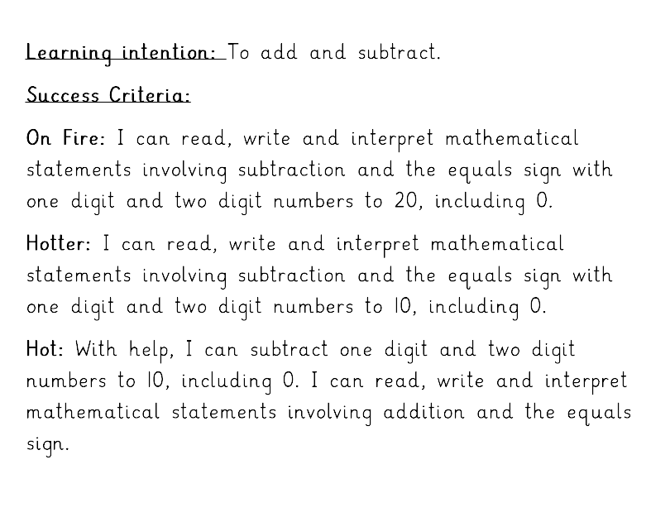

Slide 6
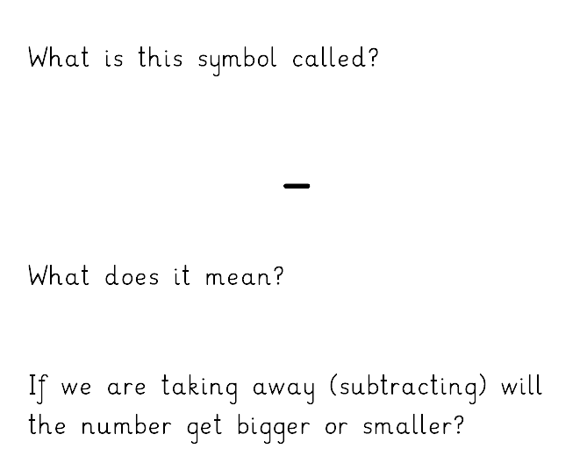
Today we are learning about Subtraction.
Subtract, minus, take away
Smaller

Slide 7
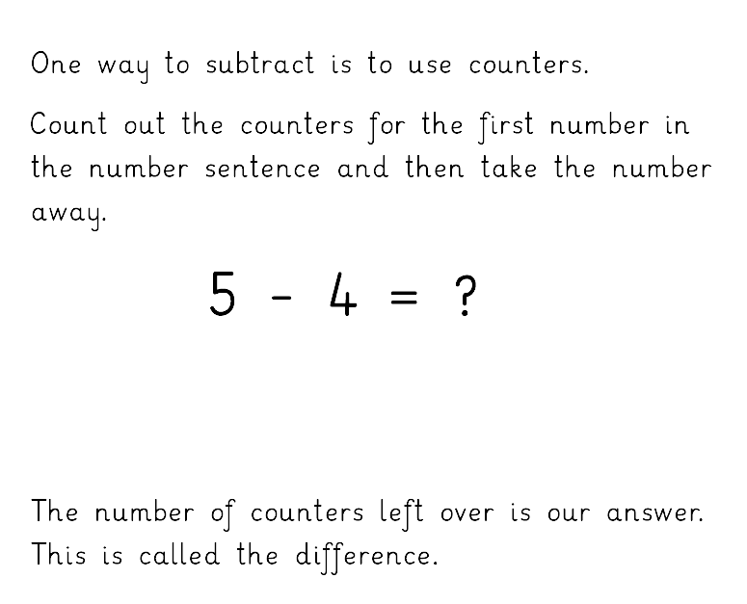

1

Slide 8
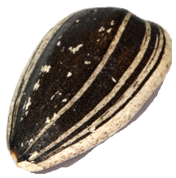
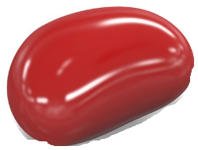




Count out objects and take them away to solve the subtraction questions on the next slide.
Write down the whole number sentences with your answers before checking the answers.
You can use the number line to help.

Slide 9


Now let’s try these
5 – 2 = 3
4 – 2 = 2
6 – 1 = 5
8 – 7 = 1
10 – 6 = 4

Slide 10
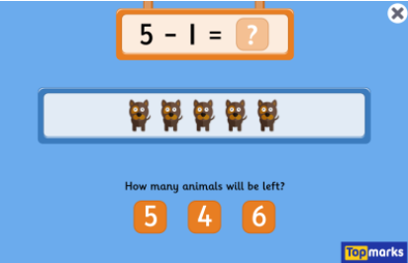
Subtraction to 10 game
https://www.topmarks.co.uk/subtraction/subtraction-to-10

Slide 11
Day 2

Slide 12
Watch the counting in 10s video and see if you can write the numbers from 10-100 in order!
https://www.youtube.com/watch?v=-gmEe0-_ex8

Slide 13

How far can you count?
https://www.youtube.com/watch?v=CyYh1raLGBs

Slide 15
Today we are learning about Subtraction.
Subtract, minus, take away
Smaller

Slide 16
1

Slide 17
Count out objects and take them away to solve the subtraction questions on the next slide.
Write down the whole number sentences with your answers before checking the answers.
You can use the number line to help.

Slide 18
Now try these….

Slide 19
Check your answers….

Slide 20
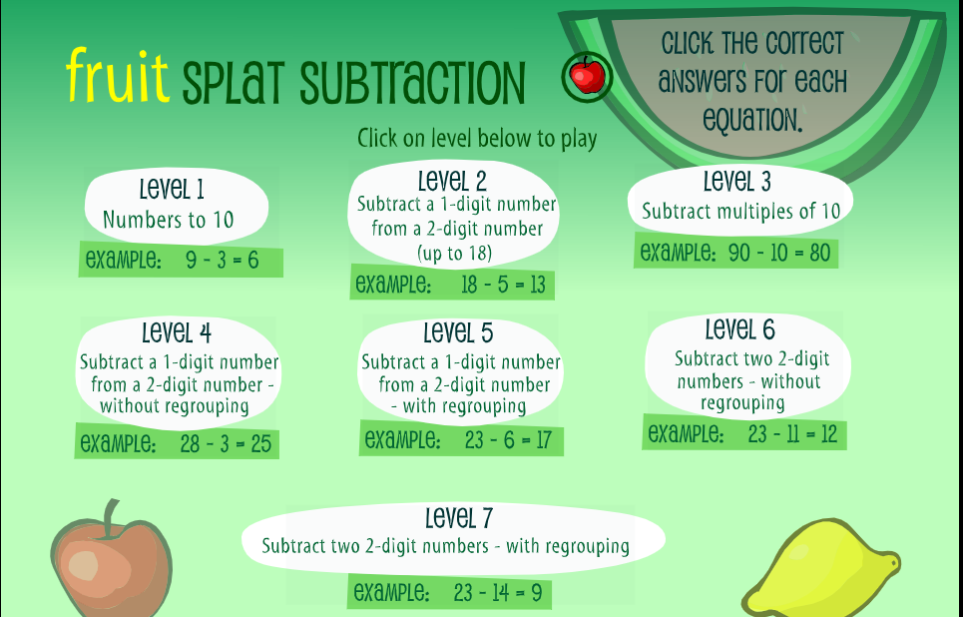
https://www.sheppardsoftware.com/math/subtraction/fruit-splat-game/

Slide 21
Day 3

Slide 22
Watch the counting in 10s video and see if you can write the numbers from 10-100 in order!
https://www.youtube.com/watch?v=-gmEe0-_ex8

Slide 23
What is one less than……
?
5 = 6

Slide 24
What is one less than……
?
3 = 4

Slide 25
What is one less than……
?
8 = 9

Slide 26
What is one less than……
?
9 = 10

Slide 27
What is one less than……
?
15 = 16

Slide 28
What is one less than……
?
11 = 12

Slide 29
What is one less than……
?
19 = 20

Slide 30
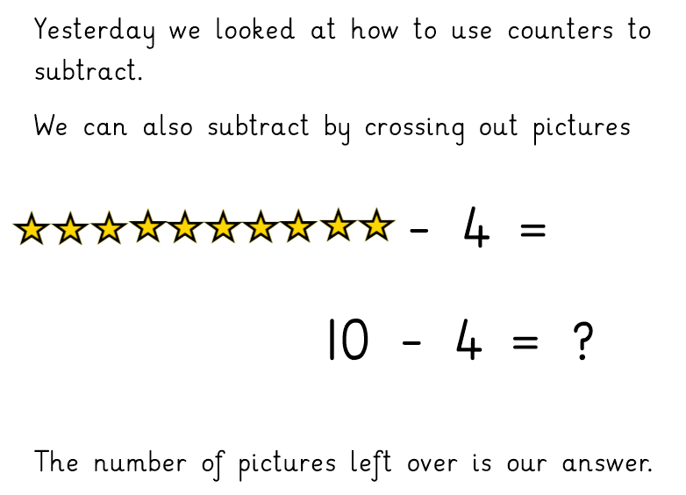

6
6

Slide 31
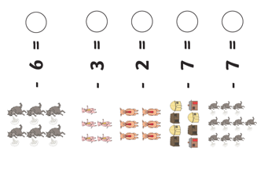
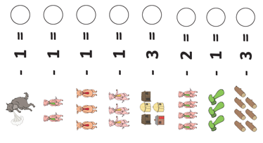
Now try these…

Slide 32
0
Check your answers.
0
0
1
2
2
2
4
2
2
1
2
1
3
4

Slide 33
https://www.sheppardsoftware.com/math/subtraction/fruit-splat-game/

Slide 34
Day 4

Slide 35
Watch the counting in 10s video and see if you can write the numbers from 10-100 in order!
https://www.youtube.com/watch?v=-gmEe0-_ex8

Slide 36

Lets count back from 100 and exercise!
https://www.youtube.com/watch?v=v82X6XhsQhs

Slide 37
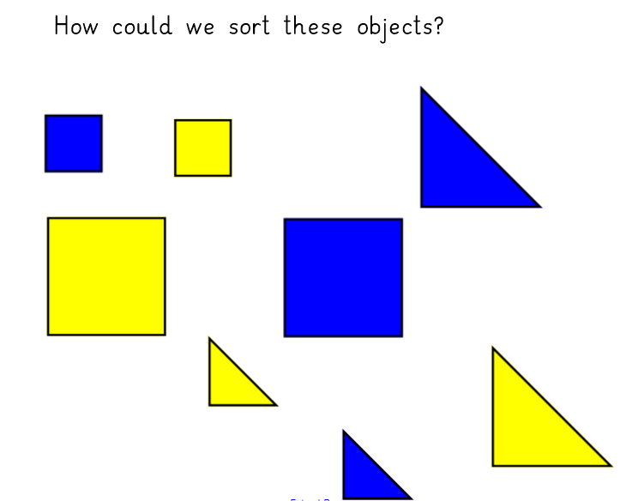

Slide 38
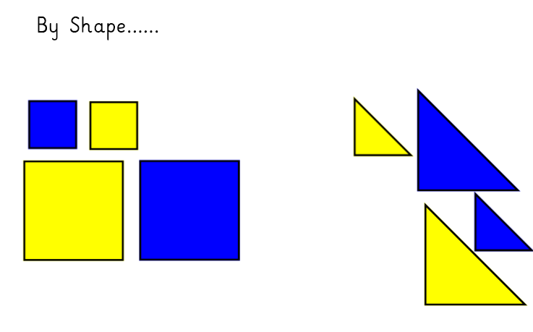

Slide 39
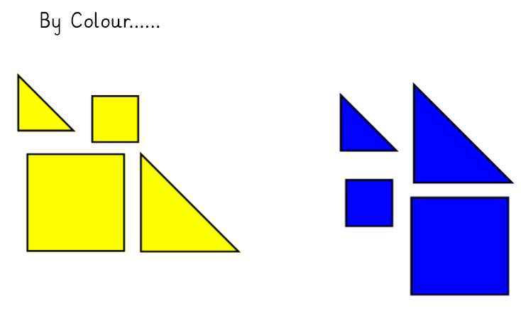

Slide 40
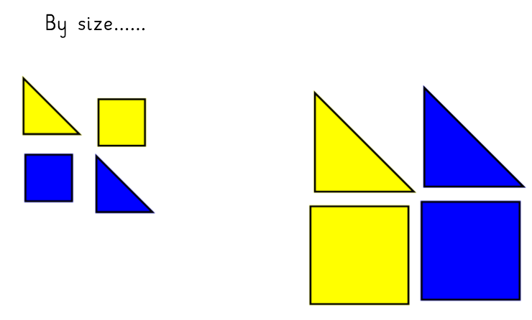

Slide 42
6
6

Slide 43
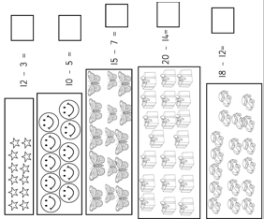
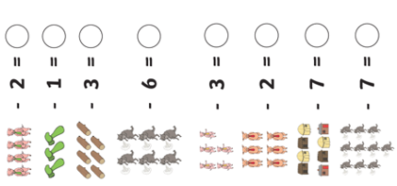
Now try these…

Slide 44
2
9
Check your answers.
2
4
5
0
8
2
6
4
1
6
3

Slide 45
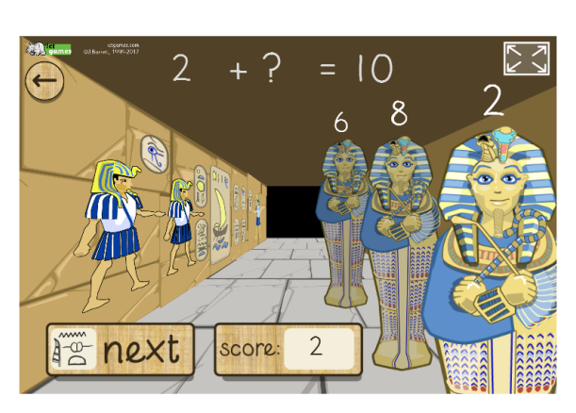
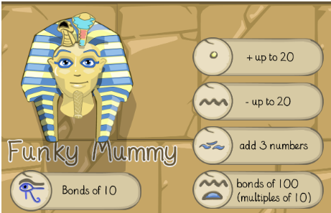
Day 5: Funky Mummy Subtraction up to 20
http://www.ictgames.com/mobilePage/funkyMummy/index.html

