Slide 1
Year 1
Maths Home Learning
Week Beginning 01.11.2021

Slide 2
This Week………
Day 1: Slide 3-11: Maths Practical: Number formation.
Day 2: Slides 12-16: Maths Pictorial: Addition.
Day 3: Slides 17-22: Maths Pictorial: Addition.
Day 4: Slides 23-37: Maths Pictorial: Addition.
Day 5: Slides 38-42: Maths Abstract: Addition.

Slide 3
Day 1

Slide 4
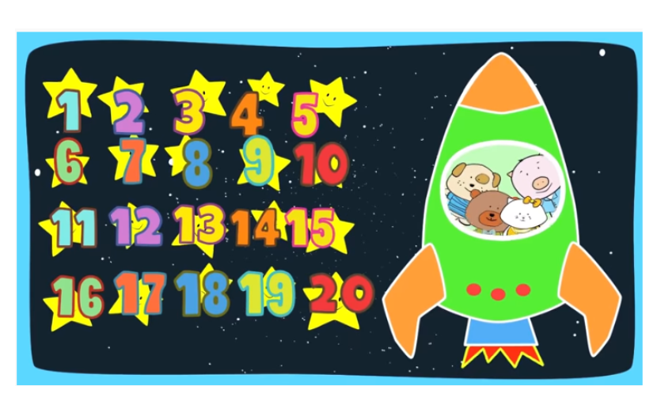
DAY 1:
Let's count to twenty together!
https://www.youtube.com/watch?v=D0Ajq682yrA

Slide 5
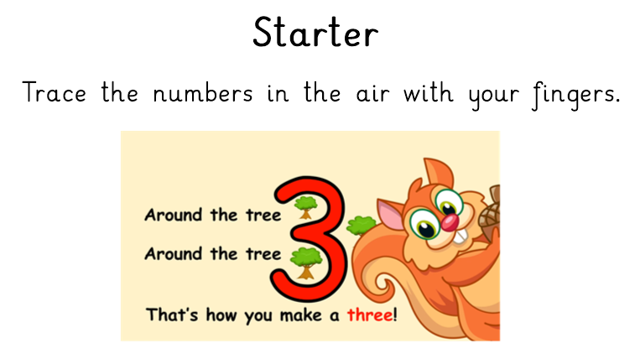
https://www.youtube.com/watch?v=vjB5aSyWD6U

Slide 6
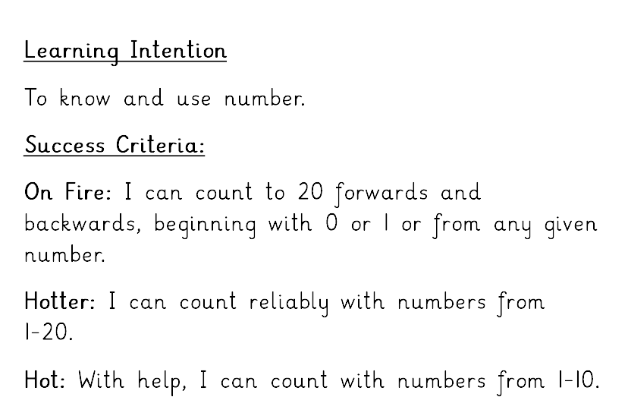

Slide 7
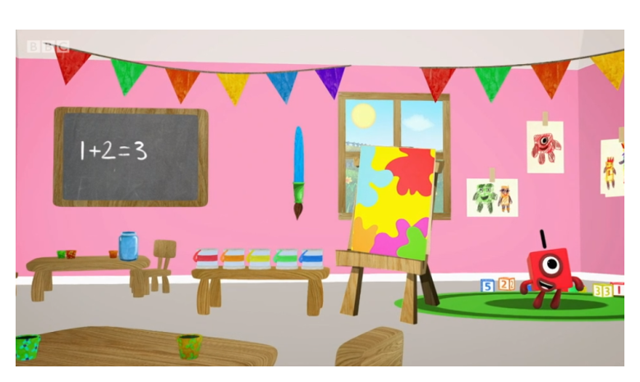
Day 1:
Trace the numbers with your finger.
https://www.bbc.co.uk/iplayer/episode/p077rk5n/numbersongs-lets-all-draw-numbers

Slide 8
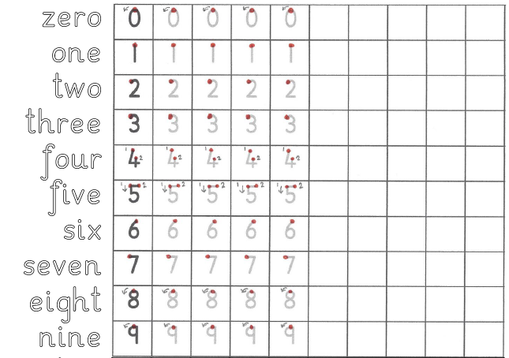
Day 1
Maths Practical Lesson.
Practise forming the numbers and words zero to nine.

Slide 9
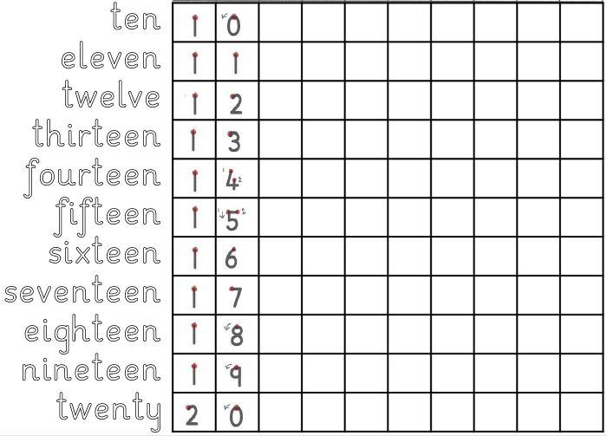
Day 1
Maths Practical Lesson.
Practise forming the numbers and words ten to twenty.

Slide 10
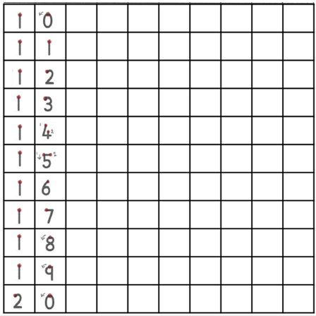

Day 1
Maths Practical Lesson.
Practise forming the numbers from twenty to thirty.

Slide 11
Day 2

Slide 12
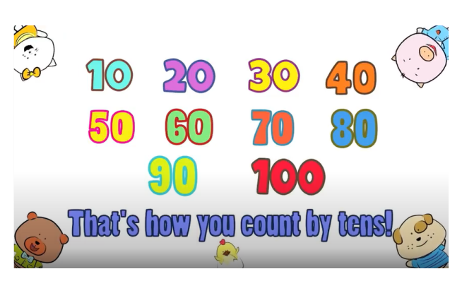
Day 2: Maths Pictorial lesson
Watch the counting in 10s video and see if you can write the numbers from 10-100 in order!
https://www.youtube.com/watch?v=-gmEe0-_ex8

Slide 13
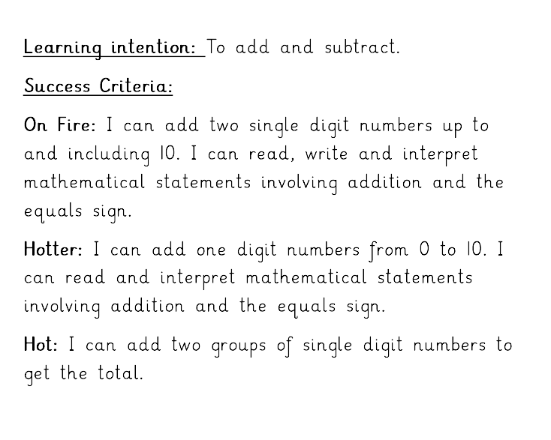

Slide 14
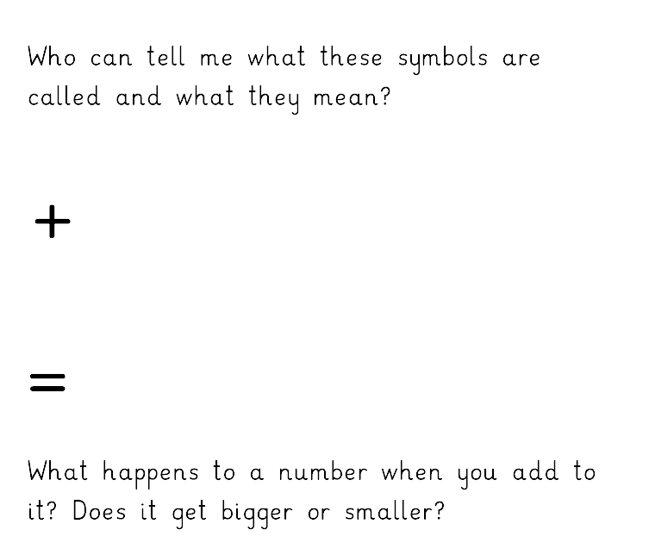
Day 2: Maths Pictorial lesson
Today we are learning about adding numbers together.
Add or plus
Equals
It gets bigger

Slide 15
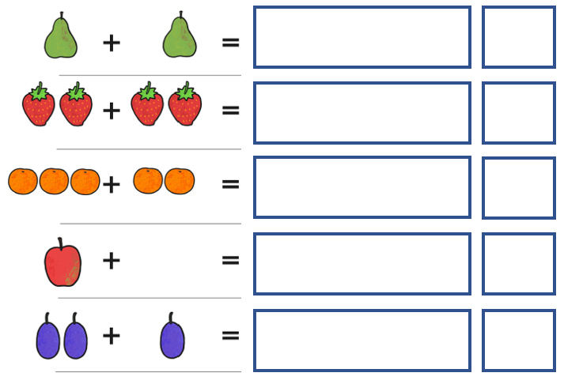
Day 2: Maths Pictorial task
Draw the total fruit for each number sentence.
Write the number.

Slide 16
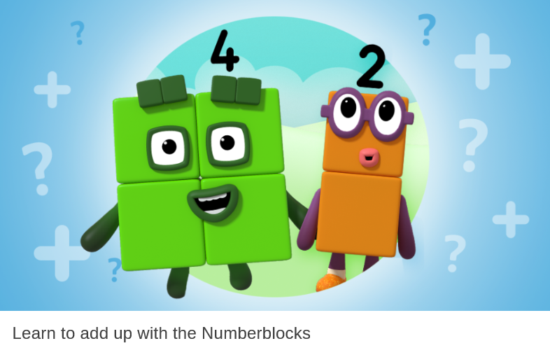
Do the Numberblocks Adding Up Quiz!
https://www.bbc.co.uk/cbeebies/puzzles/numberblocks-adding-up-quiz

Slide 17
Day 3

Slide 18
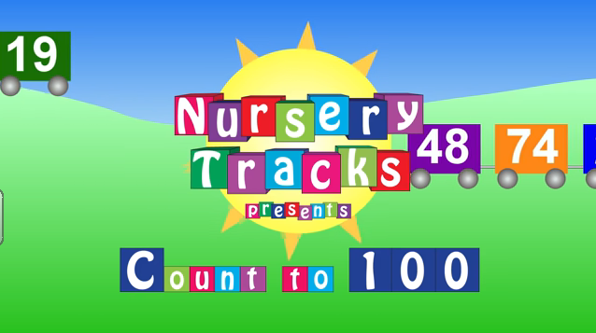
Day 3: Maths Pictorial Lesson
How far can you count?
https://www.youtube.com/watch?v=CyYh1raLGBs

Slide 20
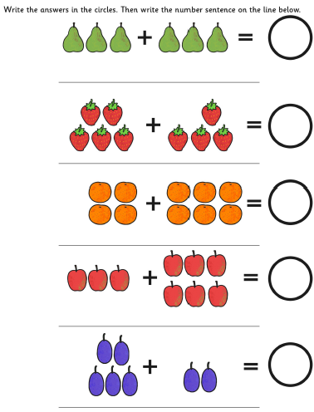
Day 3: Maths Pictorial task
Write the number to complete the number sentence.
Write the whole number sentence.
6
3 + 3 = 6

Slide 21
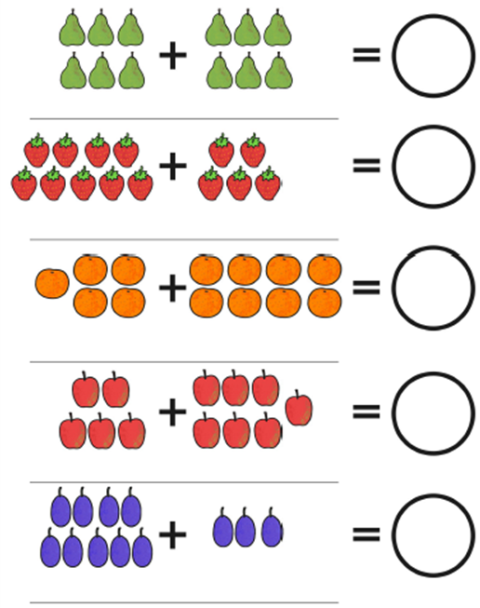
Day 3: Maths Pictorial task
Write the number to complete the number sentence.
Write the whole number sentence.

Slide 22
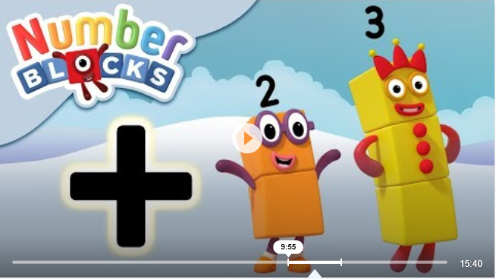
Day 3: Maths Pictorial Lesson
Watch the Numberblocks video to learn more about adding up!
www.youtube.com%2Fwatch%3Fv%3DsPRMOSmDPBM&usg=AOvVaw2kuOOGFp9OjMyM4fH7wlym

Slide 23
Day 4

Slide 24
Day 4: Maths Abstract Lesson
How far can you count?
https://www.youtube.com/watch?v=CyYh1raLGBs

Slide 26
Day 4: Using a Number Track for Addition
This presentation explains how we use a number track to help children begin to add 2 numbers together within 6, then within 10.
http://www.primaryresources.co.uk/maths/powerpoint/using_a_number_track_in_reception.ppt

Slide 27

What’s the difference between a number track and a number line?
0 | 1 | 2 | 3 | 4 | 5 | 6 | 7 | 8 | 9 | 10
A number track is a sequence of numbers, each inside its own square.
We teach this first.
Whereas, a number line is where the numbers are attached to markers on a line. This method of addition / subtraction comes later.

Slide 28

Using a number track for addition
A number track can be drawn, using chalk, on the ground outside.
It can a track of numbers drawn on paper inside.
Children can count as they physically jump, to help them add on the other number.
This is great for children who learn best by doing (kinaesthetic learners).

Slide 29
How to use a number track for addition
Start by adding two numbers which total no more than 6.
3 add 2. Say these words. Then ask your child, ‘Which number do we start on?’ The child stands on (or points to) number 3.
Then say, ‘We need to add 2 more.’ (Pause to let the information sink in).
0 | 1 | 2 | 3 | 4 | 5 | 6 | 7 | 8 | 9 | 10
‘So that’s 2 jumps. Let’s do it together.’
‘So which number have we landed on?’ (Pause) ‘5, that’s right!’
‘Well done! You have used a number track to add two numbers together.’
Then recap on what you’ve done. ‘So we did, 3 add 2. We started on 3, then we did 2 jumps. 3 add 2 makes 5.’

Slide 30
Try these number tracks with your child!

Slide 31
2 + 1 =
0 | 1 | 2 | 3 | 4 | 5 | 6 | 7 | 8 | 9 | 10
2 + 1 = 3

Slide 32
1 + 3 =
0 | 1 | 2 | 3 | 4 | 5 | 6 | 7 | 8 | 9 | 10
1 + 3 = 4

Slide 33
4 + 2 =
0 | 1 | 2 | 3 | 4 | 5 | 6 | 7 | 8 | 9 | 10
4 + 2 = 6

Slide 34
When your child is confident with addition within 6, move on to totals to 10.

Slide 35
5 + 4 =
0 | 1 | 2 | 3 | 4 | 5 | 6 | 7 | 8 | 9 | 10
5 + 4 = 9

Slide 36
3 + 5 =
0 | 1 | 2 | 3 | 4 | 5 | 6 | 7 | 8 | 9 | 10
3 + 5 = 8

Slide 37
Addition vocabulary to use with your child:
Add Can you add these 2 numbers together?
More Can you add 3 more?
Makes 4 and 2 makes 6
Altogether 2 and 3, altogether makes 5
Equals 5 add 5 equals 10
1 more 1 more than 8 is 9

Slide 38
Day 5

Slide 39
Day 5: Maths Abstract Lesson
How far can you count?
https://www.youtube.com/watch?v=CyYh1raLGBs

Slide 41
Day 5 Task: Use the Number Track to answer these questions.
3 + 5 =
2 + 6 =
6 + 3 =
10 + 2 =
8 + 6 =
11 + 7 =
12 + 8 =
7 + 10 =
3 + 5 = 8
2 + 6 = 8
6 + 3 = 9
10 + 2 = 12
8 + 6 = 14
11 + 7 = 18
12 + 8 = 20
7 + 10 = 17
0 | 1 | 2 | 3 | 4 | 5 | 6 | 7 | 8 | 9 | 10 | 11 | 12 | 13 | 14 | 15 | 16 | 17 | 18 | 19 | 20

Slide 42
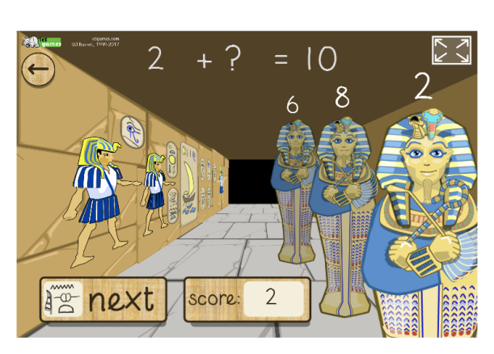
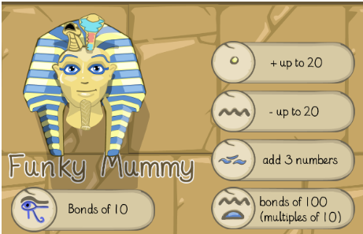
Funky Mummy Addition up to 20
http://www.ictgames.com/mobilePage/funkyMummy/index.html

