Slide 1
English Home Learning
Week Beginning 13.9.21

Slide 2
This week…
Day 1 – Grammar – Capital letters
Day 2 – Handwriting
Day 3 – Grammar- Adjectives
Day 4 – Drawing and labelling characters
Day 5 – Writing sentences about character from Supertato.

Slide 3
Sending your work to your teacher: Remember to send all your hard work to your teachers so they can send you feedback and badges on Marvellous Me! Miss Dawson- 1A@hortongrangeacademy.co.uk Mr Taylor- 1B@hortongrangeacademy.co.uk Miss Matthews- 1C@hortongrangeacademy.co.uk

Slide 4
Day 1
https://www.youtube.com/watch?v=c3g2gqt2TpA

Slide 6
Day 1- Today you will be forming capital letters and then matching the correct capital letter to each lower case letter.

Slide 7
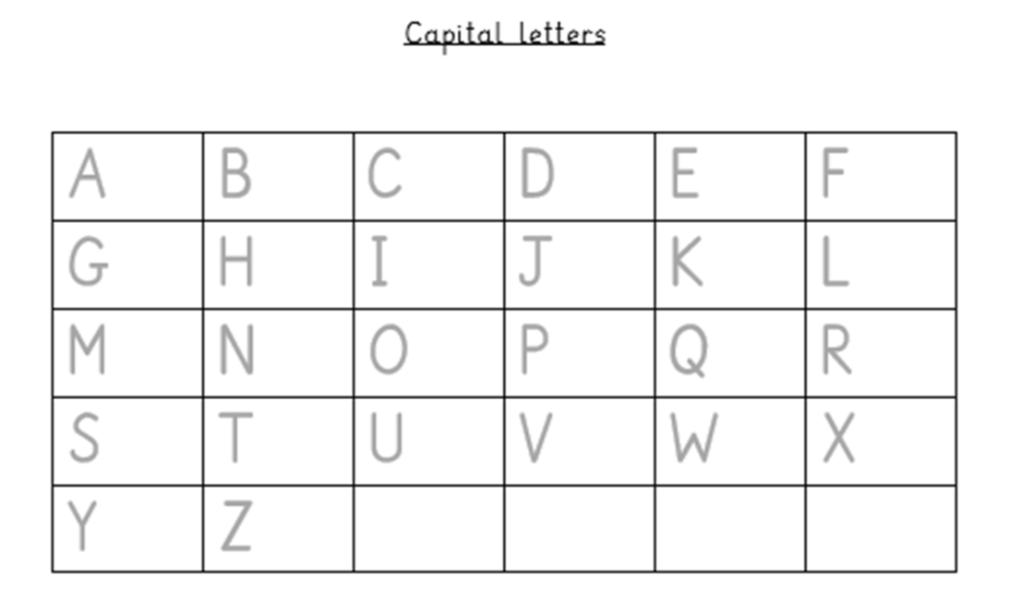

Slide 8
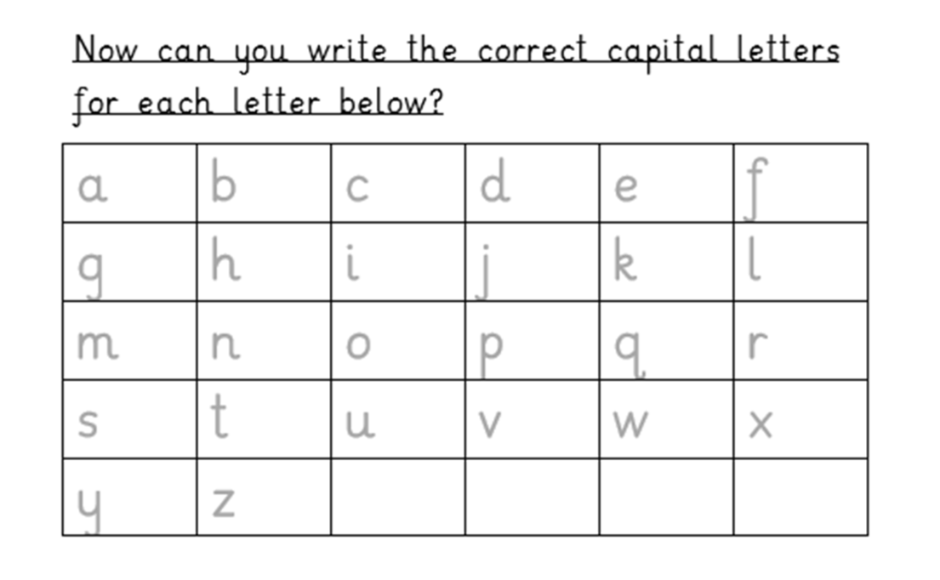

Slide 9
Day 2 - Handwriting
Today you will be practising your letter formation.
Let’s warm up our hands and fingers ready to write first:
https://www.youtube.com/watch?v=o9D5lfqZF3o

Slide 10
Day 2 - Handwriting
Today you will be practising your letter formation of the following letters: c and o
Let’s look at how we form these letters…

Slide 11
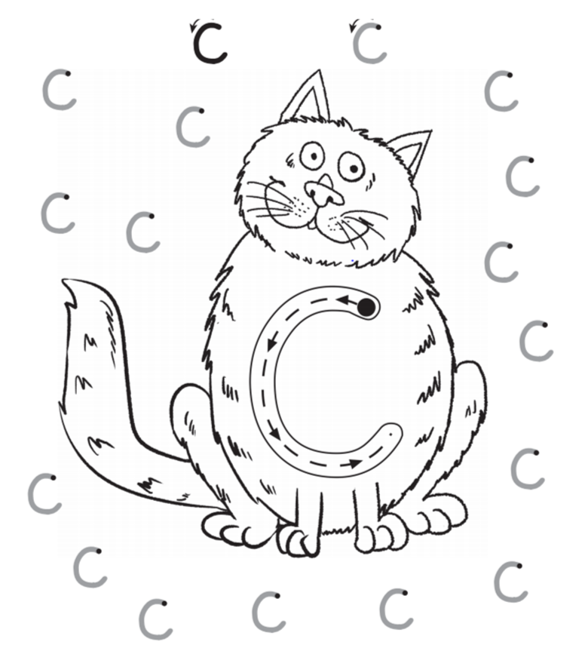
Day 2 - Handwriting
Look carefully at where you will start and which way the arrows point as this shows you how to form this letter:
Practise forming the letter c in the air with your finger.

Slide 12
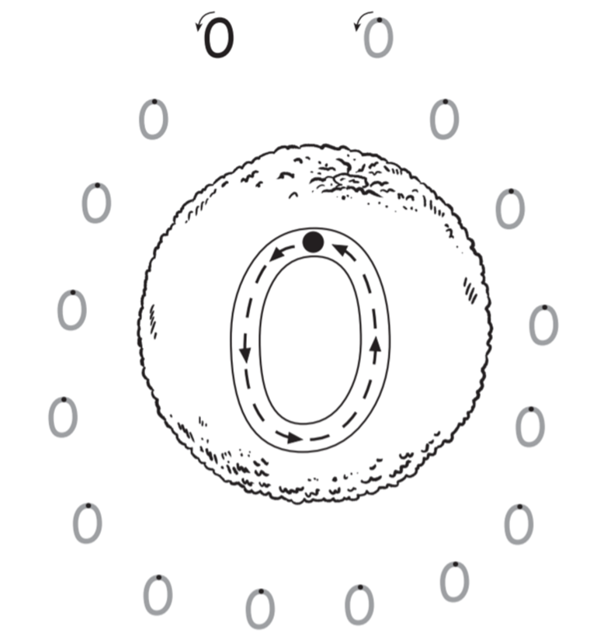
Day 2 - Handwriting
Look carefully at where you will start and which way the arrows point as this shows you how to form this letter:
Practise forming the letter o in the air with your finger.

Slide 13
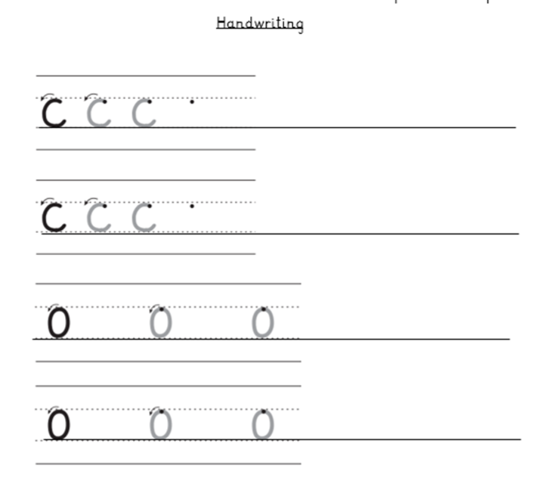
Day 2
Can you now practise writing the letters in your home learning book…
Once you have done 2 lines of the letters, can you write the some words with these letters in. Think really carefully about how you form each letter.

Slide 14
Day 3
Today you will be doing some Grammar work all about adjectives.

Slide 19
Now can you write a sentence to describe each picture?
e.g. The sheep is white.

Slide 20
Day 4
Today and tomorrow we will be thinking about the characters from our new class book.

Slide 23
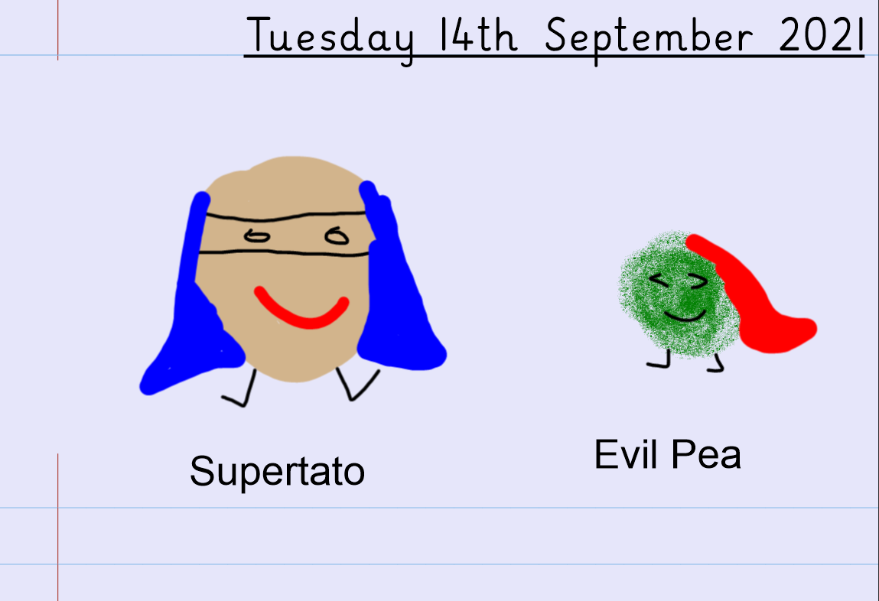
Can you draw and label any other characters?

Slide 24
Day 5
Today you will be using the work you did yesterday to help you to write sentences about each character from the book that you drew yesterday.

Slide 25
Using yesterdays work, can you now write sentences to describe each character you drew?

Slide 26
e.g. Supertato is brave. Evil Pea is green.
Remember to include capital letters and full stops.

