Slide 1
Year 1 Maths Home Learning
Week Beginning 21.6.21

Slide 2
If you are learning from home,
don’t forget to send your work to
your teacher:
Mrs O’Sullivan- 1A@hortongrangeacademy.co.uk
Mr Taylor- 1B@hortongrangeacademy.co.uk
Miss Matthews- 1C@hortongrangeacademy.co.uk

Slide 3
This Week………
Fractions
School Jam Activities: See the activities sent to your APP this week.
Day 1: Describing movement
Day 2: Movement from a start position
Day 3: Movement from different start positions
Day 4: Drawing movement
Day 5: Movement fun day

Slide 4
Day 1

Slide 5
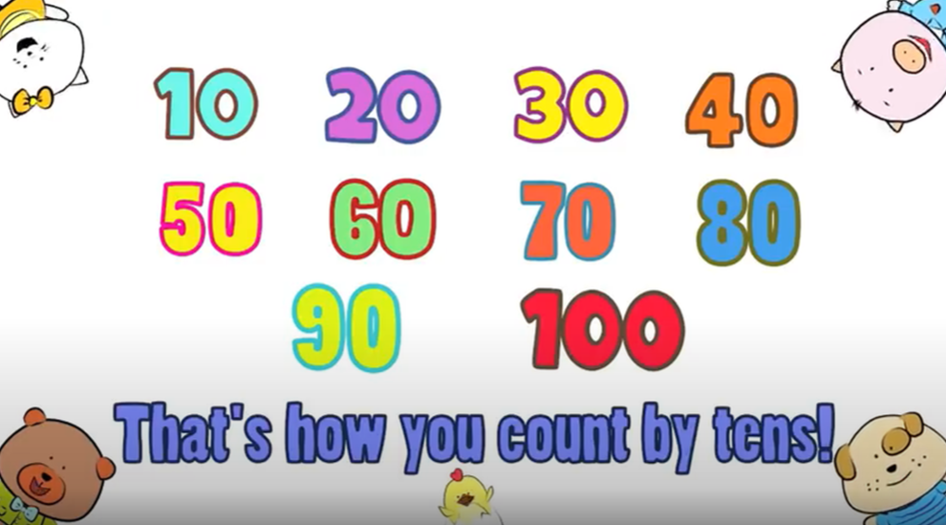
Sing along with the song to learn counting in 10s!
https://www.youtube.com/watch?v=-gmEe0-_ex8

Slide 6
OMS- let’s get your
brains ready for
Maths!

Slide 7
What have we done and what will we do?
Last week, you look at fractions of shapes and objects. You looked at fractions of amounts and length.
Today, you will be looking at describing movement of objects.

Slide 8
Follow this video from white rose maths, it will show you what we are doing today.
https://vimeo.com/546135912

Slide 9
TASK – Practical
Take a spoon or another object and place it at the start position. Then ask your grown up to challenge you to turn your spoon
A quarter turn
A half turn
A three-quarter turn
A full turn
Try this with other objects and challenge your grown ups

Slide 10
Day 2

Slide 11
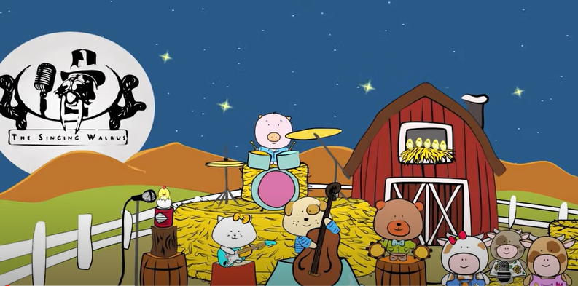
OMS- let’s get your brains ready for Maths!
https://www.youtube.com/watch?v=5FaBDqOmiyI

Slide 12
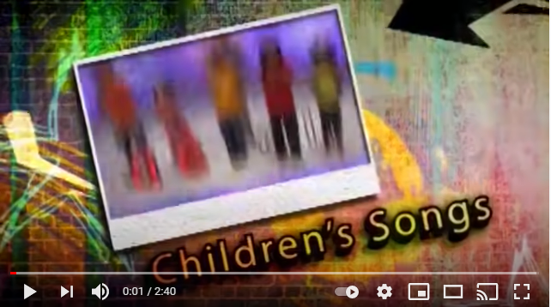
OMS- let’s get your
brains ready for
Maths!
Subtraction
6 – 2 = 3 – 3 = 12 – 3 =
https://www.youtube.com/watch?v=pwQKugrFmJQ

Slide 13
What have we done and what will we do?
Yesterday, you looked at turns practically.
Today, you will be looking at choosing the correct turn from a group of pictures.

Slide 14
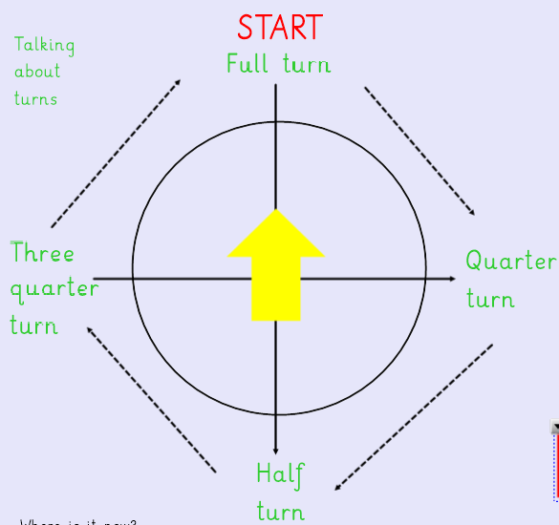

Slide 15
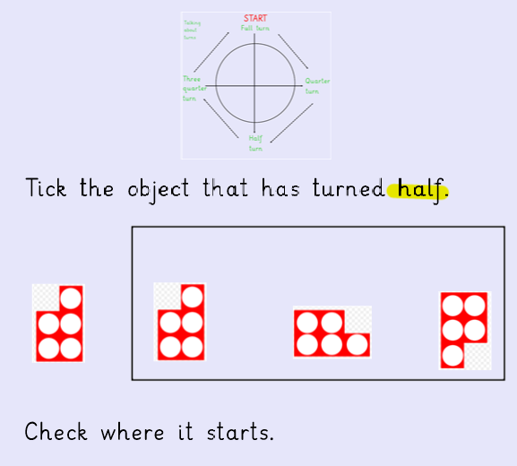
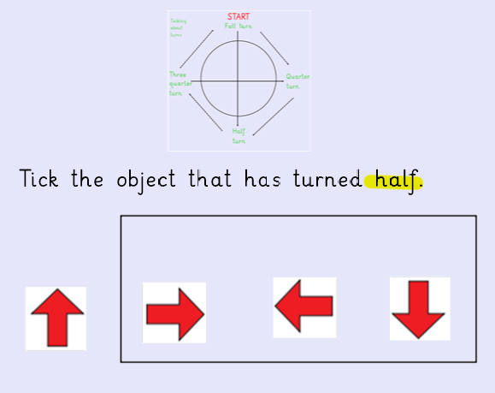

Slide 17
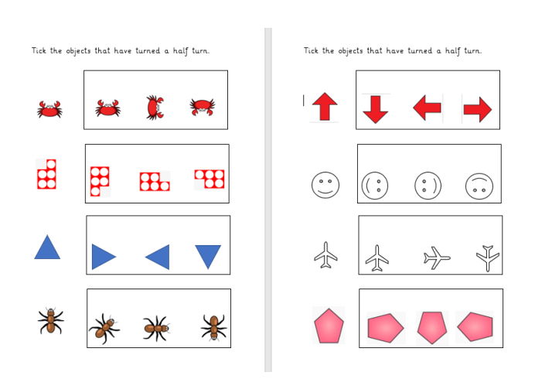
Carrots and Tomatoes

Slide 18
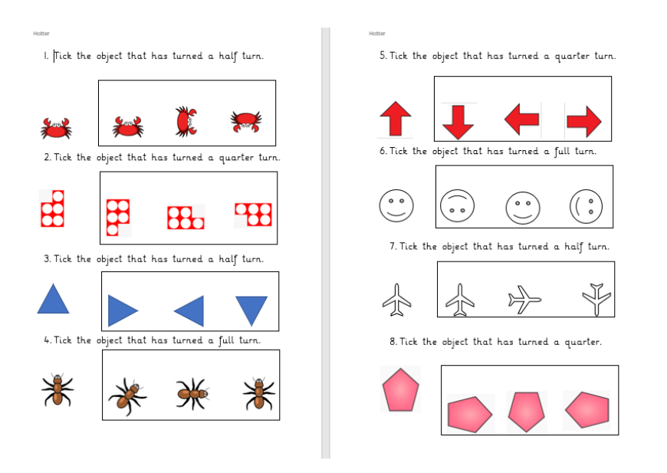
Aubergines, Broccoli and Bananas

Slide 19
Day 3

Slide 20
OMS- let’s get your
brains ready for
Maths!
https://www.youtube.com/watch?v=vmyzMyDtQRI

Slide 21
What have we done and what will we do?
Yesterday, you looked at position and movement of objects a half, a quarter and a full turn.
Today, you will be looking at this again but with different starting points.

Slide 23
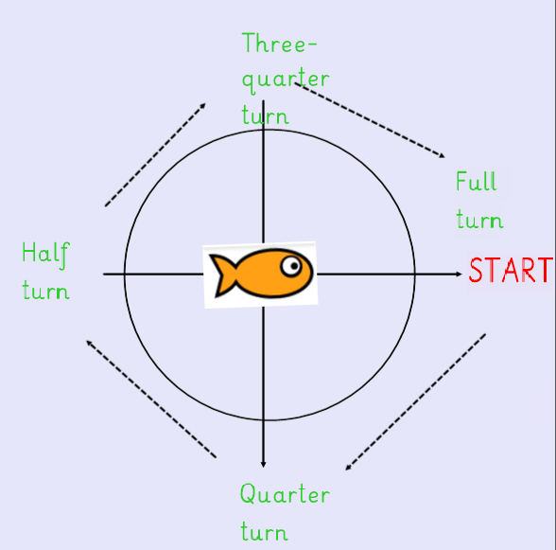

Slide 24
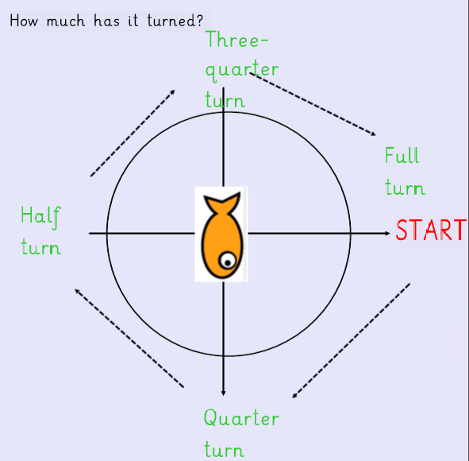
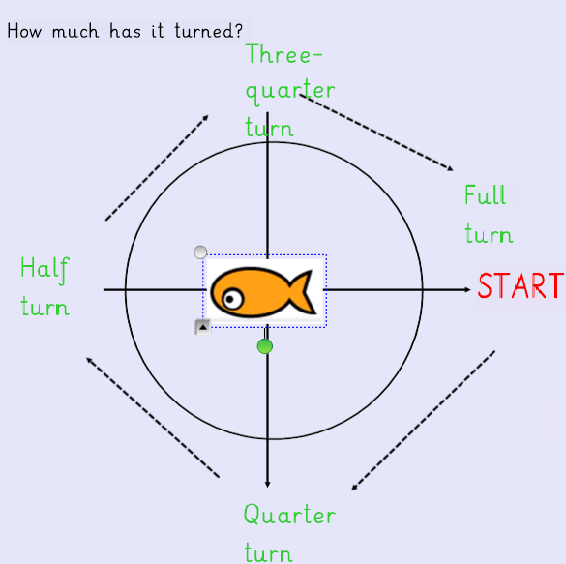
Quarter turn Half turn

Slide 25
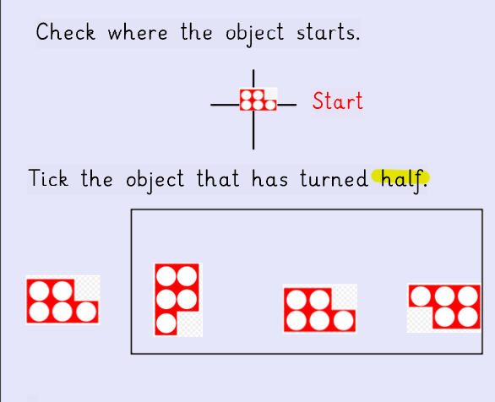
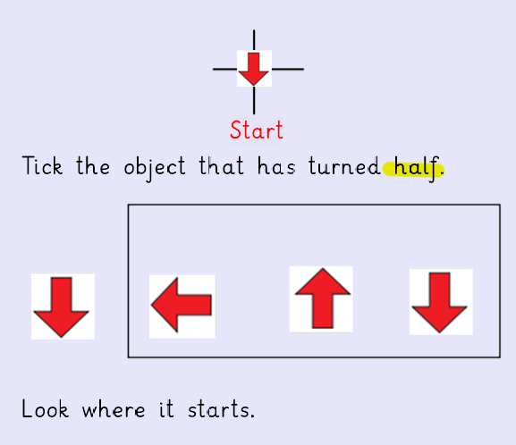

Slide 26
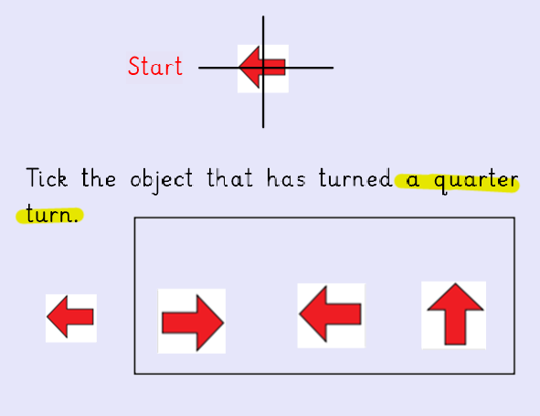

Slide 27
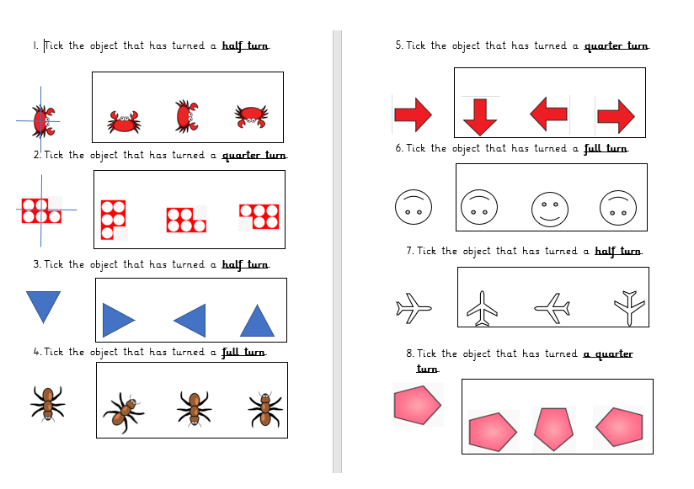
All

Slide 28
Day 4

Slide 29
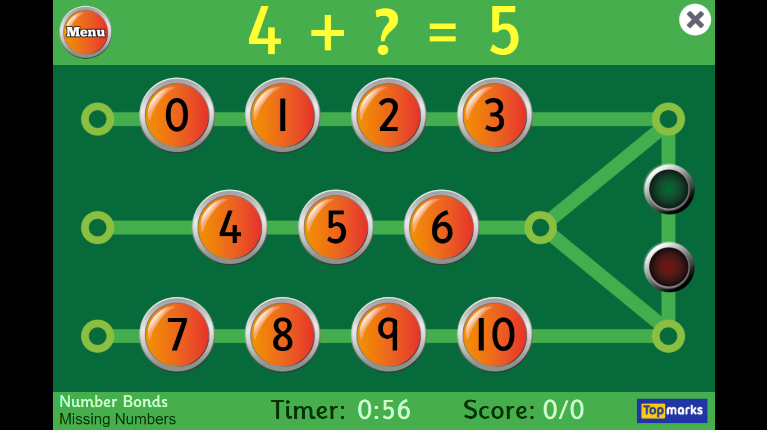
OMS- let’s get your
brains ready for
Maths!
Choose number
Bonds
Choose missing
numbers (-and+)
https://www.topmarks.co.uk/maths-games/hit-the-button

Slide 30
What have we done and what will we do?
Yesterday, you looked at quarter, half, three-quarter and full turns from different starting points.
Today, you will be putting that to the test by drawing objects after they have turned.

Slide 32
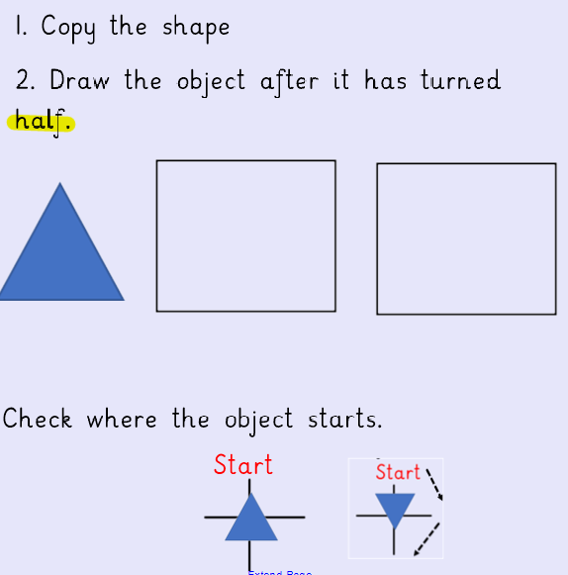
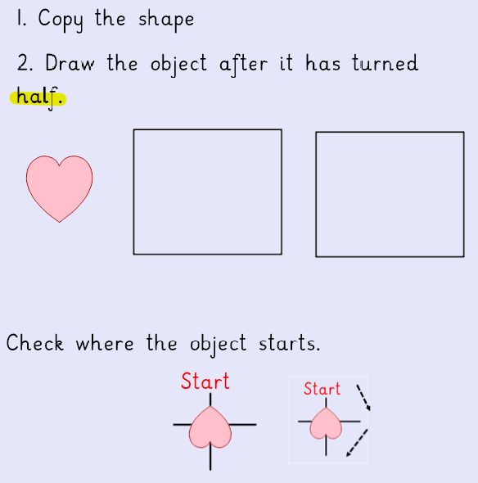

Slide 34
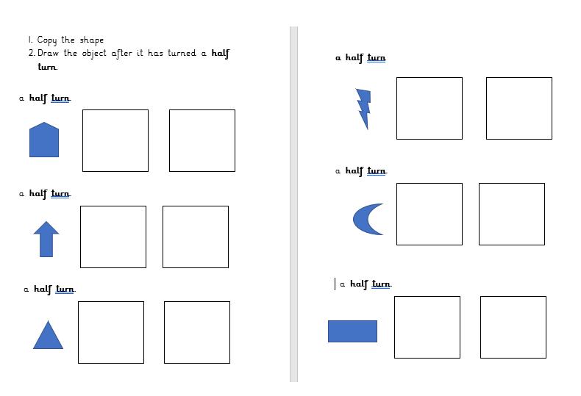
All

Slide 35
Day 5

Slide 36
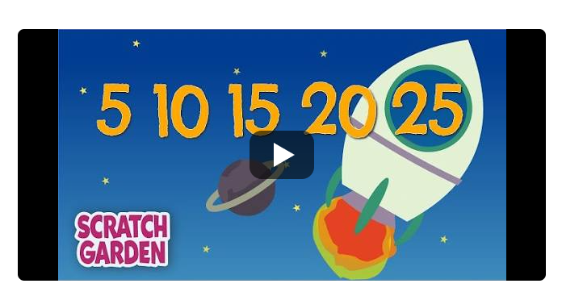
OMS- let’s get your
brains ready for
Maths!
https://www.youtube.com/watch?v=EemjeA2Djjw

Slide 37
What have we done and what will we do?
Yesterday, movement and turns.
Today, we will have a look a video related to describing movement and then play an internet game related to movement. Enjoy!

Slide 38
https://www.bbc.co.uk/teach/supermovers/ks1-maths-position-&-direction/zhh9scw

Slide 39
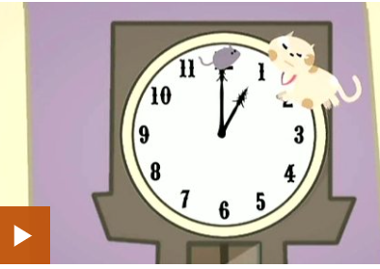
https://www.bbc.co.uk/bitesize/clips/zf7xn39

Slide 40
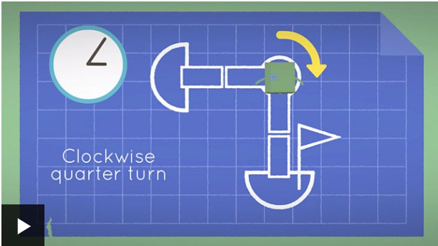
https://www.bbc.co.uk/bitesize/topics/z2grd2p/articles/zwv6b82

Slide 41
Which was the best video and why?

Slide 42
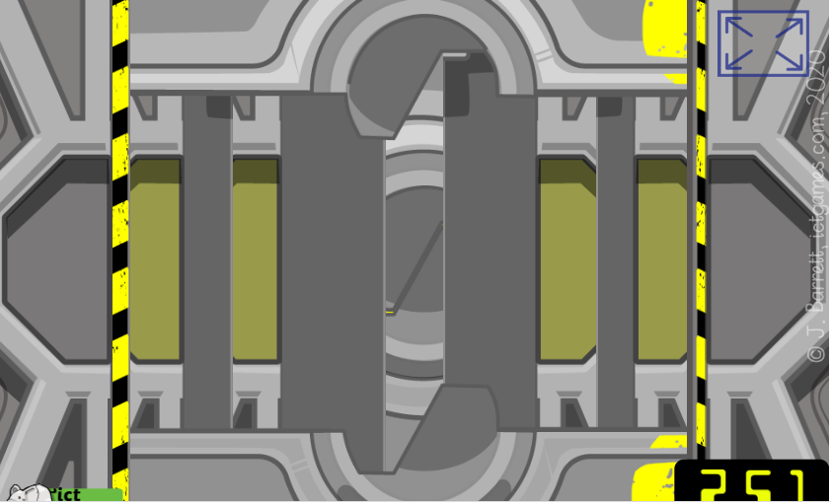
Task – Play this!
https://www.ictgames.com/mobilePage/deadlyDoors/index.html

Slide 43
Missing numbers
Choose number
bonds
Choose missing
numbers (-and+)
https://www.topmarks.co.uk/maths-games/hit-the-button

