Slide 1
Maths Home Learning
Week Beginning 17th May 2021

Slide 2
This week…
Day 1 – Division
Day 2 – Division
Day 3 – Arithmetic
Day 4 – Division
Day 5 – Division

Slide 3
Day 1

Slide 4
Remember to sent your home learning to your teacher.
Miss Ackernley 3a@hortongrangeacademy.co.uk
Mrs Batool 3b@hortongrangeacademy.co.uk
Miss Croot 3c@hortongrangeacademy.co.uk

Slide 5
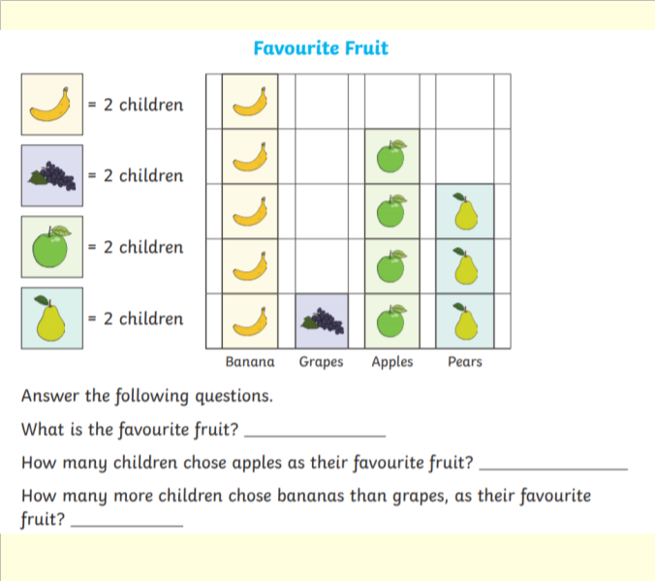
Day 1

Slide 6
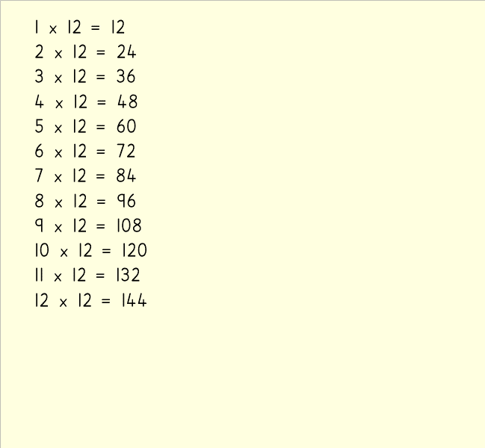
Day 1

Slide 7
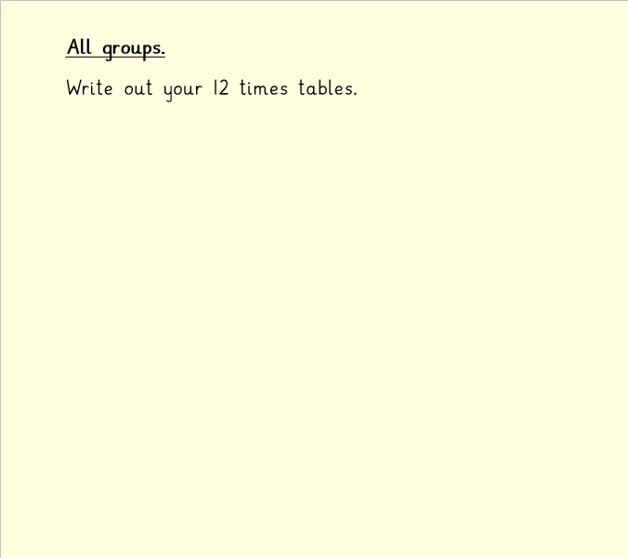
Day 1

Slide 8
Day 1

Slide 9
Day 1

Slide 10
Day 1

Slide 11
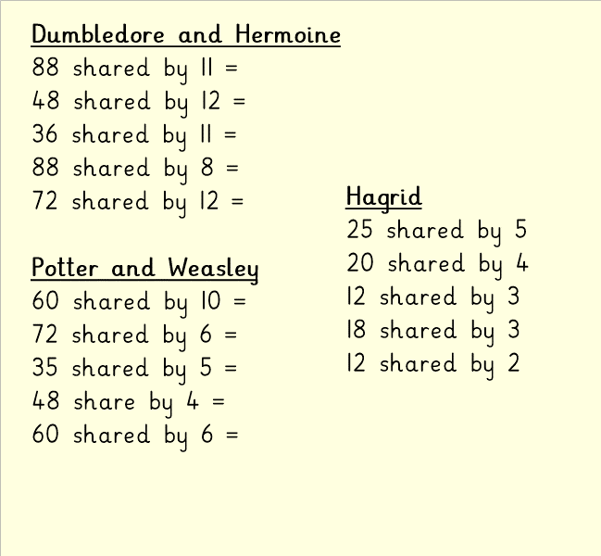
Day 1

Slide 12
Day 2

Slide 13
Remember to sent your home learning to your teacher.
Miss Ackernley 3a@hortongrangeacademy.co.uk
Mrs Batool 3b@hortongrangeacademy.co.uk
Miss Croot 3c@hortongrangeacademy.co.uk

Slide 14
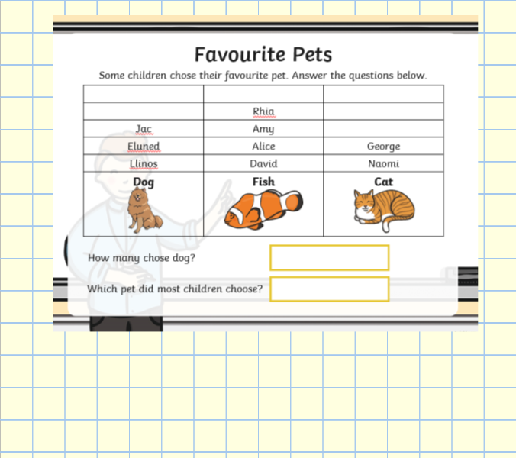
Day 2

Slide 15
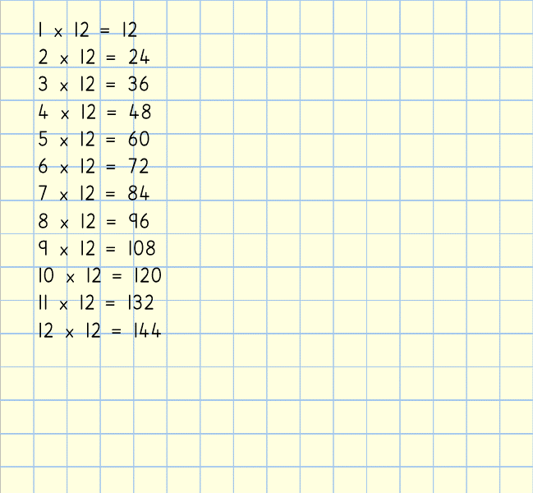
Day 2

Slide 16
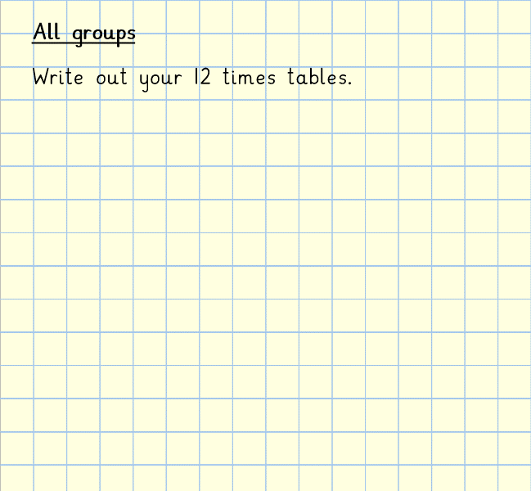
Day 2

Slide 17
Day 2

Slide 18
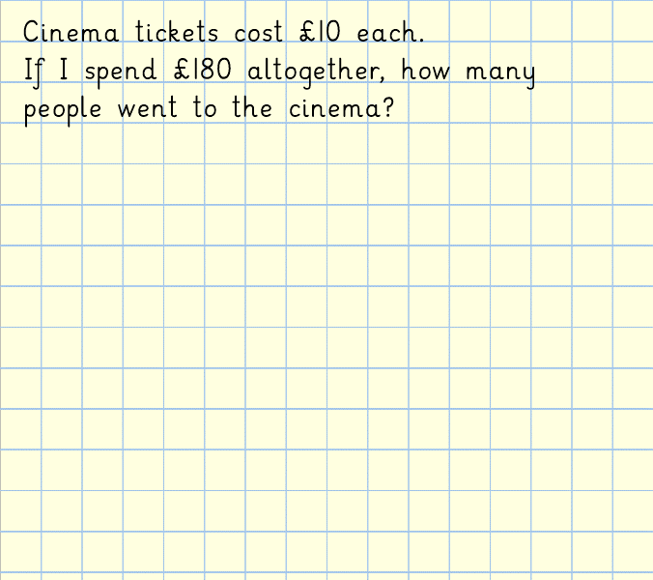
Day 2

Slide 19
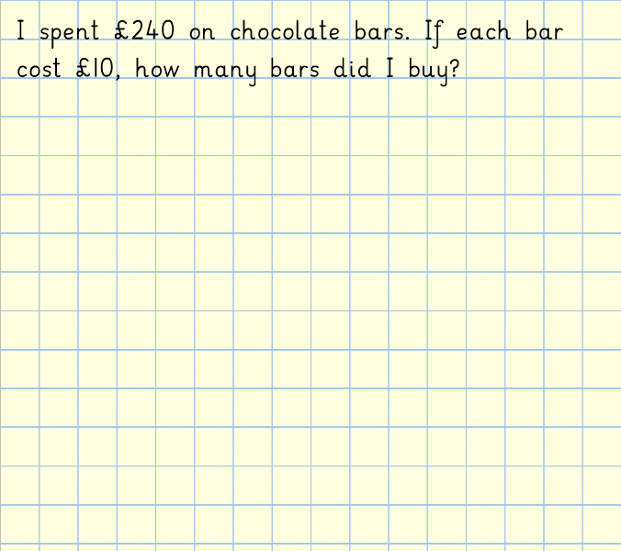
Day 2

Slide 20
Day 2

Slide 21
Day 3

Slide 22
Remember to sent your home learning to your teacher.
Miss Ackernley 3a@hortongrangeacademy.co.uk
Mrs Batool 3b@hortongrangeacademy.co.uk
Miss Croot 3c@hortongrangeacademy.co.uk

Slide 24
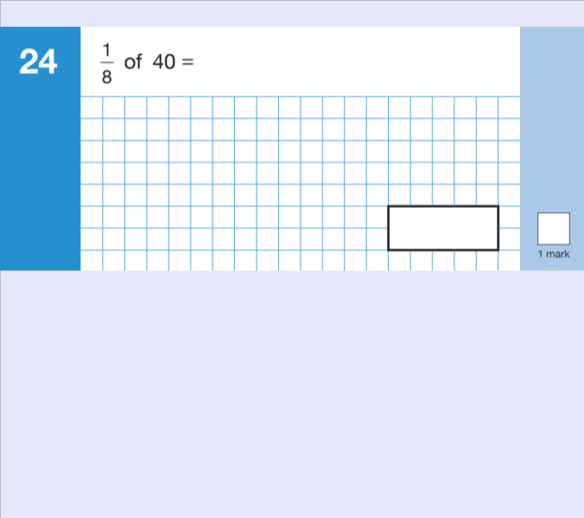

Slide 25
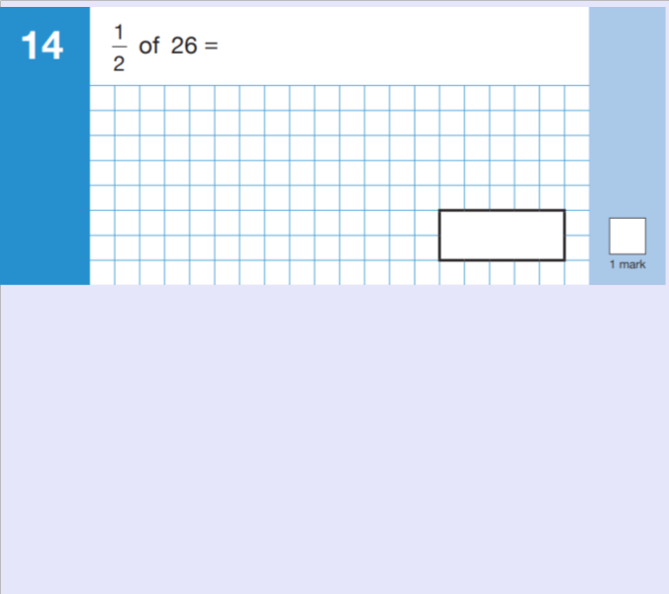

Slide 26
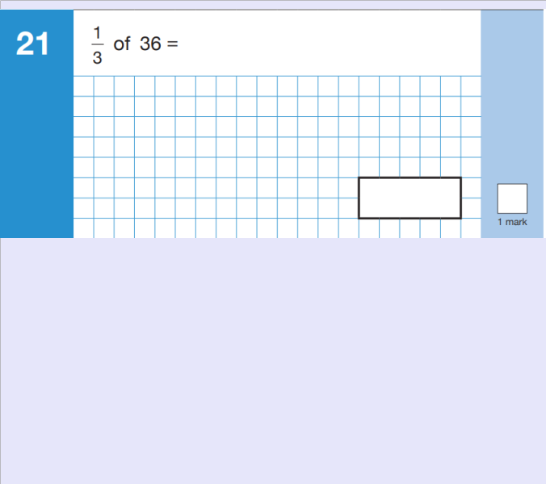

Slide 27
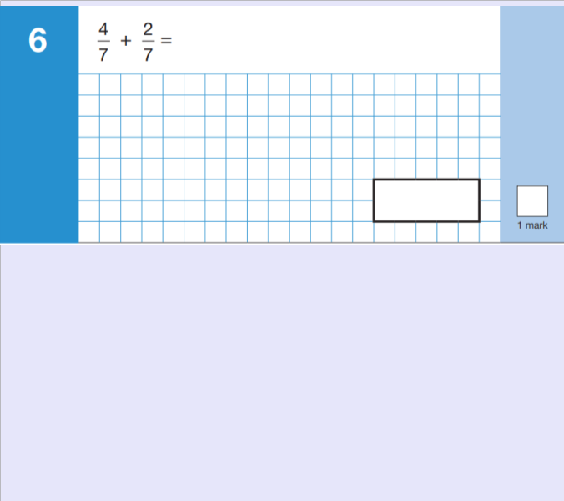

Slide 29
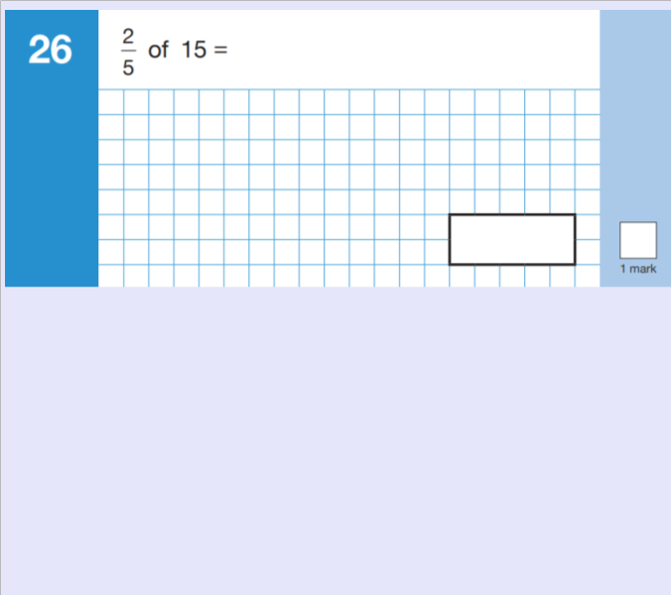

Slide 30
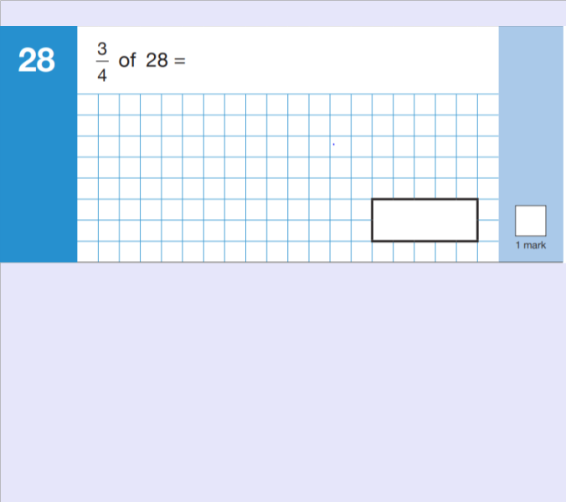

Slide 31
Day 4

Slide 32
Remember to sent your home learning to your teacher.
Miss Ackernley 3a@hortongrangeacademy.co.uk
Mrs Batool 3b@hortongrangeacademy.co.uk
Miss Croot 3c@hortongrangeacademy.co.uk

Slide 33
Day 4

Slide 34
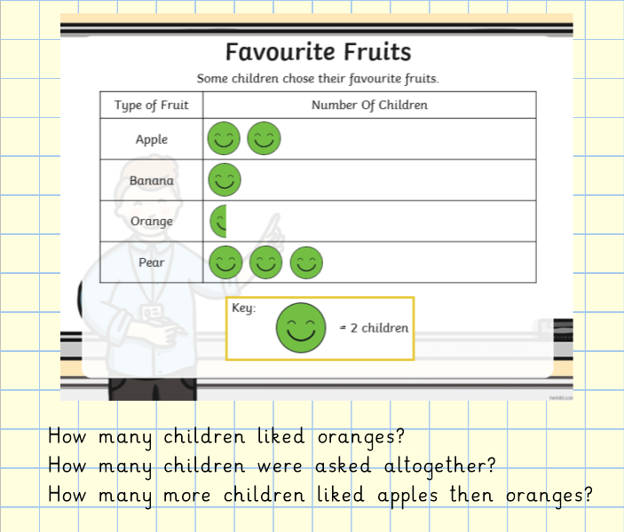
Day 4

Slide 35
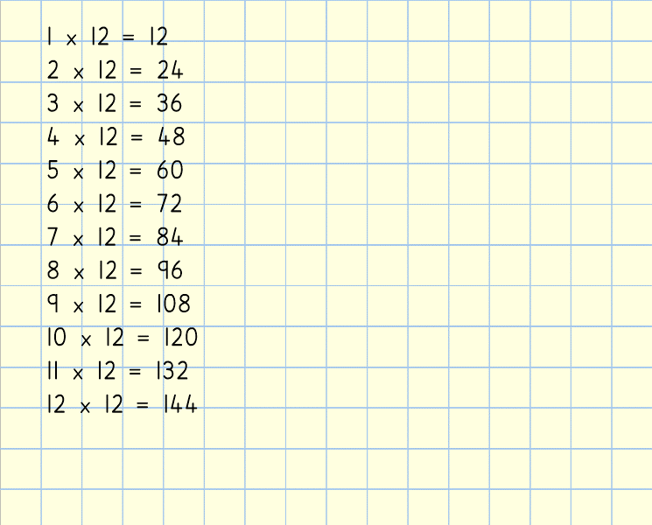
Day 4

Slide 36
Day 4

Slide 37
Day 4

Slide 38
Day 4

Slide 39
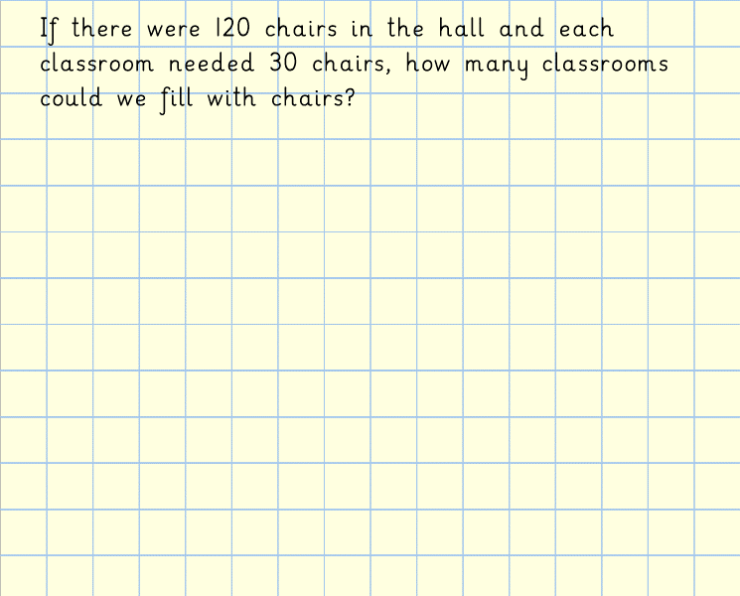
Day 4

Slide 40
Day 4

Slide 41
Day 4

Slide 42
Day 5

Slide 43
Remember to sent your home learning to your teacher.
Miss Ackernley 3a@hortongrangeacademy.co.uk
Mrs Batool 3b@hortongrangeacademy.co.uk
Miss Croot 3c@hortongrangeacademy.co.uk

Slide 44
Day 5

Slide 45
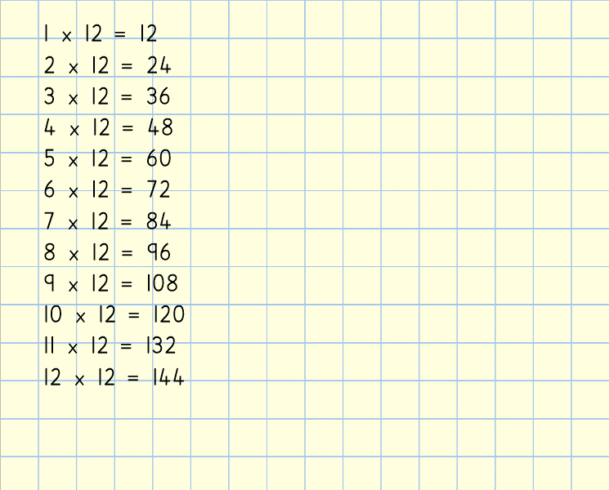
Day 5

Slide 46
Day 5

Slide 47
Day 5

Slide 48
Day 5

Slide 49
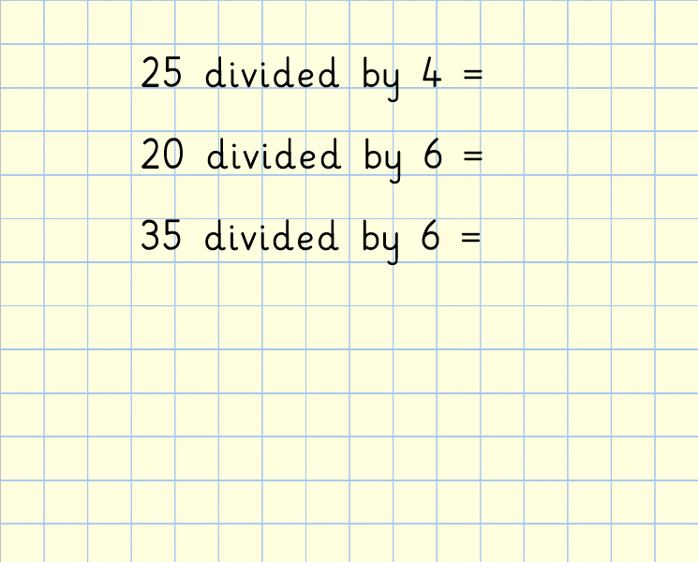
Day 5

Slide 50
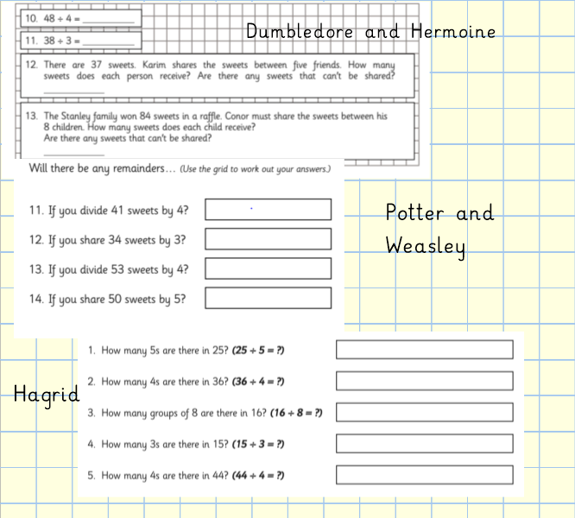
Day 5

Slide 51
Day 5

