Slide 1
Year 1 Maths Home Learning
Week Beginning 3.5.21

Slide 2
If you are learning from home,
don’t forget to send your work to
your teacher:
Mrs O’Sullivan- 1A@hortongrangeacademy.co.uk
Mr Taylor- 1B@hortongrangeacademy.co.uk
Miss Matthews- 1C@hortongrangeacademy.co.uk

Slide 3
This Week………
Multiplication
School Jam Activities: See the activities sent to your APP this week.
Day 1: Monday- Bank Holiday
Day 2: Number Formation Practise
Day 3: Practically sharing to divide
Day 4: Sharing to divide by drawing groups
Day 5: Sharing to divide by drawing groups

Slide 4
Day 2

Slide 5
One
Thirteen
Four
Twenty
Two
Fifteen
15
1
4
2
13
20
Day 2
Maths
Match the numbers to the words.

Slide 6
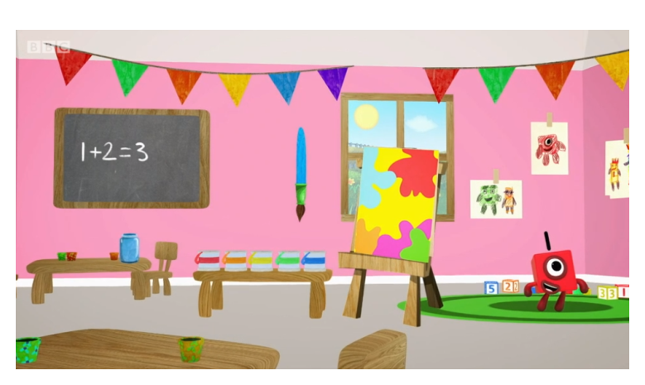
Day 2:
Trace the numbers with your finger.
https://www.bbc.co.uk/iplayer/episode/p077rk5n/numbersongs-lets-all-draw-numbers

Slide 7
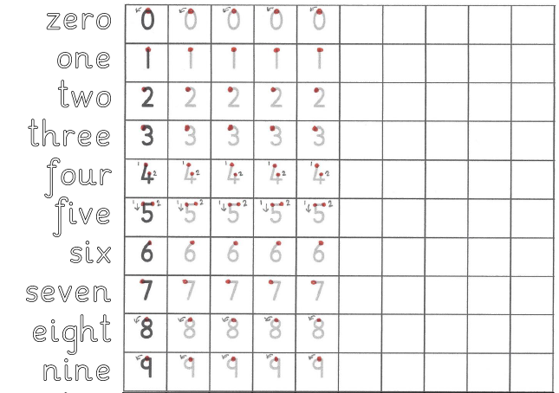
Day 2
Maths Practical Lesson.
Practise forming the numbers and words zero to nine.

Slide 8
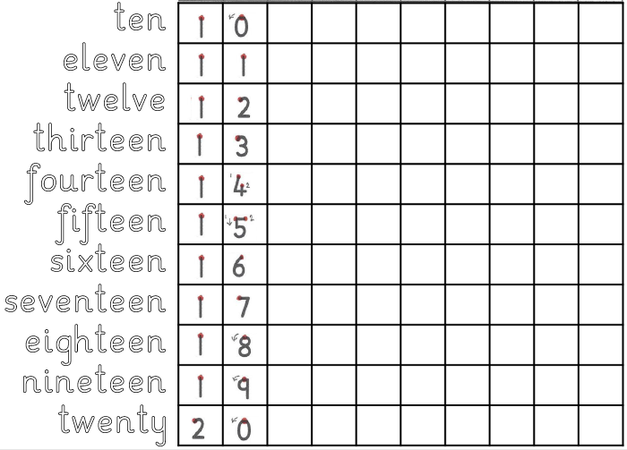
Day 2
Maths Practical Lesson.
Practise forming the numbers and words ten to twenty.

Slide 9
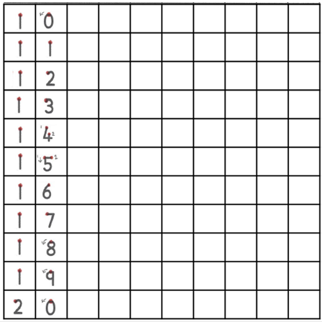
Day 2
Maths Practical Lesson.
Practise forming the numbers from twenty to thirty.

Slide 10
Day 3

Slide 11
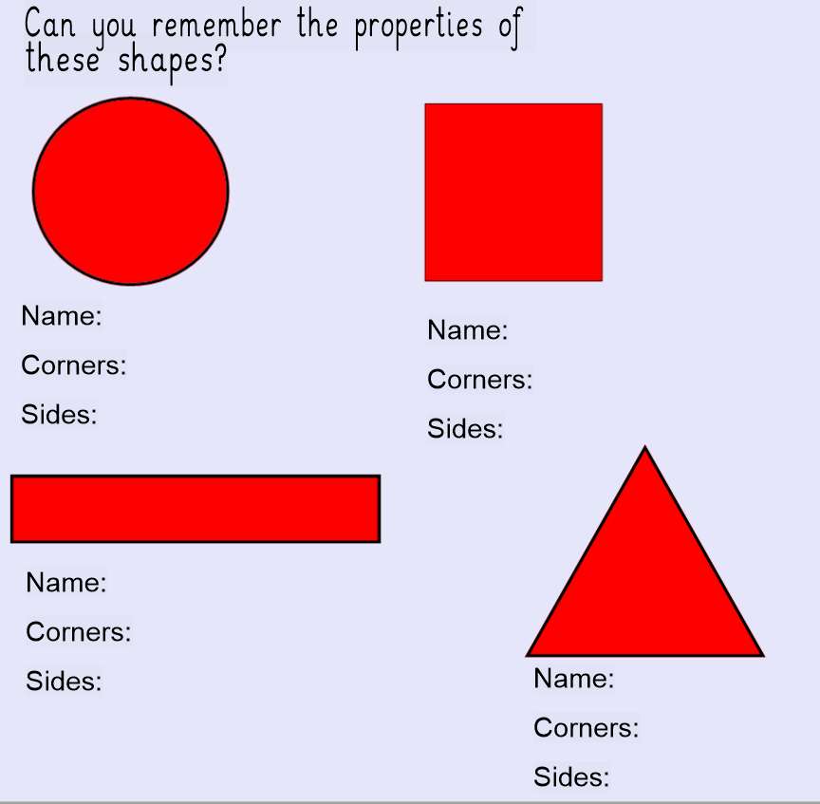
OMS- let’s get
your brains
ready for Maths!

Slide 13
Today you will be dividing by sharing objects into groups.
When you divide, each group you share into must have an equal amount in.
Let’s look at some examples together…

Slide 16
Now you try this question…
Share 6 objects equally into 2 groups.
6 ÷ 2 =

Slide 17
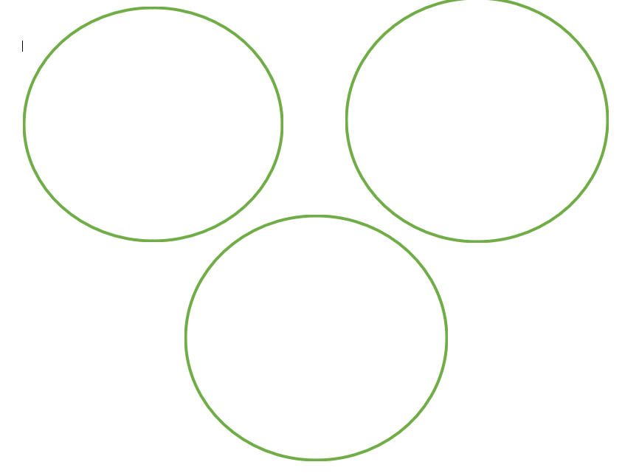
Now you try this question…
Share 12 objects equally into 3 groups.
12 ÷ 3 =

Slide 18
Now you have some division number sentences to read and solve.
You are going to do this by practically. Use objects from in your house to make groups to find the answers to the following questions:
You might want to use: Remember to
-coins draw the
-blocks correct amount
-pencils of hoops!
-small toys

Slide 19
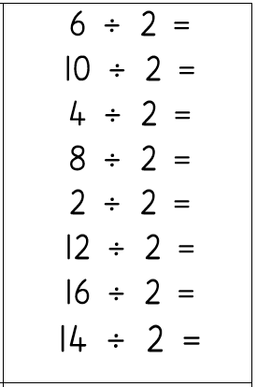
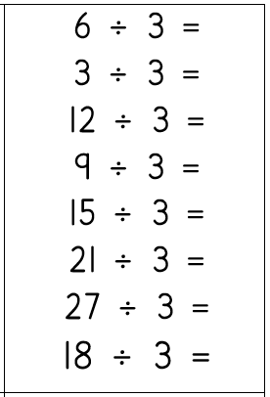
Carrots & Tomatoes
Bananas, Broccoli & Aubergines

Slide 20
Day 4

Slide 21
OMS- let’s get
your brains ready
for Maths!

Slide 23
Today you will be dividing again by sharing into equal groups.
Now we have tried this practically, you will now draw objects into groups to help you to find the answers for each number sentence.
Let’s look at some examples together…

Slide 26
Can you try this question?
Remember to share equally into the groups!

Slide 27
Can you try this question?
Remember to share equally into the groups!

Slide 28
Can you try this question?
You must now draw your own groups!
Remember to share equally into the groups!

Slide 29
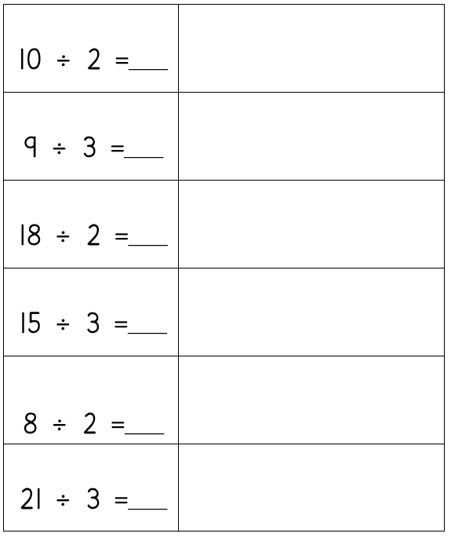
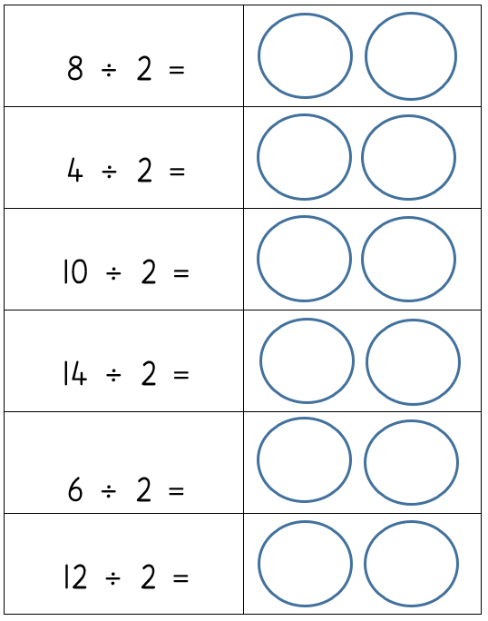
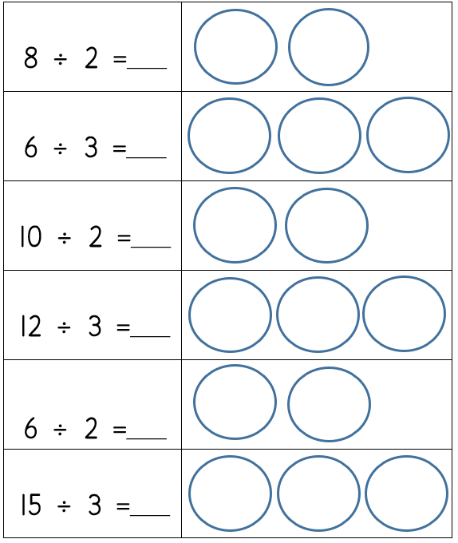
In your home learning books can you solve the following questions:
Bananas & Broccoli
Carrots & Tomatoes
Aubergines

Slide 30
Day 5

Slide 31
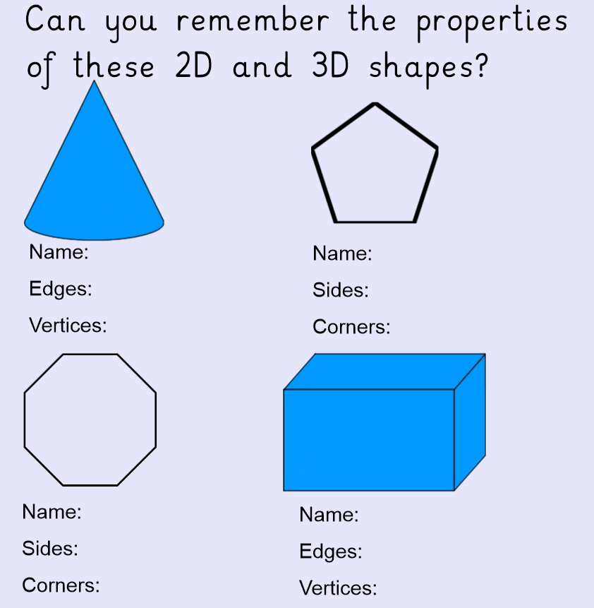
OMS- let’s get
your brains ready
for Maths!

Slide 33
Today you will be dividing again by sharing into equal groups.
Now we have tried this practically and by drawing into groups, you will now draw the groups as well to help you to find the answers for each number sentence.
Let’s look at some examples together…

Slide 37
Can you try this question?
You must now draw your own groups!
Remember to share equally into the groups!

Slide 38
Can you try this question?
You must now draw your own groups!
Remember to share equally into the groups!

Slide 39
Can you try this question?
You must now draw your own groups!
Remember to share equally into the groups!

Slide 40
Can you try this question?
You must now draw your own groups!
Remember to share equally into the groups!

Slide 41
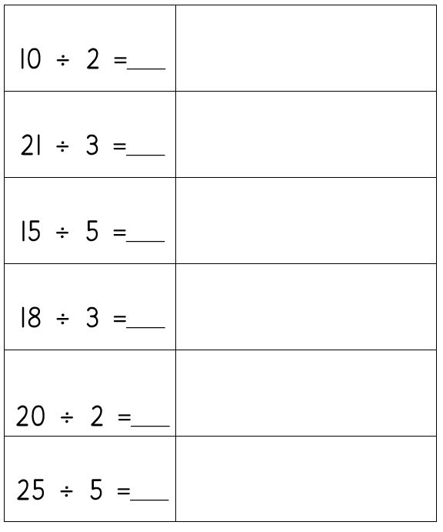
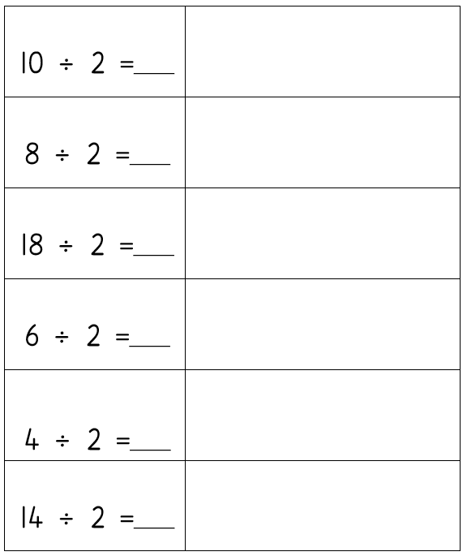
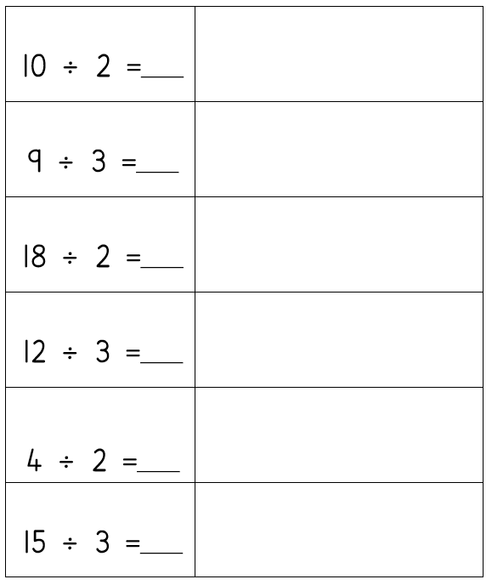
In your home learning books can you solve the following questions:
Bananas & Broccoli
Carrots & Tomatoes
Aubergines

Slide 42
Don’t forget to send your fantastic
work from this week to your teacher:
Mrs O’Sullivan- 1A@hortongrangeacademy.co.uk
Mr Taylor- 1B@hortongrangeacademy.co.uk
Miss Matthews- 1C@hortongrangeacademy.co.uk

