Slide 1
English Home Learning
Week Beginning 10.5.21

Slide 2
This week…
Day 1 – Guided Reading
Day 2 – Handwriting 1
Day 2 – Diary
Day 3 – Features of a Diary
Day 4 – Holiday (Eid)
Day 5 – Holiday (Eid)

Slide 3
Sending your work to your teacher: Remember to send all your hard work to your teachers so they can send you feedback and badges on Marvellous Me! Mrs O’Sullivan- 1A@hortongrangeacademy.co.uk Mr Taylor- 1B@hortongrangeacademy.co.uk Miss Matthews- 1C@hortongrangeacademy.co.uk

Slide 4
Day 2 - Handwriting 1
Today you will be recapping your letter formation.
Let’s warm up our hands and fingers ready to write first:
https://www.youtube.com/watch?v=o9D5lfqZF3o

Slide 5
Day 1 - Guided Reading

Slide 6
Day 1 - Guided Reading
Read this book on Bug club.
Make sure you read the book carefully because you will be answering some questions about the text.
Use your log in details to log into Bug club. The book will be at the very end of your allocated books in the ‘my stuff’ section.
https://www.activelearnprimary.co.uk/login?c=0

Slide 7
This week’s book:
This week’s book is a fiction book.
This means that it is a made up story describing
imaginary events and people.
We will be focusing on retrieval skills by answering questions about what we have read today. However, the last question is an opinion question. This means there is no right or wrong answer – only your ideas!

Slide 8
Questions to ask and answer:
Talk about these questions with an adult at home. Once you have talked about the answers you could write your answers into your home learning book.
What activities do the children try to do in the book (there are 5)?
Can the children do the activities alone?
What do you think the children would say next on page 12?
Which of the activities looks like the most fun?
Challenge: Could you write and draw pictures to show the next 2 pages of the book.

Slide 9
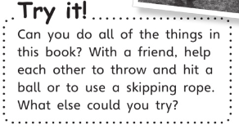
Now you’ve completed today’s questions, can you try this?

Slide 10
Day 2 - Handwriting 1
Today you will be recapping your letter formation of unit 6 letters.
Let’s look at how we form these letters…

Slide 11
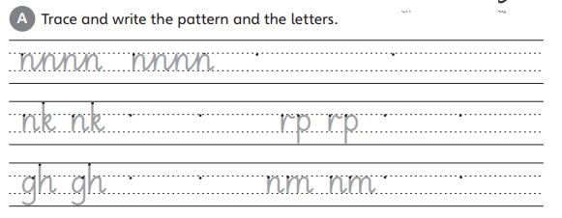
Day 2 - Handwriting 1
Look carefully at where you will form this pattern and letters. For the first pattern, our pencil doesn’t leave the page.
Practise forming the letters underneath.

Slide 12
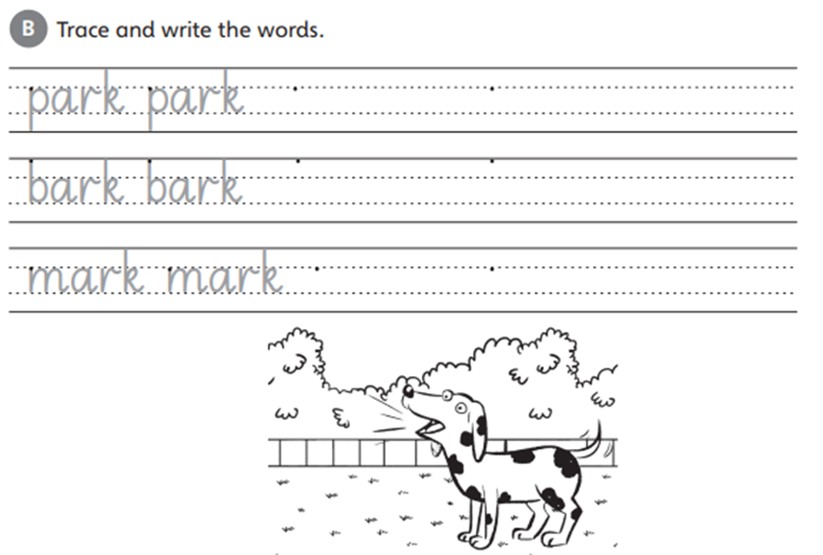
Day 2
Look carefully at where you will start: the dot.
Can you now practise writing these words in your home learning book…

Slide 13
Day 2
This is our word of the week.
Can you think of any more sentences that use the word ‘express’?

Slide 14
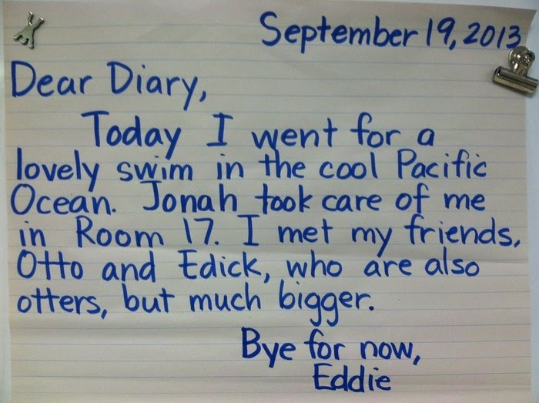
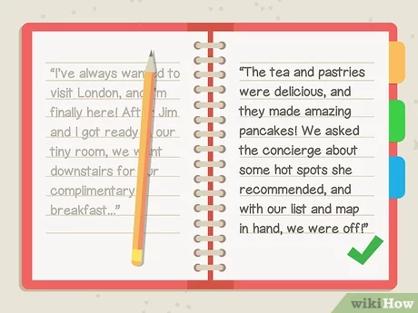
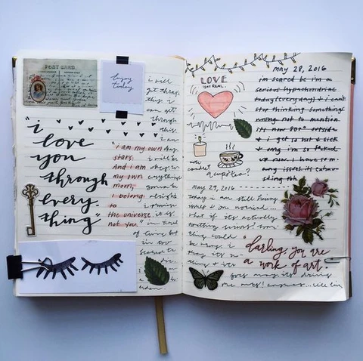
Day 2
Our new focus is...
….diary writing

Slide 15
Day 2
Today you will be reading Beegu’s diary and answering questions.
This week’s text:
This week’s text is a fiction text.
This means that it is a imaginary diary.
We will be focusing on retrieval skills by answering questions about what we have read.

Slide 16
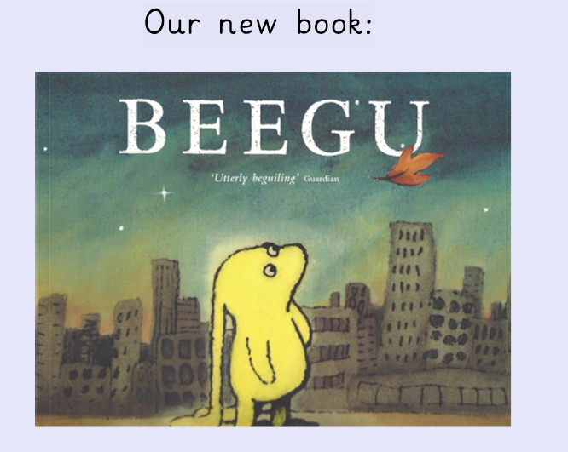
Can you remember what happens?

Slide 18
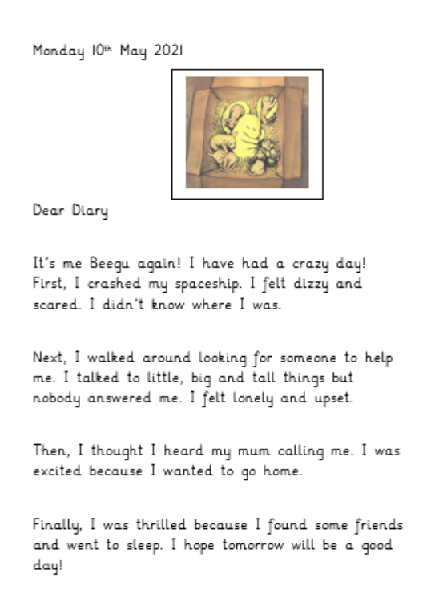
Let’s read the diary…

Slide 19
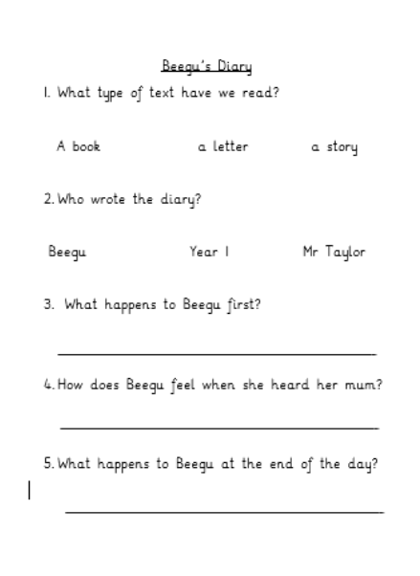
Day 2 – Task 1
Challenge: What is the first thing we write in a diary entrance?
What is the last thing we write? Could we write it differently?
Try answering these questions in your home learning book

Slide 20
Day 3
Yesterday we read Beegu’s diary.
Today, you will be looking at the features of a diary and highlighting them.

Slide 21
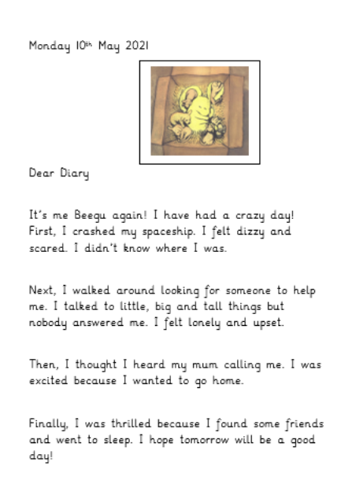
Let’s read Beegu’s diary again

Slide 22
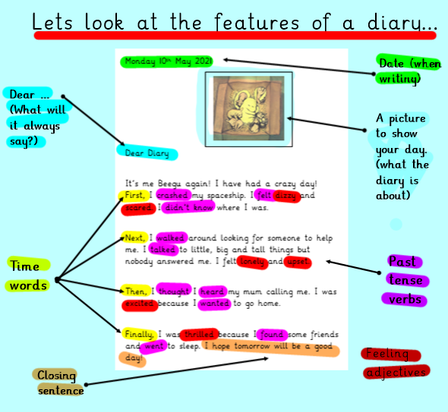
There are a lot of features but don’t
worry just look at them one at a time!
What comes first?
Who do we write to in a diary?
Do we always write to them?
Why do you think we use past verbs?
What’s the last sentence?
How could you change it?

Slide 23
Day 3 – Task
Have a go!

Slide 24
Day 4 and 5
Have a fantastic Eid!

