Slide 1
Curriculum Home Learning
W/B: 03.05.21

Slide 2
Day 1: Spelling
Day 2: Geography
Day 3: PSHE and Geography
Day 4: Spanish
Day 5: RE and Words of the Week

Slide 3
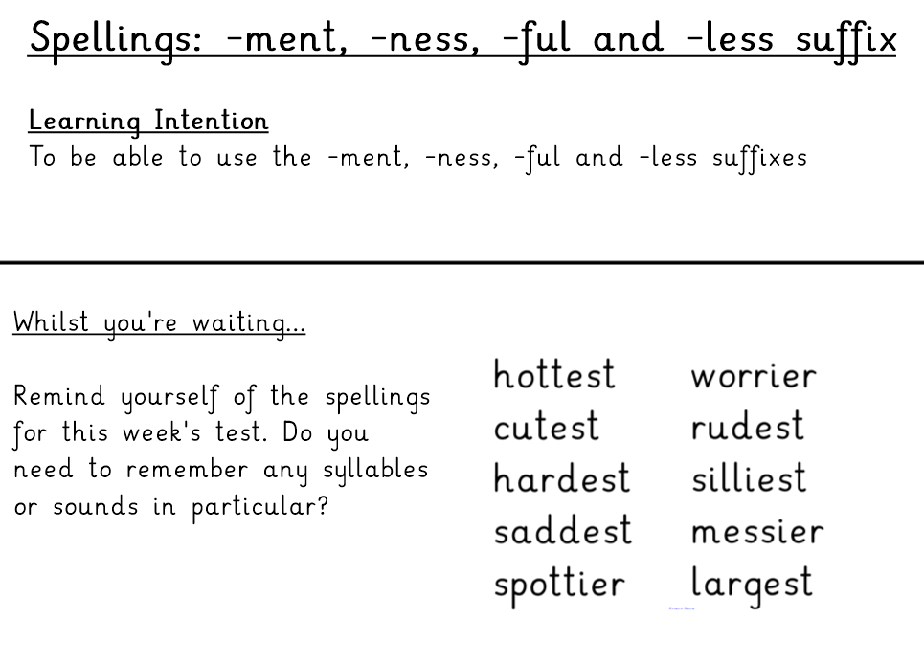
Day 1 – Spelling and Handwriting

Slide 6
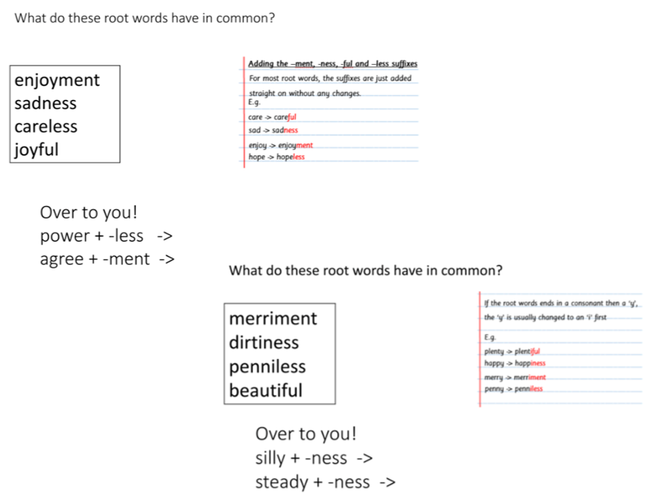

Slide 8
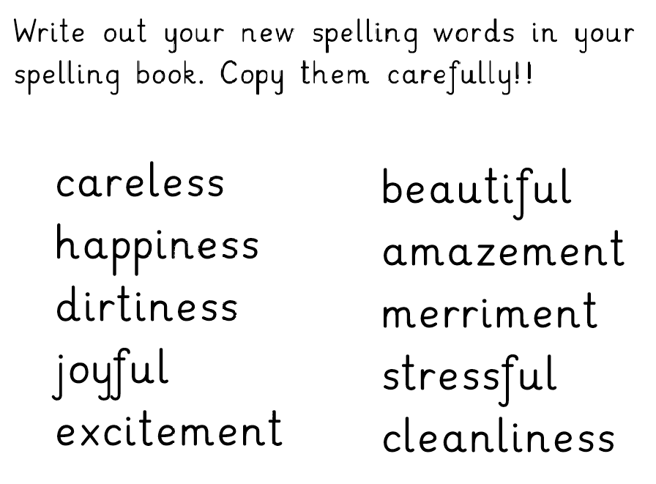

Slide 9
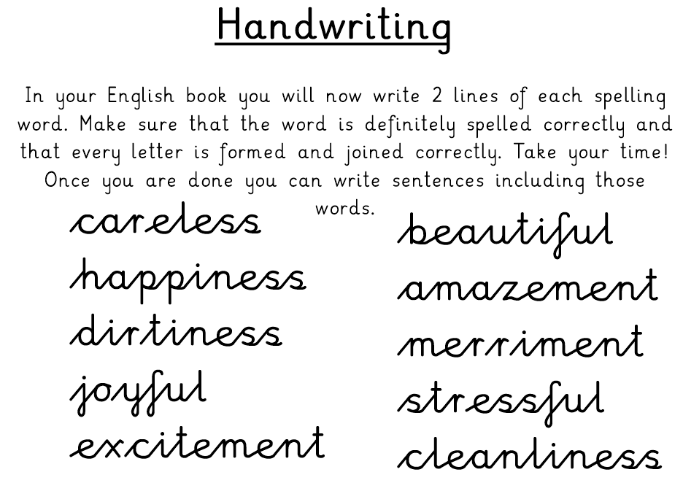

Slide 10
Day 2 - Geography

Slide 13
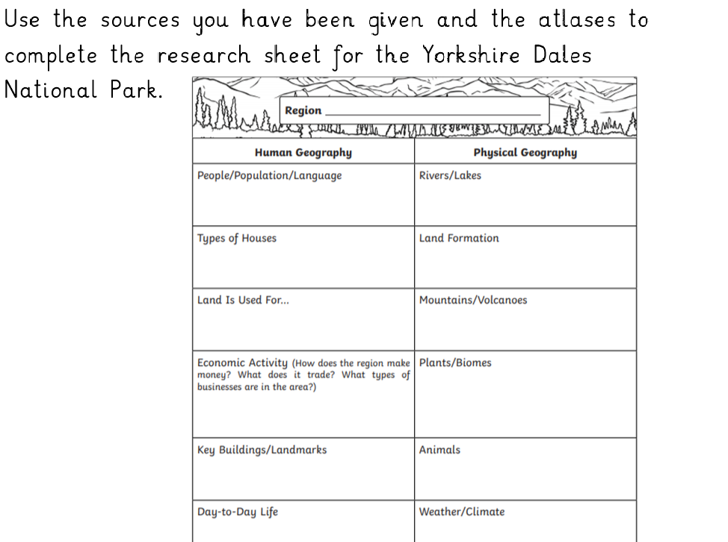

Slide 15
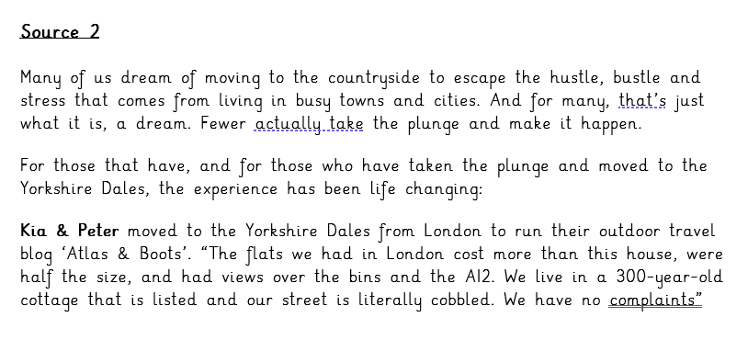

Slide 16
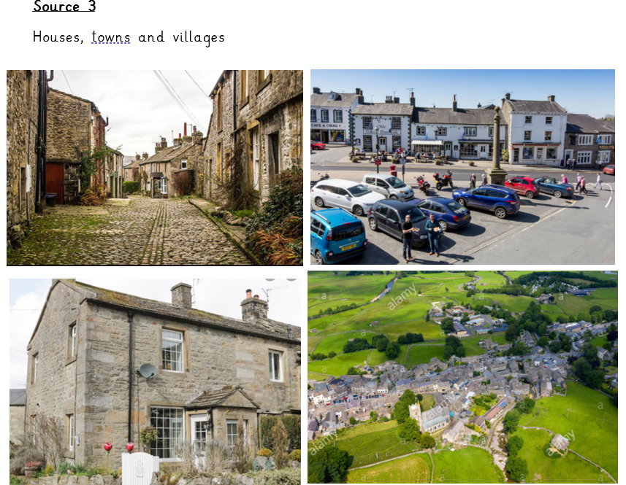

Slide 18
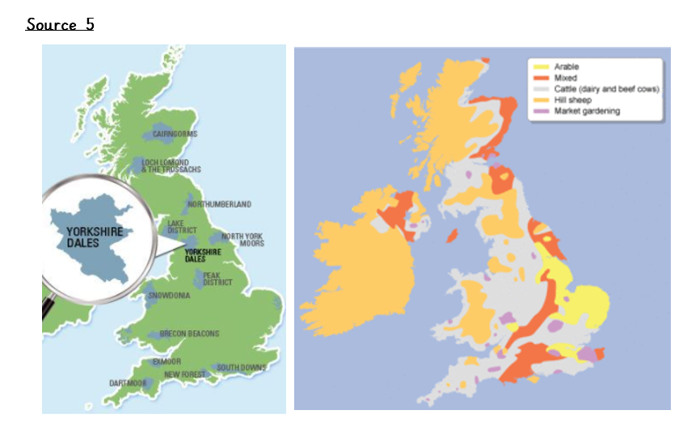

Slide 19
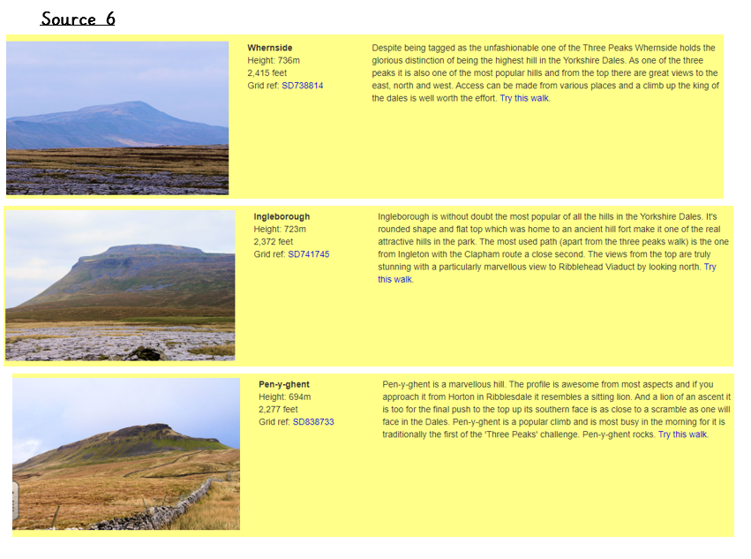

Slide 22
Day 3 – PSHE and Geography

Slide 25
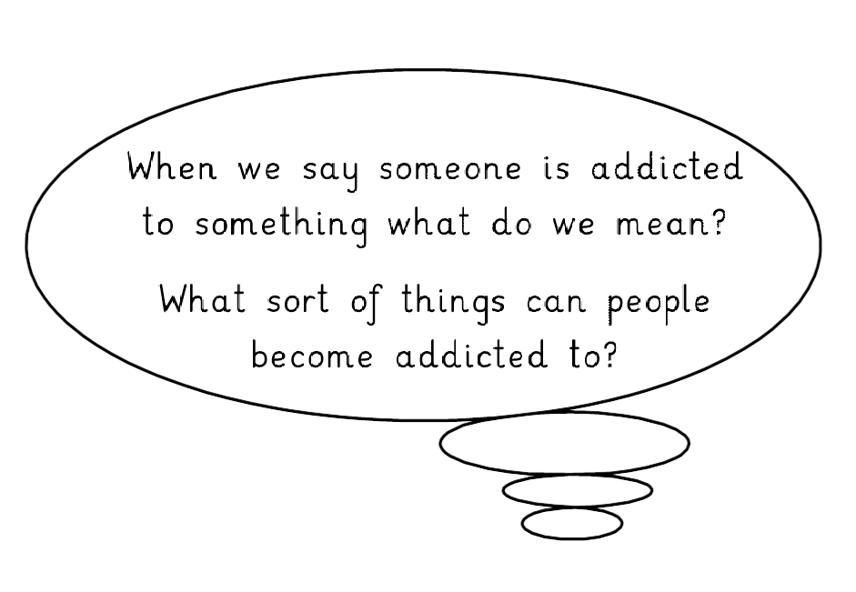

Slide 26
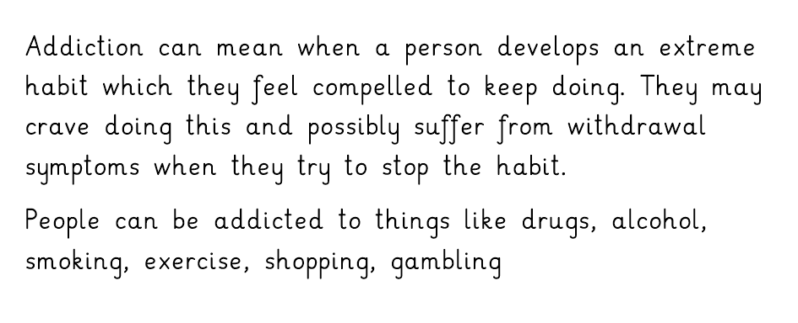

Slide 29
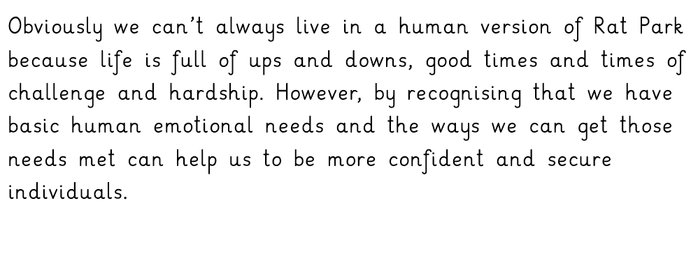

Slide 32
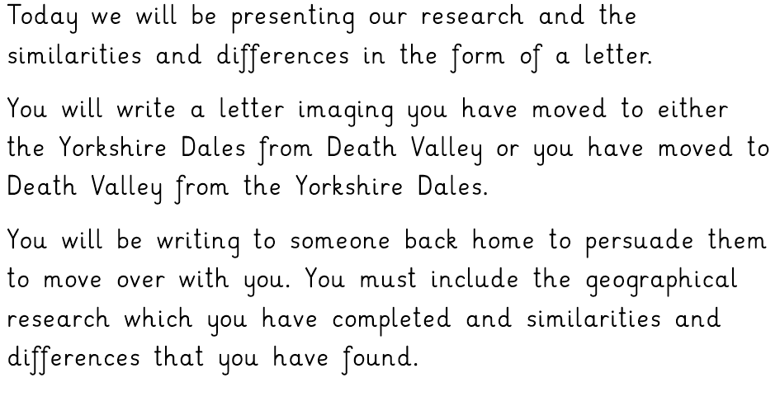

Slide 33
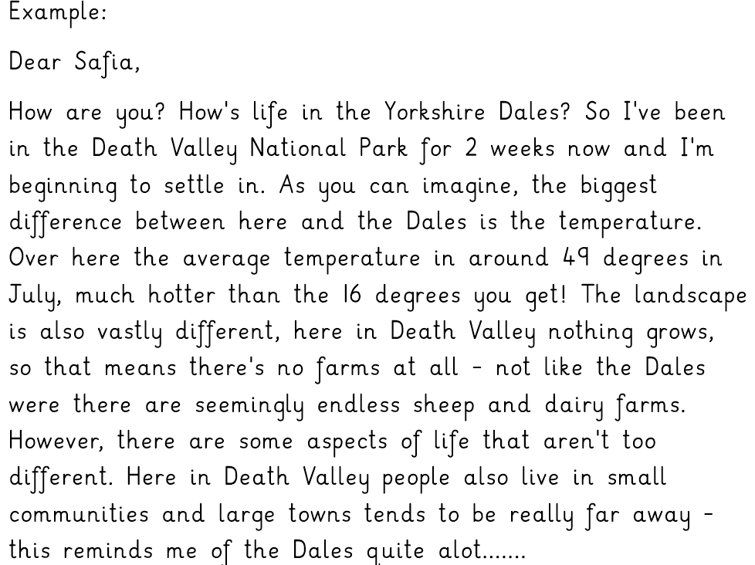

Slide 34
Day 4 - Spanish

Slide 35
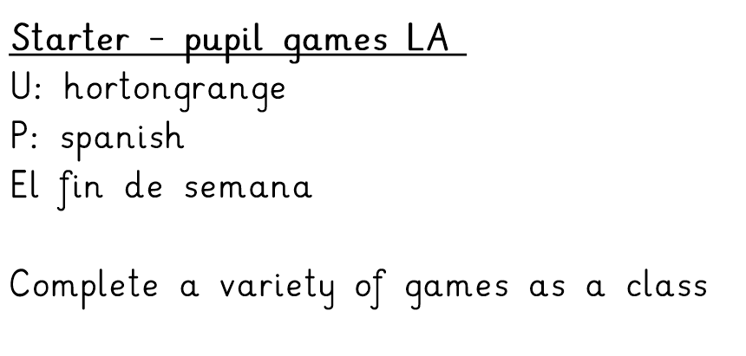

Slide 36
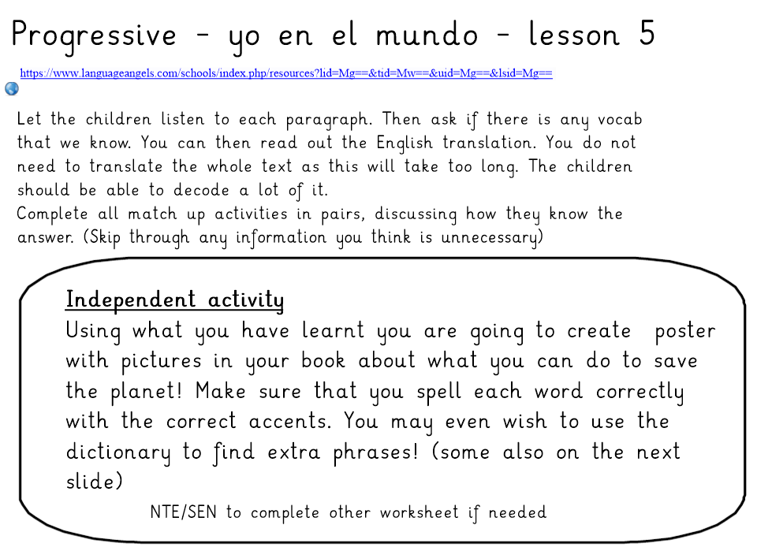

Slide 37
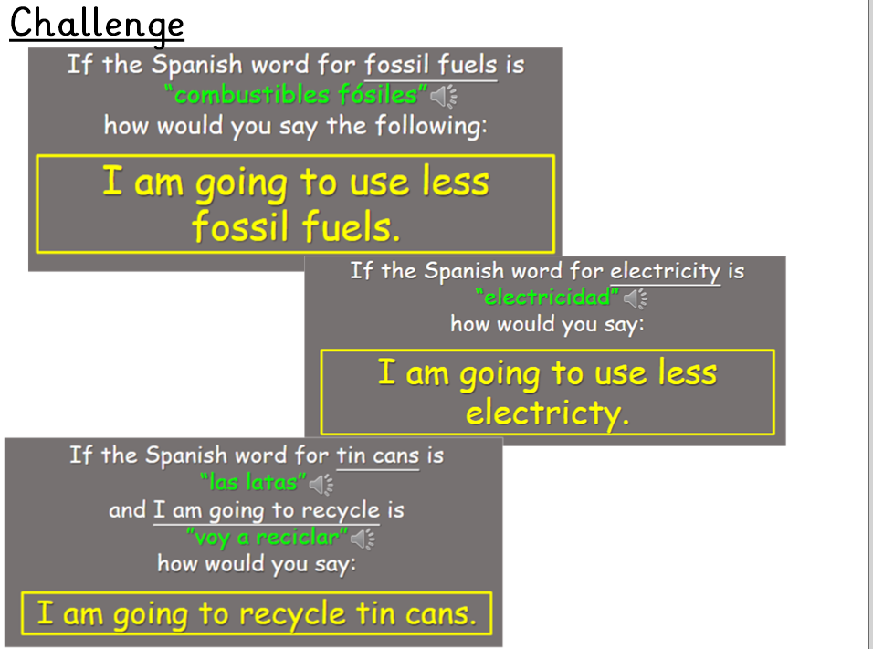

Slide 38
Day 5 - RE and WOTW

Slide 47
WOTW 06.05.2021

Slide 48
WOTW competent Pessimistic Exasperated

Slide 49
Synonyms:
able
skilled
Word:competent
Word class: adjective
Definition: having the necessary ability, knowledge, or skill to do something successfully.
In context: ‘’He was a highly competent surgeon“
Your sentence:

Slide 50
Synonyms:
Negative
hopeless
Word: pessimistic
Word class: adjective
Definition: tending to see the worst aspect of things or believe that the worst will happen.
In context: "he was pessimistic about the prospects“
Your sentence:

Slide 51
Synonyms:
Uncommon
abnormal
Word: Eccentric
Word class: adjective
Definition:(of a person or their behaviour) unconventional and slightly strange.
In context: “His eccentric behaviour lost him his job.”
Your sentence:

