Slide 1
Year 1 Maths Home Learning
Week Beginning 26.4.21

Slide 2
If you are learning from home,
don’t forget to send your work to
your teacher:
Mrs O’Sullivan- 1A@hortongrangeacademy.co.uk
Mr Taylor- 1B@hortongrangeacademy.co.uk
Miss Matthews- 1C@hortongrangeacademy.co.uk

Slide 3
This Week………
Multiplication
School Jam Activities: See the activities sent to your APP this week.
Day 1: Drawing arrays to multiply
Day 2: Reading arrays
Day 3: Choosing your own multiplication method
Day 4: Multiplication problem solving
Day 5: Multiplication problem solving

Slide 4
Day 1

Slide 5
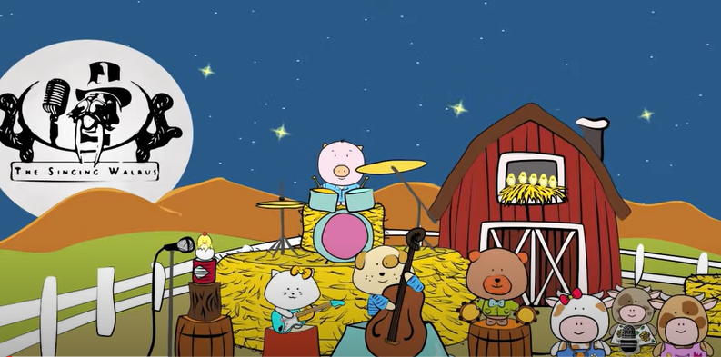
OMS- let’s get your brains ready for Maths!
https://www.youtube.com/watch?v=5FaBDqOmiyI

Slide 6
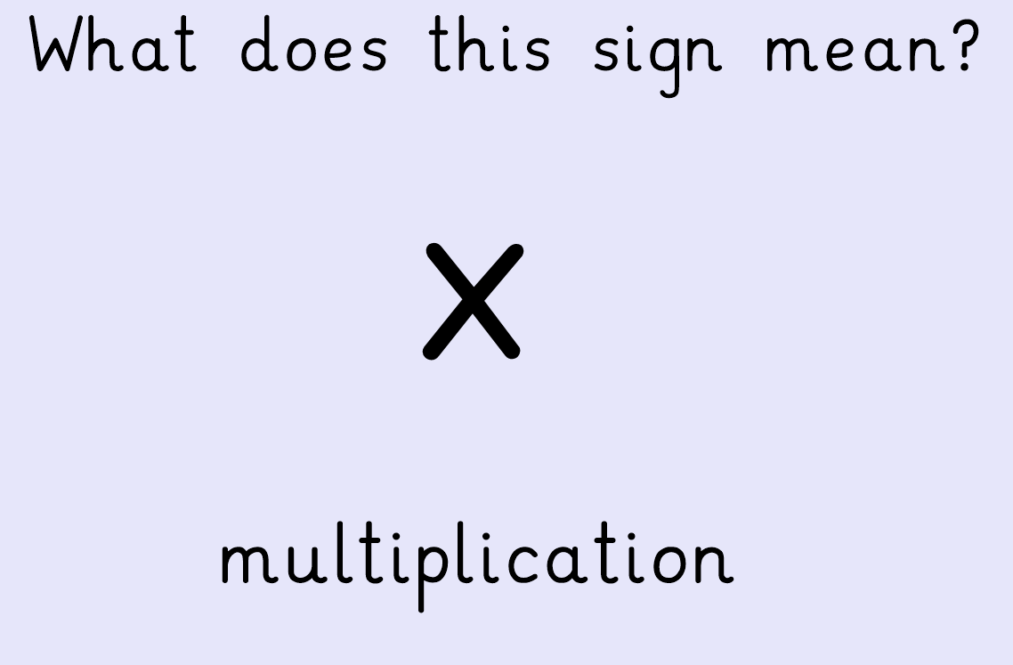

Slide 7
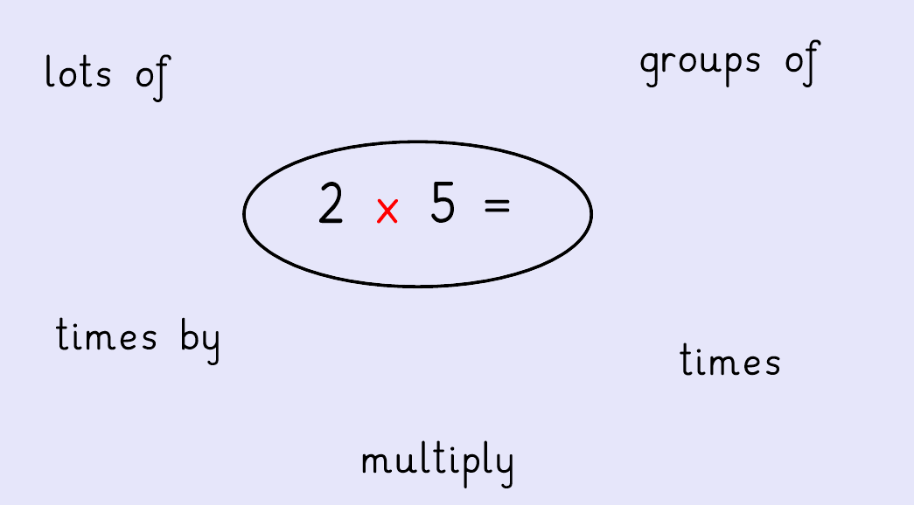
There are lots of different ways we can say
multiplied by

Slide 9
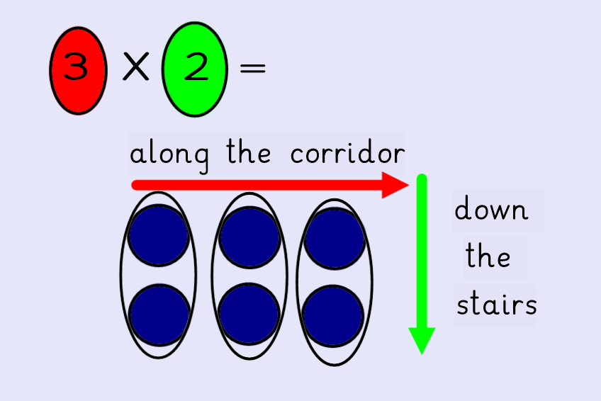

Slide 10
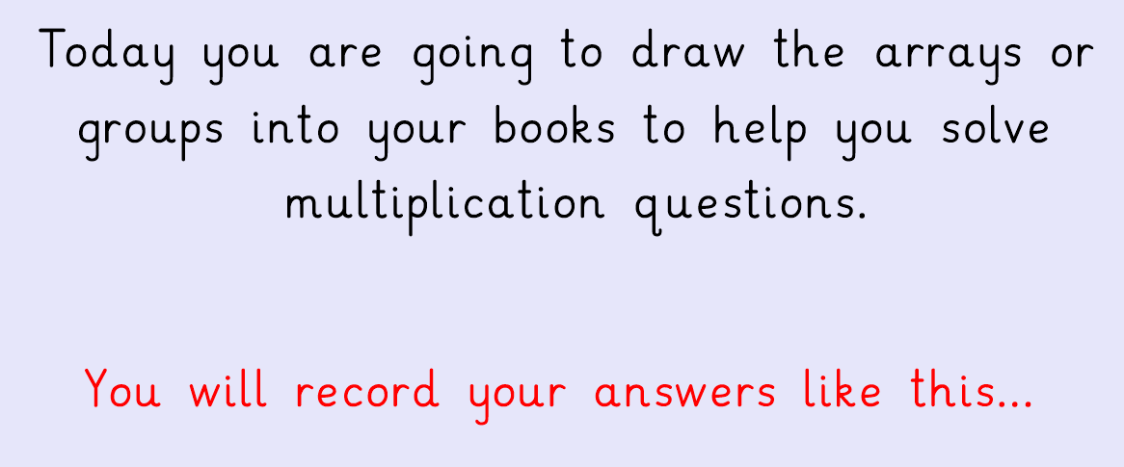
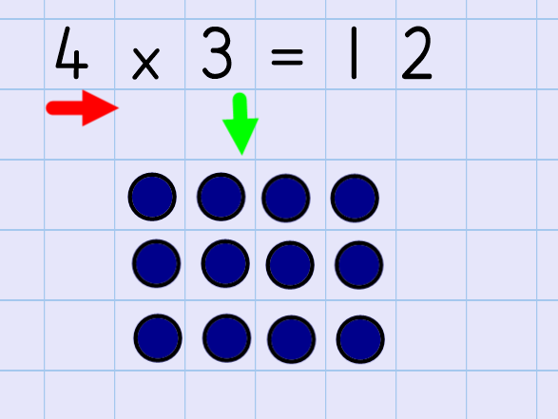

Slide 11
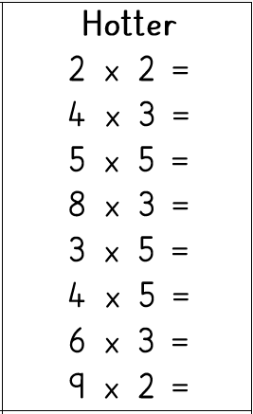
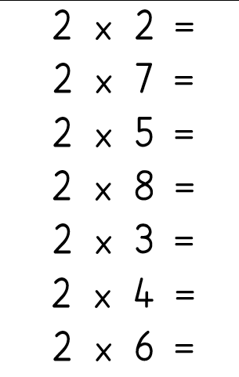
In your books you are going to be solving these questions by drawing arrays:
Bananas, Broccoli & Aubergines
Carrots & Tomatoes

Slide 12
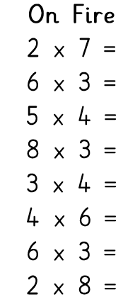
Further challenge:
Can you try these mixed questions drawing arrays for each question?

Slide 13
Day 2

Slide 14
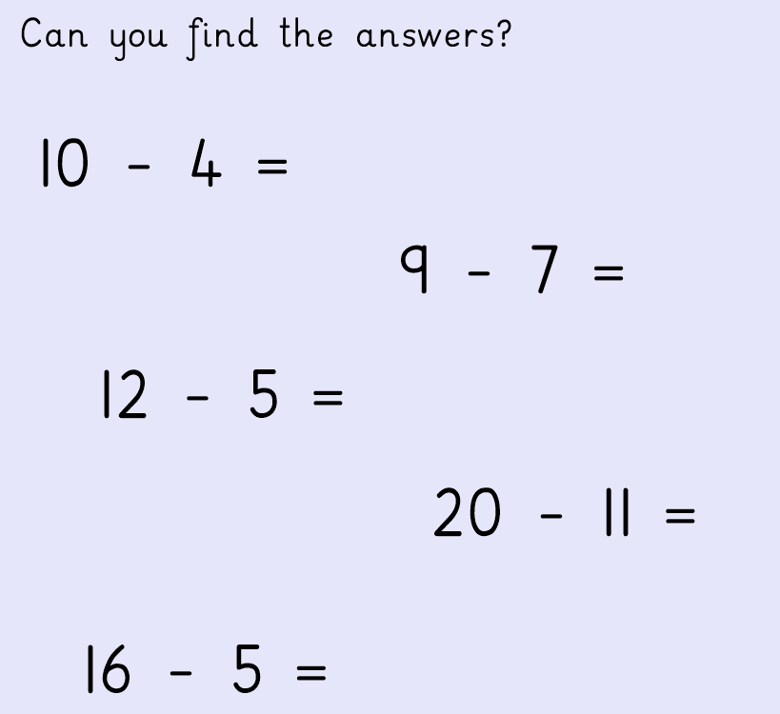
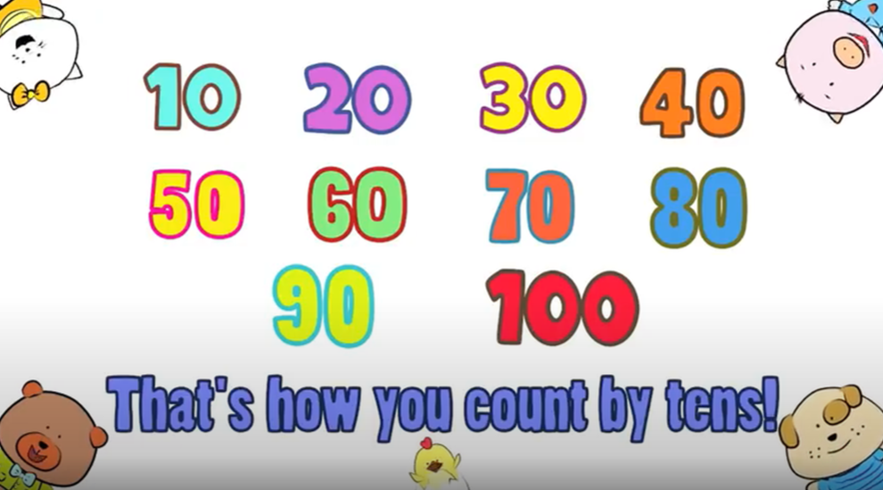
OMS- let’s get your brains ready for Maths!
https://www.youtube.com/watch?v=-gmEe0-_ex8

Slide 16
There are lots of different ways we can say
multiplied by

Slide 17
Let’s recap arrays together…

Slide 19
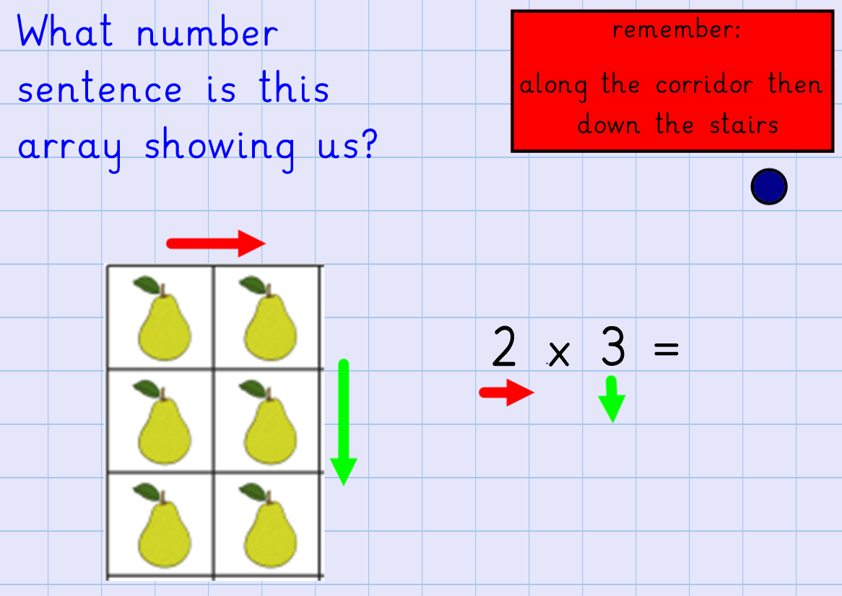

Slide 20
Now you try this question…

Slide 21
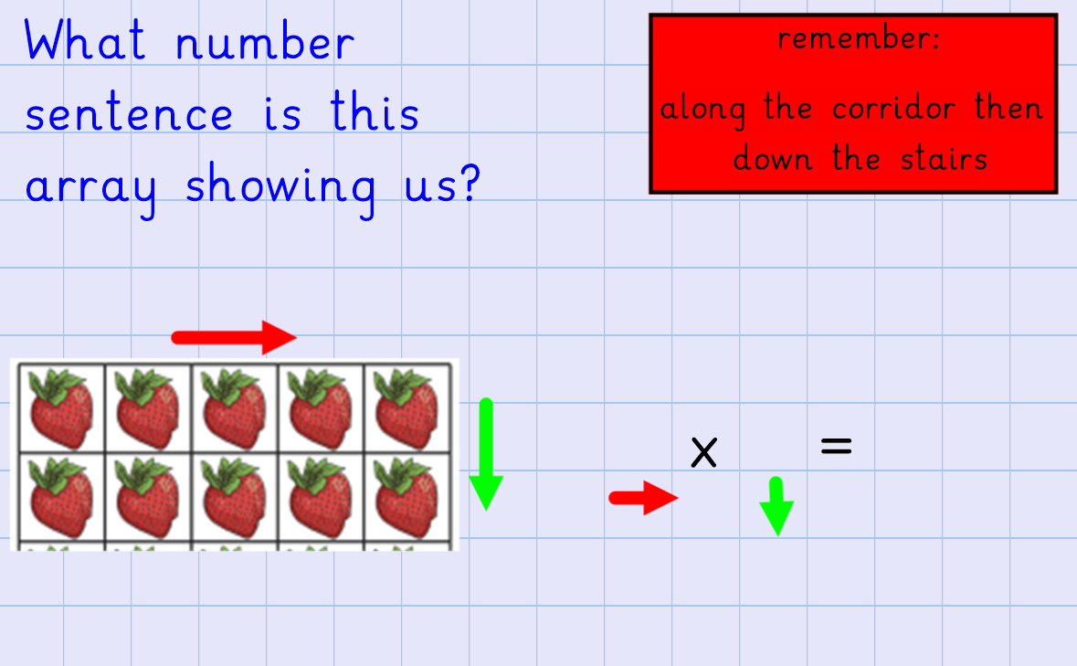
Now you try this question…

Slide 22
Now you have some arrays to read and turn into number sentences.
You can record your answers on these sheets if you can print them off or you can record the number sentences in your books.
Don’t forget to take pictures
and send them to your
teacher.

Slide 23
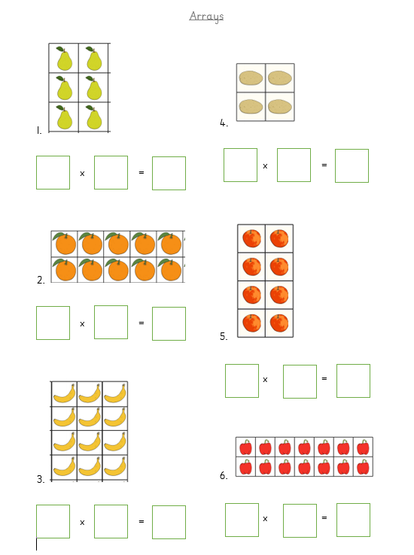
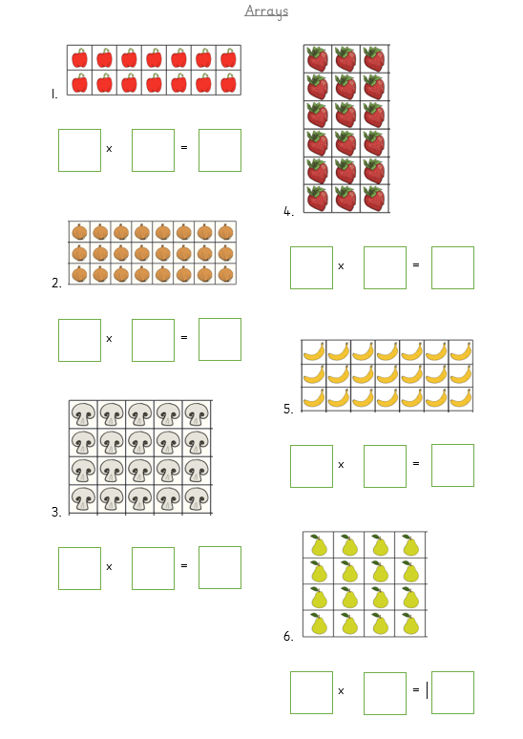
Bananas, Broccoli & Aubergines
Carrots & Tomatoes

Slide 24
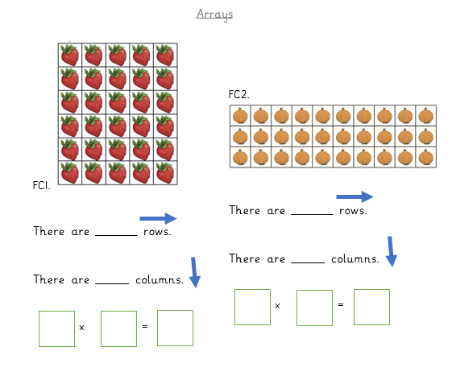
Further challenge:
Can you try these questions?

Slide 25
Day 3

Slide 26
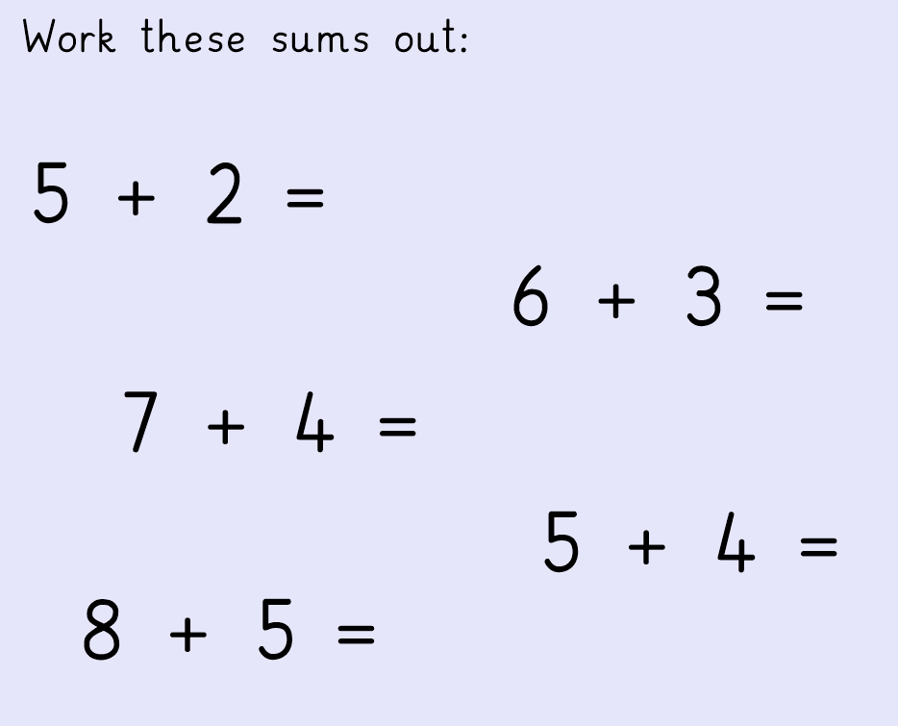
OMS- let’s get your brains ready for Maths!

Slide 28
There are lots of different ways we can say
multiplied by

Slide 29
Today you will have some multiplication problems to solve. You can use the pictures to help you or you can draw groups or arrays to find the answers.
Now we have tried all the methods, you can now choose which one you find easiest to use.
Let’s look at some examples together…

Slide 30
/arrays
12
12 sweets
altogether
2 bags
6 sweets in each bag

Slide 31
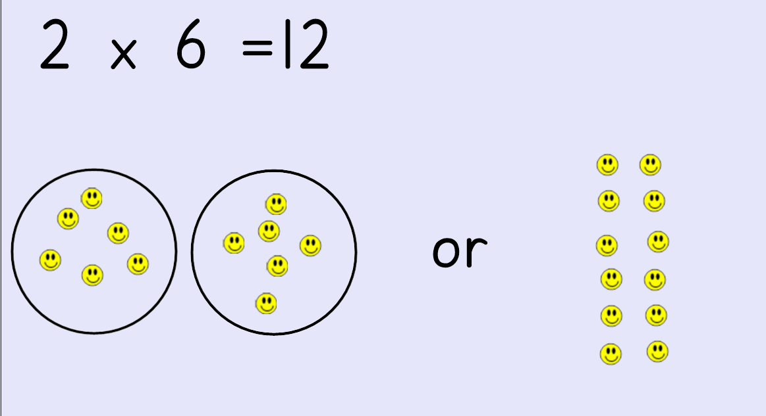

Slide 32
3 groups
5 biscuits in each group
15 biscuits
altogether

Slide 33
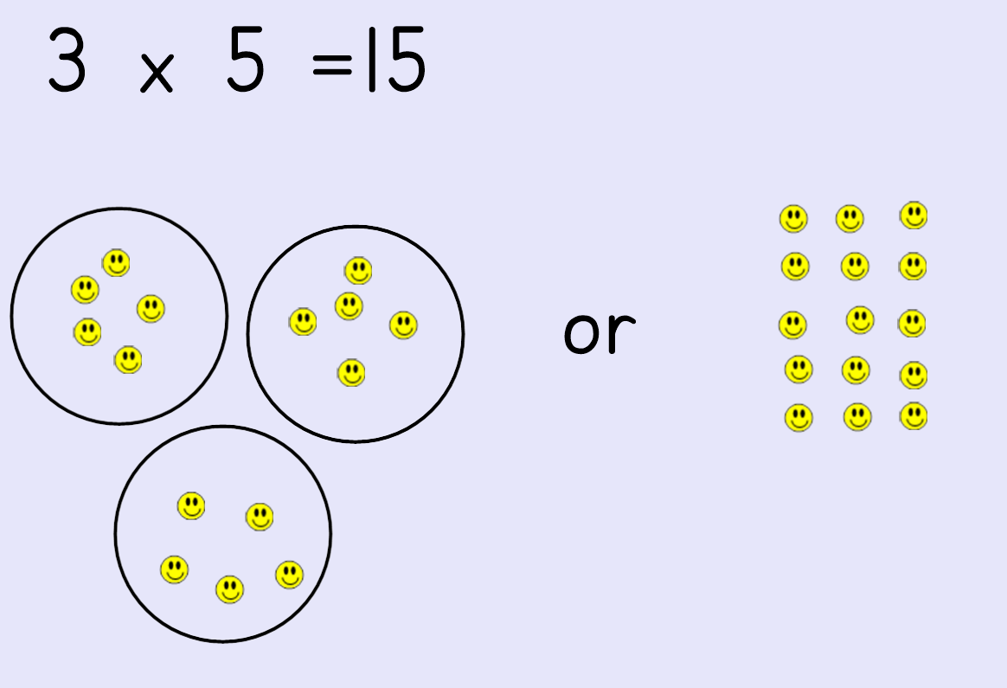

Slide 34
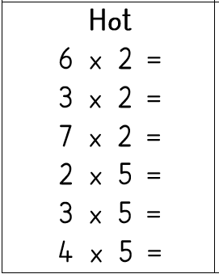
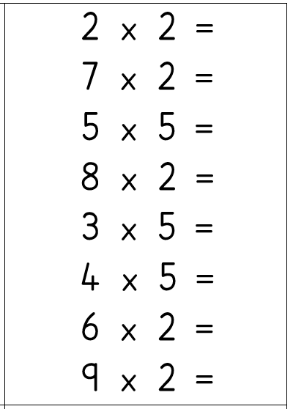
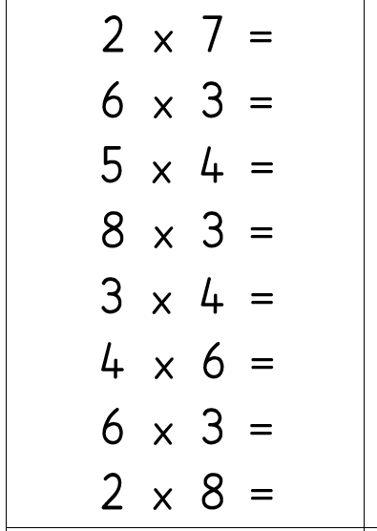
In your home learning books can you solve
the following questions:
Aubergines
Bananas & Broccoli
Carrots & Tomatoes

Slide 35
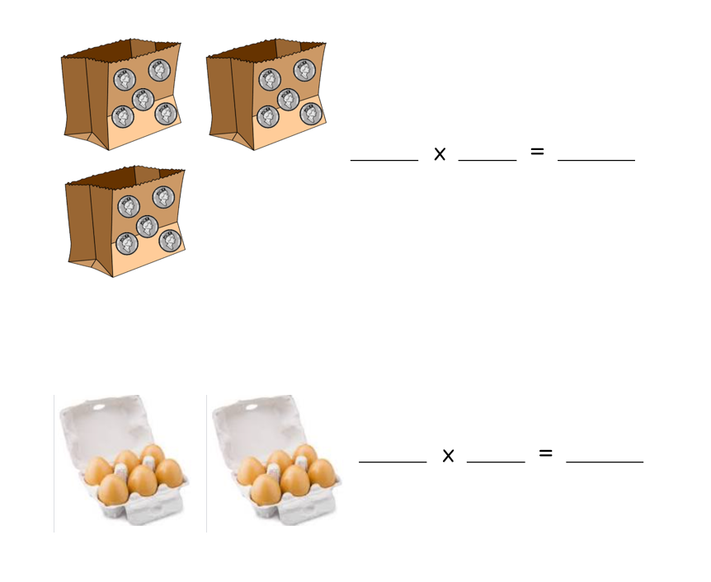
Further Challenge:

Slide 36
Day 4

Slide 37
OMS- let’s get your brains ready for Maths!
https://www.youtube.com/watch?v=GvTcpfSnOMQ

Slide 39
There are lots of different ways we can say
multiplied by

Slide 40
Today you will have some multiplication word problems to solve. You can use the pictures to help you or you can draw groups or arrays to find the answers.
Now we have tried all the methods, you can now choose which one you find easiest to use.
Let’s look at some examples together…

Slide 41
grouping
arrays
pictures

Slide 42
pictures
arrays
grouping

Slide 43
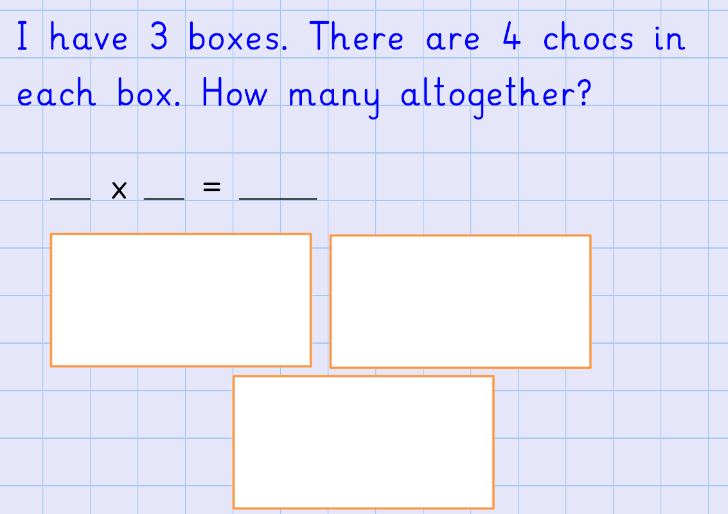

Slide 44
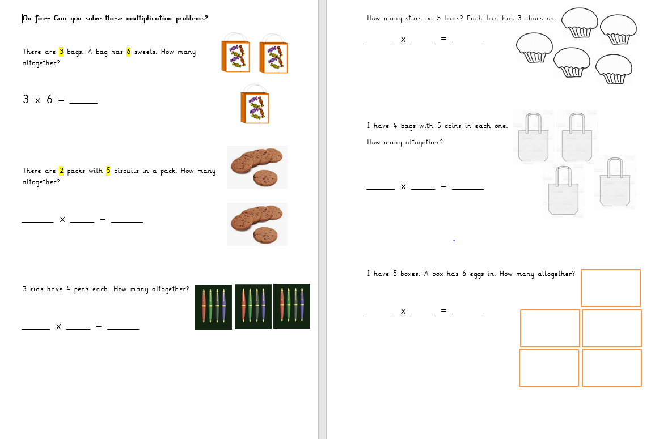
In your home learning books can you solve
the following questions:
Bananas

Slide 45
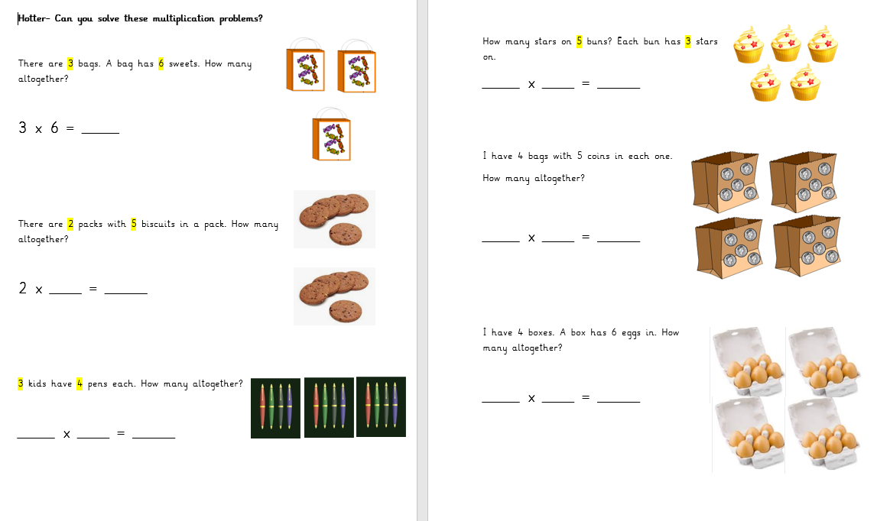
In your home learning books can you solve
the following questions:
Broccoli
&
Aubergines

Slide 46
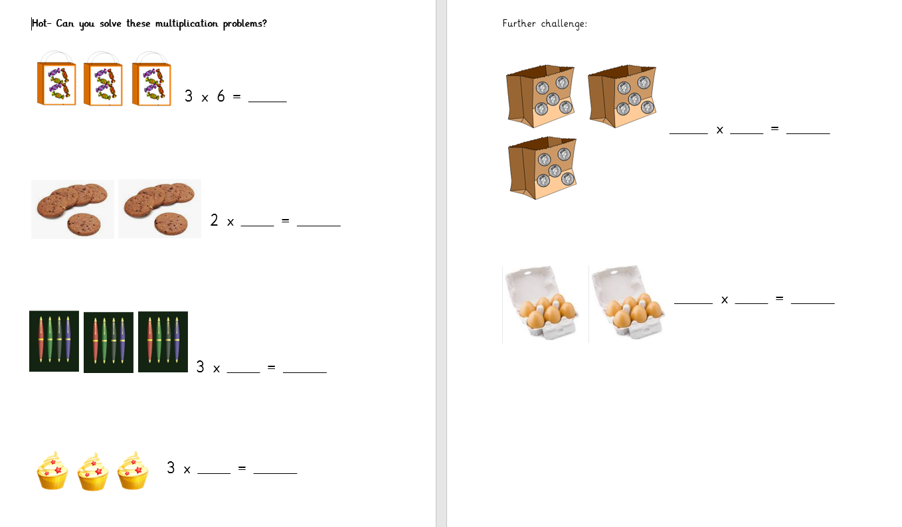
In your home learning books can you solve
the following questions:
Carrots
&
Tomatoes

Slide 47
Day 5

Slide 48
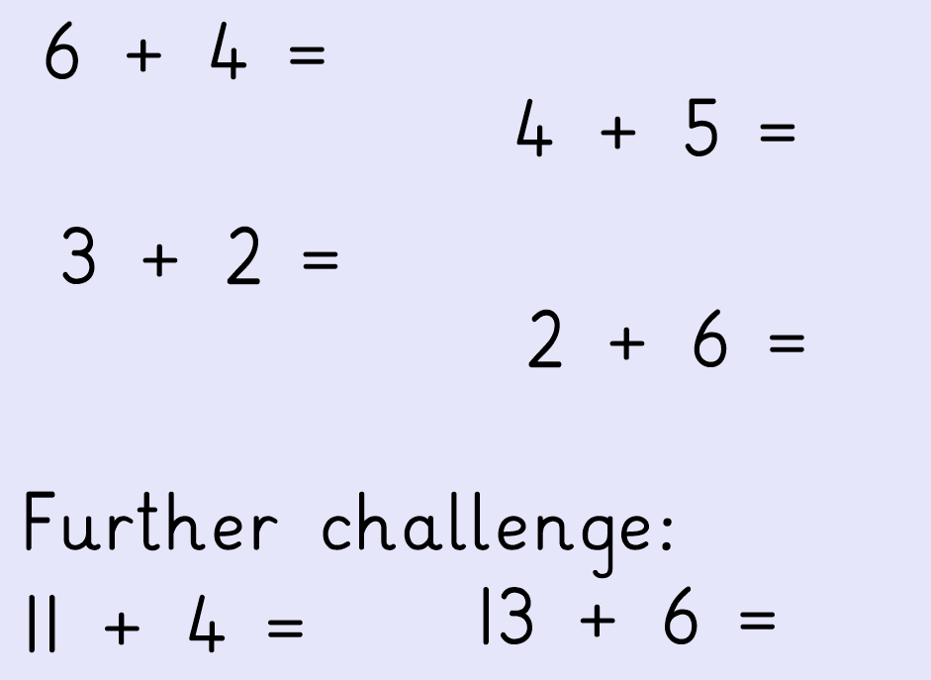
OMS- let’s get your brains ready for Maths!

Slide 50
There are lots of different ways we can say
multiplied by

Slide 51
Today you will have some multiplication word problems to solve. You can use the pictures to help you or you can draw groups or arrays to find the answers.
Now we have tried all the methods, you can now choose which one you find easiest to use.
Let’s look at some examples together…

Slide 52
grouping
arrays
pictures

Slide 53
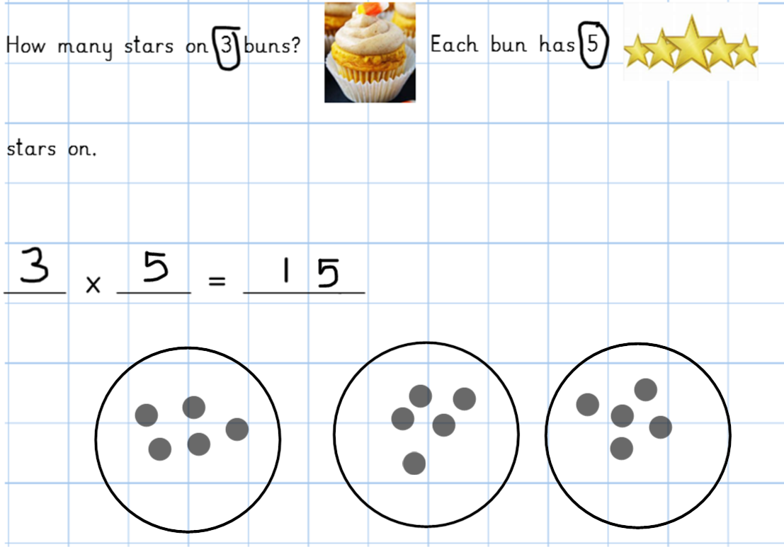

Slide 56
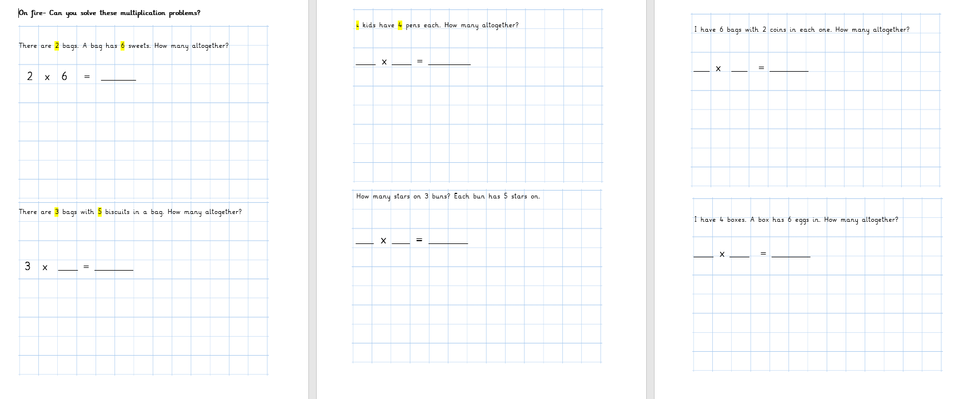
In your home learning books can you solve
the following questions:
Bananas

Slide 57
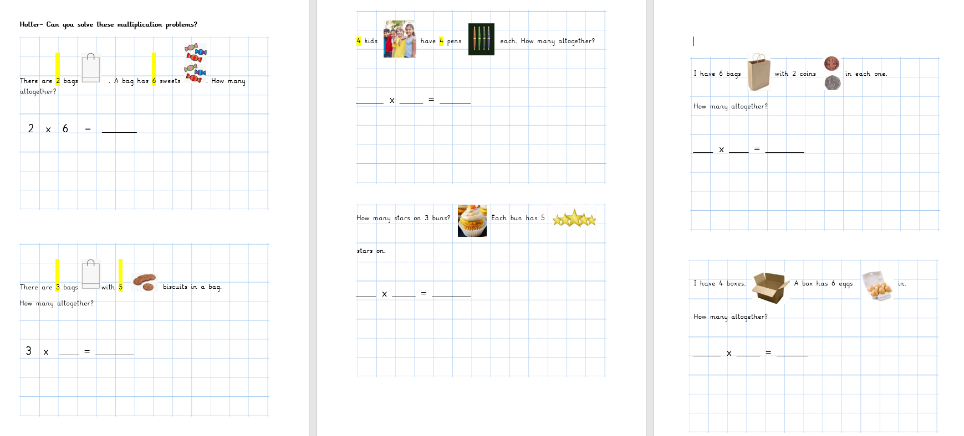
In your home learning books can you solve
the following questions:
Broccoli, Aubergines & Carrots

Slide 58
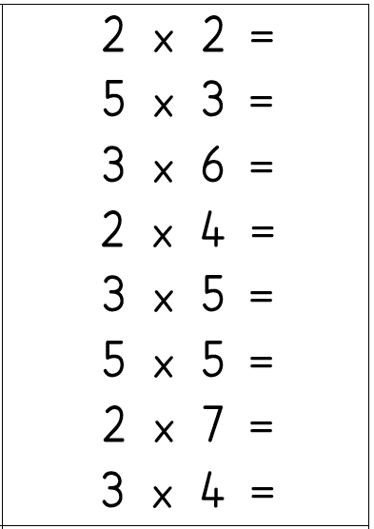
In your home learning books can you solve
the following questions by drawing picrutes or groups to help you:
Tomatoes
e.g.
2 x 2 = 4

