Slide 1
English Home Learning
Week Beginning 22.03.21

Slide 2
Day 1 - Grammar and Spelling Test and Rule
Day 2 – Modern Olympics and Famous Olympians
Day 3 – Olympic Ceremonies and 2021 Olympic Games
Day 4 – Write up Encyclopedia page
Day 5 – Guided Reading: The Proudest Blue

Slide 3
Day 1- Grammar

Slide 15
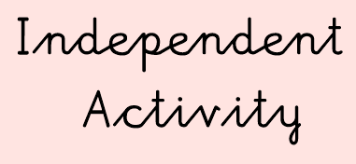

Slide 17
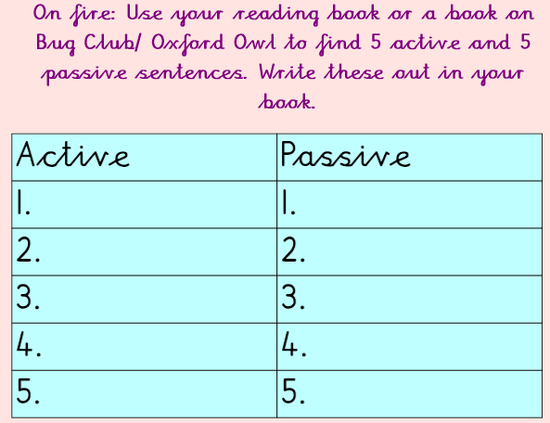

Slide 19
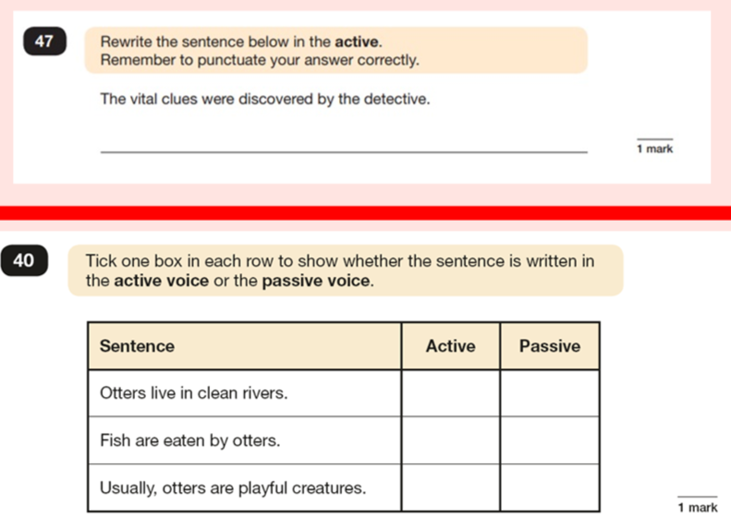

Slide 21
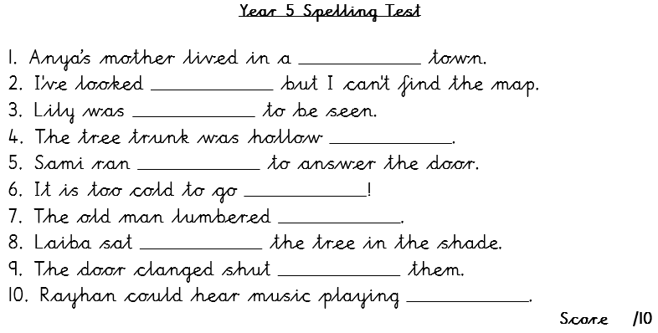
Hotter/On Fire

Slide 22
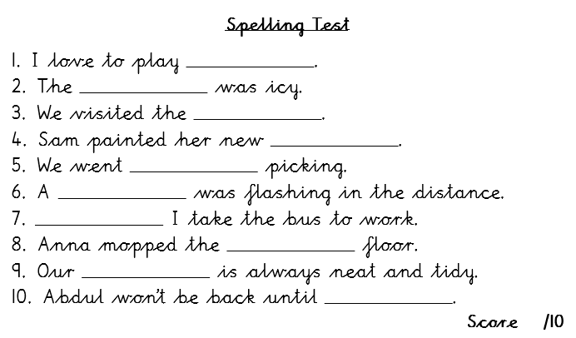
Hot

Slide 23
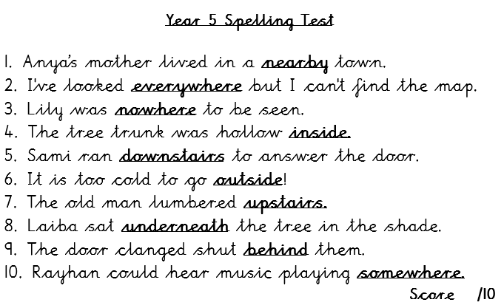
Hotter/On Fire Transcript for Parents (if required)

Slide 24
Hot Transcript for Parents (if required)

Slide 25
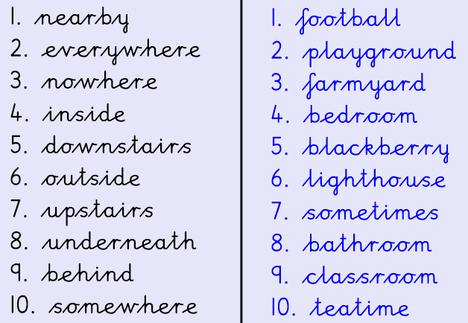
Self-assessment
Now mark your spelling test.
If you have spelt a word incorrectly, practise writing it out five times.
Hotter/On Fire
Hot

Slide 27
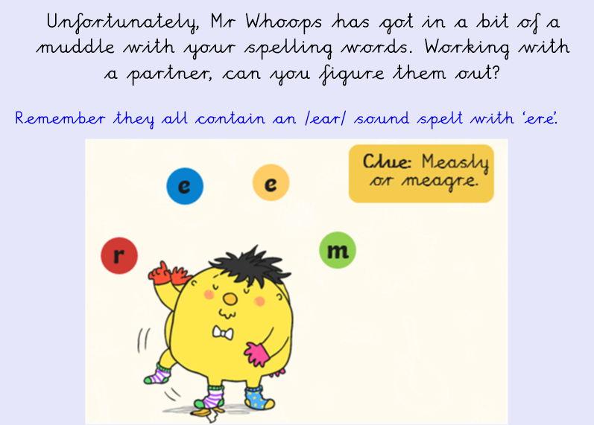

Slide 39
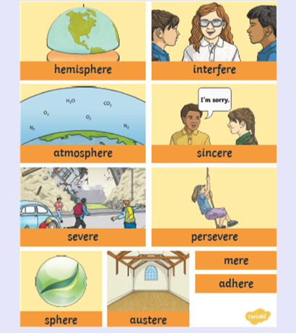

Slide 40
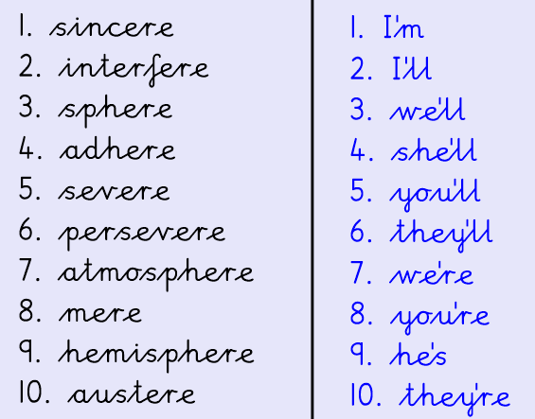
Hotter/On Fire
Hot

Slide 44
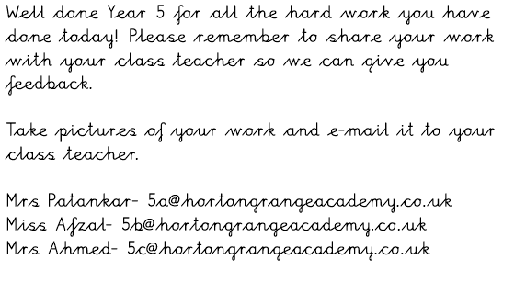
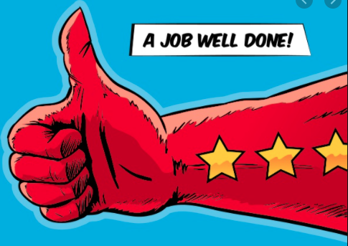

Slide 45
Day 2

Slide 46
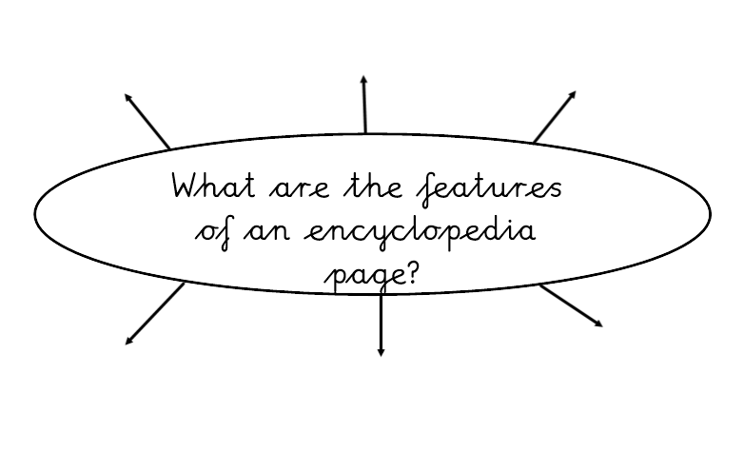

Slide 48
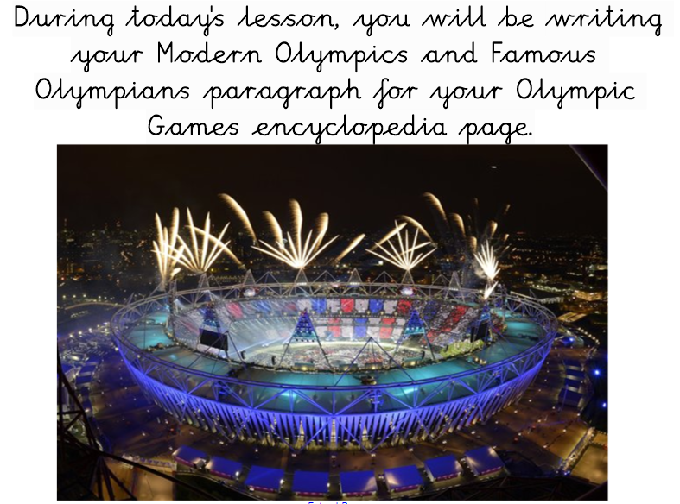

Slide 53
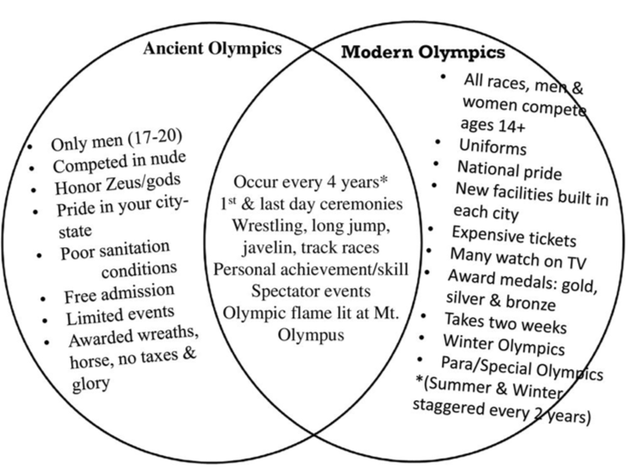

Slide 55
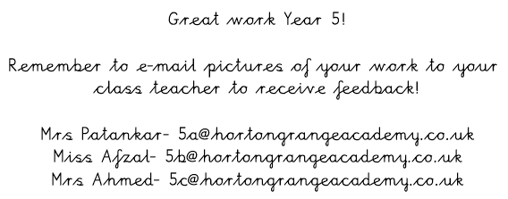

Slide 56
Day 3

Slide 57
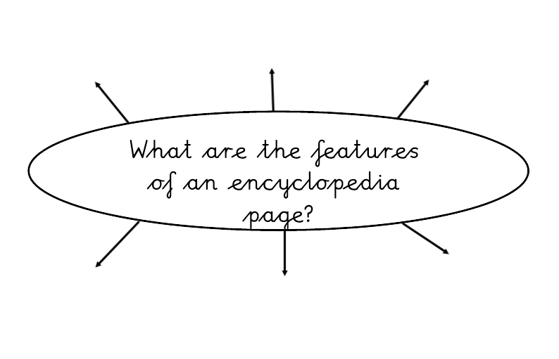

Slide 66
Day 4

Slide 67
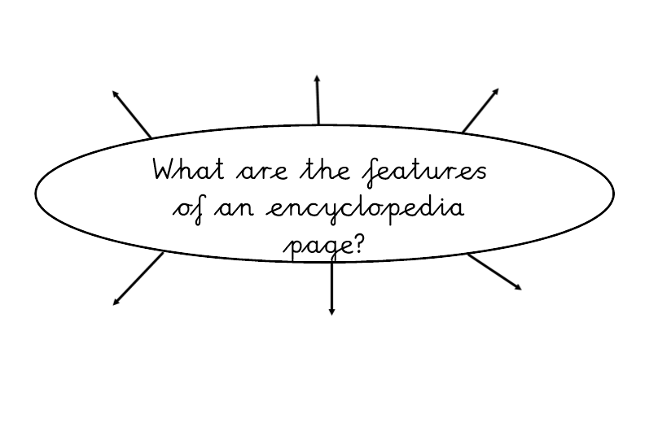

Slide 79
Day 5 – Guided Reading

Slide 80
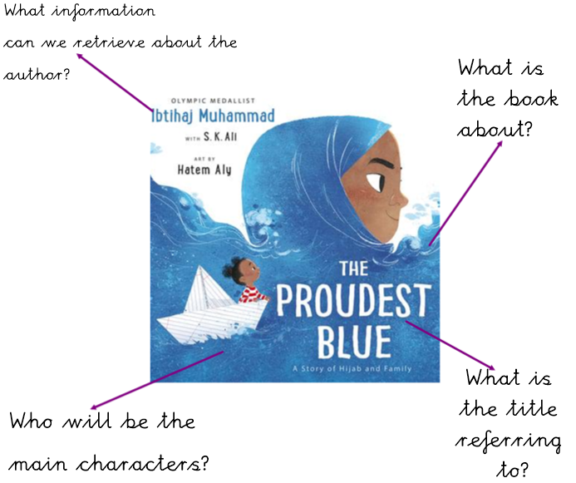

Slide 81
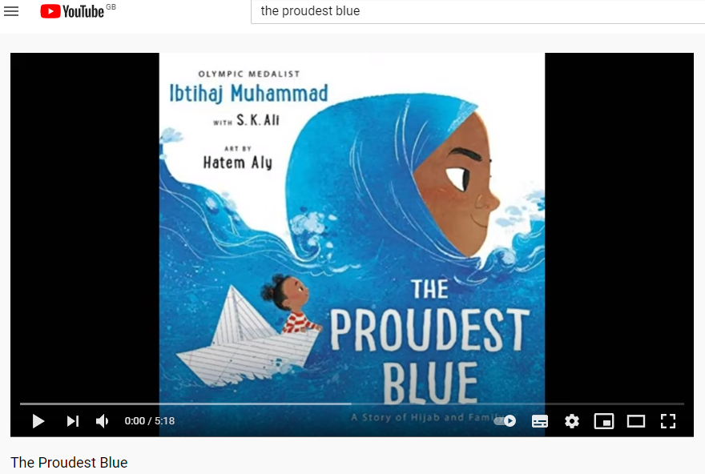
Read the text using the following link: https://www.youtube.com/watch?v=XJiTBmfy-LI&t=3s

Slide 94
