Slide 1
English Home Learning
Week Beginning 8.3.21

Slide 2
This week…
Day 1 – Grammar – Choosing & using verbs
Day 2 – Handwriting 1
Day 2 – Exploring the features of instructions
Day 3 – Sequencing instructions
Day 4 – Handwriting 2
Day 4 – Highlighting the features of instructions
Day 5 – Guided Reading – What is the same?

Slide 3
Sending your work to your teacher: Remember to send all your hard work to your teachers so they can send you feedback and badges on Marvellous Me! Mrs O’Sullivan- 1A@hortongrangeacademy.co.uk Mr Taylor- 1B@hortongrangeacademy.co.uk Miss Matthews- 1C@hortongrangeacademy.co.uk

Slide 4
Day 1
https://www.bbc.co.uk/bitesize/articles/z3y9vwx

Slide 8
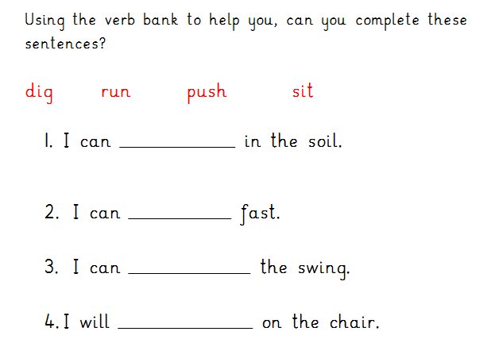
Day 1- Try this in your book:

Slide 9
Day 2 - Handwriting 1
Today you will be practising your letter formation.
Let’s warm up our hands and fingers ready to write first:
https://www.youtube.com/watch?v=o9D5lfqZF3o

Slide 10
Day 2 - Handwriting 1
Today you will be practising your letter formation of the following letter: o
Let’s look at how we form this letter…

Slide 11
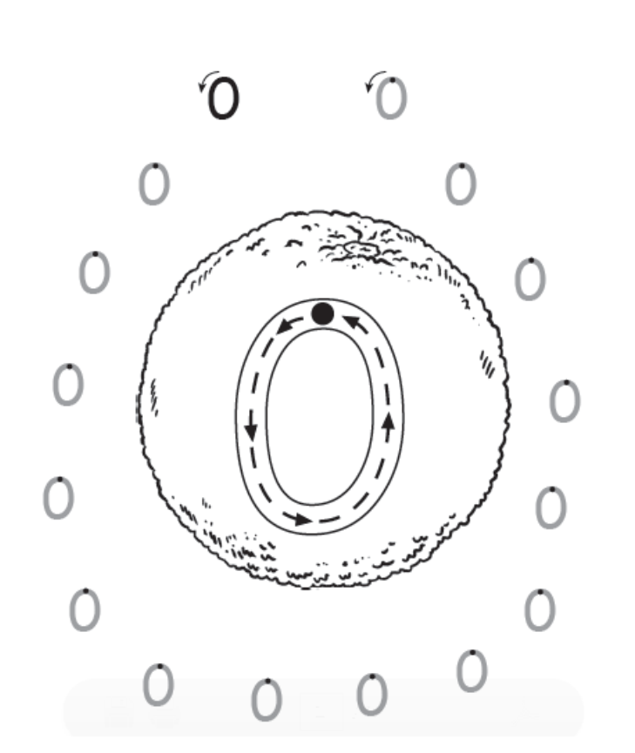
Day 2 - Handwriting 1
Look carefully at where you will start and which way the arrows point as this shows you how to form this letter:
Practise forming the letter o in the air with your finger.

Slide 12
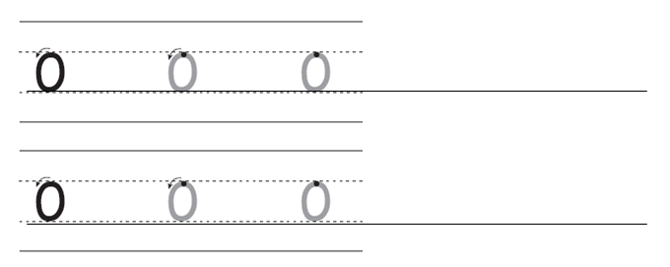
Day 2
Can you now practise writing the letter in your home learning book…
Once you have done 2 lines of the letter, can you write the following words with this letter in. Think really carefully about how you form each letter.

Slide 13
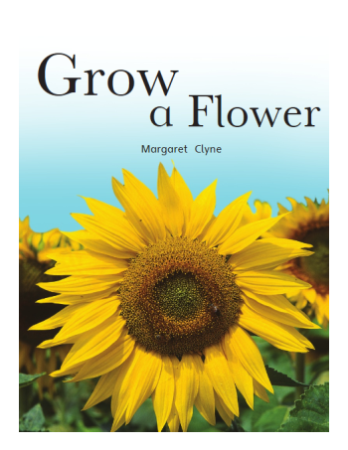
Day 2
This week you will be looking at some instructions again. Can you remember the book you read last week in Guided Reading?
Can you remember what the
instructions were about?
Let’s recap the features of instructions first…

Slide 14
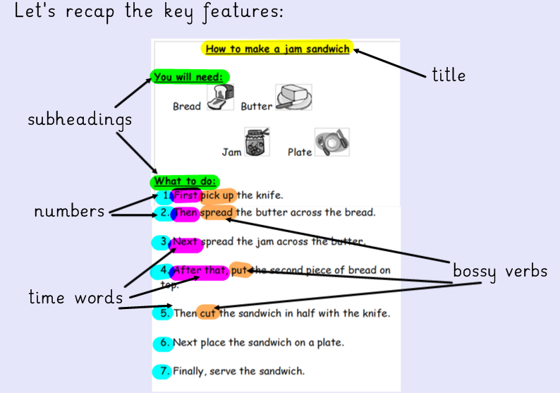

Slide 15
Day 2
Today you will be highlighting the key features of a new set of instructions.
Use the example of the previous page to help you.

Slide 16
Day 2

Slide 17
Day 3 - Handwriting 2
Today you will be practising your letter formation of the following letter: s
Let’s look at how we form this letter…

Slide 18
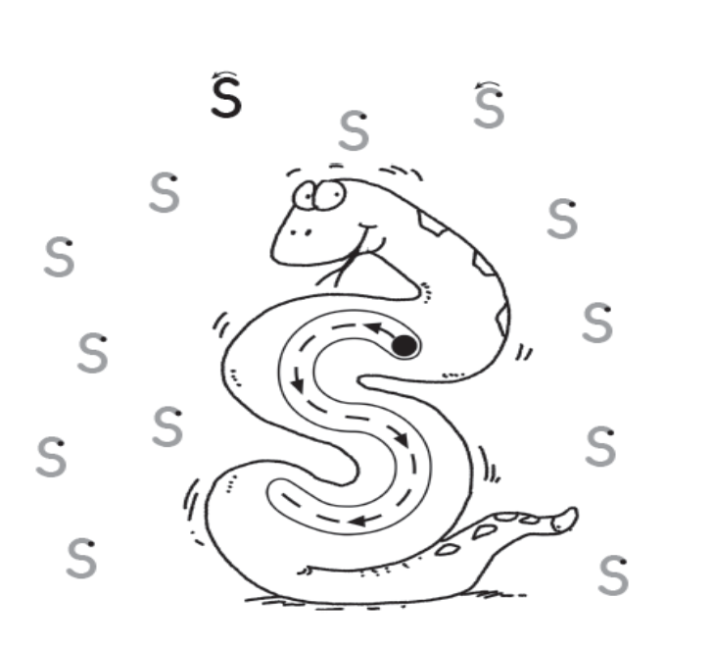
Day 3 - Handwriting 2
Look carefully at where you will start and which way the arrows point as this shows you how to form each letter:
Practise forming the letter s in the air with your finger.

Slide 19
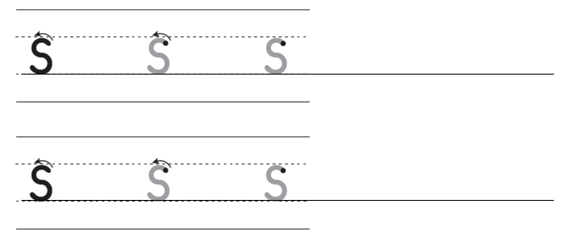
Day 3
Can you now practise writing the letter s in your home learning book…
Once you have done 2 lines of each letter can you write the following words with these letters in. Think really carefully about how you form each letter.

Slide 20
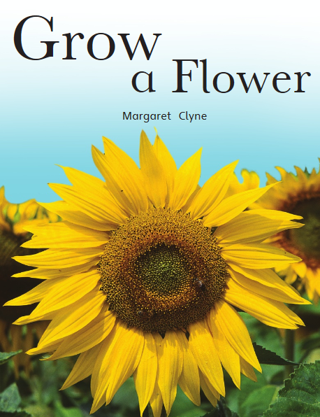
Day 3
Yesterday you found the key features of instructions.
Use Bug club to re-read this text:

Slide 21
Day 3 Today we are going to be sequencing the instructions for how to grow a flower. Remember sequencing means putting them into the right order.

Slide 23
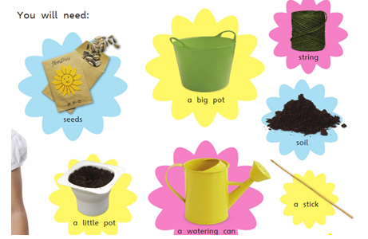
These instructions are in the wrong order. Can you write these as a set of instructions into your book in the correct order?

Slide 24
Day 4
This week we have been looking at instructions for how to grow a flower.
Yesterday you sequenced the instructions.
Today you will be highlighting the key features in the instructions you wrote yesterday.

Slide 25
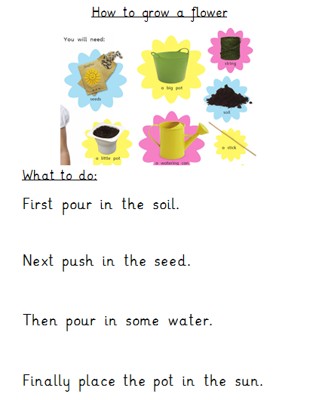
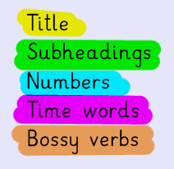
Using the instructions
you wrote yesterday,
use different colours
or underlining to
highlight the key
features in your
instructions:
Further challenge:
Can you add numbers to
your instructions?

Slide 26
Day 5 - Guided Reading

Slide 27
Day 5 - Guided Reading
Read this book on Bug club.
Make sure you read the book carefully because you will be answering some questions about the text.
Use your log in details to log into Bug club. The book will be at the very end of your allocated books in the ‘my stuff’ section.
https://www.activelearnprimary.co.uk/login?c=0

Slide 28
This weeks book:
This weeks book is a non-fiction book.
This means that it is a text about information,
events or people
We will be focusing on retrieval skills by answering questions about what we have read today.

Slide 29
Questions to ask and answer:
Talk about these questions with an adult at home. Once you have talked about the answers you could write your answers into your home learning book.
What do the children and animals all have? (page 2-3)
What pets are in the text? (page 3-4)
What is the same about all these creatures? (page 5-6)
What is the same? (page 8-9)
What is the same? (page 10-11)

