Slide 1
Curriculum
Week Commencing: 04.01.21

Slide 2
This Week
Day 1: History – How Yorkshire has changed
Day 2: History – Life as a Victorian
Day 3: History – The Industrial Revolution
Day 4: RE
Day 5: Computing

Slide 3
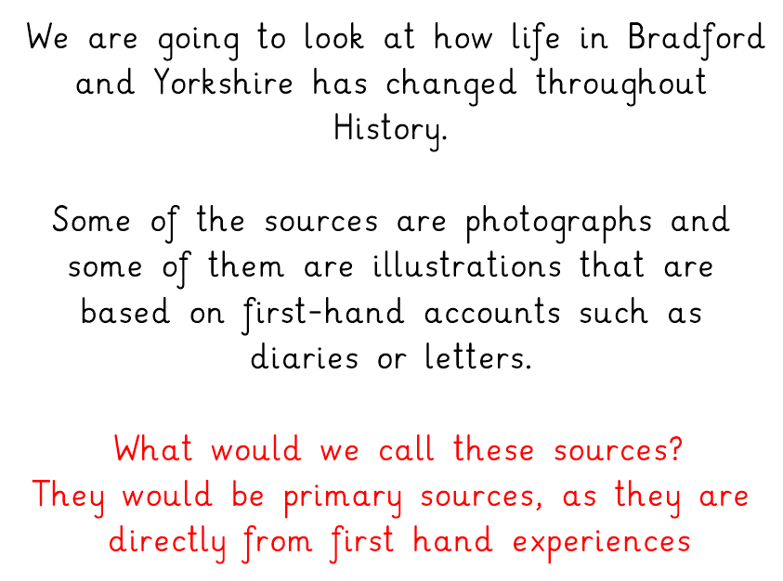
Day 1 – How Yorkshire has changed over the years

Slide 4
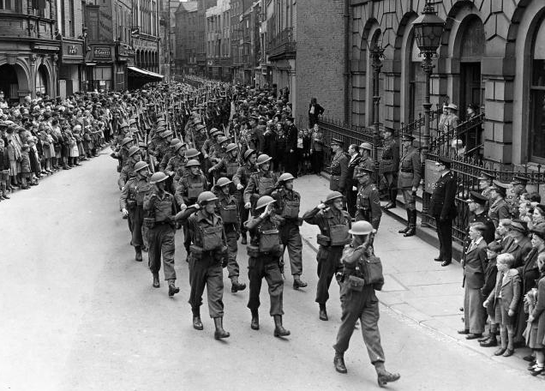
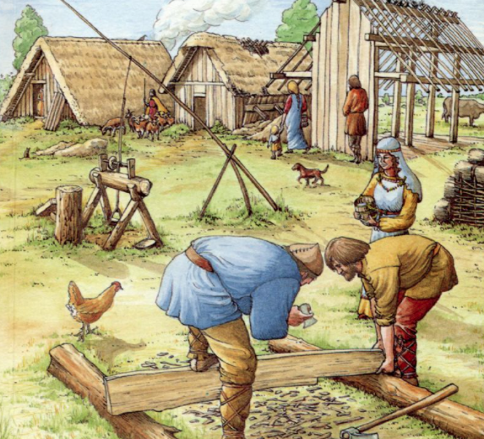
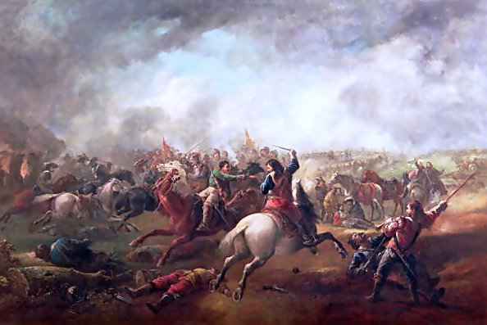
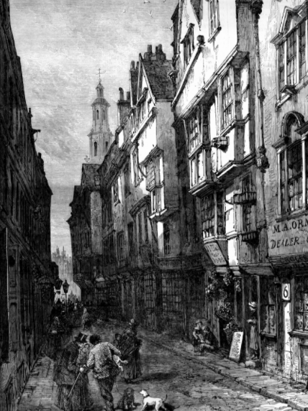
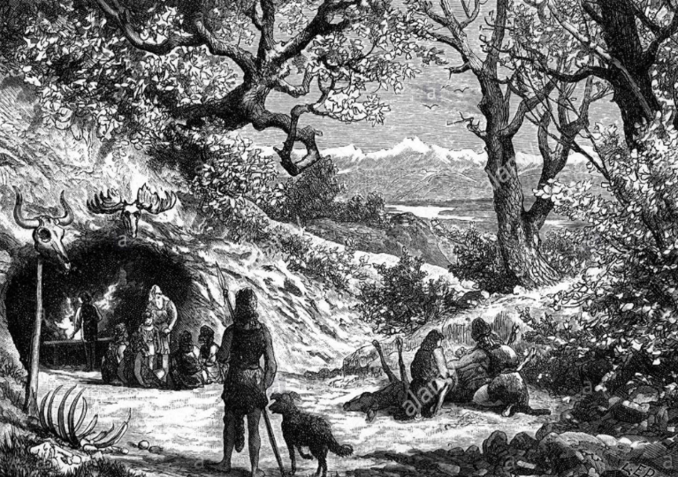
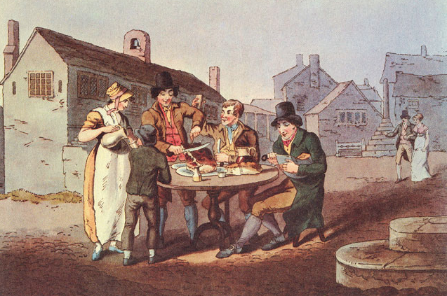
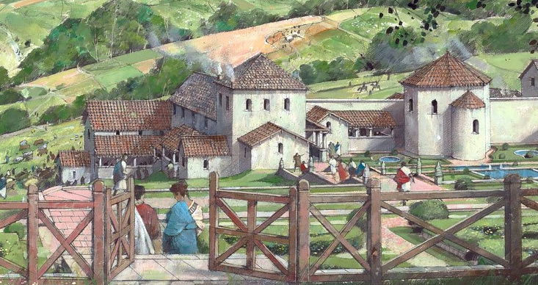
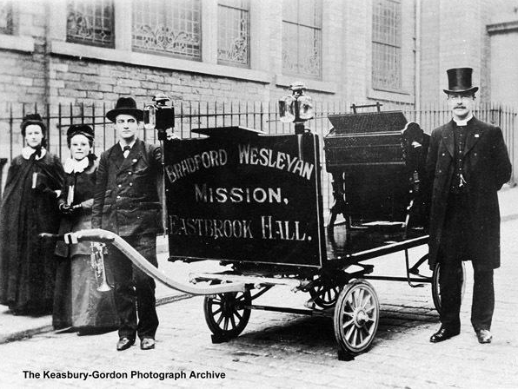
How would you place these pictures of Yorkshire chronologically?
Which would you place as the earliest? Why?
What clues could you use to help you?

Slide 5
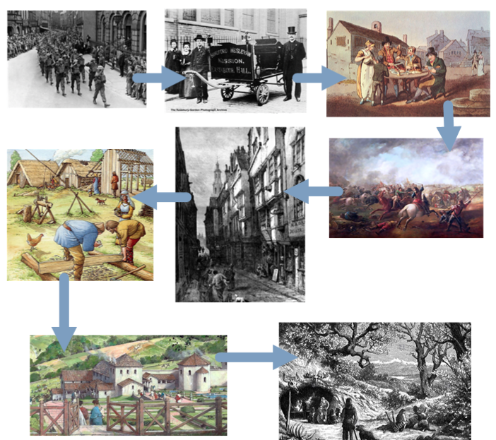
This is the sources in chronological order.
Were you correct?

Slide 7
Day 2 – Life as a Victorian

Slide 9
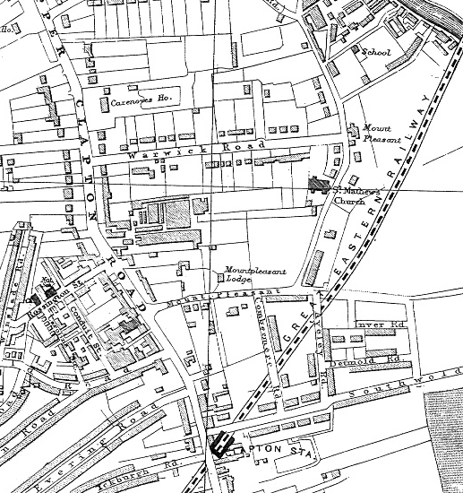
Look at Source 1.
This is a map of Yorkshire from 1890s.
What things does it show?
Are all the streets the same width?
What work places are shown?
Are there any parks or open fields, schools or churches?
Can you find Conduit Street off Rossington Street?

Slide 10
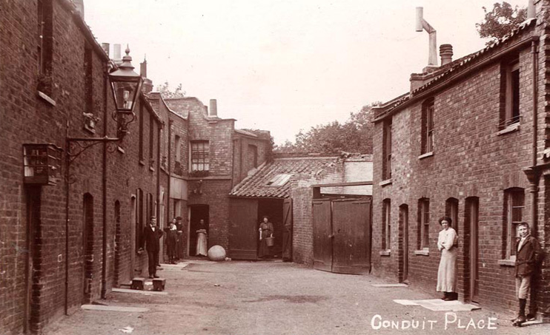
Look at Source 2.
This is a photograph of Caroline Cottages, Conduit Place, taken around the 1890s.
Are these homes for the rich or the poor?
How many families lived in Conduit Place? (Handy hint: count the front doors)
How many rooms do you think each home had?
What would go on in each room?
Where would the children play?
There is only one young person in this photo. Does that mean that:
- no children lived here except him?
- the people that lived here were comfortably off because they could afford to send their children to school?
- school was compulsory in the 1890s, so the children would be in school?
Can you see what the woman at the end of the street is carrying?

Slide 11
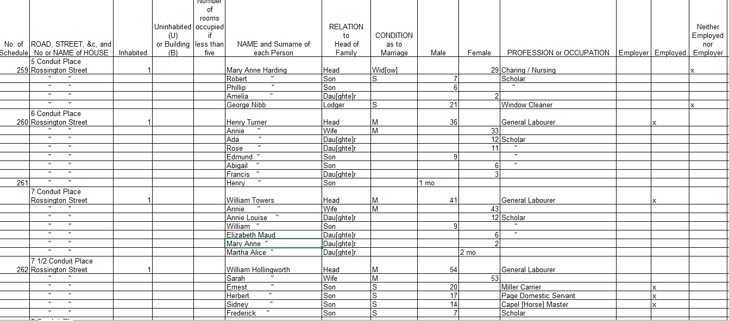
Look at Source 3.
This is the 1891 census return for Conduit Place.
What type of work did the head of the household do?
Did the children go out to work?
Did the wives go out to work?
Can you spot any of our focus children?

Slide 12
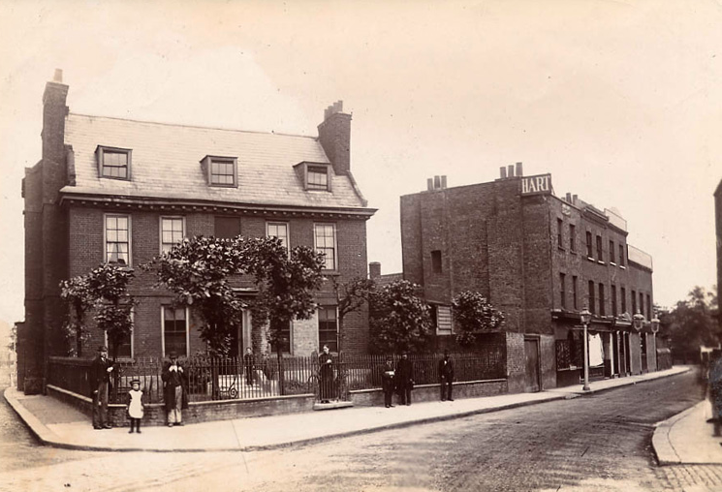
Look at Source 4.
This is a photograph of Eagle House, just down the road from Conduit Street.
Did this house belong to a rich or poor family?
How many families do you think lived here?
How many floors does the house appear to have?
How many rooms do you think the house might have?
What tells you that this photo was posed?

Slide 13
Look at Source 5.
This is the census return for Eagle House.
What does George Glover do for a living?
How many children does he have?
Is this family middle class or working class?

Slide 15
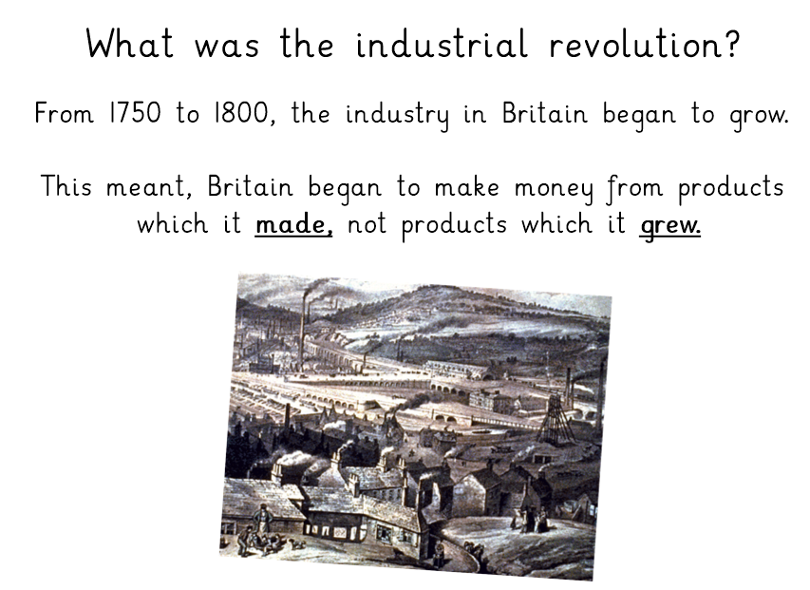
Day 3 – The Industrial Revolution
https://www.bbc.co.uk/teach/class-clips-video/history-ks1--ks2-explain-this-industrialisation/zmmx6v4

Slide 19
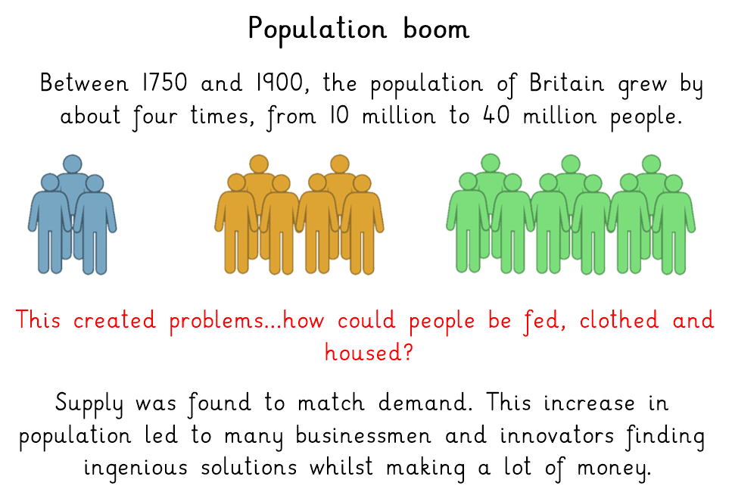

Slide 20
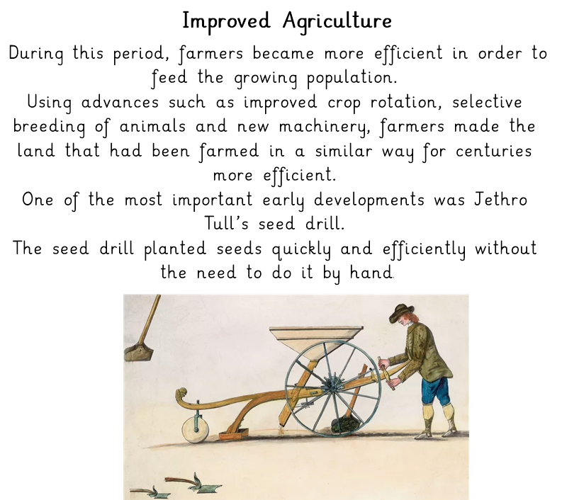

Slide 21
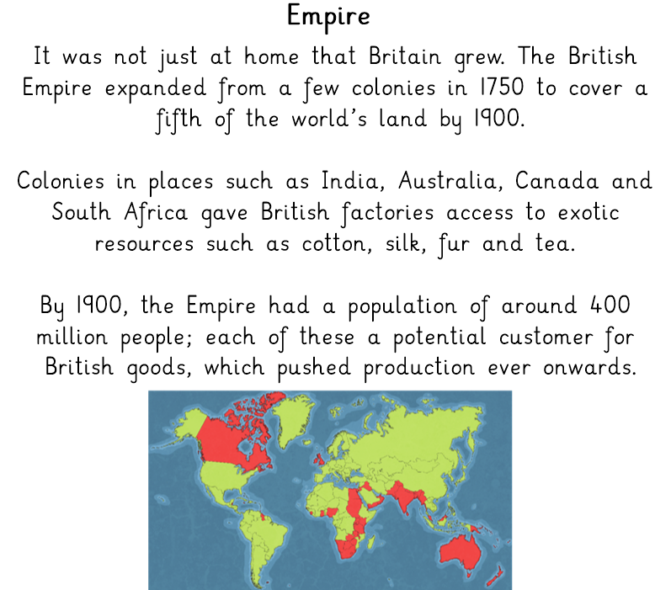

Slide 23
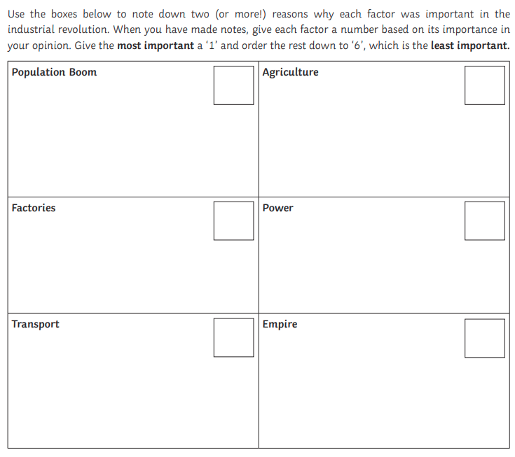
Further challenge:
Now that you have chosen your order of importance, explain why you have made your choices for 1 and 6.

Slide 24
Day 4 – RE: Celtic beliefs

Slide 29
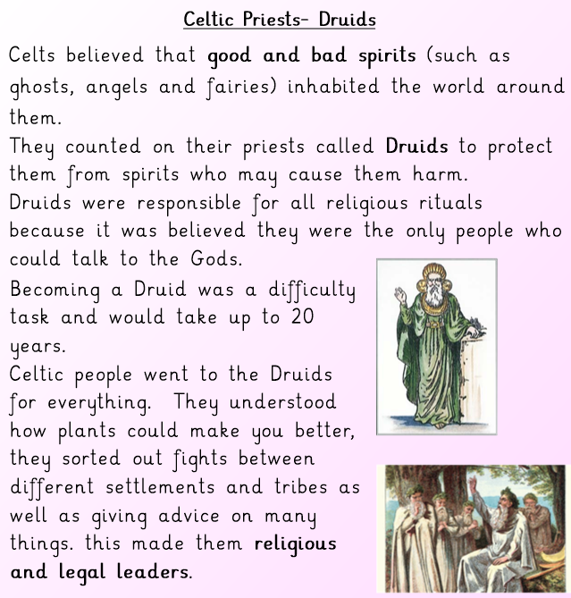

Slide 30
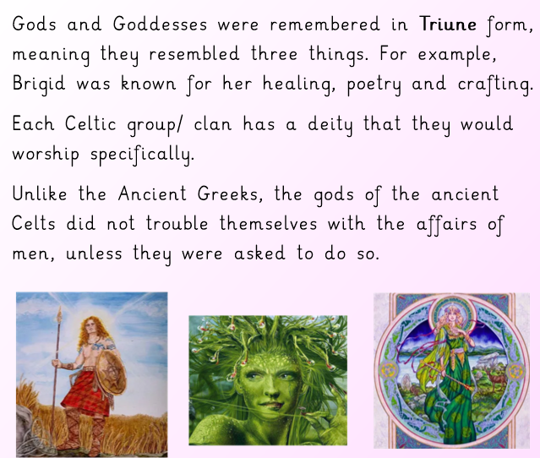

Slide 31
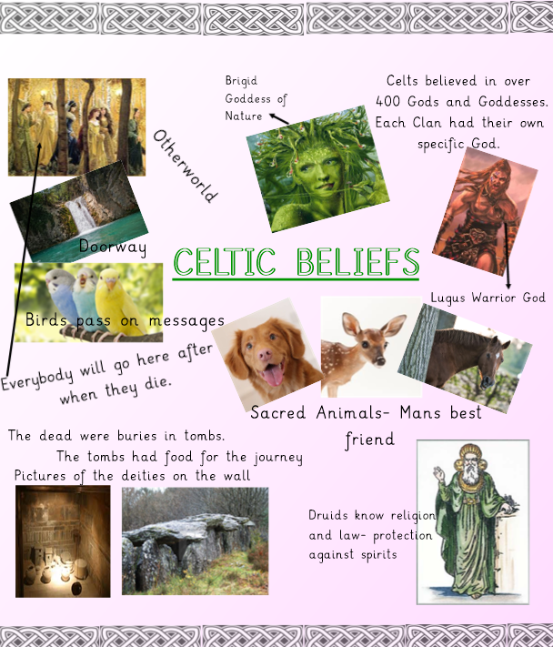
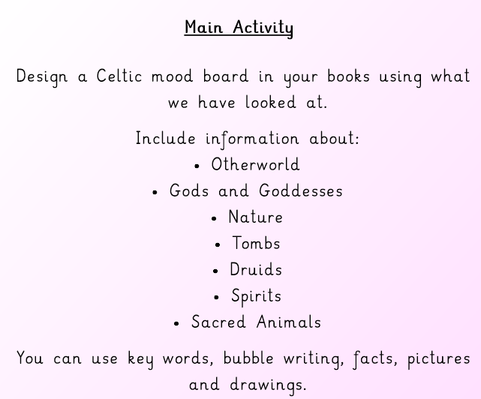

Slide 32
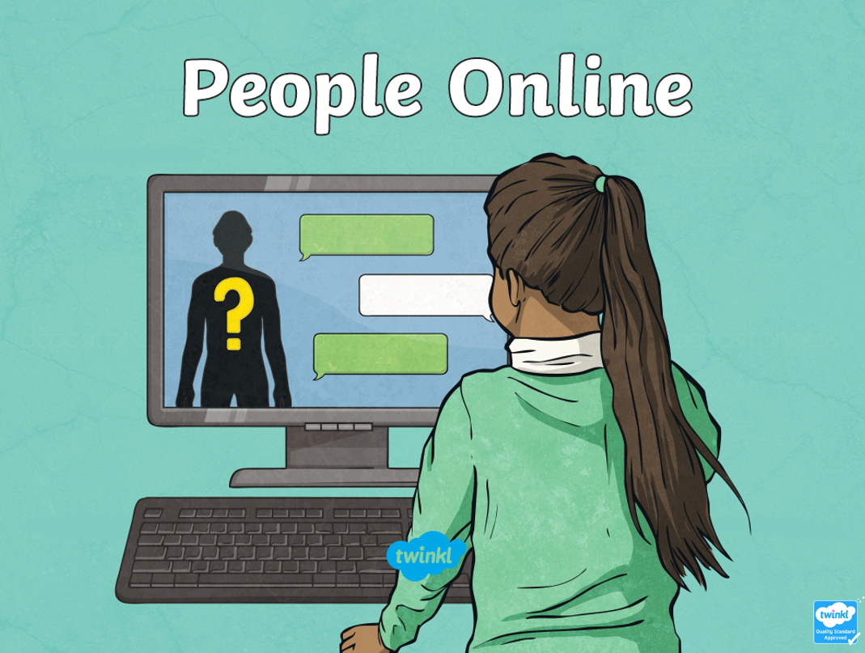
Day 5 – Online safety

Slide 33
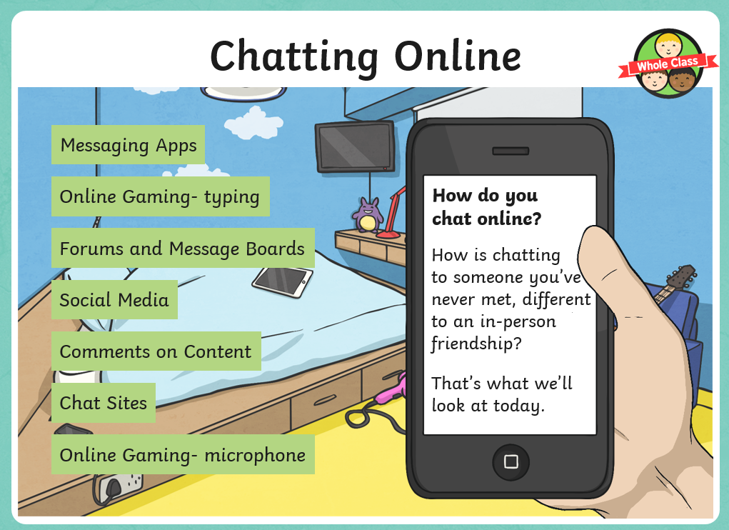

Slide 35
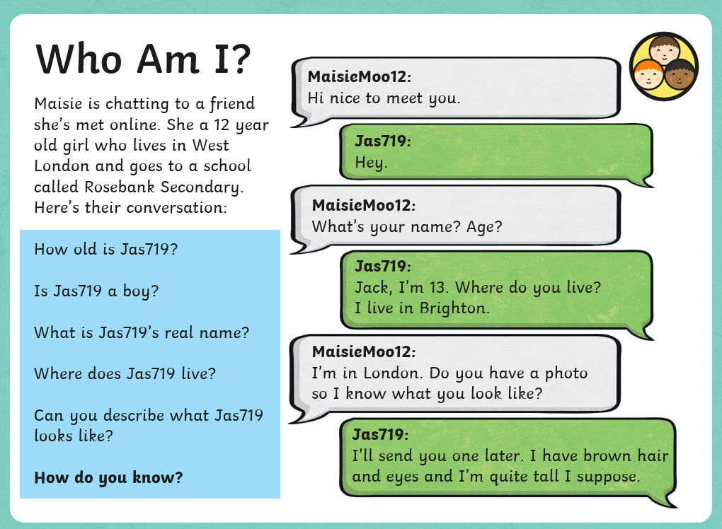

Slide 37
