Slide 1
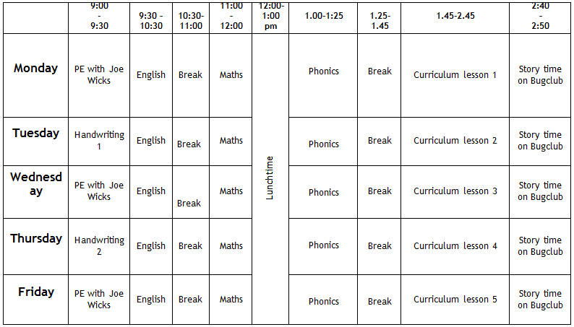
Home Learning timetable:

Slide 2
Phonics Home Learning
Week Beginning 11.1.21

Slide 3
This week…
Day 1 – ow
Day 2 – ur
Day 3 – or
Day 4 – ar
Day 5 – tricky words

Slide 4
Below are some useful links to videos and websites you can use to support with Phonics lessons at home:
https://www.youtube.com/watch?v=jPVbJ-IaHIw&feature=youtu.be
https://www.youtube.com/watch?v=TI-pfeaErY4
https://www.youtube.com/watch?v=ixndECFUbIo
www.phonicsplay.co.uk

Slide 5
Day 1- ow Today you will be looking at the sound ow as in owl. Watch the video below to find out all about the sound. Make sure you: -Practise saying the sound -Blend the words to read them by sounding them out -Have a go at writing words with the sound in https://www.youtube.com/watch?v=DV3vzwk9E_Q

Slide 6
Day 1- ow Practise blending these words with today’s sound in to read them. You can write them down and add the sounds buttons to the words if you would like to.

Slide 7
Day 1- ow

Slide 8
Day 1- ow Log into Phonics Play. Play buried treasure (ow sound)

Slide 9
Day 2- ur Today you will be looking at the sound ur as in fur. Watch the video below to find out all about the sound. Make sure you: -Practise saying the sound -Blend the words to read them by sounding them out -Have a go at writing words with the sound in https://www.youtube.com/watch?v=pcNgbnrvWqo

Slide 10
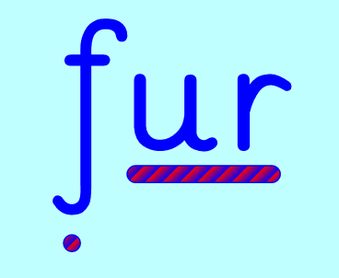
Day 2- ur Practise blending these words with today’s sound in to read them. You can write them down and add the sounds buttons to the words if you would like to.

Slide 11
Day 2- ur

Slide 12
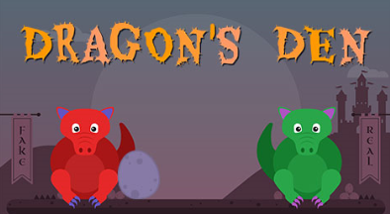
Day 2- ur Log into Phonics Play. Play dragon’s den (ur sound)

Slide 13
Day 3- or Today you will be looking at the sound or as in born. Watch the video below to find out all about the sound. Make sure you: -Practise saying the sound -Blend the words to read them by sounding them out -Have a go at writing words with the sound in https://www.youtube.com/watch?v=X2C_ANTT7zs

Slide 14
Day 3- or Practise blending these words with today’s sound in to read them. You can write them down and add the sounds buttons to the words if you would like to.

Slide 15
Day 3- or

Slide 16
Day 3- or Log into Phonics Play. Play picnic on pluto (or sound)

Slide 17
Day 4- ar Today you will be looking at the sound ar as in dark. Watch the video below to find out all about the sound. Make sure you: -Practise saying the sound -Blend the words to read them by sounding them out -Have a go at writing words with the sound in https://www.youtube.com/watch?v=Jf2dx5IbeZE

Slide 18
Day 4- ar Practise blending these words with today’s sound in to read them. You can write them down and add the sounds buttons to the words if you would like to.

Slide 19
Day 4- ar

Slide 20
Day 4- ar Log into Phonics Play. Play buried treasure (ar sound)

Slide 21
Day 5- tricky words Today you will be looking at some tricky words. Remember tricky words are words which you cannot sound out. Watch the video below, whilst watching the video make sure you: -Practise saying the word -Have a go at writing words with the sound in https://www.youtube.com/watch?v=R087lYrRpgY

Slide 22
Day 5- tricky words Today you will be looking at some tricky words. Remember tricky words are words which you cannot sound out. Watch the video below, whilst watching the video make sure you: -Practise saying the word -Have a go at writing words with the sound in https://www.youtube.com/watch?v=R087lYrRpgY

Slide 23
Day 5- tricky words Log into Phonics Play. Remember tricky words are words which you cannot sound out. Play the tricky word trucks (phase 2 and 3)

