Slide 1
Year 1 Maths Home Learning
Week Beginning 11.01.2021
Click the link for a video explaining this week’s learning
https://youtu.be/BJWpBWAQXII

Slide 2
This Week………
Day 1: Slide 3-9: Maths Practical: Number formation.
Day 2: Slides 10-21: Maths Practical and Pictorial: Subtraction
Day 3: Slides 22-36: Maths Pictorial and Abstract: Subtraction
Day 4: Slides 37-49: Maths Practical: Number Bond subtraction facts
Day 5: Slides 50-68: Maths Pictorial: Number Bond subtraction facts

Slide 3
Day 1

Slide 4
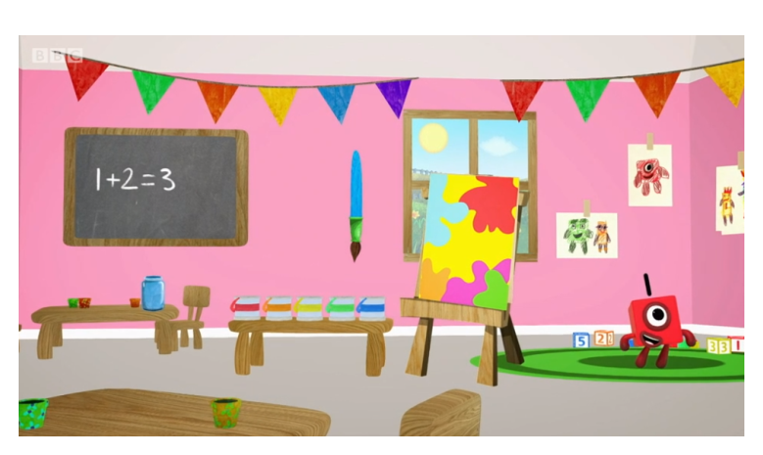
Day 1:
Trace the numbers with your finger.
https://www.bbc.co.uk/iplayer/episode/p077rk5n/numbersongs-lets-all-draw-numbers

Slide 5
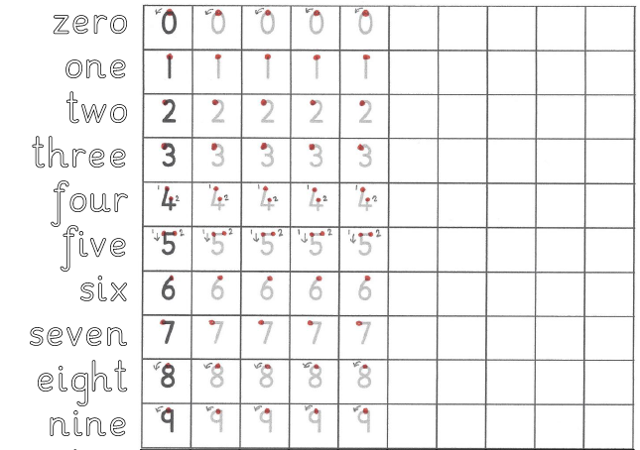
Day 1
Maths Practical Lesson.
Practise forming the numbers and words zero to nine.

Slide 6
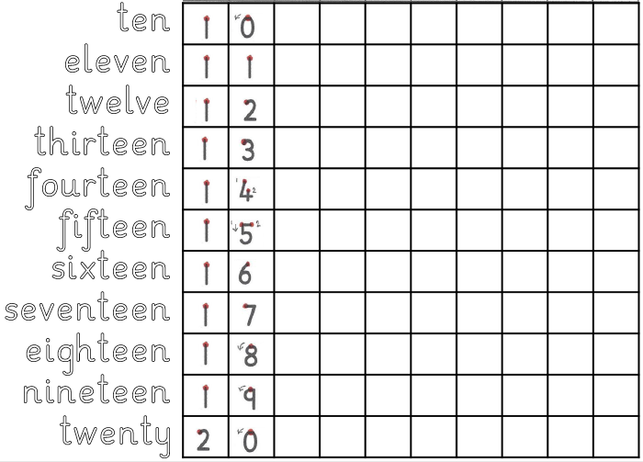
Day 1
Maths Practical Lesson.
Practise forming the numbers and words ten to twenty.

Slide 7
one
twenty
thirty
fourteen
forty
fifty
thirteen
30
20
1
40
14
13
50
Day 1
Maths
Match the numbers to the words.

Slide 8
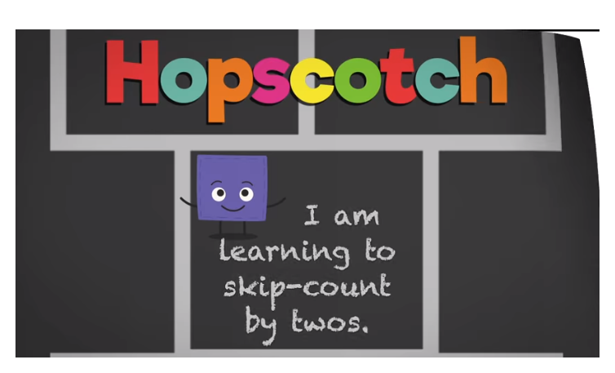
Sing along with the song to learn counting in 2s!
https://www.youtube.com/watch?v=8nokRGhevCw

Slide 9
Use the number track to help you count in 2s up to 30.
Write the numbers down in order from 0-30

Slide 10
Day 2

Slide 11
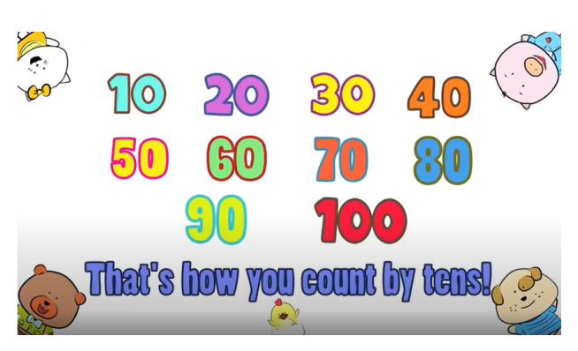
Day 2: Maths
Watch the counting in 10s video and see if you can write the numbers from 10-100 in order!
https://www.youtube.com/watch?v=-gmEe0-_ex8

Slide 12
What is 6 more than 8?
Count on 6 places from 8 to find out...
What is 12 more than 4?
Count on 12 places from 4 to find out...
= 14
= 16

Slide 13
What is 5 less than 18?
Count back 5 places from 18 to find out...
What is 16 less than 18?
Count back 16 places from 18 to find out...
= 13
= 2

Slide 14
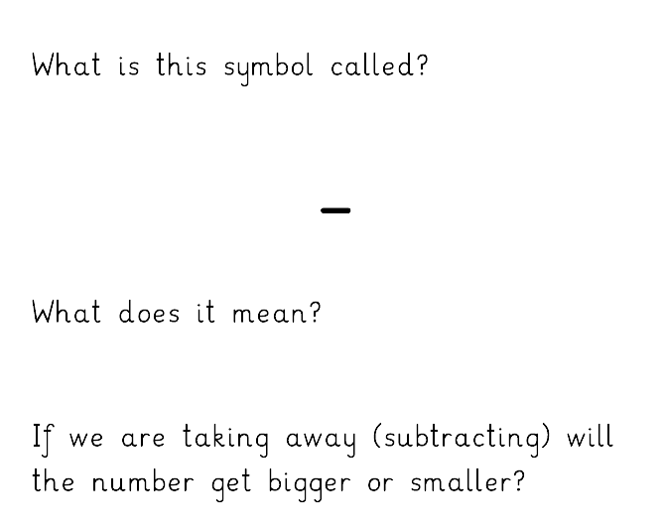
Day 2: Subtraction
Subtract,
minus,
take away
Smaller

Slide 15
Day 2: Practical
1

Slide 16
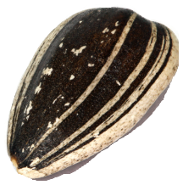
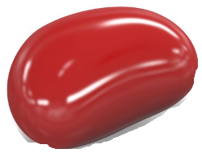
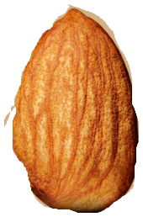
Task 1: Practical
Count out objects and take them away to solve the subtraction questions on the next slide.
Write down the whole number sentences with your answers before checking the answers.
You can use the number line to help.

Slide 17
Now let’s try these
5 – 2 = 3
4 – 2 = 2
6 – 1 = 5
8 – 7 = 1
10 – 6 = 4

Slide 18
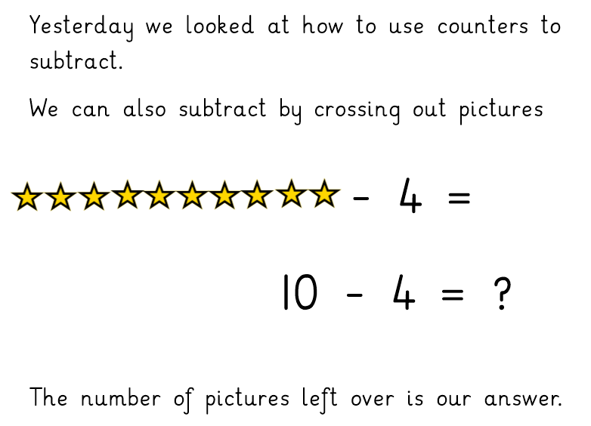
Day 2: Pictorial
6
6

Slide 19
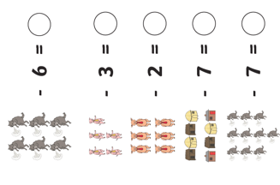
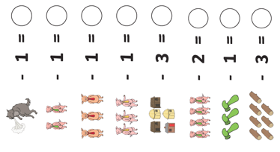
Task 2: Pictorial
Now try these…

Slide 20
0
Check your answers.
0
0
1
2
2
2
4
2
2
1
2
1
3
4

Slide 21
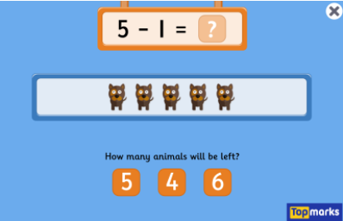
Subtraction to 10 game
https://www.topmarks.co.uk/subtraction/subtraction-to-10

Slide 22
Day 3
Click the link below to watch a video of today’s lesson
https://youtu.be/1wRtfKxZ9_Y

Slide 23
Sing along with the song to learn counting in 2s!
https://www.youtube.com/watch?v=8nokRGhevCw

Slide 24
Use the number track to help you count in 2s up to 30.
Write the numbers down in order from 0-30
Use the number track to help you count in 2s up to 30.
Write the numbers down in order from 0-30

Slide 25
Day 3
Yesterday we looked at using practical equipment to subtract.
1

Slide 26
Day 3
We also looked at crossing out pictures to subtract.
6
6

Slide 27
Sometimes we need to draw our own pictures and
cross them out to solve subtraction questions.
5 - 2

Slide 28
5
Let’s start by drawing 8 dots…
then cross 3 out….
then count how many are left.

Slide 29
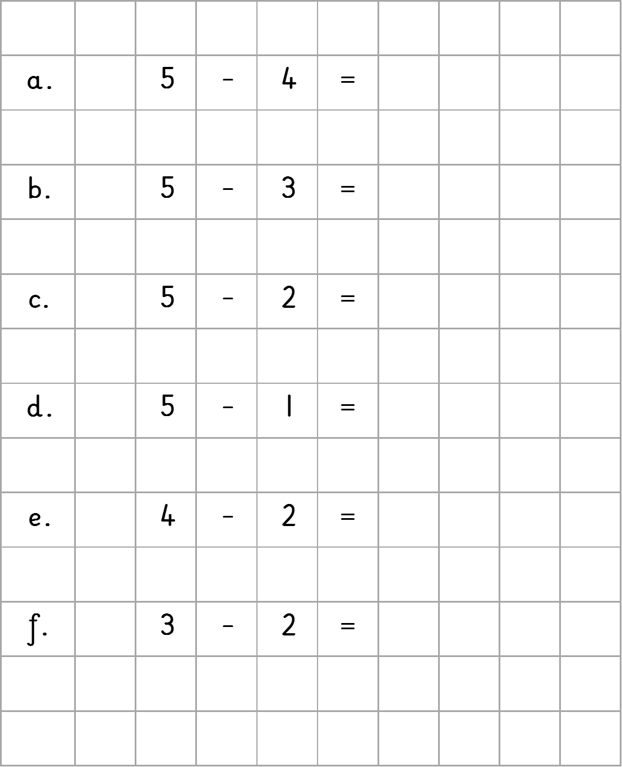
Task 1:
Solve these by drawing and crossing out dots.

Slide 30
1
Check your answers.
2
3
4
2
1

Slide 31
We can also use a Number Track to subtract.

Slide 32
4

Slide 33
Practise
4 – 1 = 3
6 – 2 = 4
5 – 1 = 4
9 – 7 = 2
10 – 4 = 6

Slide 34
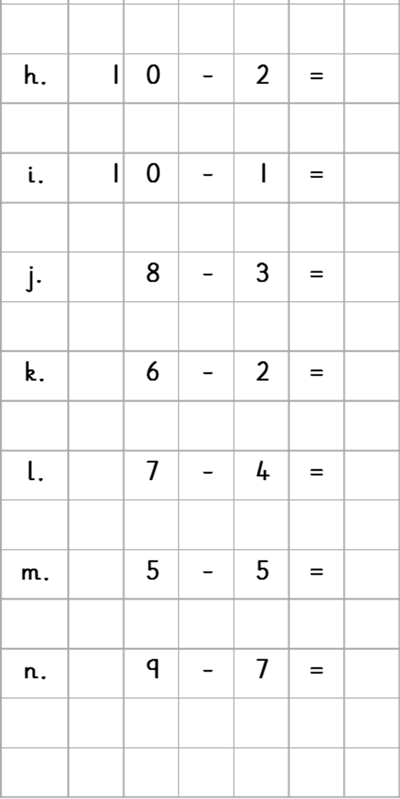
Now try these…

Slide 35
1
8
Check your answers.
2
9
3
5
4
4
3
5
0
6
2
7

Slide 36
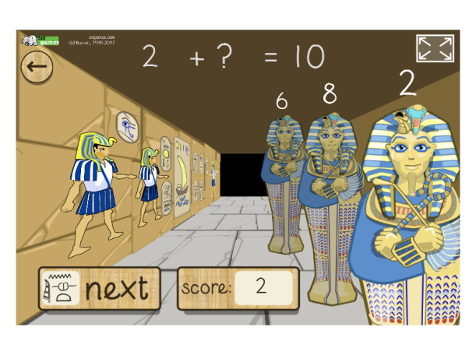
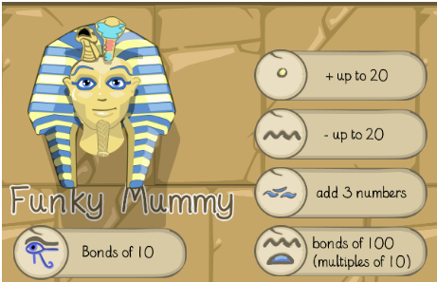
Day 3: Funky Mummy Subtraction up to 20
http://www.ictgames.com/mobilePage/funkyMummy/index.html

Slide 37
Day 4

Slide 38
Day 4: Maths
Watch the counting in 10s video and see if you can write the numbers from 10-100 in order!
https://www.youtube.com/watch?v=-gmEe0-_ex8

Slide 39
Last week we learnt about number bonds.
Can you remember what a number bond is?

Slide 40
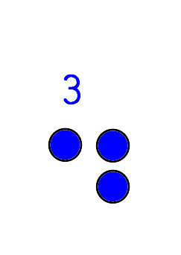
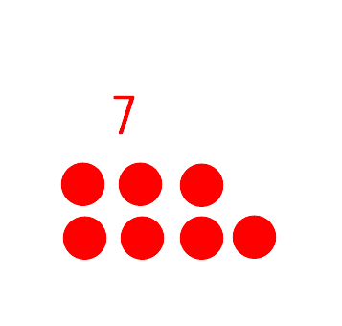

Slide 41
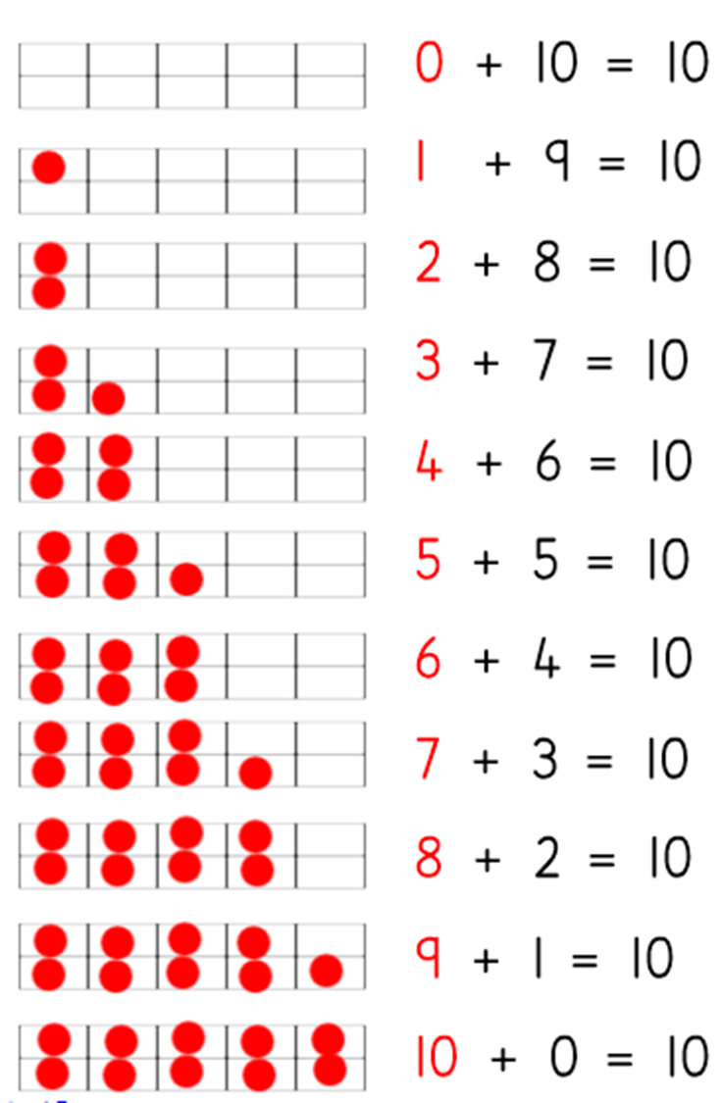

Slide 42
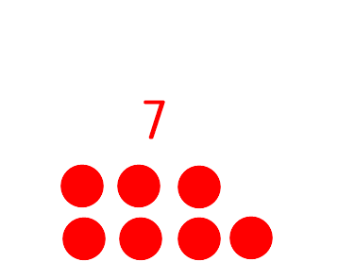

Slide 43
Let’s watch this video!
Tens Frame Subtraction Song - YouTube

Slide 44
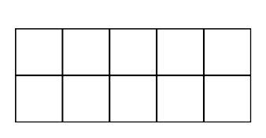
This is called a Tens Frame, we used one last week.
How many squares has it got?
Can you draw one to use for our maths task today?

Slide 45
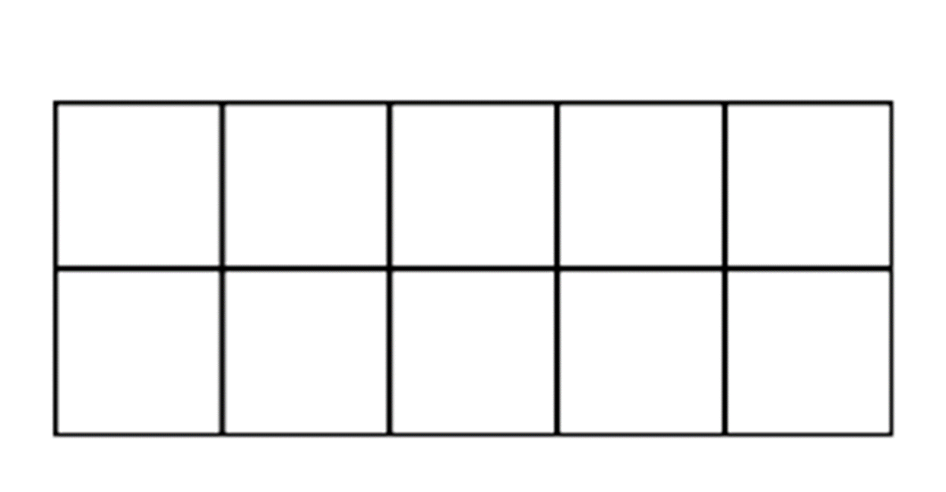
9

Slide 46
7

Slide 47
3

Slide 48
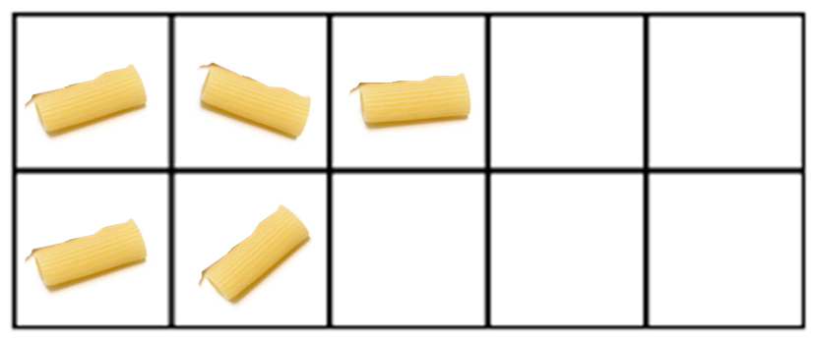

Slide 50
Day 5

Slide 51
Sing along with the song to learn counting in 2s!
https://www.youtube.com/watch?v=8nokRGhevCw

Slide 52
Use the number track to help you count in 2s.
Write the numbers down in order

Slide 53
We have been learning about Number Bonds.
Can you remember what a number bond is?

Slide 55
Yesterday we found out that we can use Number Bonds for subtraction too!

Slide 56
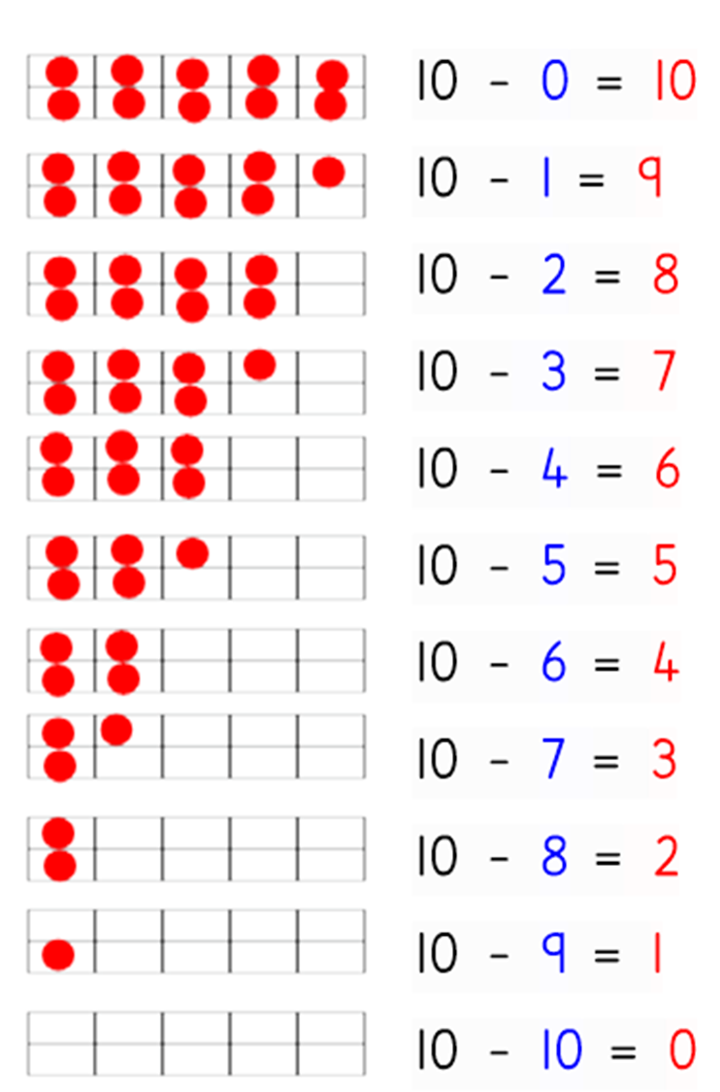

Slide 57
Let’s watch this video!
Tens Frame Subtraction Song - YouTube

Slide 58
Today we are going to draw pictures of counters and cross them out to work out number bond subtraction facts.

Slide 59
We need to cross out the number of counters we are subtracting.
10 – 9 = ?

Slide 60
Here, we will cross out 9 counters.
10 – 9 = ?

Slide 61
We count the number of counters left.
Our answer is 1.
10 – 9 = ?
1

Slide 62
How many counters do we need to cross out to solve this subtraction question?
8
2

Slide 63
How many counters do we need to cross out to solve this subtraction question?
2
8

Slide 64
How many counters do we need to cross out to solve this subtraction question?
4
6

Slide 65
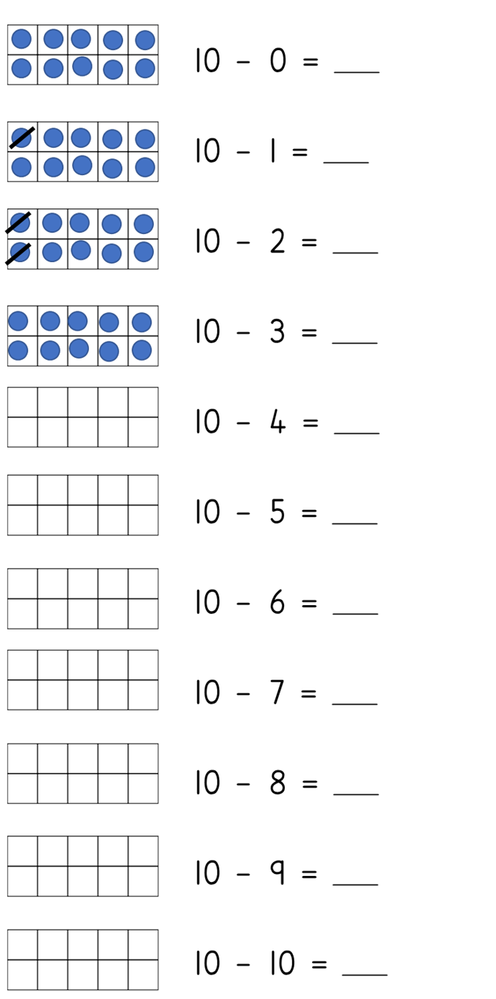
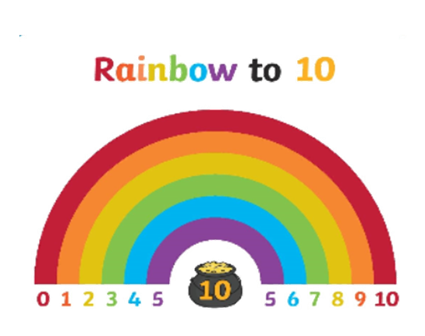
10
9
8
7
6
5
4
3
2
1
0
Task 1 : Draw and cross out the counters to work out the answers.

Slide 66
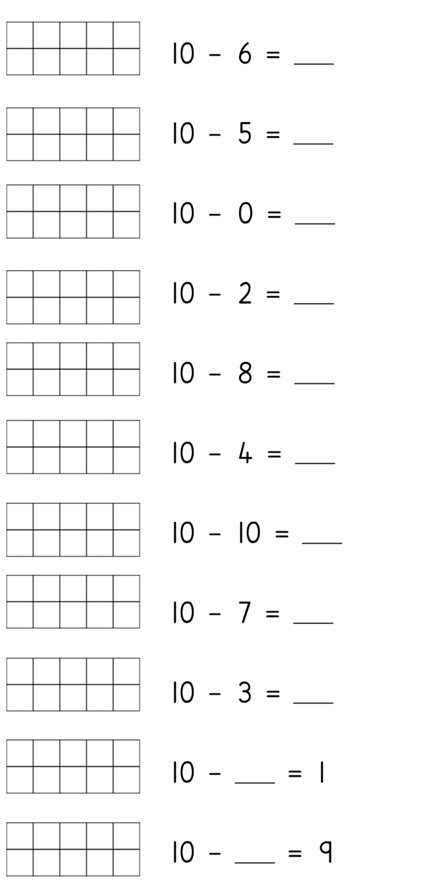
4
5
10
8
2
6
0
3
7
Task 2 : Draw and cross out the counters to work out the answers.
9
1

Slide 68
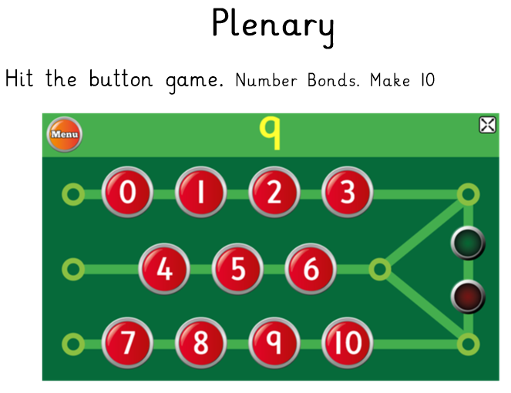
https://www.topmarks.co.uk/maths-games/hit-the-button

