Slide 1
Year 1 Maths Home Learning
Week Beginning 04.01.2021

Slide 2
This Week………
Day 1: Slide 3-9: Maths Practical: Number formation.
Day 2: Slides 10-30: Maths Practical: Number Bonds to 10
Day 3: Slides 31-45: Maths Practical: Number Bonds to 10
Day 4: Slides 46-61: Maths Pictorial: Number Bonds to 10
Day 5: Slides 62-81: Maths Pictorial: Number Bonds to 10

Slide 3
Day 1

Slide 4
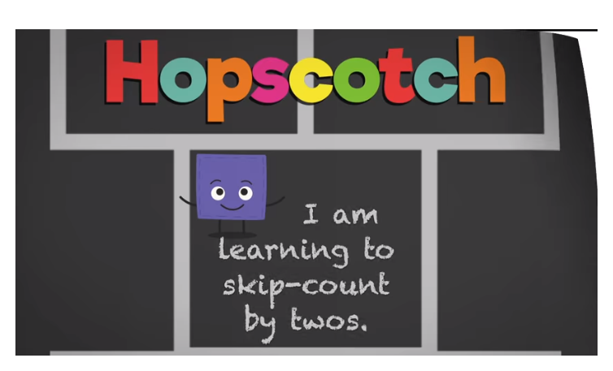
Sing along with the song to learn counting in 2s!
https://www.youtube.com/watch?v=8nokRGhevCw

Slide 5
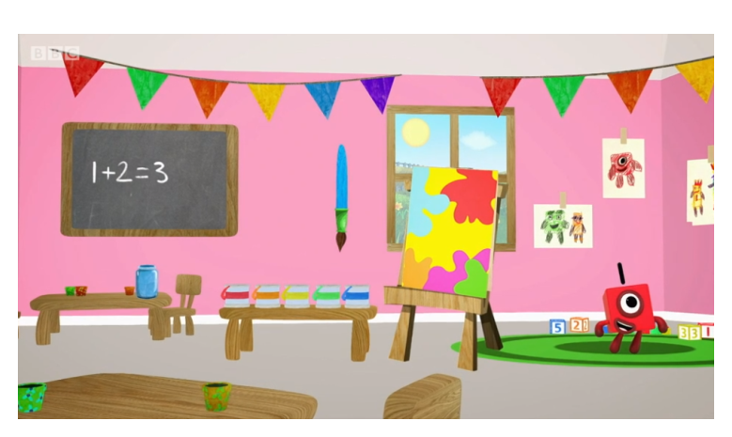
Day 1:
Trace the numbers with your finger.
https://www.bbc.co.uk/iplayer/episode/p077rk5n/numbersongs-lets-all-draw-numbers

Slide 6
Four
Thirteen
Eighteen
Twelve
Five
Fifteen
15
4
12
18
5
13
Day 1
Maths
Match the numbers to the words.

Slide 7
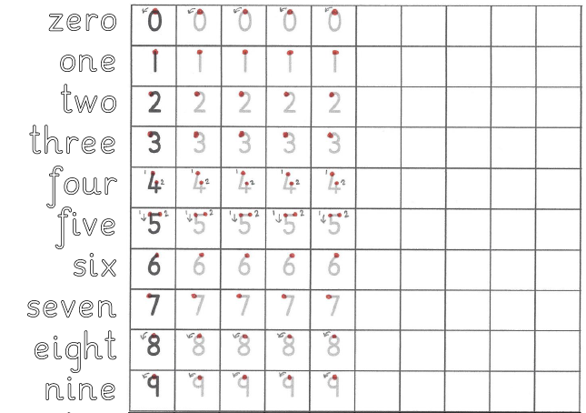
Day 1
Maths Practical Lesson.
Practise forming the numbers and words zero to nine.

Slide 8
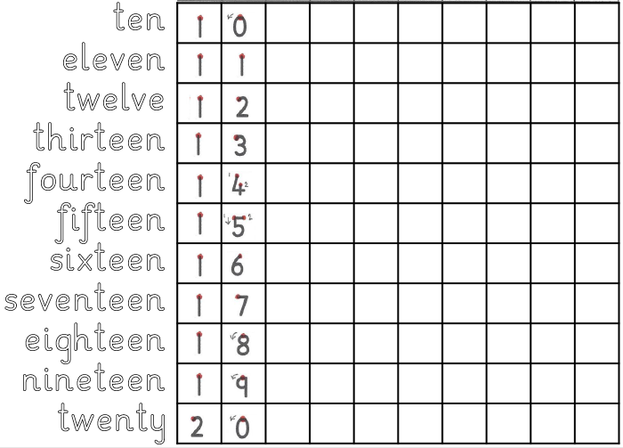
Day 1
Maths Practical Lesson.
Practise forming the numbers and words ten to twenty.

Slide 9
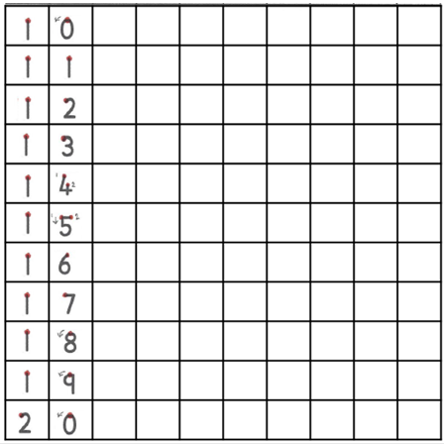
Day 1
Maths Practical Lesson.
Practise forming the numbers from twenty to thirty.

Slide 10
Day 2

Slide 11
Sing along with the song to learn counting in 2s!
https://www.youtube.com/watch?v=8nokRGhevCw

Slide 12
Use the number track to help you count in 2s.
Write the numbers down in order

Slide 14
5
5

Slide 15
https://www.youtube.com/watch?v=OvbWuiYn-Uk

Slide 17
Task
The following slides show all the different number bond to make the number 10.

Slide 18
Task
For each one, work out which Numicon piece is needed to make the number 10.
Write your number sentence down and check if you are right!

Slide 19
1 + 9 = 10

Slide 20
2 + 8 = 10

Slide 21
3 + 7 = 10

Slide 22
4 + 6 = 10

Slide 23
5 + 5 = 10

Slide 24
6 + 4 = 10

Slide 25
7 + 3 = 10

Slide 26
8 + 2 = 10

Slide 27
9 + 1 = 10

Slide 28
10 + 0 = 10

Slide 29
Number bonds to 10
0 + 10 = 10 10 + 0 = 10
1 + 9 = 10 9 + 1 = 10
2 + 8 = 10 8 + 2 = 10
3 + 7 = 10 7 + 3 = 10
4 + 6 = 10 6 + 4 = 10
5 + 5 = 10

Slide 30
Now it’s your turn.
Using the Numicon, find all the different number bonds to 10 and write down as Maths Stories.

Slide 31
Day 3

Slide 32
What is 2 more than 8?
Count on 2 places from 8 to find out...
What is 6 more than 4?
Count on 6 places from 4 to find out...
= 10
= 10

Slide 33
What is 5 less than 10?
Count back 5 places from 10 to find out...
What is 8 less than 10?
Count back 8 places from 10 to find out...
= 5
= 2

Slide 34
Sing along with the song to learn counting in 2s!
https://www.youtube.com/watch?v=8nokRGhevCw

Slide 35
Use the number track to help you count in 2s.
Write the numbers down in order

Slide 37
6
4

Slide 38
https://www.youtube.com/watch?v=OvbWuiYn-Uk

Slide 41
?

Slide 42
?

Slide 43
?

Slide 44
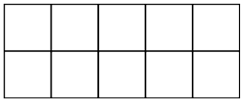
Task
Use the Tens Frame you drew and objects to find ALL the different number bonds to 10.
Write each number bond equation down as you find it.

Slide 45
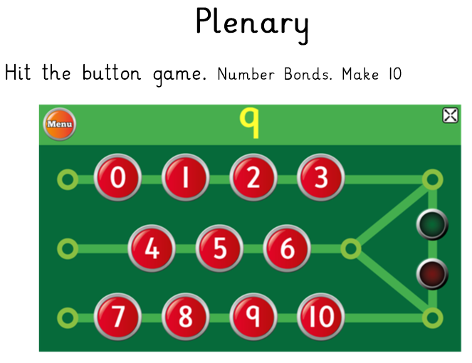
https://www.topmarks.co.uk/maths-games/hit-the-button

Slide 46
Day 4

Slide 47
What is 3 more than 9?
Count on 3 places from 9 to find out...
What is 7 more than 7?
Count on 7 places from 7 to find out...
= 12
= 14

Slide 48
What is 5 less than 20?
Count back 5 places from 20 to find out...
What is 11 less than 17?
Count back 11 places from 17 to find out...
= 15
= 6

Slide 49
Sing along with the song to learn counting in 2s!
https://www.youtube.com/watch?v=8nokRGhevCw

Slide 50
Use the number track to help you count in 2s up to 30.
Write the numbers down in order from 0-30

Slide 52
3
7

Slide 53
https://www.youtube.com/watch?v=OvbWuiYn-Uk

Slide 56
As the first number in the equation increases by one,
the second number decreases by one.

Slide 59
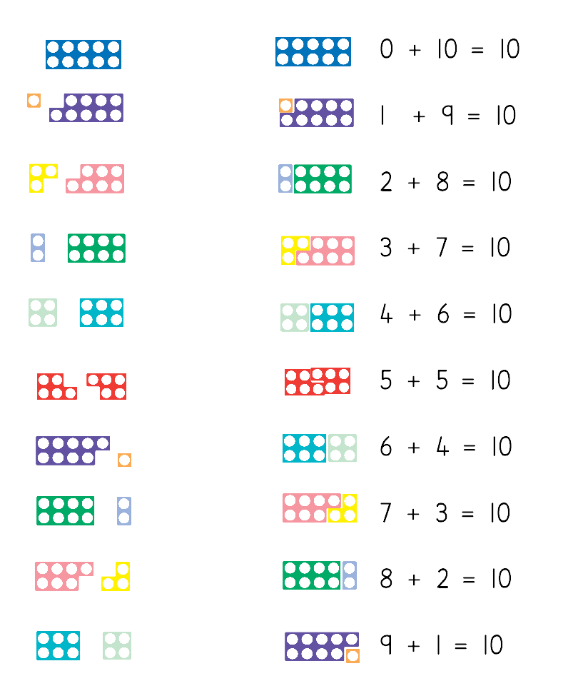
Questions

Slide 60
Answers

Slide 61
https://www.topmarks.co.uk/maths-games/hit-the-button

Slide 62
Day 5

Slide 63
What is 5 more than 4?
Count on 5 places from 4 to find out...
What is 12 more than 7?
Count on 12 places from 7 to find out...
= 9
= 19

Slide 64
What is 14 less than 20?
Count back 14 places from 20 to find out...
What is 10 less than 12?
Count back 10 places from 12 to find out...
= 6
= 2

Slide 65
Sing along with the song to learn counting in 2s!
https://www.youtube.com/watch?v=8nokRGhevCw

Slide 66
Use the number track to help you count in 2s up to 30.
Write the numbers down in order from 0-30

Slide 68
1
9

Slide 69
https://www.youtube.com/watch?v=OvbWuiYn-Uk

Slide 73
?

Slide 74
?

Slide 75
?

Slide 76
Task
Draw the counters to solve the missing number equations.
Warning! The second set of questions are mixed up!

Slide 77
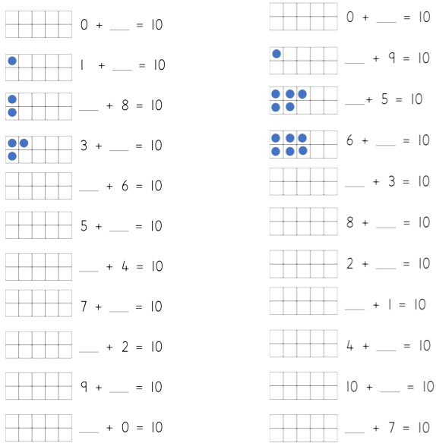

Slide 78
10
10
1
9
2
5
7
4
4
7
5
2
6
8
3
9
8
6
1
0
10
3

Slide 79
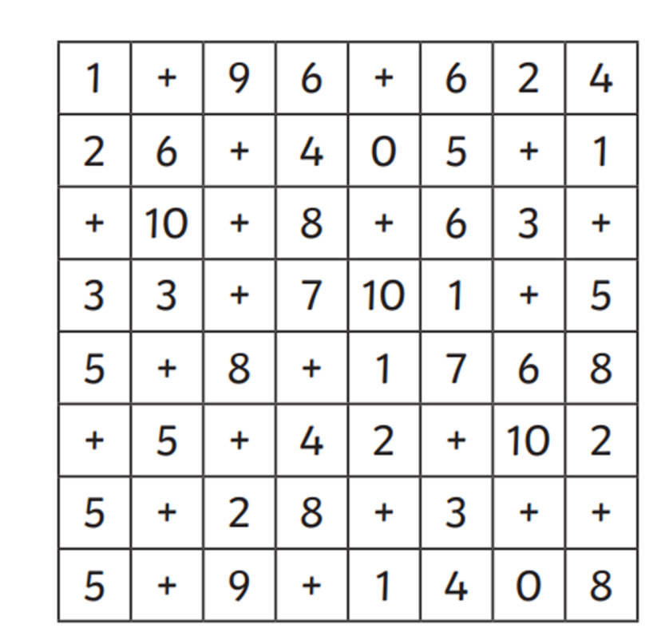
Further Challenge
Can you find all 11 number bond expressions in the grid?
They can be written across, up and down or diagonally.
They must have a + in between the numbers.

Slide 80
Answers

Slide 81
https://www.topmarks.co.uk/maths-games/hit-the-button

