Slide 1
English Home Learning
Week Beginning 04.01.21

Slide 2
This week…
Day 1 – Diary Entries
Day 2 – Features of a diary entry
Day 3 – Chronological Order and Time Conjunctions
Day 4 –Bug Club reading text (Reading Comprehension)
Day 5 – Holiday recount

Slide 3
Day 1 – Diary Entry
What is a diary entry?

Slide 4
Day 1 – Diary Entry
What might a diary entry be used for?

Slide 5
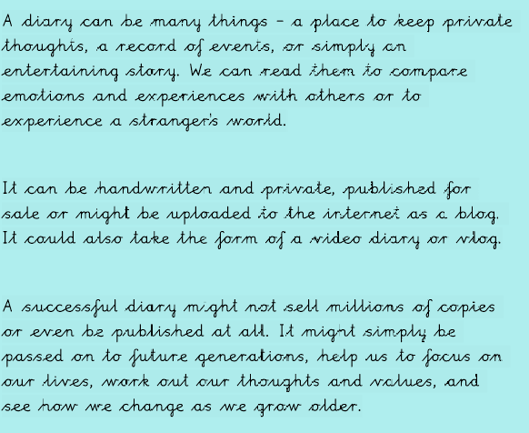
Day 1 – What might a diary entry be used for?
Are you familiar with any successful diary entries?

Slide 6
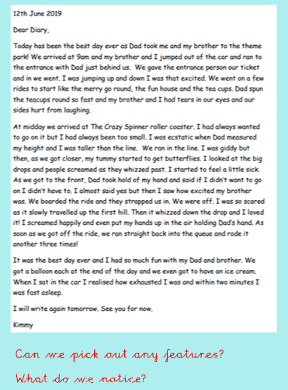
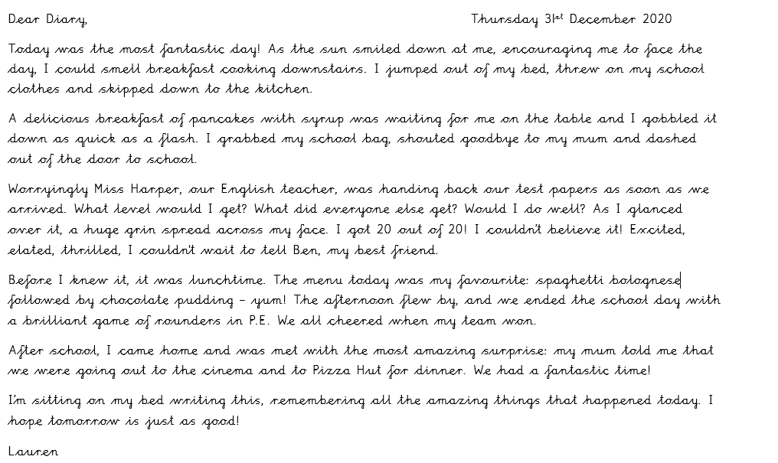
Task – Look at these diary entries. Write down the main features.

Slide 7
Day 2 – What are the features of a diary entry?

Slide 8
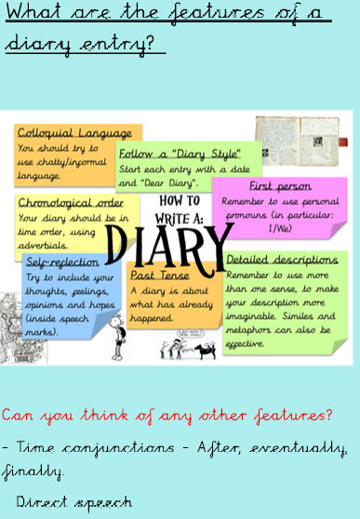
Day 2 - Features of a diary entry
Did you pick out any of these features during the previous session?
Did you know what each of these terms meant?

Slide 9
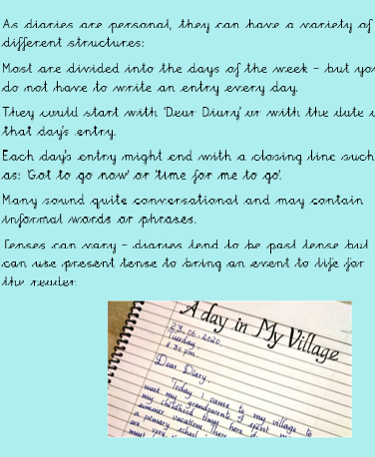
Day 2 – Structuring a diary entry
Did you notice this structure during the previous session?

Slide 10
Day 2 – Structuring a diary entry
Did you notice this structure during the previous session?

Slide 11
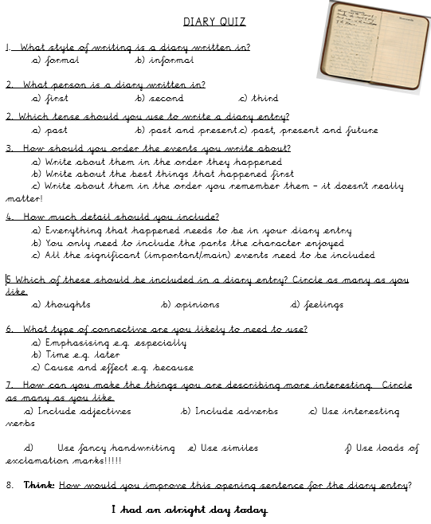
Main Task – Diary Entry Quiz
Apply the knowledge you have gained to answer these questions.

Slide 12
Day 3 – Chronological order and Time Conjunctions
What is chronological order?
What are time conjunctions?

Slide 13
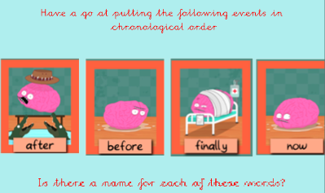
Day 3 – Chronological order
Chronological order is the order in which things happen.
https://www.bbc.co.uk/bitesize/topics/zhk82hv/articles/zydsb82

Slide 14
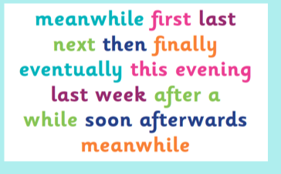
Day 3 – Time conjunctions

Slide 15
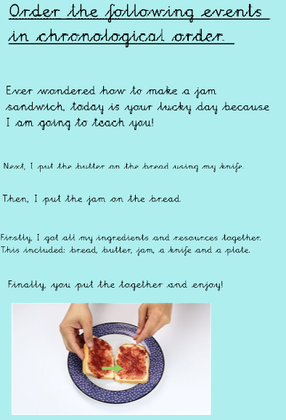
Day 3 – Order the following events in chronological order.
What type of language is being used?

Slide 16
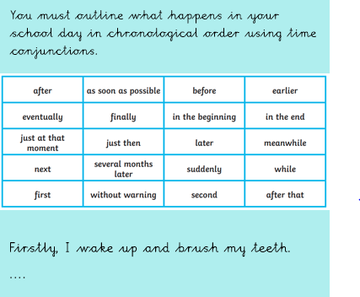
Main Task – Write a diary entry about one of your school days.

Slide 17
Day 4 – Reading comprehension
To be able to understand a text
Answer the following questions on the Bug Club Book : Whose is this?
What type of text is this?
Was your prediction correct?
What is your favourite animal?
Who is the author?
As you read click on the bugs to answer the questions!
https://www.activelearnprimary.co.uk/resources#bugclub

Slide 18
Day 4 – Whose is this?

Slide 19
Day 5 – Write a recount about your holidays!
What is a recount?
A recount retells an experience or an event that happened in the past. The purpose of a recount can be to inform, entertain or to reflect and evaluate. A recount can focus on a specific section of an event or retell the entire story. A recount should always be told in the order that things happened.
Task
Write a recount of your Christmas holidays.

