Slide 1
English Home Learning
Week Beginning 04.01.2020

Slide 2
This week…
Day 1 – Reading Top Cat.
Day 2 – Answering questions about Top Cat.
Day 3 – Phonics letter .
Day 4 – Phonics letter.
Day 5 – Tricky words.

Slide 3
Day 1- Top Cat
Listen and watch the story of Top Cat
https://www.youtube.com/watch?v=u937W7luDiQ

Slide 4
Can you find these words in your book?
top
am
cat
I

Slide 5
Can you write these words into your yellow book?
top
am
cat
I

Slide 6
Don’t forget to email your work to your teacher!
ra@hortongrangeacademy.co.uk –Miss Bedford
rb@hortongrangeacademy.co.uk – Miss Beaumont
rc@hortongrangeacademy.co.uk – Mrs Wilson

Slide 7
Day 2- Questions about Top Cat

Slide 8
Listen and watch the story of Top Cat again.
https://www.youtube.com/watch?v=u937W7luDiQ

Slide 9
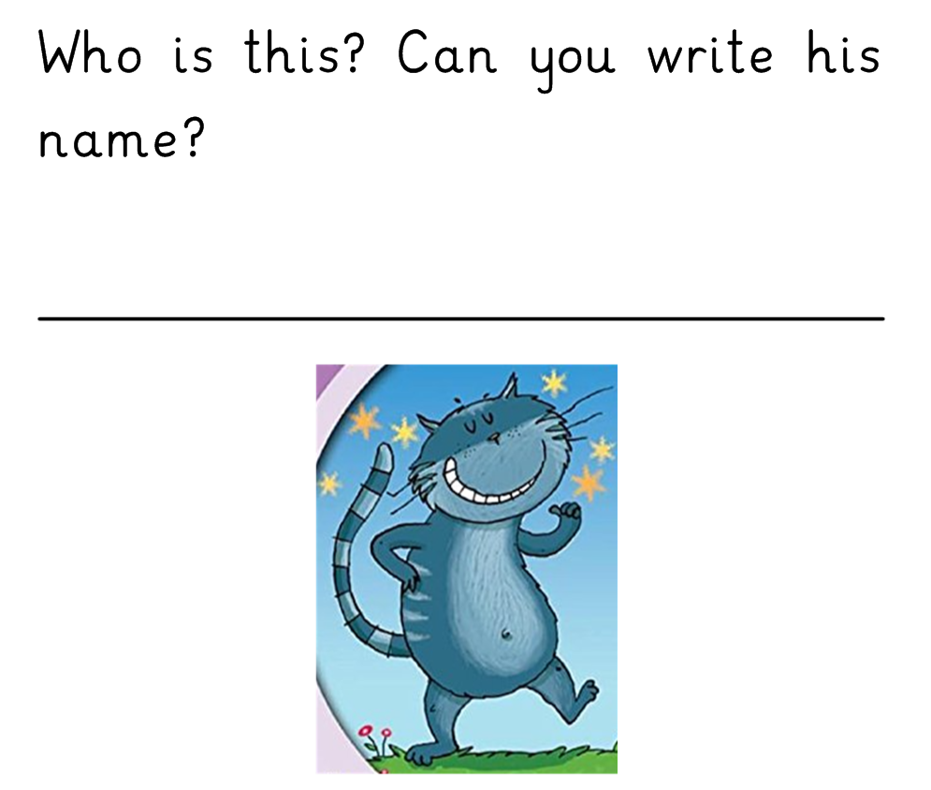

Slide 10
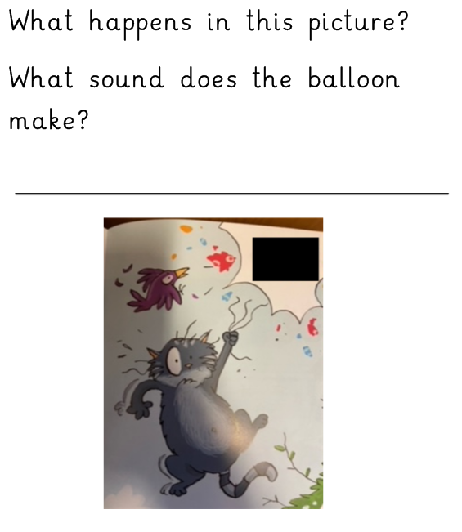

Slide 11
Don’t forget to email your work to your teacher!
ra@hortongrangeacademy.co.uk –Miss Bedford
rb@hortongrangeacademy.co.uk – Miss Beaumont
rc@hortongrangeacademy.co.uk – Mrs Wilson

Slide 12
Day 3- Phonics
Listen to the Jolly Phonics song.
https://www.youtube.com/watch?v=euxN7LGOoLc

Slide 13
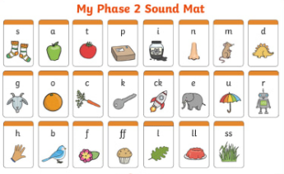
Say all the sounds you can see.

Slide 15
Can you read these words below:
mum run cup mug jug bun

Slide 16
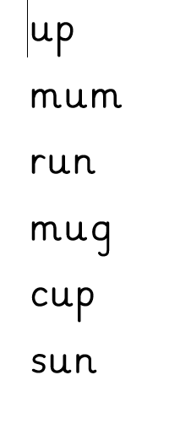
Write these words into your book and put your own sound buttons on them.

Slide 17
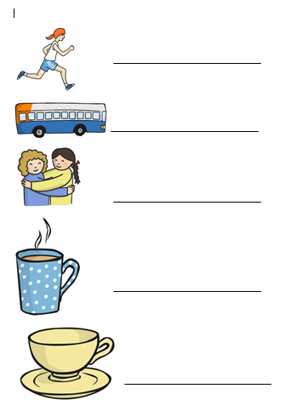
Can you spell these words using your phonics fingers. Write the words in your book and draw the picture at the side.

Slide 18
Do you know any other words that have the letter a in them? Write 3 of your own words that have the letter a and draw a picture of it.

Slide 19
Day 4- Phonics
Listen to the Jolly Phonics song.
https://www.youtube.com/watch?v=euxN7LGOoLc

Slide 20
Say all the sounds you can see.

Slide 22
Can you read these words below:
rug run ram rat rip rim

Slide 23
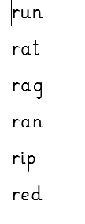
Write these words into your book and put your own sound buttons on them.

Slide 24
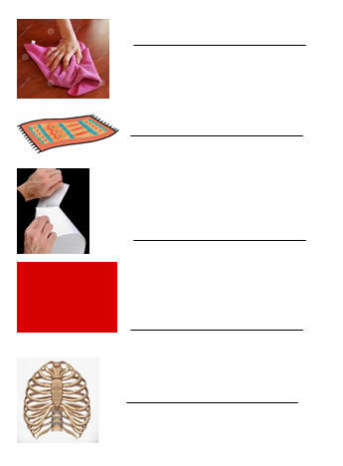
Can you spell these words using your phonics fingers. Write the words in your book and draw the picture at the side.

Slide 25
Do you know any other words that have the letter a in them? Write 3 of your own words that have the letter a and draw a picture of it.

Slide 26
Day 5- Tricky Words
Listen to the Tricky Words song.
https://www.youtube.com/watch?v=TvMyssfAUx0

Slide 27
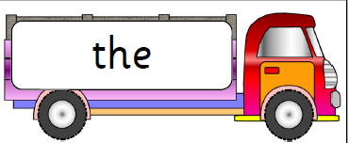
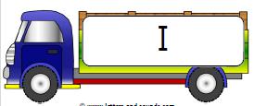
We are learning the tricky words:

Slide 28
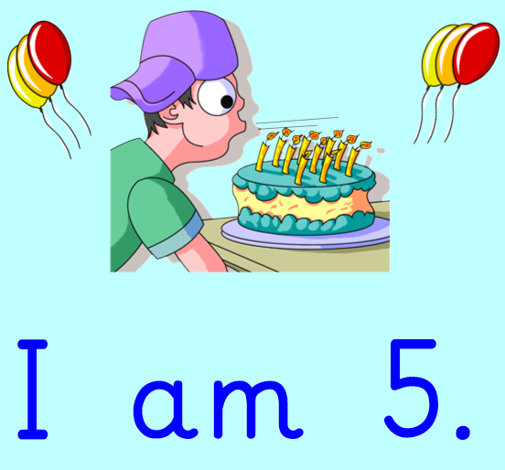
Can you find the tricky word in this sentence?

Slide 29
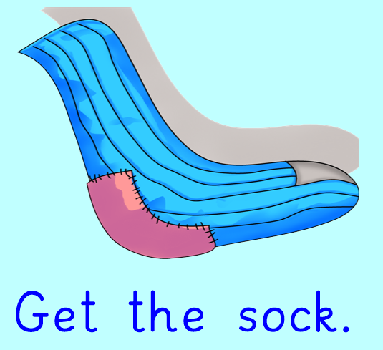
Can you find the tricky word in this sentence?

Slide 30
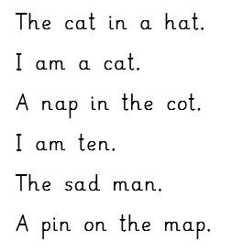
Can you read these sentences?

Slide 31
Can you copy write these sentences into your book?

