Slide 1
Curriculum Home Learning
Week Beginning 11.12.2021

Slide 2
This week…
Day 1 – Types of houses
Day 2 – On your way to school
Day 3 – Walk around your local area
Day 4 – Different types of transport
Day 5 – Transport

Slide 3
Day 1 – Types of houses

Slide 9
Can you answer these questions in your book…
What kind of house do you live in?
Do you know the number of your house? Try and write you door number.
Do you know the street name?
Can you draw a picture of your house?

Slide 10
Don’t forget to email your work to your teacher!
ra@hortongrangeacademy.co.uk – Miss Bedford
rb@hortongrangeacademy.co.uk – Miss Beaumont
rc@hortongrangeacademy.co.uk – Mrs Wilson

Slide 11
Day 2 – On your way to school

Slide 12
Talk to a grown up about what you see on your way to school.

Slide 13
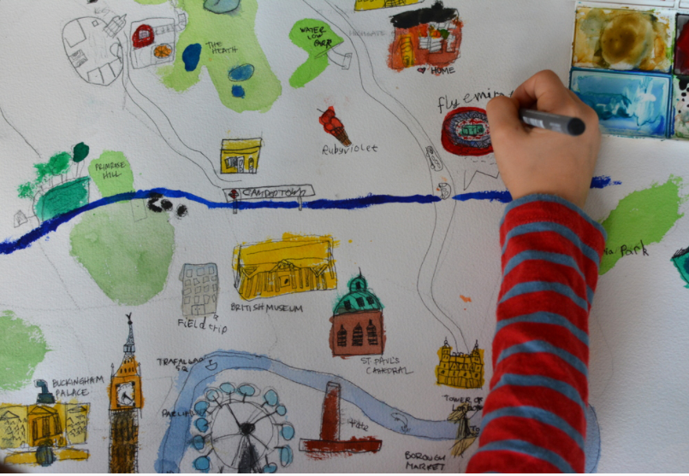
Draw a map of your way to school and plot some of the places you see.

Slide 14
Don’t forget to email your work to your teacher!
ra@hortongrangeacademy.co.uk – Miss Bedford
rb@hortongrangeacademy.co.uk – Miss Beaumont
rc@hortongrangeacademy.co.uk – Mrs Wilson

Slide 15
Day 3 – Walk around your local area

Slide 16
Take your map on a walk around your local area.
Is there anything that you didn’t draw on your map? Add that now.
Challenge: Can you add some street names to your map.

Slide 17
Don’t forget to email your work to your teacher!
ra@hortongrangeacademy.co.uk – Miss Bedford
rb@hortongrangeacademy.co.uk – Miss Beaumont
rc@hortongrangeacademy.co.uk – Mrs Wilson

Slide 18
Day 4 – Different types of transport See the next slide for a video of the lesson.

Slide 19
Use the link to see the live lesson. https://youtu.be/r_n2TL1-ex8

Slide 20
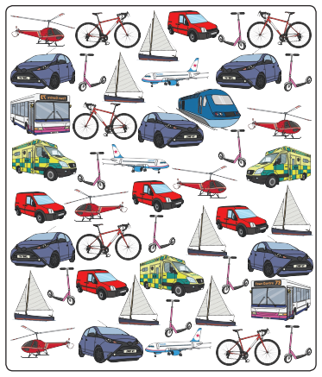
Can you count all the … helicopters cars trains ambulances vans bikes scooters aeroplanes buses boats
Write the answers
In your books.

Slide 21
Don’t forget to email your work to your teacher!
ra@hortongrangeacademy.co.uk – Miss Bedford
rb@hortongrangeacademy.co.uk – Miss Beaumont
rc@hortongrangeacademy.co.uk – Mrs Wilson

Slide 22
Day 5 – Transport

Slide 23
In your books …..
How do you travel to school?
What sort of transport do you see on the way?
Can you write the words and draw a picture?

Slide 24
Don’t forget to email your work to your teacher!
ra@hortongrangeacademy.co.uk – Miss Bedford
rb@hortongrangeacademy.co.uk – Miss Beaumont
rc@hortongrangeacademy.co.uk – Mrs Wilson

