Slide 1
Curriculum
Week Commencing: 11.01.2021

Slide 2
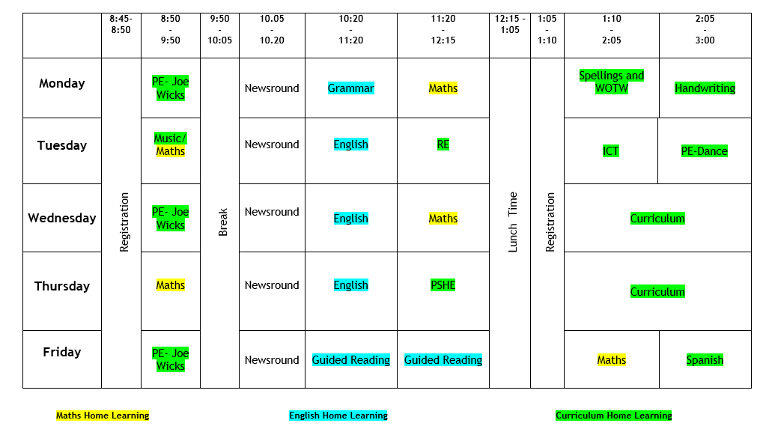

Slide 3
Monday- 9am- PE with Joe Wicks
Use the link below to access the live channel at 9am:
https://www.youtube.com/channel/UCAxW1XT0iEJo0TYlRfn6rYQ

Slide 4
Monday- 1pm- Spellings and
Words of the week

Slide 5
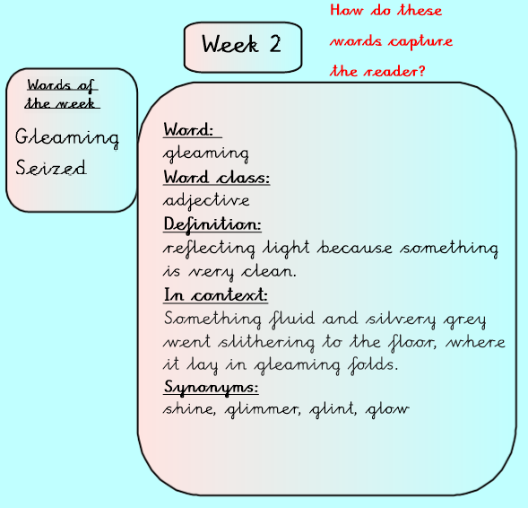
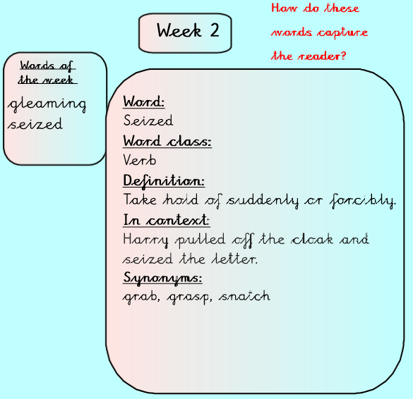
Monday- 1pm- Spellings and
Words of the week
Can you think of 3 sentences with each words?
How do these words capture the reader?

Slide 6
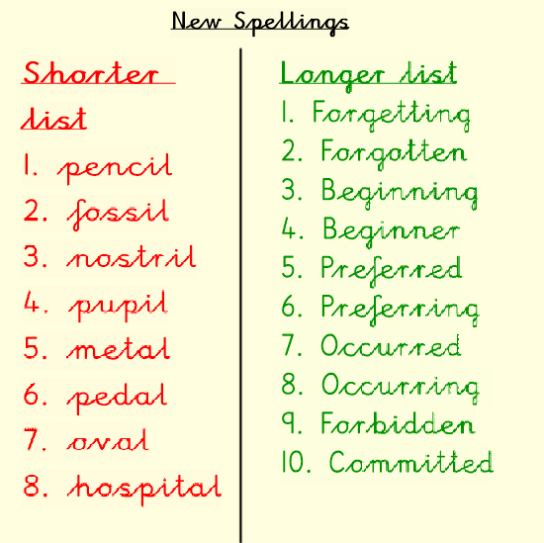
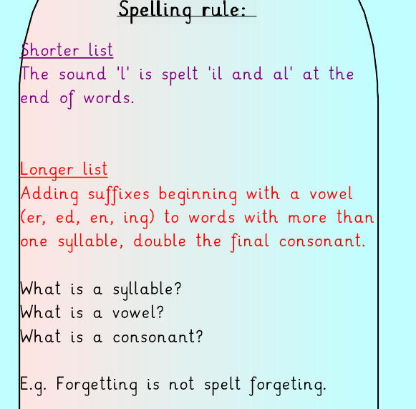
Monday- 1pm- Spellings and
Words of the week
Learn these spellings for next weeks spelling test!
Put each word into a sentence!

Slide 7
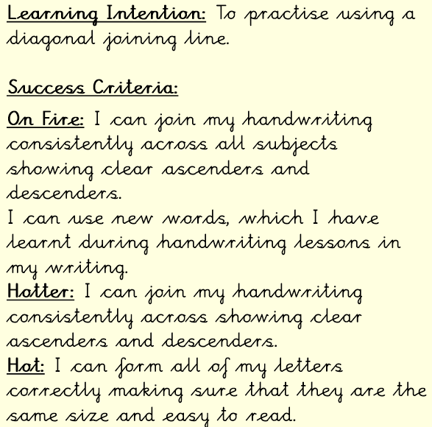
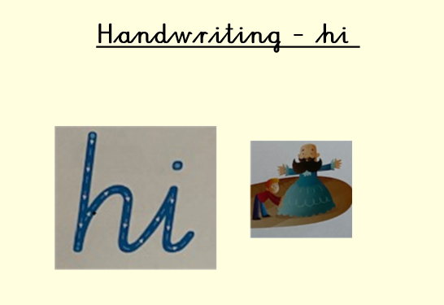
Monday- 2pm- Handwriting

Slide 8
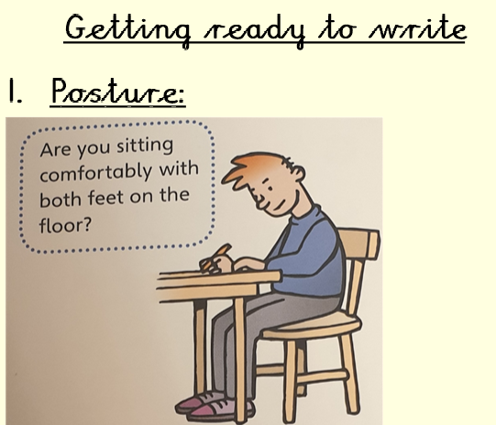
Monday- 2pm- Handwriting

Slide 9
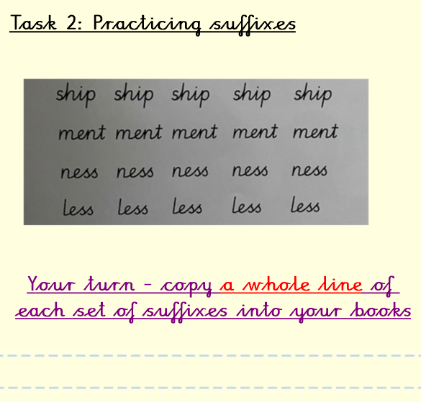
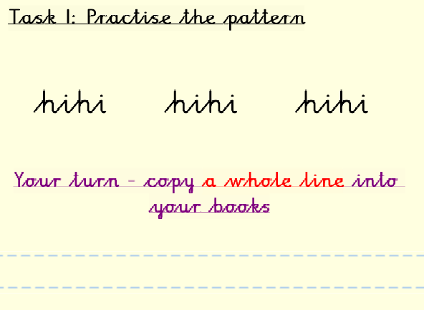
Monday- 2pm- Handwriting
What is a suffix?

Slide 10
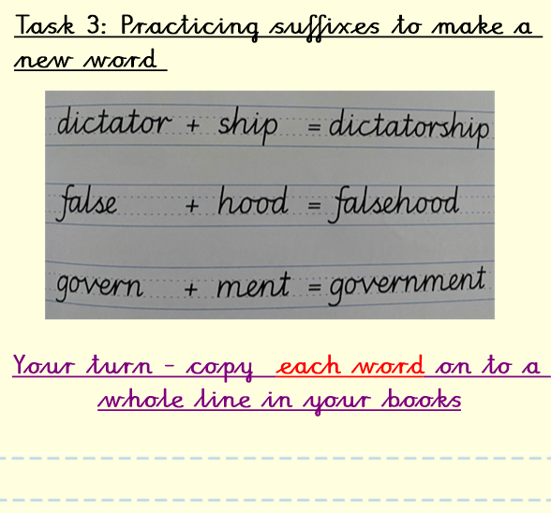
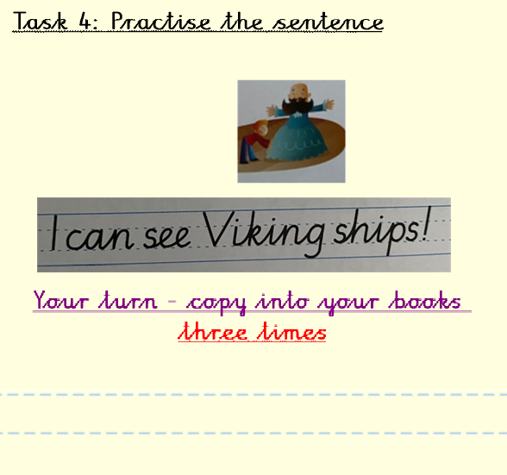
Monday- 2pm- Handwriting

Slide 11
Monday- 2pm- Handwriting

Slide 12
Tuesday- 9am- Singing- Join in
Use the link below to access the live channel at 9am:
https://www.youtube.com/singup

Slide 13
Tuesday- 11.20am- RE

Slide 14
Tuesday- 11.20am- RE

Slide 15
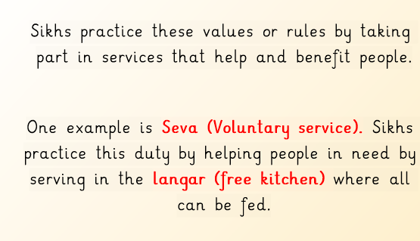
Tuesday- 11.20am- RE
Watch the video below for more information:
https://www.bbc.co.uk/bitesize/clips/z36tvcw

Slide 16
Tuesday- 11.20am- RE

Slide 17
Tuesday- 11.20am- RE
Answers

Slide 18
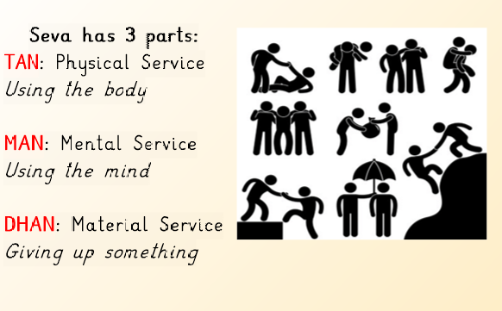
Tuesday- 11.20am- RE
Watch the video below to learn about different types of Seva at the gurdwara:
https://www.youtube.com/watch?v=zi6i_fNEgZU

Slide 19
Tuesday- 11.20am- RE

Slide 20
Tuesday- 11.20am- RE

Slide 21
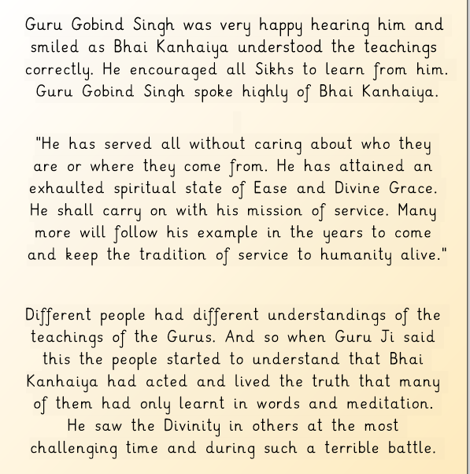
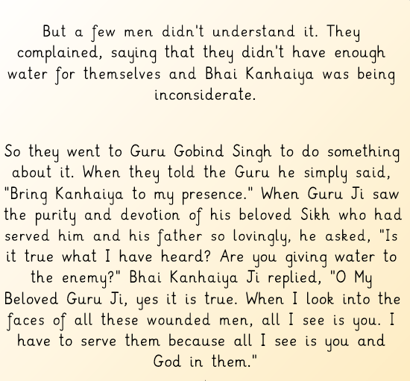
Tuesday- 11.20am- RE

Slide 22
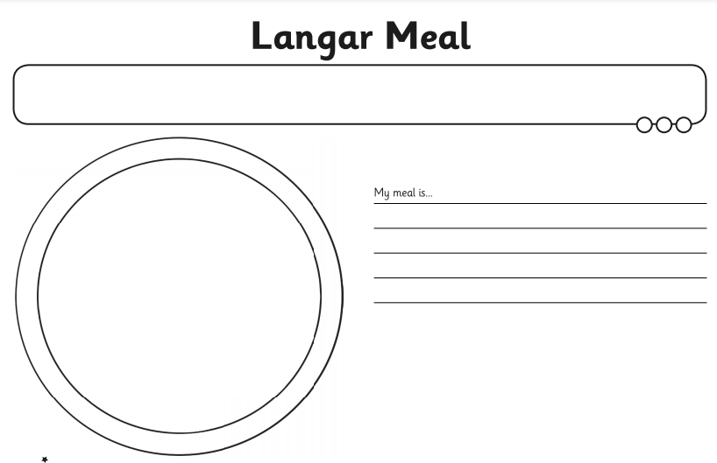
Tuesday- 11.20am- RE Main Task

Slide 23
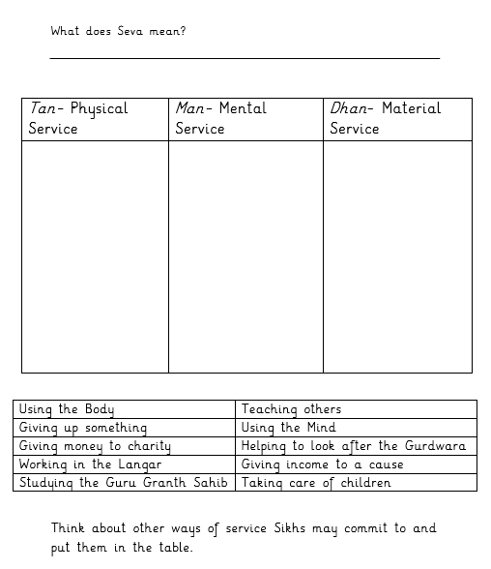
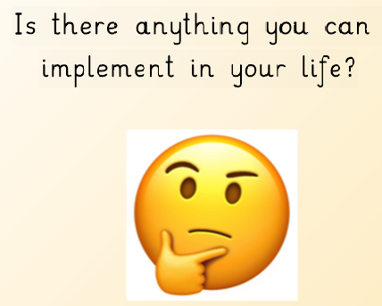
Tuesday- 11.20am- RE
ON FIRE
HOTTER

Slide 24
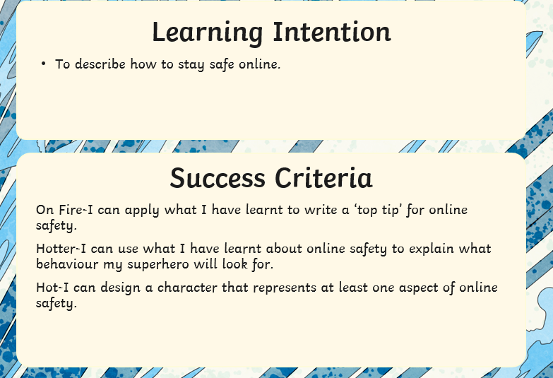
Tuesday- 1pm- ICT

Slide 25
Tuesday- 1pm- ICT

Slide 26
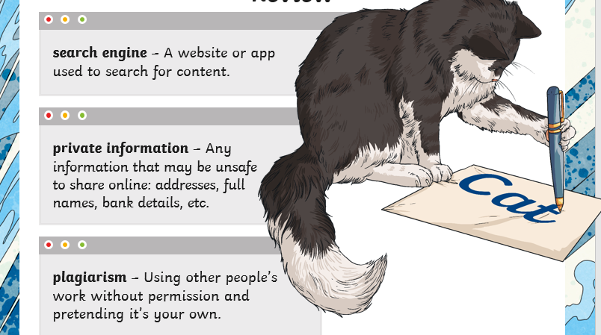
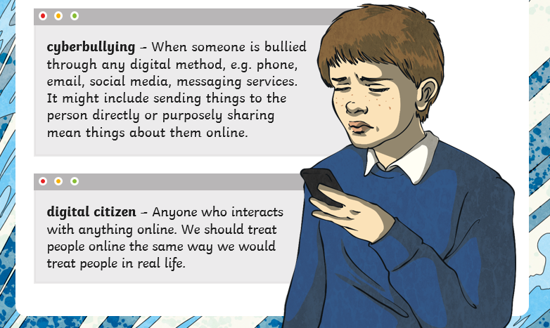
Tuesday- 1pm- ICT- Answers

Slide 27
Tuesday- 1pm- ICT

Slide 28
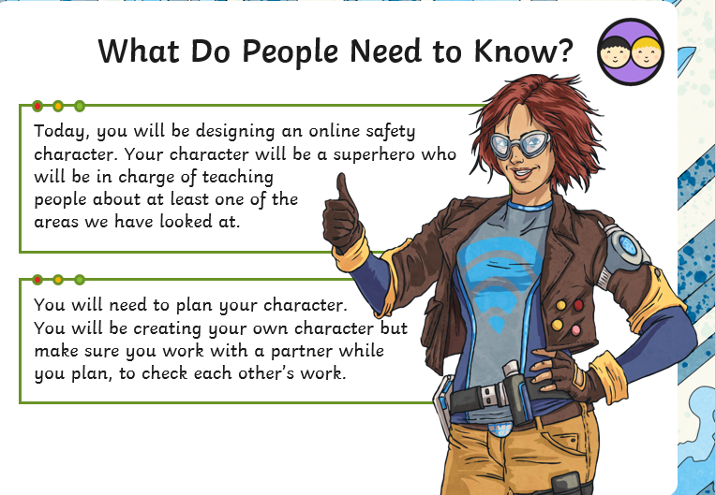
Tuesday- 1pm- ICT- Task

Slide 29
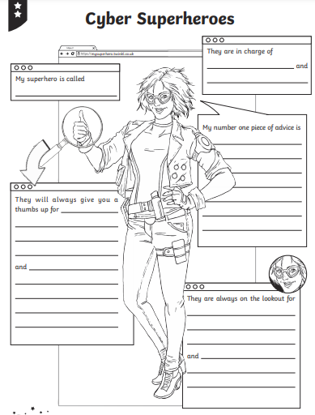
Tuesday- 1pm- ICT- Task
Your character can look how you want it to.
Remember the most important thing is the message you are conveying!

Slide 30
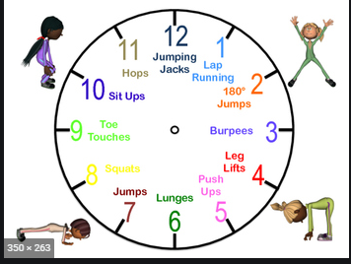
Tuesday- 2pm- PE
Remember to WARM UP
Why is it important to warm up?
What happens to our heart?
What else should we do to our muscles?

Slide 31
Tuesday- 2pm- PE-
Choose which activity you would like to complete.
You can pick more than one if you wish!
Get your family to join in.

Slide 32
Tuesday- 2pm- PE

Slide 33
Tuesday- 2pm- PE

Slide 34
Tuesday- 2pm- PE

Slide 35
Tuesday- 2pm- PE

Slide 36
Tuesday- 2pm- PE

Slide 37
Wednesday- 9am- PE with Joe
Wicks
Use the link below to access the live channel at 9am:
https://www.youtube.com/channel/UCAxW1XT0iEJo0TYlRfn6rYQ

Slide 38
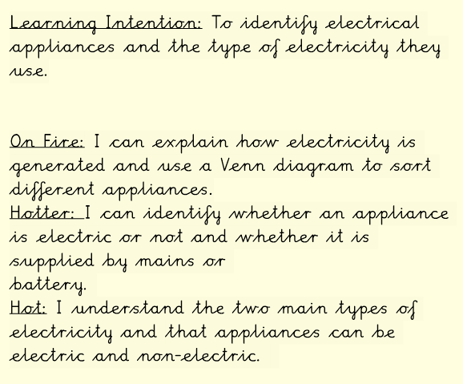
Wednesday- 1-3pm- Science

Slide 39
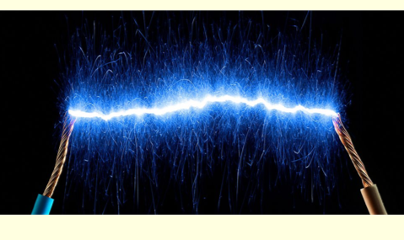
Wednesday- 1-3pm- Science
Watch this video to find out more:
https://www.bbc.co.uk/bitesize/topics/z2882hv/articles/zcwnv9q

Slide 40
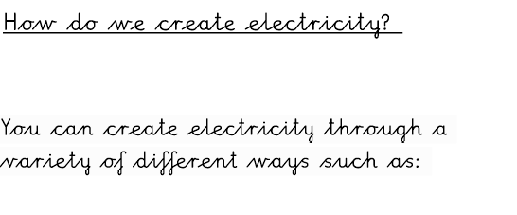
Wednesday- 1-3pm- Science

Slide 41
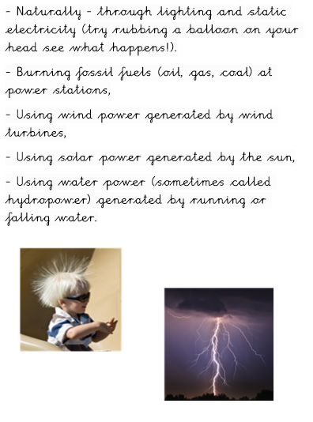
Wednesday- 1-3pm- Science

Slide 42
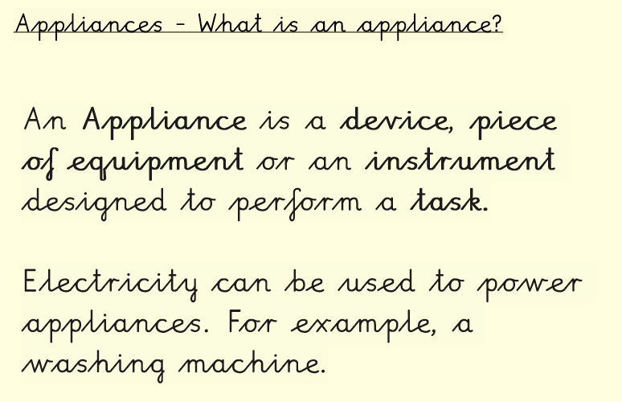
Wednesday- 1-3pm- Science
Create a table to write your answers.

Slide 43
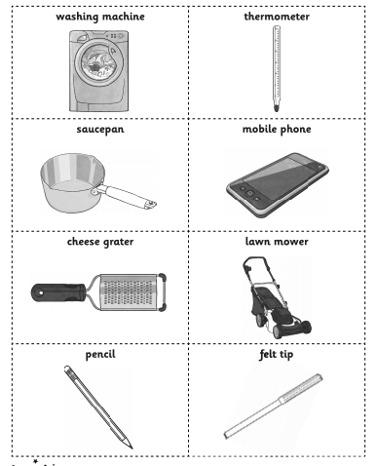
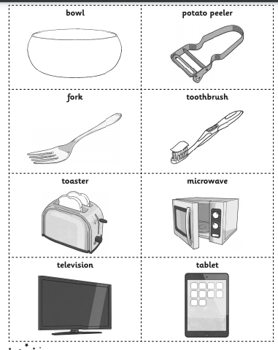
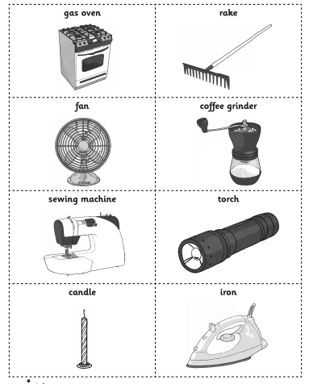
Wednesday- 1-3pm- Science

Slide 44
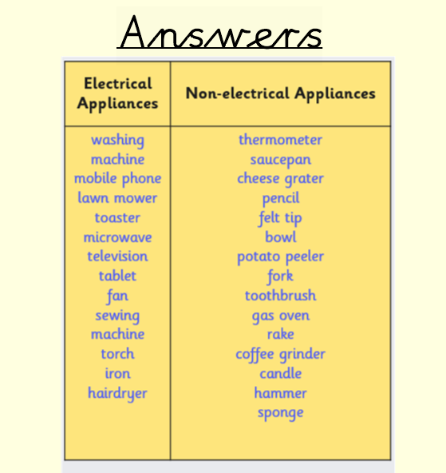
Wednesday- 1-3pm- Science

Slide 45
Wednesday- 1-3pm- Science

Slide 46
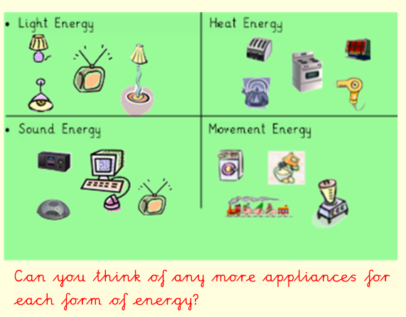
Wednesday- 1-3pm- Science

Slide 47
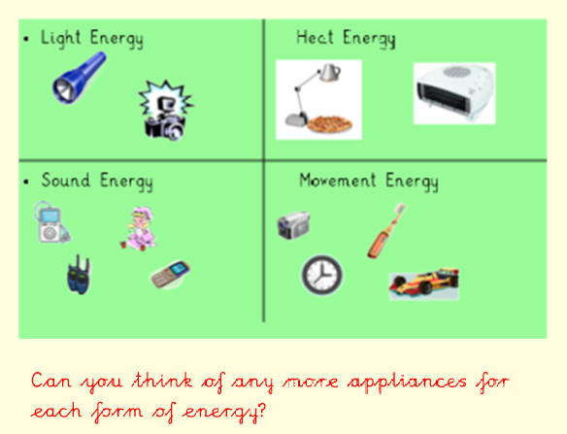
Wednesday- 1-3pm- Science

Slide 48
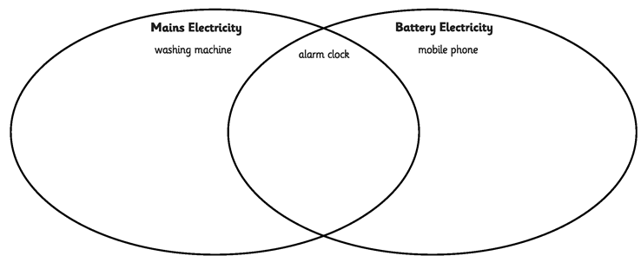
Wednesday- 1-3pm- Science Task
Use the starter cards to complete the Venn Diagram.
Can you think of anymore?

Slide 49
Thursday- 11.20am- PSHE
For the PSHE lesson you will be able to listen to the input by a teacher.
On the next slide if you hover over the page you will see a play button to start.
Remember:
You can pause when a question is asked if you need more time.
You can pause if you need to write anything.
You will be able to see the slides referred to after the recording has stopped. This will enable you to access the task on the slides after it.
You can send pictures of your work after you have completed the work.
Try to answer questions in as much detail in your yellow home learning book!

Slide 51
Thursday- 11.20am- PSHE

Slide 52
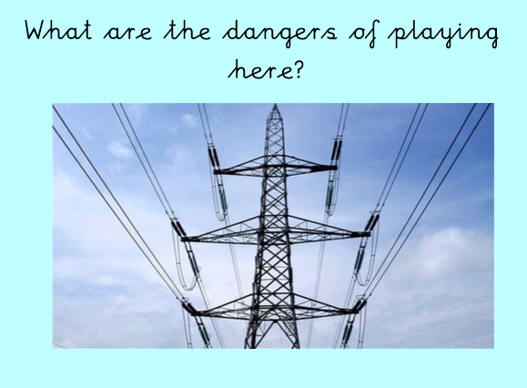
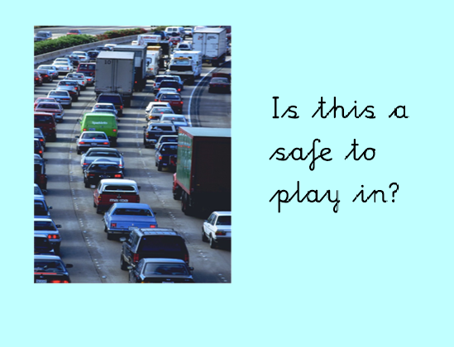
Thursday- 11.20am- PSHE

Slide 53
Thursday- 11.20am- PSHE

Slide 54
Thursday- 11.20am- PSHE- TASK
Identify the risk in each picture.
2. Is there a risk in each one?
3. What could happen if we don’t manage this risk?

Slide 55
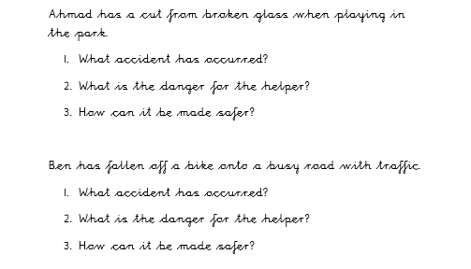
Thursday- 11.20am- PSHE- TASK

Slide 56
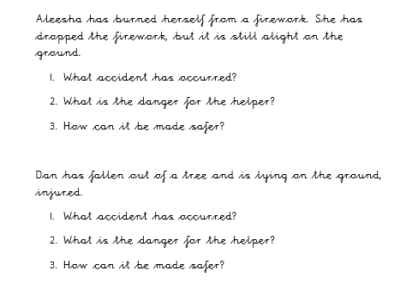
Thursday- 11.20am- PSHE- TASK

Slide 57
Thursday- 1-3pm- Science

Slide 58
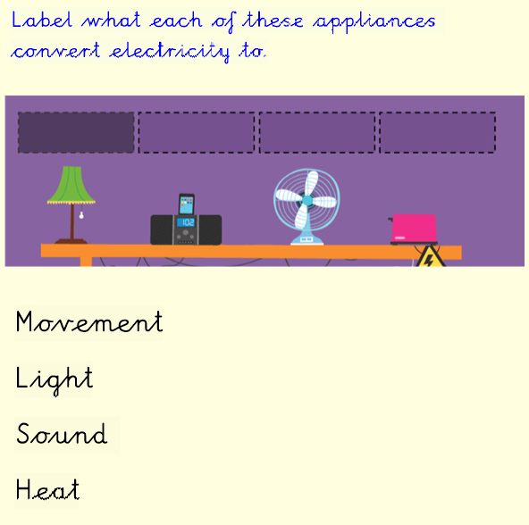
Thursday- 1-3pm- Science Recap

Slide 59
Thursday- 1-3pm- Science
https://www.bbc.co.uk/bitesize/topics/z2882hv/articles/zxv482p
Watch this video and make notes on what you learn!

Slide 60
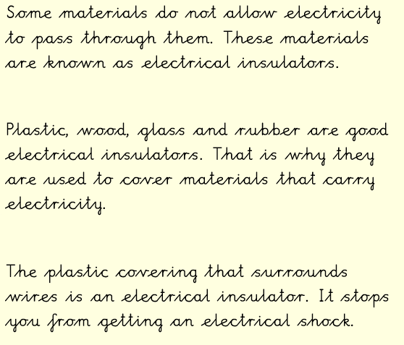
Thursday- 1-3pm- Science

Slide 61
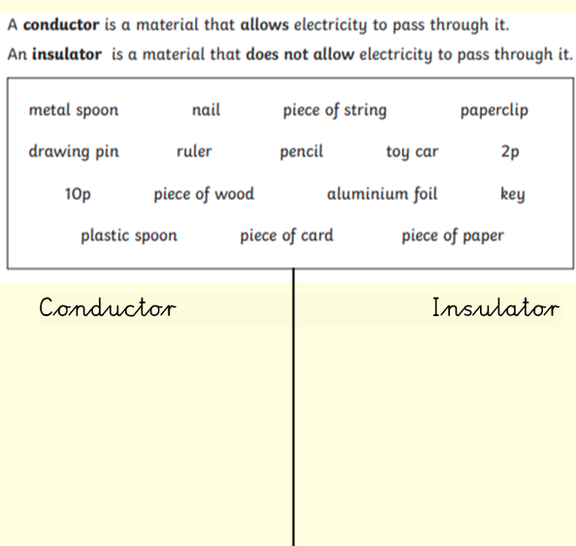
Thursday- 1-3pm- Science Task

Slide 62
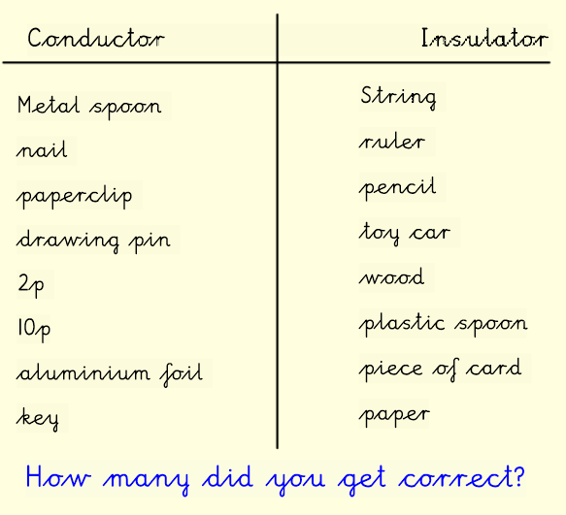
Thursday- 1-3pm- Science ANSWERS

Slide 63
Thursday- 1-3pm- Science Challenge

Slide 64
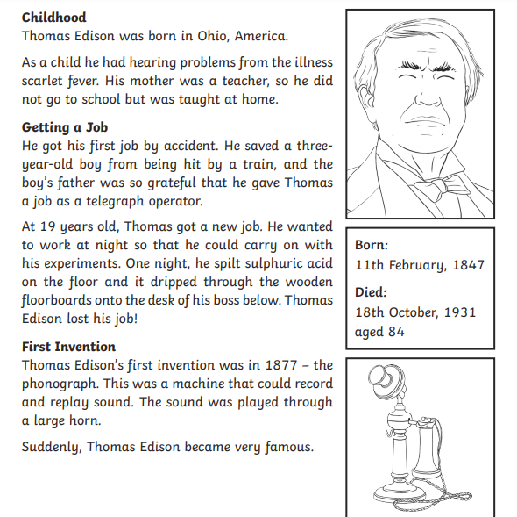
Thursday- 1-3pm- Science ANSWERS

Slide 65
Friday- 9am- PE with Joe
Wicks
Use the link below to access the live channel at 9am:
https://www.youtube.com/channel/UCAxW1XT0iEJo0TYlRfn6rYQ

Slide 66
Friday- 2pm- Spanish

Slide 67
Friday- 2pm- Spanish

Slide 68
Friday- 2pm- Spanish

Slide 69
Friday- 2pm- Spanish

Slide 70
Friday- 2pm- Spanish

Slide 71
Friday- 2pm- Spanish- TASK

Slide 72
Friday- 2pm- Spanish Support Sheet
EXAMPLE

