Slide 1
Maths Home Learning
Week Beginning 14.12.20

Slide 2
This week…
Day 1 – Arithmetic: test
Day 2 – Adding and subtracting mixed numbers
Day 3 - Adding and subtracting mixed numbers
Day 4 – Christmas Maths activity

Slide 3
This week we will be practising our 8 time tables
Listen to the video, practise chanting and play the games to practise. What score can you reach?
https://www.timestables.co.uk/8-times-table.html
https://www.topmarks.co.uk/maths-games/hit-the-button

Slide 4
Day 1
Complete the following arithmetic test in 30 minutes and then check your answers. Identify what you need to work on over the holidays.

Slide 5
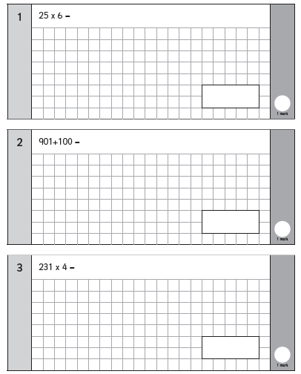
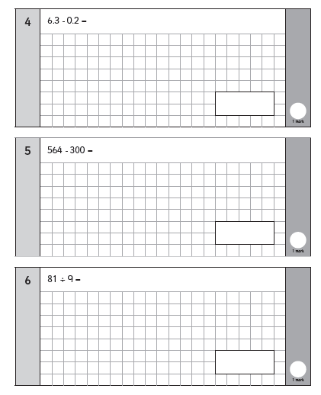
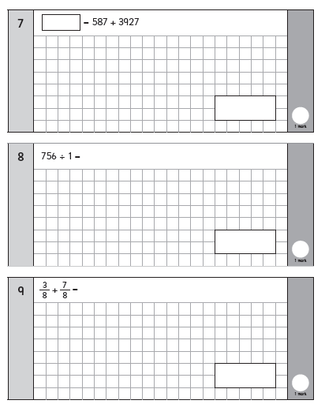

Slide 6
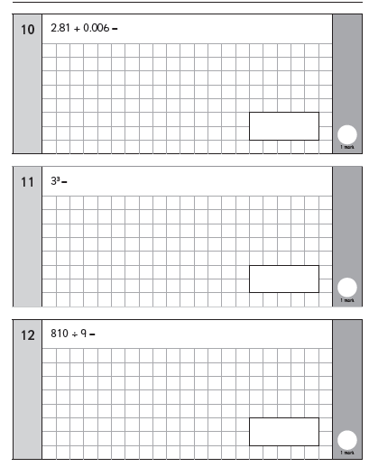
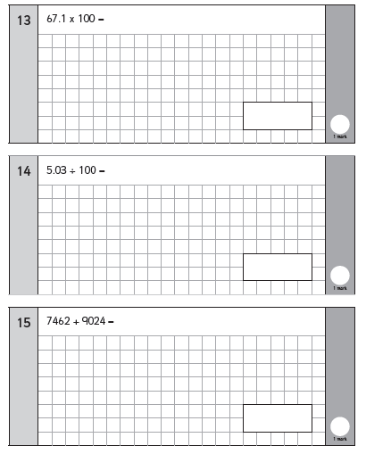
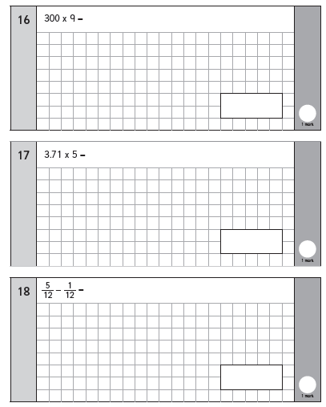

Slide 7
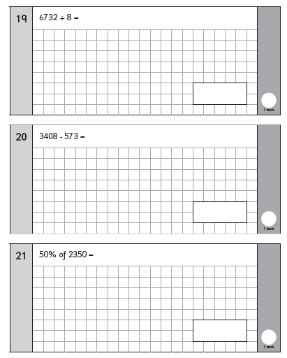
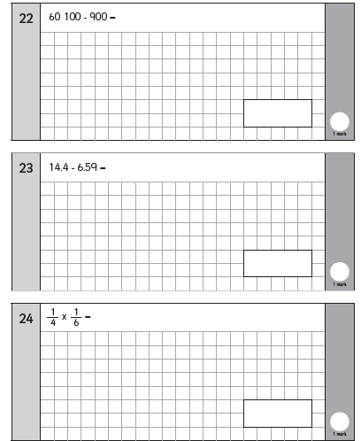
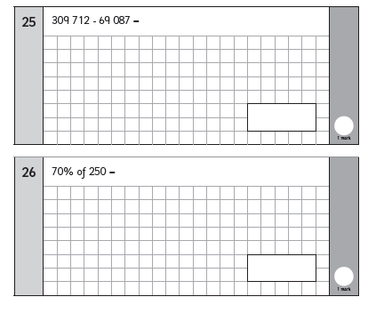

Slide 8
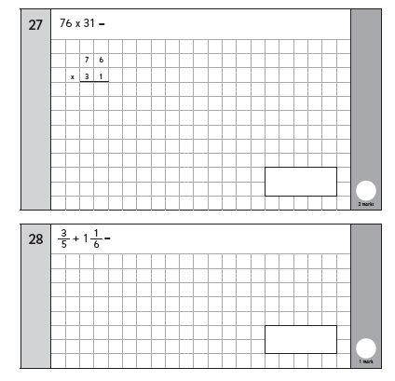
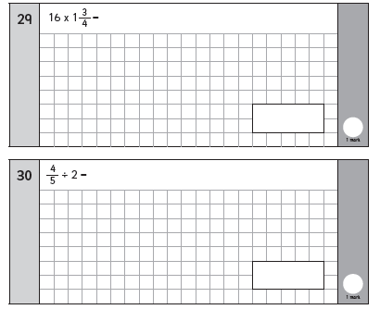

Slide 9
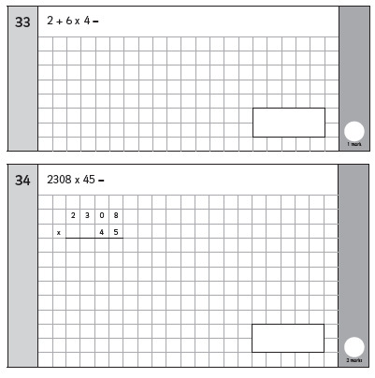
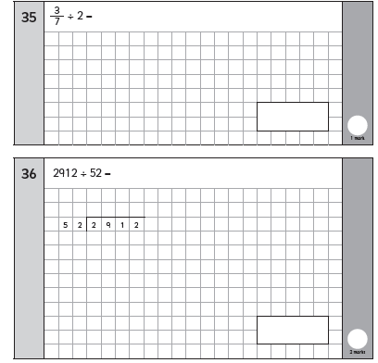

Slide 10
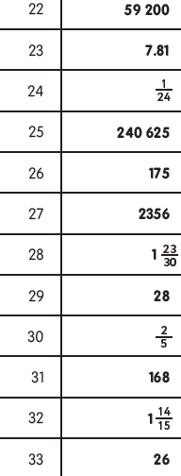
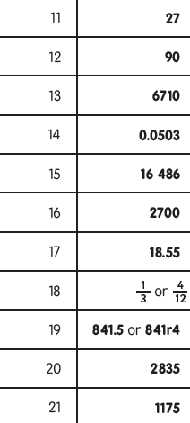
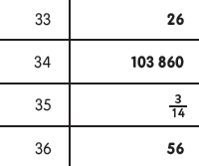
Answers

Slide 11
Day 2 – Adding and subtracting fractions

Slide 15
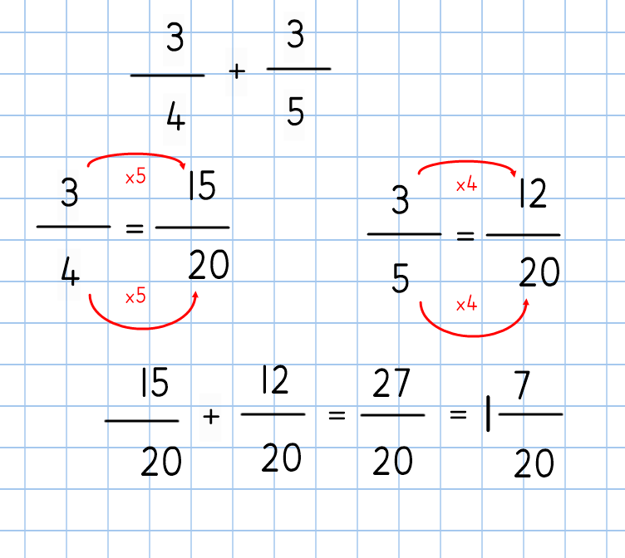

Slide 18
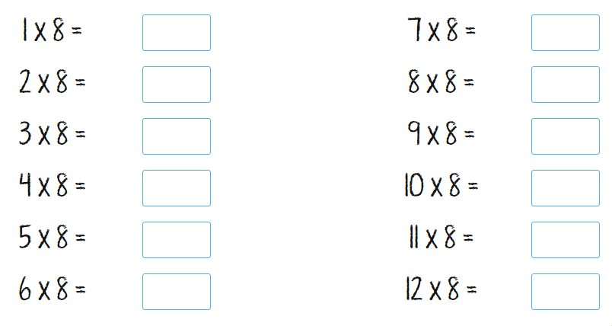
Can you answer these multiplication facts?

Slide 19
Day 3 – Adding and subtracting mixed numbers

Slide 21
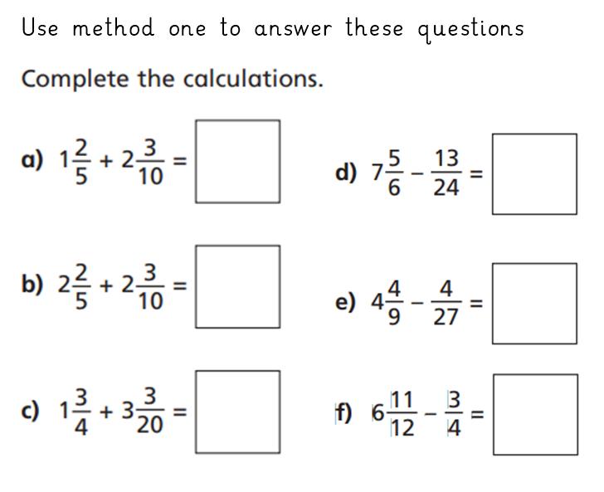

Slide 23
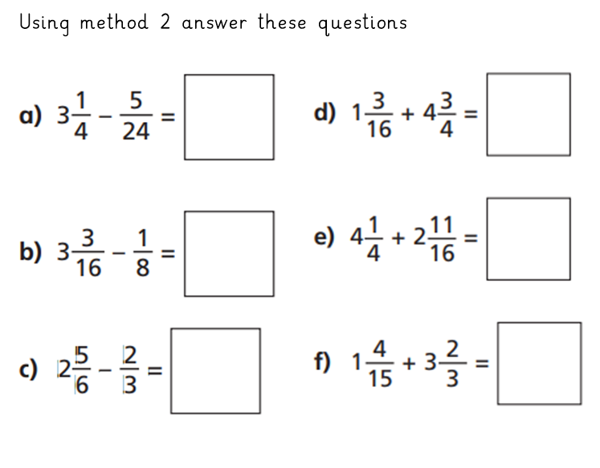

Slide 24
Day 4 – Christmas maths
Print the following slide and follow the rules to colour a Christmas picture!

Slide 25
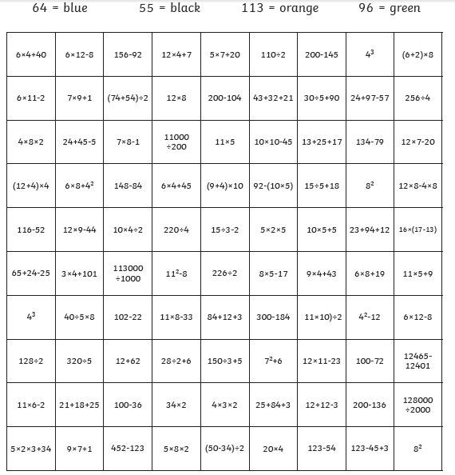

Slide 26
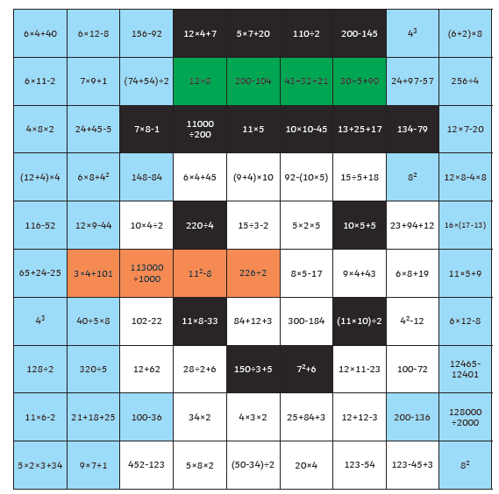
Answer – did you get it right?

