Slide 1
Maths Home Learning
Week Beginning 7.12.2020

Slide 2
This week… We will learn:
Day 1 – Measuring Mass
Day 2 – Adding and Subtracting Mass
Day 3 – Measuring Capacity
Day 4 – Adding and Subtracting Capacity
Day 5 – Time

Slide 3
Arithmetic
Let’s learn our x 6 tables
Sing along!
https://www.youtube.com/watch?v=f2JdnZbB2dg

Slide 4
Day 1 – Mass
Today pupils will learn about mass.
How is mass measured?
What does mass look like?

Slide 5
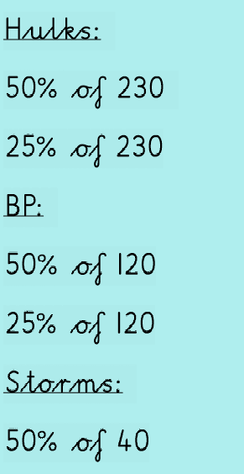
OMS Starter
How do we calculate percentages?
https://www.bbc.co.uk/bitesize/topics/znjqtfr/articles/zcfyw6f

Slide 7
Can you think of any more items that can be measured in grams and kilograms?

Slide 8
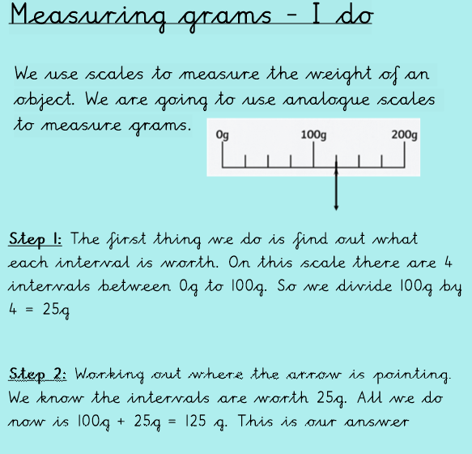
Measuring mass - I do
Is there another way in which this can be done?

Slide 9
Measuring grams – We do
Follow the steps. What is your answer?
Would you be able to convert your answer into kilograms?

Slide 10
Measuring grams– We do answers
Did you work this out correctly?

Slide 11
You do
Remember to follow the steps correctly.

Slide 12
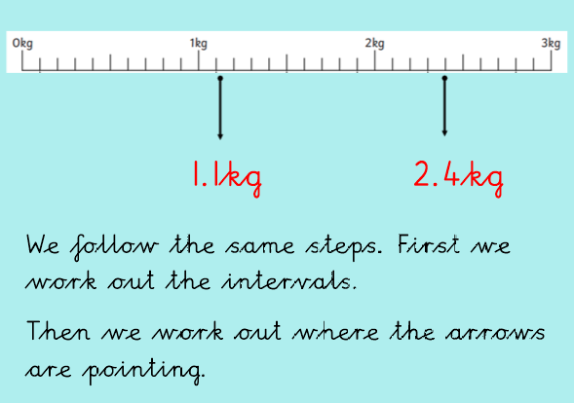
You do – Answers
Could you convert your answers into grams?

Slide 13
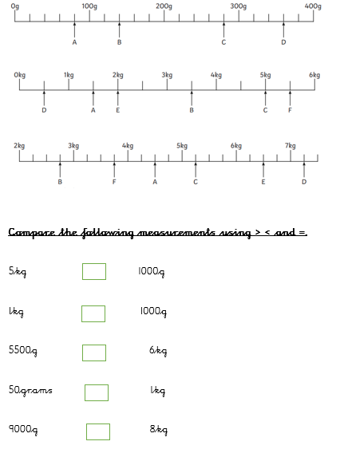
Main task and Challenges

Slide 14
Day 2 – Adding and Subtracting mass
Can you remember what we learnt about yesterday?
What is mass?
How can it be measured?
Today we will learn how to add and subtract mass.

Slide 15
Arithmetic
Let’s learn our x 8 tables
Sing along!
https://www.youtube.com/watch?v=kN3RG5iLKpo

Slide 16
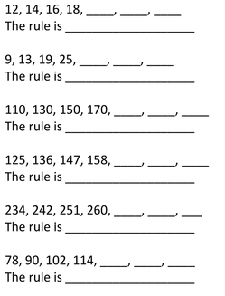
OMS:
I can describe the number pattern.
Remember to write in full sentences.

Slide 17
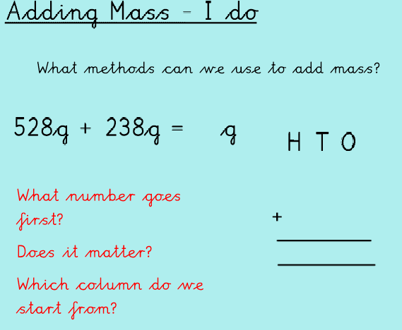
Adding mass – I do
Remember we always start with the ones column.
We leave a space above our top numbers.
With adding it does not matter if the smaller number goes on top.

Slide 18
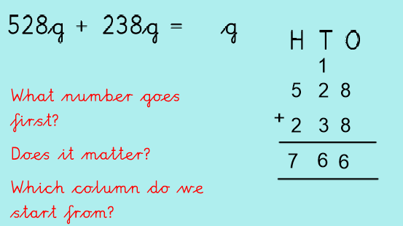
Adding mass – We do answers

Slide 19
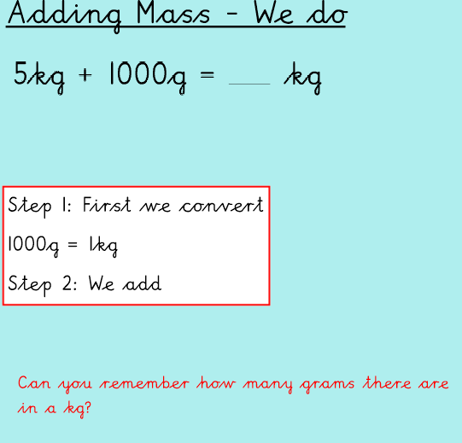
Answer
5kg + 1kg = 6kg

Slide 20
Subtracting mass – I do
We always start with the ones column.
We always put the bigger number first.

Slide 21
Subtracting mass - I do answers

Slide 22
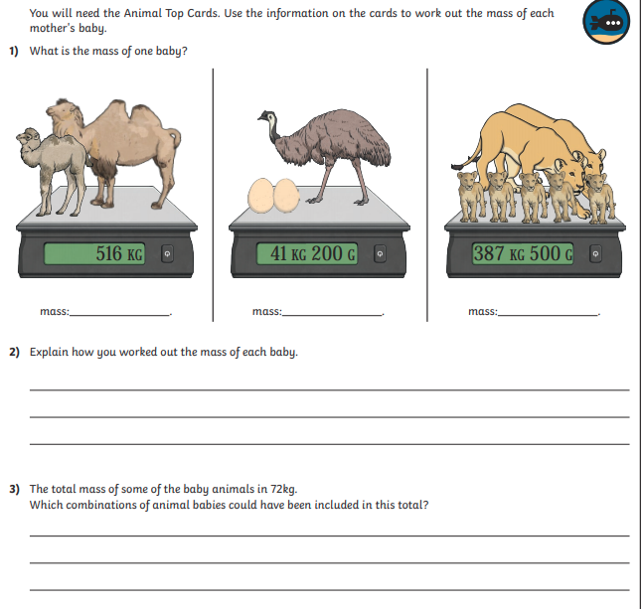
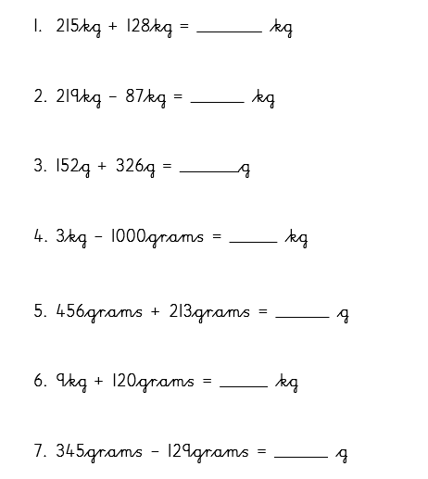
Day 2 – Main Task and challenges

Slide 23
Day 3 – Measuring capacity
What is capacity?
How can it be measured?
Today we will learn how to measure capacity.

Slide 24
Arithmetic
Let’s learn our x 8 tables
Sing along!
https://www.youtube.com/watch?v=kN3RG5iLKpo

Slide 25
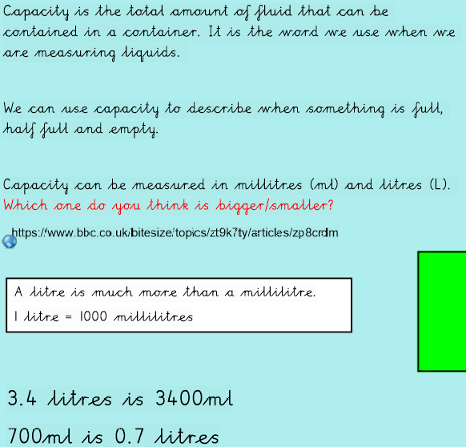
What is capacity?
Watch:
https://www.bbc.co.uk/bitesize/topics/zt9k7ty/articles/zp8crdm

Slide 26
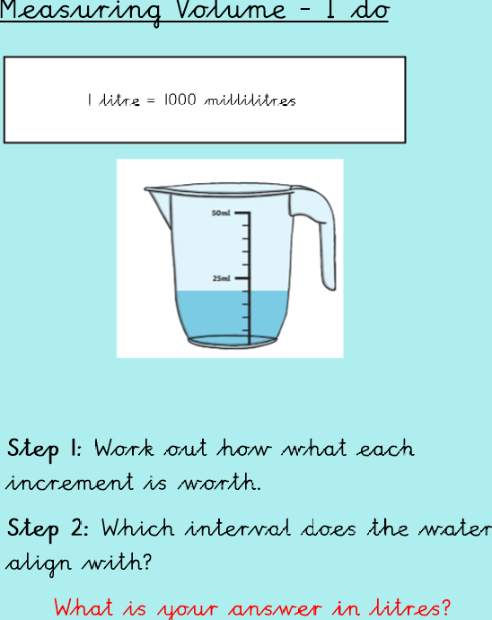
Measuring Capacity – I do
Step 1: first we work out what each increment is worth. I can see that there are 5. 25ml divided by 5 gives me 5ml.
Each increment is worth 5ml.
Step 2: I can see that the water aligns with 20ml.
Answer: 20ml

Slide 27
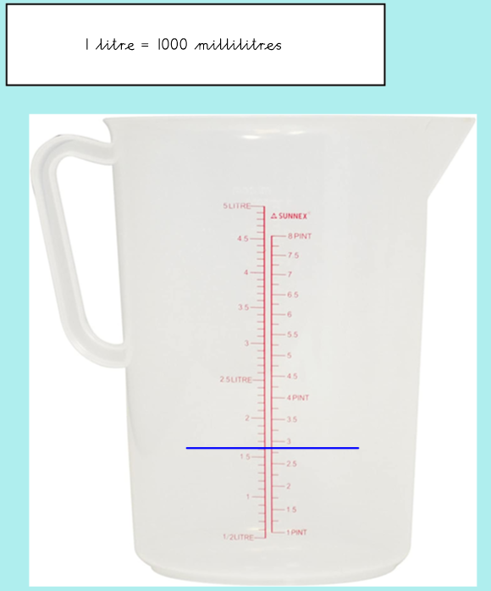
Measuring Capacity – We do
Step 1: Work out how what each increment is worth.
Step 2: Which interval does the line align with?

Slide 28
Measuring Capacity – We do answers
Answer: 1.6 litres

Slide 29
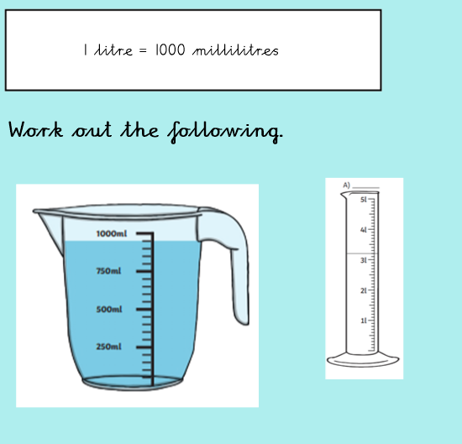
Measuring Capacity – You do
Remember to follow the steps!

Slide 30
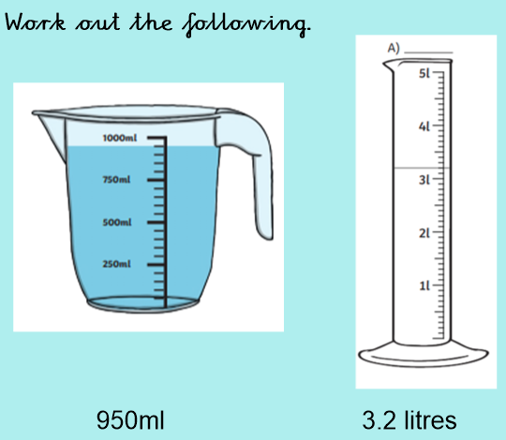
Measuring Capacity – You do answers
Did you follow the steps?
Were you correct?

Slide 31
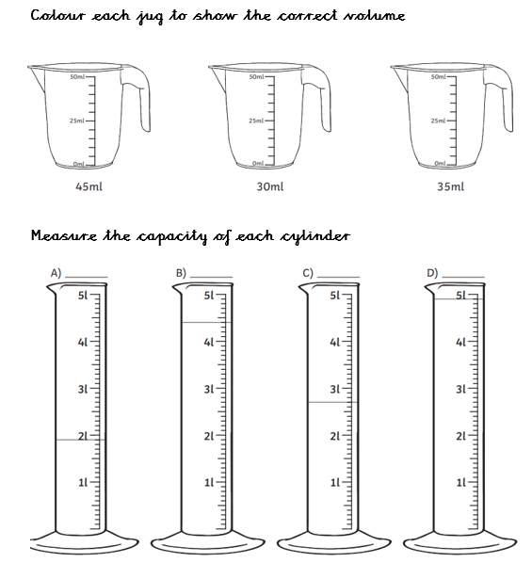
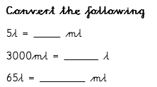
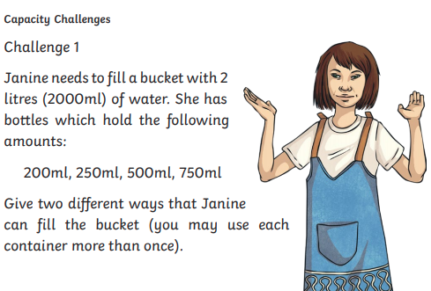
Main Task and Challenges

Slide 32
Day 4 – Adding and subtracting capacity.
Today we will continue to look at capacity. Adding and subtracting.
What is capacity?
How can it be measured?

Slide 33
Arithmetic
Use the link below to play hit the button for your 7 times table practice.
https://www.topmarks.co.uk/maths-games/hit-the-button

Slide 34
Recap – Capacity
Can you remember how to convert?

Slide 35
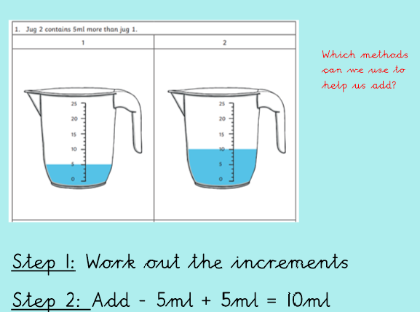
I do
If jug one has 5ml and jug 2 has 5ml more. It must be 10ml!
Can you convert this?

Slide 36
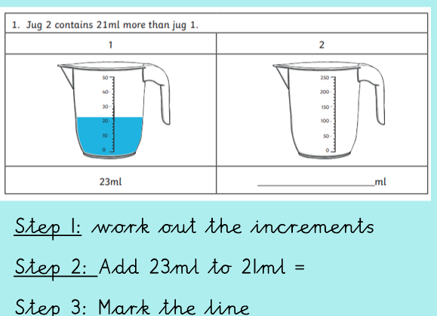
We do
Follow each of the steps to get your answer.
What do you notice about the jugs?

Slide 37
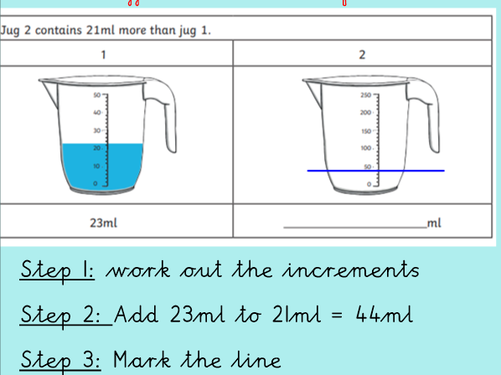
We do- Answers
Can you convert this answer into litres?

Slide 38
We do – Subtracting
Remember to follow the steps!

Slide 39
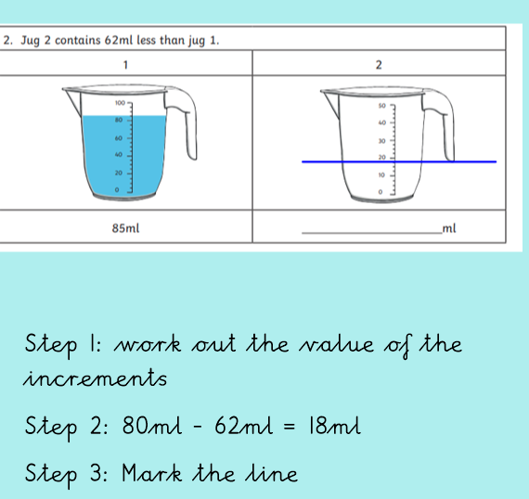
We do – Subtracting answers
Remember to follow the steps!

Slide 40
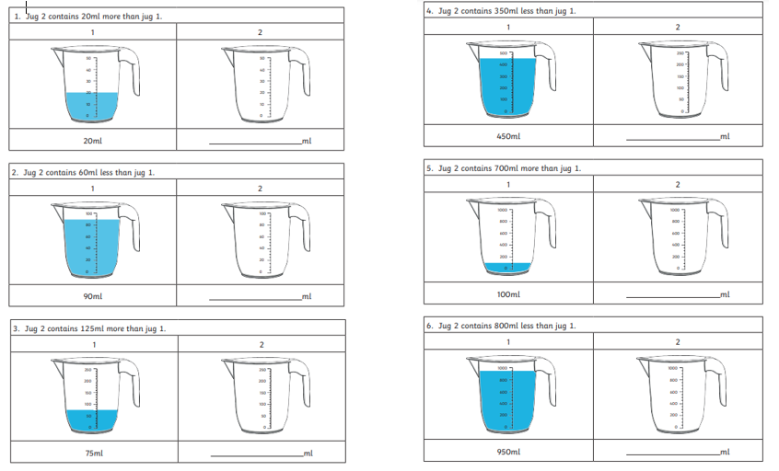
Day 4 - Main Task

Slide 41
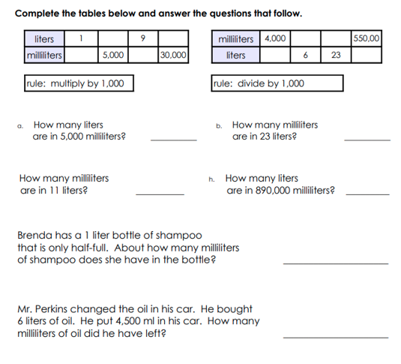
Day 4 - Challenges

Slide 42
Day 5 – Time
Today we will learn about time. We will look into key terminology such as morning, afternoon, night, midnight, noon and afternoon.
What is time?
How is time measured?
What is A.M. and P.M.?

Slide 43
Arithmetic
Test yourself on your 8 times tables.
4 X 8=
6 X 8=
8 X 8=
1 X 8=
9 X 8=
2 X 8=
10 X 8=
4 X 8=

Slide 44
Watch
https://www.bbc.co.uk/bitesize/topics/zkfycdm/articles/zcrmqty

Slide 45
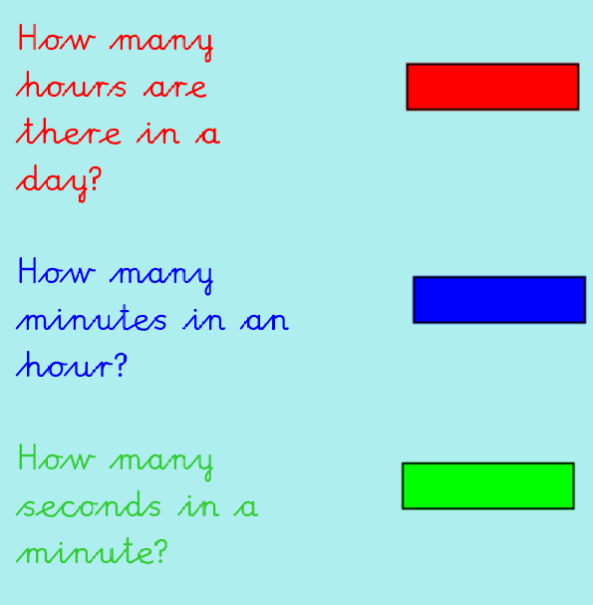

Slide 46
Answers
How many seconds are there in 2 minutes?
How many minutes are there in 3 hours?

Slide 47
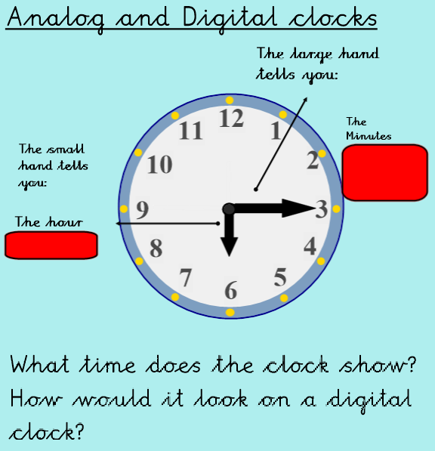
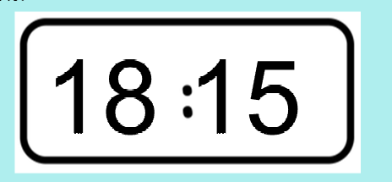
What time would be in 15 more minutes?

Slide 48
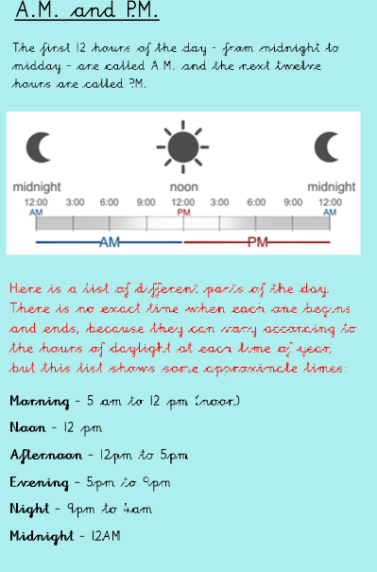
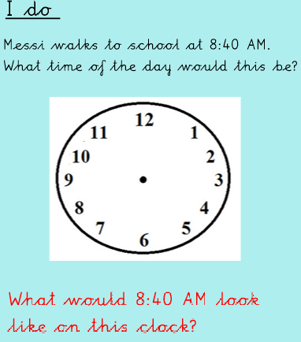
What is A.M. and P.M.? I do

Slide 49
I do - answers
How do you think it may look on a digital clock?

Slide 50
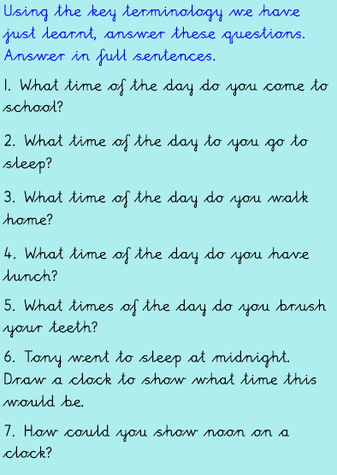
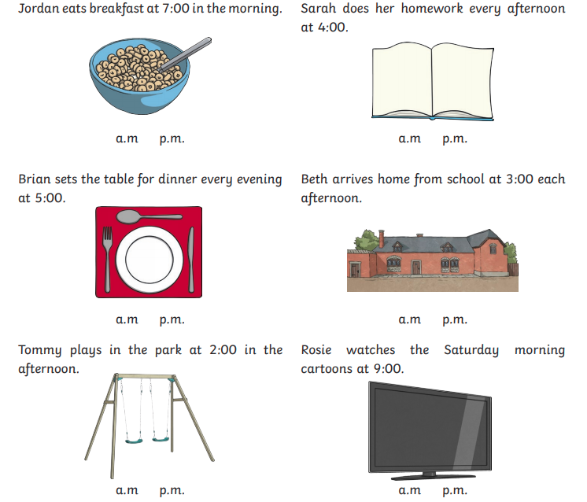
Main Task and challenges

