Slide 1
Maths Home Learning
Week Beginning 7.12.2020

Slide 2
This week…
Day 1 – Recapping numbers to 5.
Day 2 – One less
Day 3 – One less
Day 4 -One less
Day 5 -One less

Slide 3
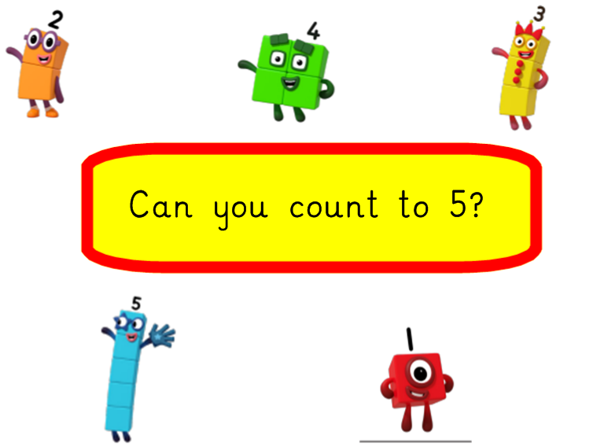
Day 1
Recapping numbers to 5.

Slide 4
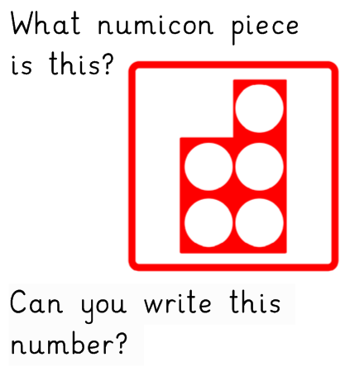

Slide 5
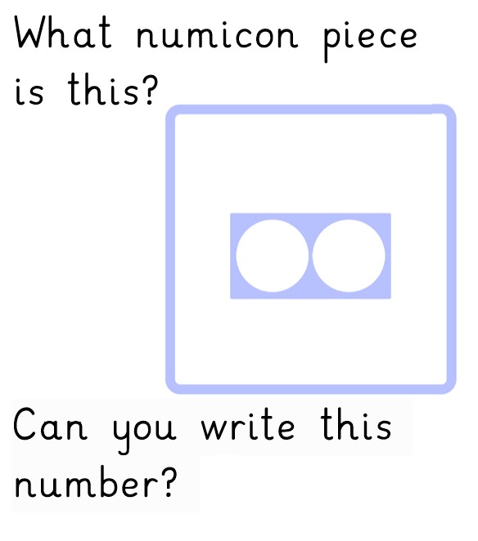

Slide 6
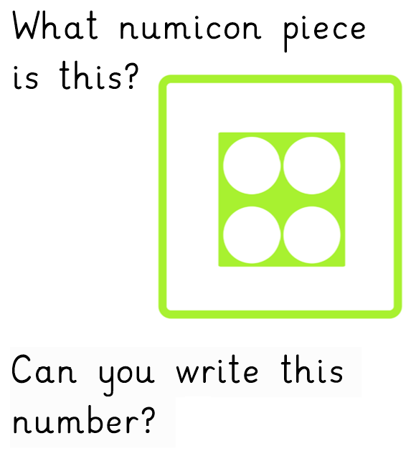

Slide 7
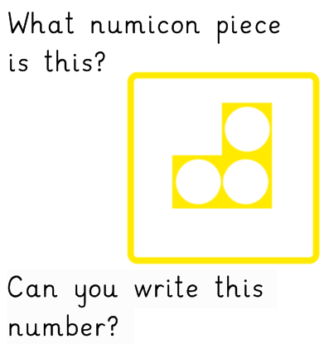

Slide 8
Activity.
In your home learning books can you write your numbers 1-5 in order.

Slide 9
Don’t forget to email your work to your teacher!
ra@hortongrangeacademy.co.uk –Miss Bedford
rb@hortongrangeacademy.co.uk – Miss Beaumont
rc@hortongrangeacademy.co.uk – Mrs Wilson

Slide 10
Day 2
One less

Slide 13
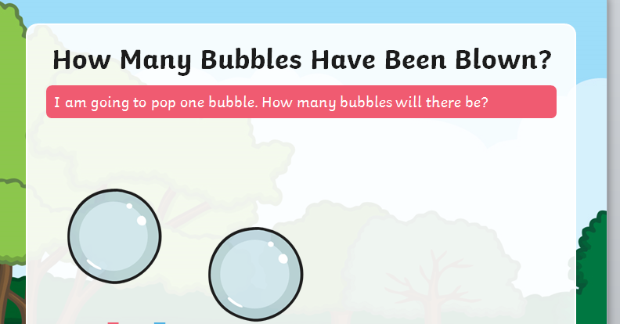

Slide 15
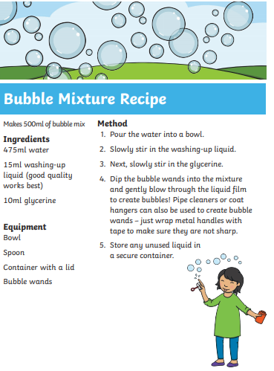
Now you try with blowing your own bubbles, counting them and popping one.
If you don’t have bubbles here is a way of making them:

Slide 16
Don’t forget to email your work to your teacher!
ra@hortongrangeacademy.co.uk –Miss Bedford
rb@hortongrangeacademy.co.uk – Miss Beaumont
rc@hortongrangeacademy.co.uk – Mrs Wilson

Slide 17
Day 3- one less

Slide 18
Let’s practise again…

Slide 20
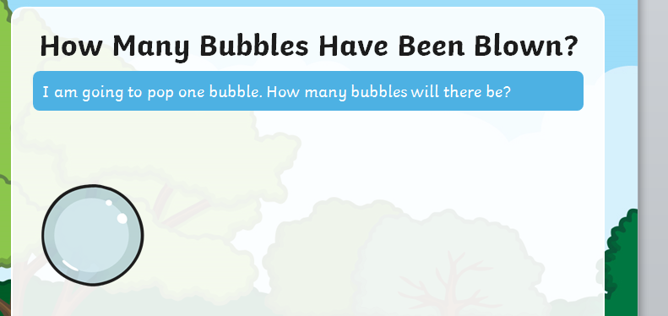

Slide 22
Now play the one less bug catcher game.
https://pbskids.org/curiousgeorge/busyday/bugs/

Slide 23
Don’t forget to email your work to your teacher!
ra@hortongrangeacademy.co.uk –Miss Bedford
rb@hortongrangeacademy.co.uk – Miss Beaumont
rc@hortongrangeacademy.co.uk – Mrs Wilson

Slide 24
Day 4 – One Less

Slide 25
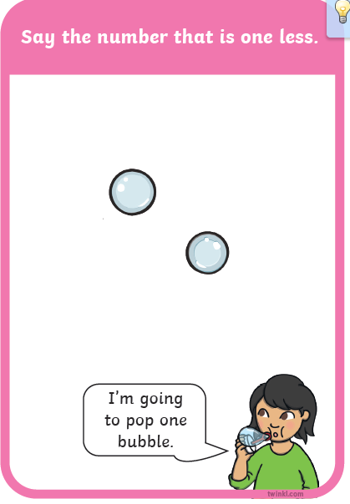

Slide 26
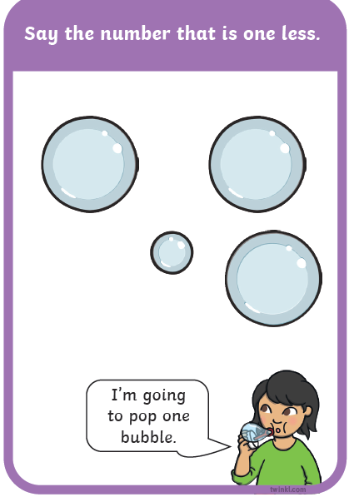

Slide 27
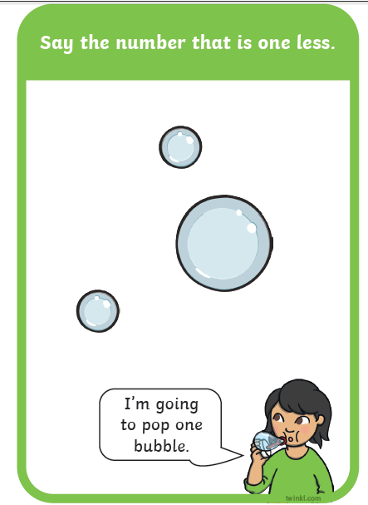

Slide 28
Can you find one less than each of these numbers?
1
2
4
5
0
1
2
3
4
5
6
7
8
9
10

Slide 29
Don’t forget to email your work to your teacher!
ra@hortongrangeacademy.co.uk –Miss Bedford
rb@hortongrangeacademy.co.uk – Miss Beaumont
rc@hortongrangeacademy.co.uk – Mrs Wilson

Slide 30
Day 5

Slide 31
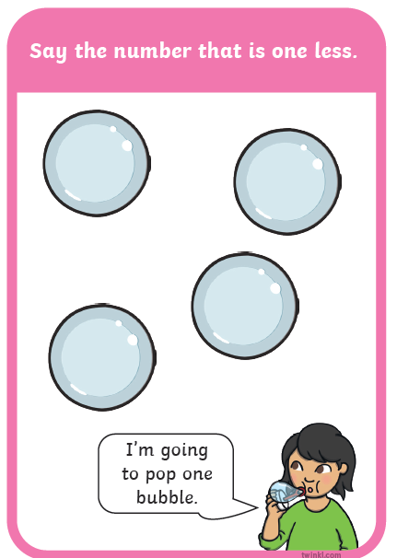

Slide 32
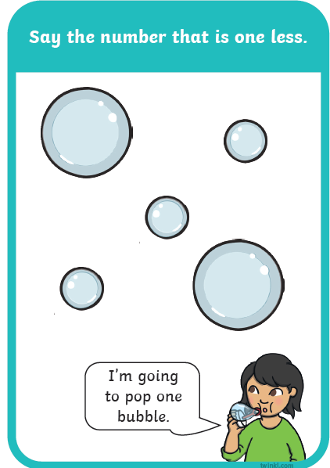

Slide 33
Can you find one less than each of these numbers?
3
2
1
0
0
1
2
3
4
5
6
7
8
9
10

Slide 34
Don’t forget to email your work to your teacher!
ra@hortongrangeacademy.co.uk –Miss Bedford
rb@hortongrangeacademy.co.uk – Miss Beaumont
rc@hortongrangeacademy.co.uk – Mrs Wilson

