Slide 1
English Home Learning
Week Beginning 14.12.20

Slide 2
Day 1 - Reading
Sing this rhyme together. Encourage your child to repeat after you.
Horsie, Horsie,
Don’t you stop.
Just let your feet go clippety clop.
Your tail goes swish,
And the wheels go round.
Giddy up! We’re homeward bound.

Slide 3
Day 2 Phonics
Play a listening game together.
Ask your child to try to imitate the sound that the pictures might make. You could then play a guessing game where you make the sound and the other person has to guess the picture.

Slide 4
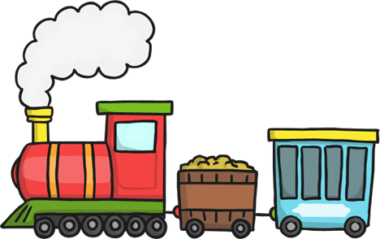
What sound do these things make?
Aspect 1

Slide 5
Day 3 Communicating
Make some playdough together.
3 cups of plain flour
3 cups of water with added food colouring of your choice
1 ½ cups of salt
6 tablespoons of cooking oil
6 teaspoons of cream of tartar
Put all of the ingredients into a pan over a low heat, and continue to stir until it all comes together. Take out of the pan, let cool and enjoy! If kept in a tupperware tub the playdough should last a while.
Using playdough is really good for your child’s physical skills and encourages communication and imagination.

Slide 6
Day 4 - Reading
This week we will be reading Christmas stories. There is a link below that will allow you to listen to a Christmas story with your child.
https://www.bbc.co.uk/cbeebies/stories/christmas-the-very-snowy-christmas

Slide 7
Day 5 Communicating
We are revising the Makaton sign for ‘toilet’ this week.

