Slide 1
Curriculum
Week Commencing:
14/12/2020

Slide 2
This Week
Day 1: Science and Art – Using shape to make animals (penguins)
Day 2: RE – Christians and Christmas
Day 3: Science – Winter, snow and ice – design a snowman
Day 4: PSHCE- What are our feelings and how can we deal with them
Day 5: PE – A winter dance

Slide 3
Day 1 – Penguins
Today we will learn about penguins.
1. What do you know about penguins?
Write your ideas down.
2. Watch this video and see if you can add more words to your brainstorm
https://www.bbc.co.uk/programmes/b04dq5tb
OR
https://www.youtube.com/watch?v=lAJB-dKTAQM
small
Penguins
bird

Slide 4
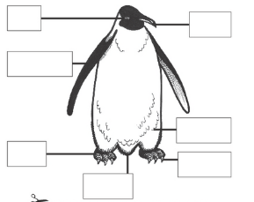
This is a penguin, can you label it? Think about what shape the different parts of the body are.
Beak
Flipper
Feathers
Tail
Claws
Eye
Foot

Slide 5
Task – Make/Draw a penguin using shapes
What colours and shapes can you see?
What could you use to make a penguin?
TASK: Draw a penguin using different shapes. If you want a challenge you could label your penguin (shapes or body parts) afterwards.

Slide 6
Example – Using shape to make a penguin
Here is an example
The body is an oval.
Flipper
The feet are triangles

Slide 7
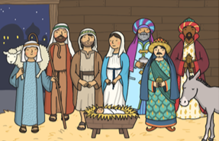
Day 2 – RE - Christmas

Slide 9
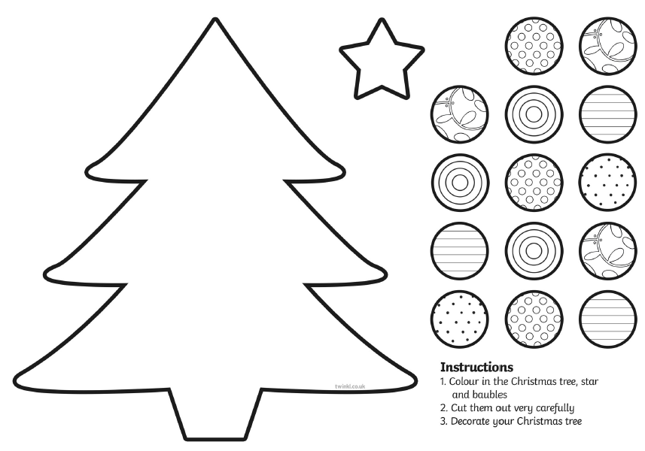
Task – Design your own Christmas tree

Slide 10
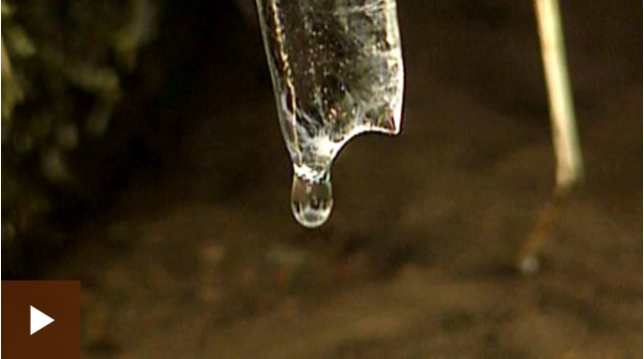
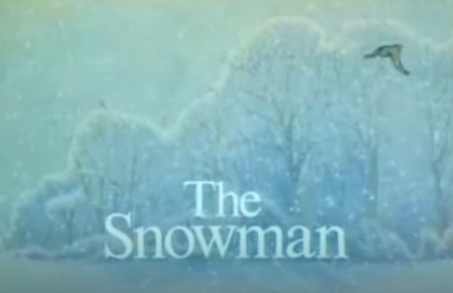
Day 3 – Science – Winter
2. The snowman was made out of snow but what do we know about snow, ice and water? Watch this video and then tell your family what you know.
1. This is a 30 minute video called the snowman. It tells the story of the life of a snowman. Watch it and enjoy!
https://www.bbc.co.uk/bitesize/clips/zpvfb9q
https://www.youtube.com/watch?v=nGmOiccZFJM
What is snow made out of?
Is water hard or easy to pick up? Why?
Is snow hard or easy to pick up? Why?
How does it feel to pick snow up?

Slide 11
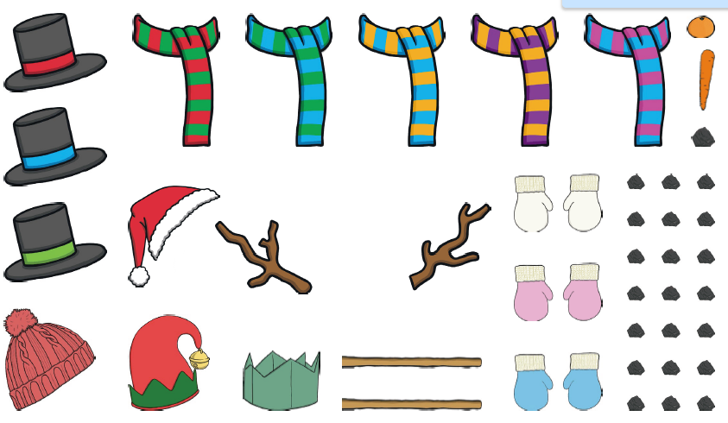
Task – Design your own snowman
Take a piece of paper and draw the outline of a snowman. Add your own accessories to your snowman.

Slide 12
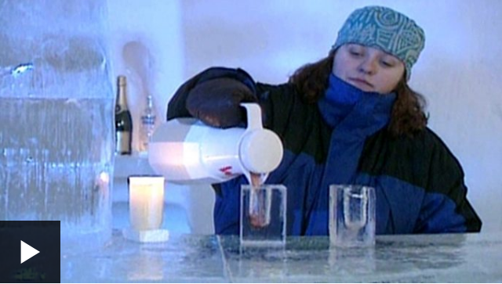
Reflection and extra knowledge
https://www.bbc.co.uk/bitesize/clips/zpvfb9q

Slide 13
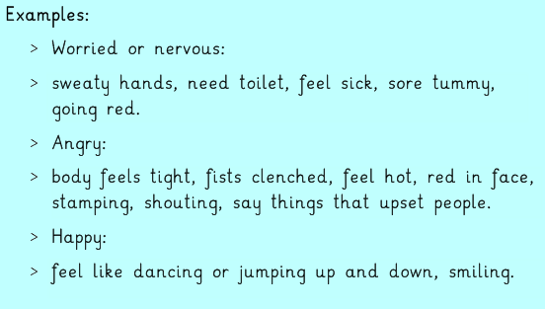
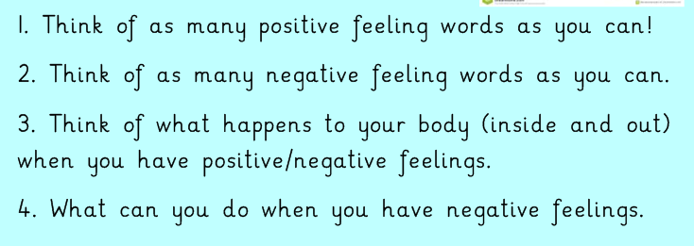
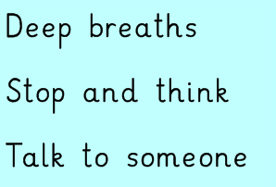
Day 4 – PSHCE – What are your feelings and how can you deal with them.
Warmer!
Can you answer these questions, they are a review of last week’s lesson.

Slide 14
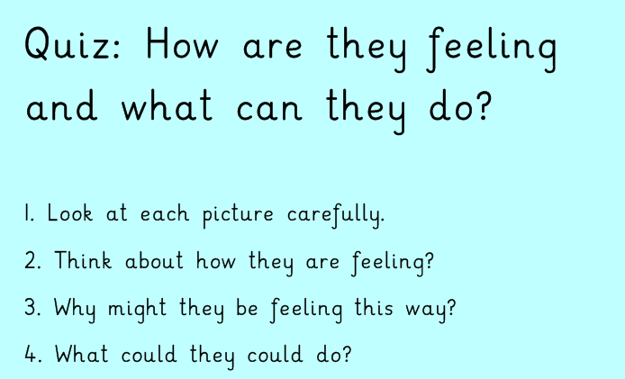
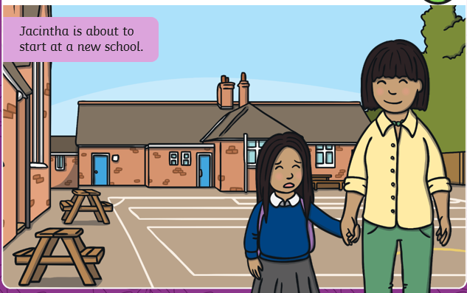
Task – How are they feeling and what can they do?

Slide 15
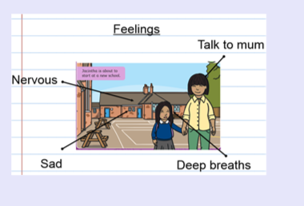
Picture Example answers

Slide 16
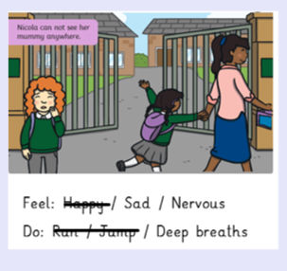
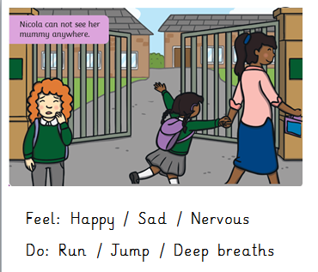
Picture Example answers

Slide 17
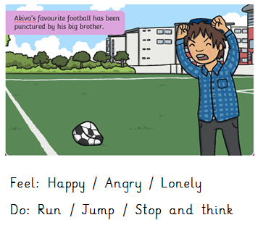
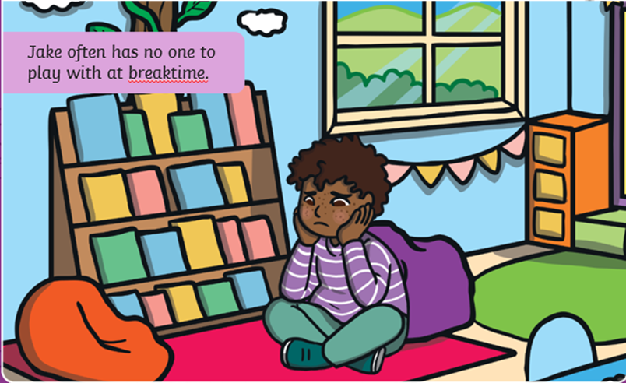
Have a go with these pictures

Slide 18
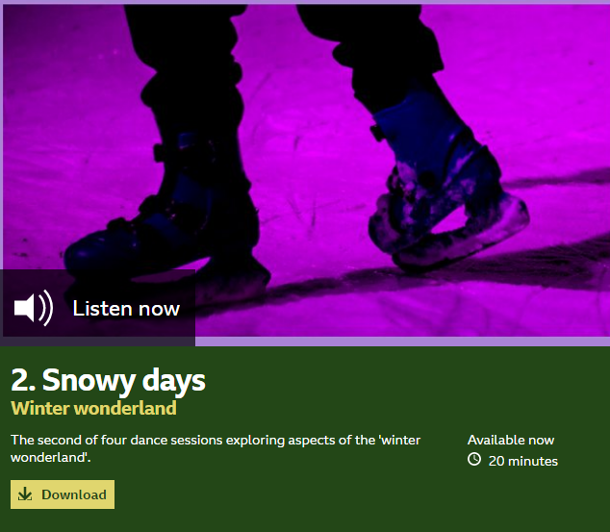
Day 5 – PE
Today you will be starting your second winter dance! Follow this link to warm up!
https://www.bbc.co.uk/programmes/b03g6vqc

Slide 19
Task – Winter Dance
This is a 30 minute video called the snowman. It tells the story of the life of a snowman. Watch it again or focus on the flying through the air section. Think about how the snowman flies through the sky – how would you feel if you were the boy in the story?
https://www.youtube.com/watch?v=nGmOiccZFJM
This is the music you will be creating a dance to today.
Here are some ideas for your dance:
Running on the spot to start flying
Flying in the air looking below
Going over the sea – and seeing a whale. You dip down.
Landing on the ground.
https://www.youtube.com/watch?v=JKfgesm5x8o
Listen to the words of the music and imagine you are the boy in the story. How do you feel, move around your house like you are flying.
Where are you arms? How are you moving your legs? Are you moving quickly or slowly?

