Slide 1
Curriculum
Week Commencing: 7.12.2020

Slide 2
This Week
Day 1: Ancient Egyptians (Pharaoh)
Day 2: Ancient Egyptians (Tutankhamun)
Day 3: PSHE
Day 4: Music
Day 5: Spanish

Slide 3
Day 1 Recap - People

Slide 4
Pharaohs
What facts do you know about Pharaohs?
Write them down in your home learning book.

Slide 5
Pharaohs
Did you know any of these?

Slide 6
Pharaohs
Did you know any of these?

Slide 7
Pharaohs
The afterlife and preparation for this was an important ritual for the Pharaoh.
TASK: What five things would you take with you if you were a pharaoh?
Explain your reasons and use a super sentence starter:
If I were Pharaoh, the five things I would take with me would be…

Slide 8
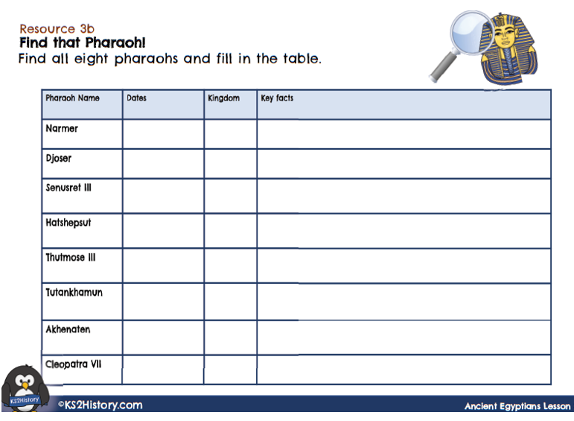
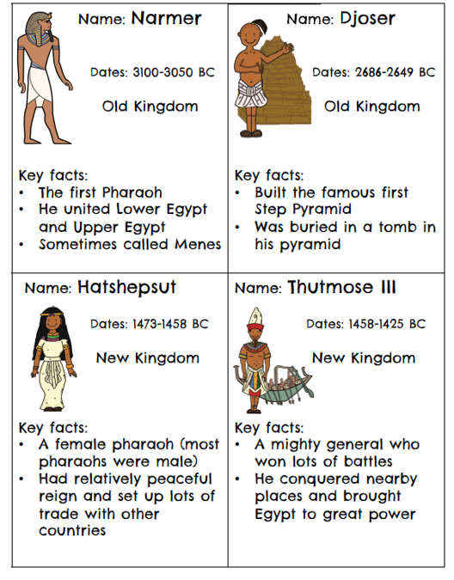
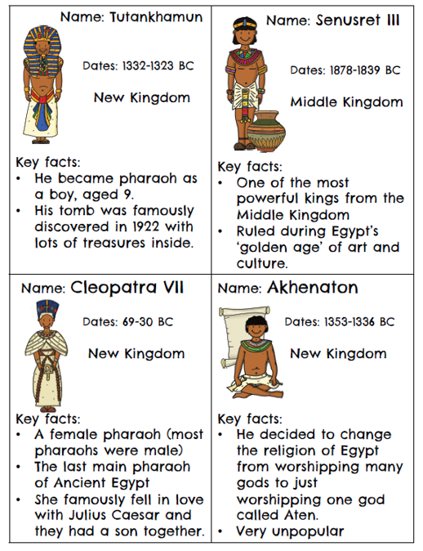
Pharaohs
TASK: Use the famous pharaoh cards to fill in key information on the table. Copy the table below into your home learning book.

Slide 9
Day 2 – Ancient Egyptians
In the previous session we learnt about the pharaoh, their role and why
they were important.
What ritual was important?
Why might there be problems taking
riches to the Afterlife?
Today we will learn about famous pharaohs – can you name one?

Slide 10
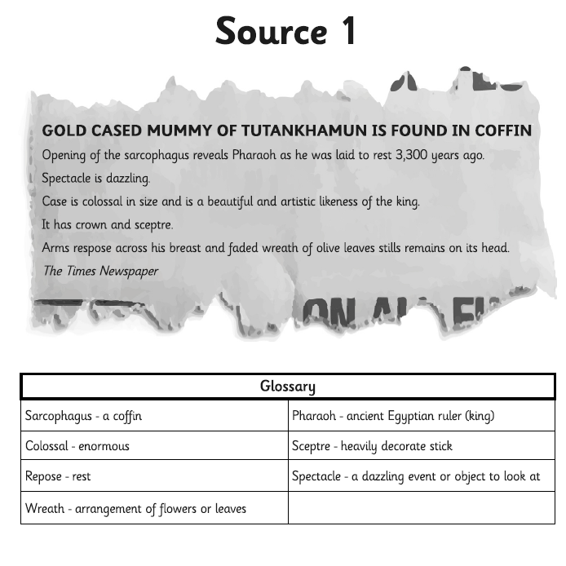
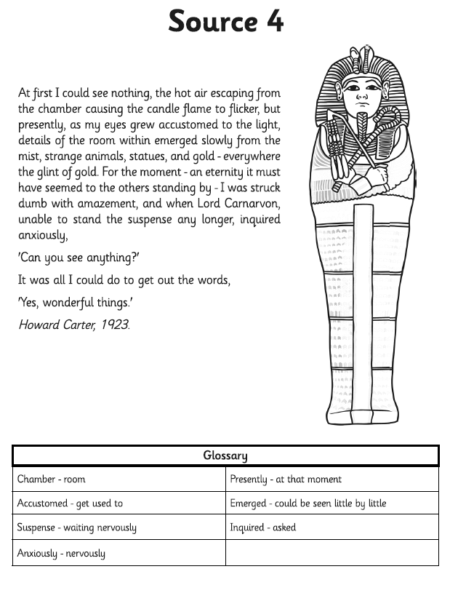
Pharaohs
Let’s be historians and use some sources to help us to think about some questions.
A source is something we use in history, that helps give us information, they are primary and secondary. How can you find out what this means? What does each source tell you?

Slide 11
Tutankhamun
This is the most famous pharaoh in Ancient Egypt, Tutankhamun took the throne when he was 9 years old and reigned for 9 years until his death aged 18.
His tomb was discovered by a group of archaeologists in 1922.
Let’s look at your sources and some more, what did you think the purpose of your source was?

Slide 12
Tutankhamun
Here is some information about the discovery of Tutankhamun and a diary entry from Howard Carter, the man who lead the group of archaeologists.
How might you have been feeling at this time?

Slide 13
The Discovery

Slide 14
Day 3 – PSHE Friendship

Slide 15
Day 3 – PSHE Friendship
Copy the diagram into your books and think about your friendships are important to you.

Slide 16
Day 3 – PSHE Friendship
Think of some ways we can help Mrs Kaur and write them into your home learning books.

Slide 17
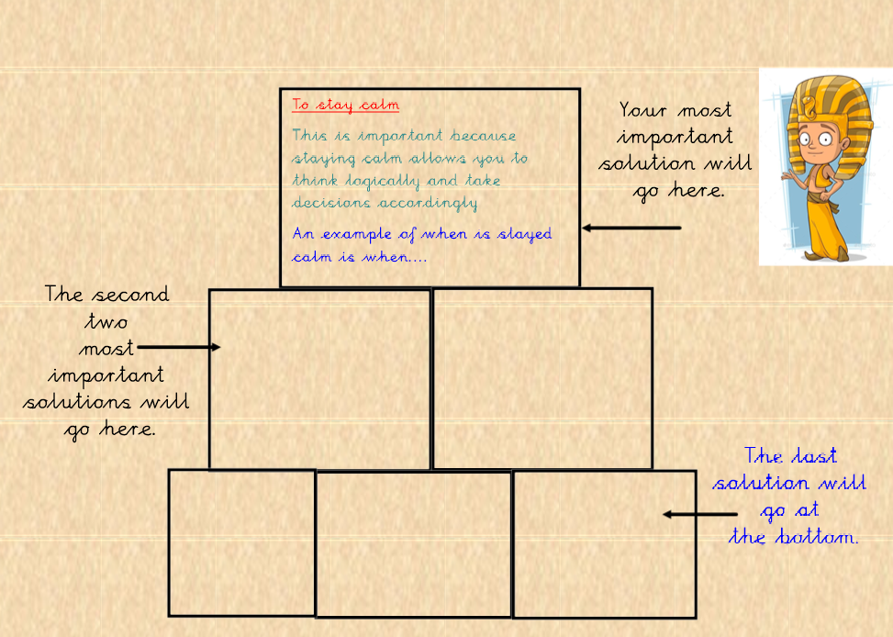
Day 3 – PSHE Main Task
Copy the table into your books USING A RULER.
Think about solutions to resolve problems, your most important will go at the top.

Slide 18
Day 4 – Music
Can you remember …
What is rhythm? Why is it important in music?
https://www.youtube.com/watch?v=BogW-2X_X6k

Slide 19
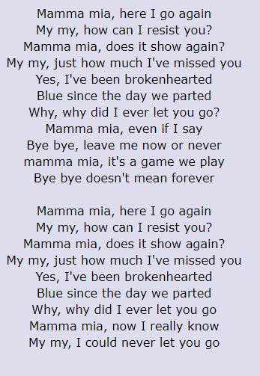
Recap – Can you remember verse 4?
Practise verse 4 and then play the You Tube video.
What moves can you add that reflect the rhythm?
Can you find the pulse?

Slide 20
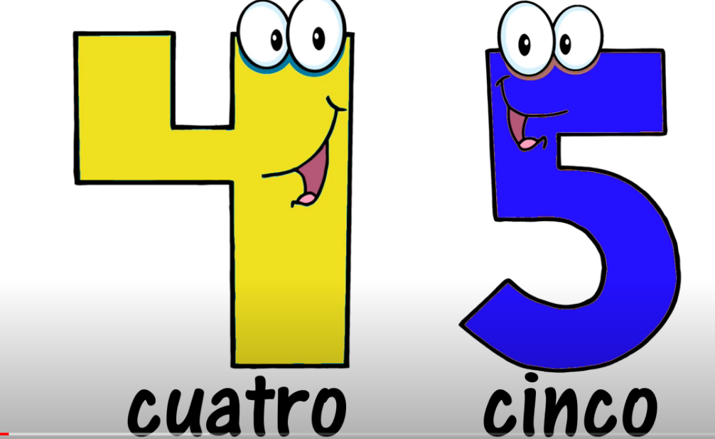
Day 5 – Spanish
Warm up! Count to 20 in Spanish! Watch the video to help you to remember the numbers!
VAMOS!
https://www.youtube.com/watch?v=zzhHrQbHZMA

Slide 21
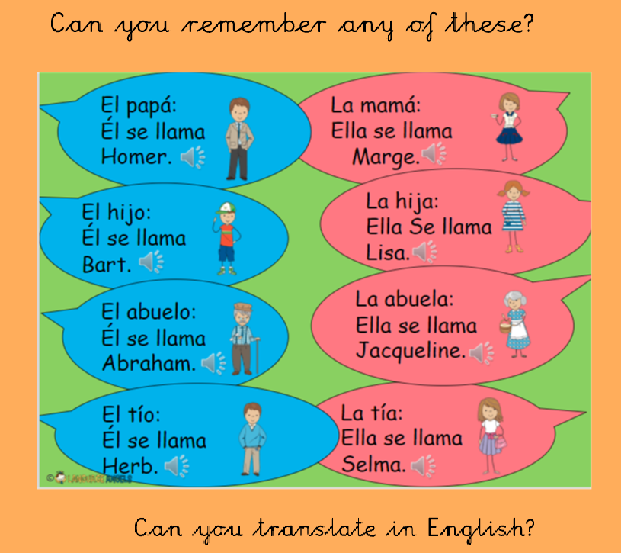
Day 5 – Spanish

Slide 22
Day 5 – Spanish

Slide 23
Day 5 – Spanish

Slide 24
Day 5 – Spanish

Slide 25
Day 5 – Spanish – Task
Use the vocabulary here to introduce your family.
Draw a picture of your family and use the language to describe them.
Your title is:
Tienes un hermono/una hermana.
You write: Si, tengo un/una hermano/hermana.
FURTHER CHALLENGE:
Can you say what the names of your siblings are?
El se llama/Ella se llama

