Slide 1
Maths Home Learning
Week Beginning 23.11.20

Slide 2
This week…
Day 1 – Arithmetic: division
Day 2 – Rounding
Day 3 – Rounding decimal numbers
Day 4 – Equivalent fractions
Day 5 – Equivalent fractions

Slide 3
This week we will be practising our 4 time tables
Listen to the video, practise chanting and play the games to practise. What score can you reach?
https://www.timestables.co.uk/4-times-table.html
https://www.topmarks.co.uk/maths-games/hit-the-button

Slide 4
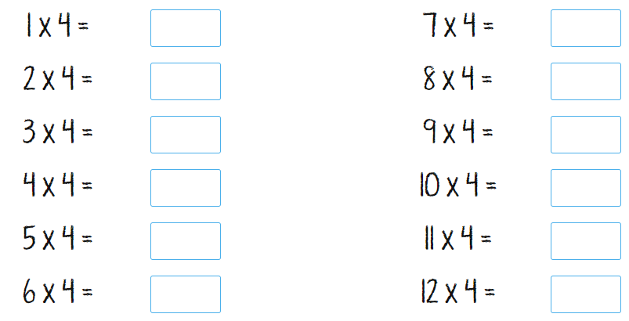
Can you answer these multiplication facts?

Slide 5
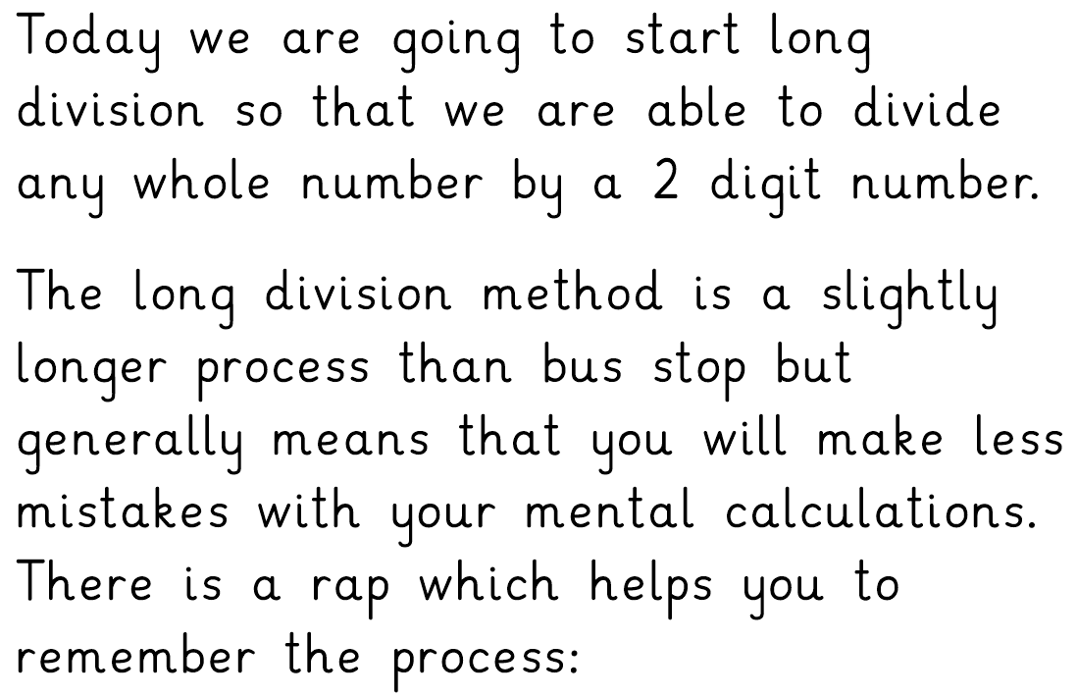
Day 1: Arithmetic – Long division

Slide 6
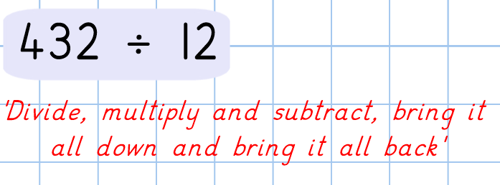
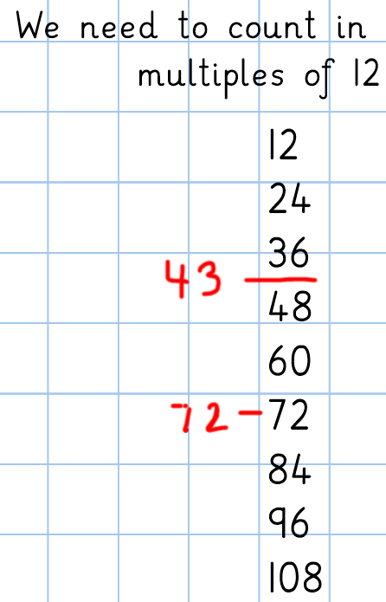
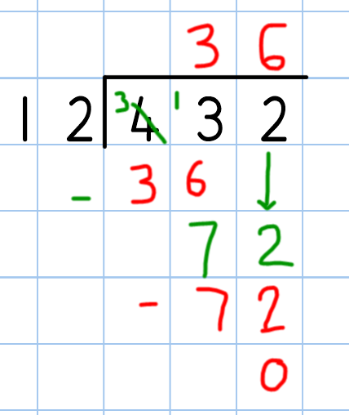
Let’s look at this long division question.
First, you will need the multiples of 12 written out.
Then following the rap, you divide, multiply and subtract. Bring it all down and bring it all back.

Slide 7
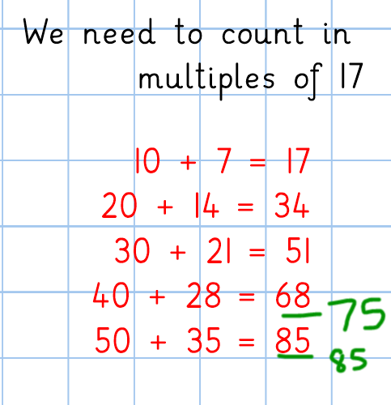
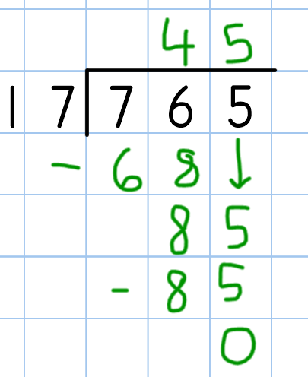

Slide 8
If you would like some further support with long division, you can explore some of these online videos:

Slide 9
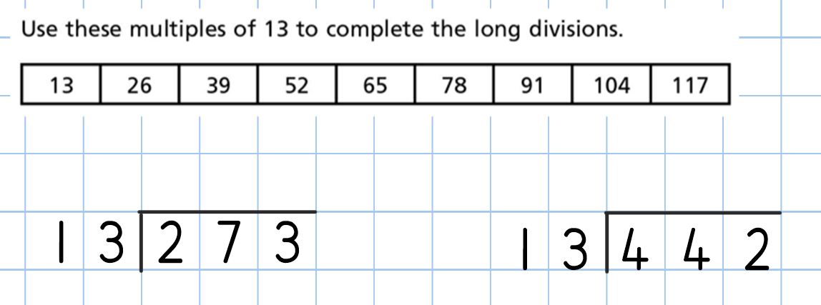
Have a go at answering some of these questions:

Slide 10
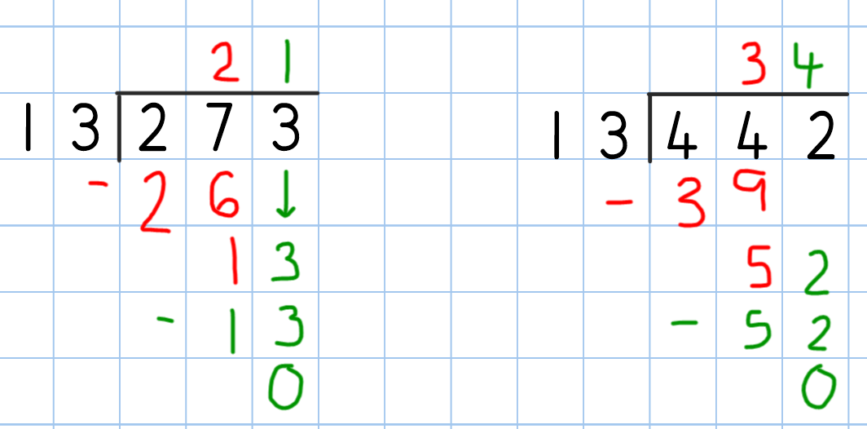
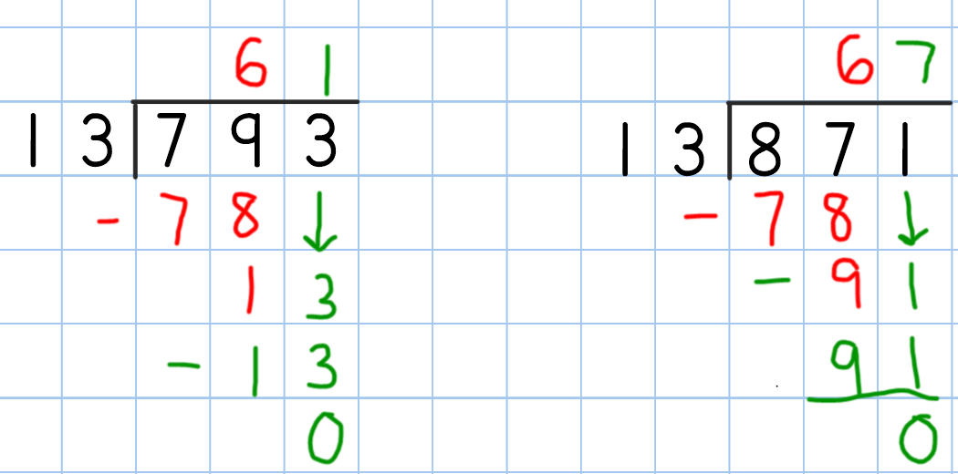
Now check you answers:

Slide 11
Now use long division to calculate:

Slide 12
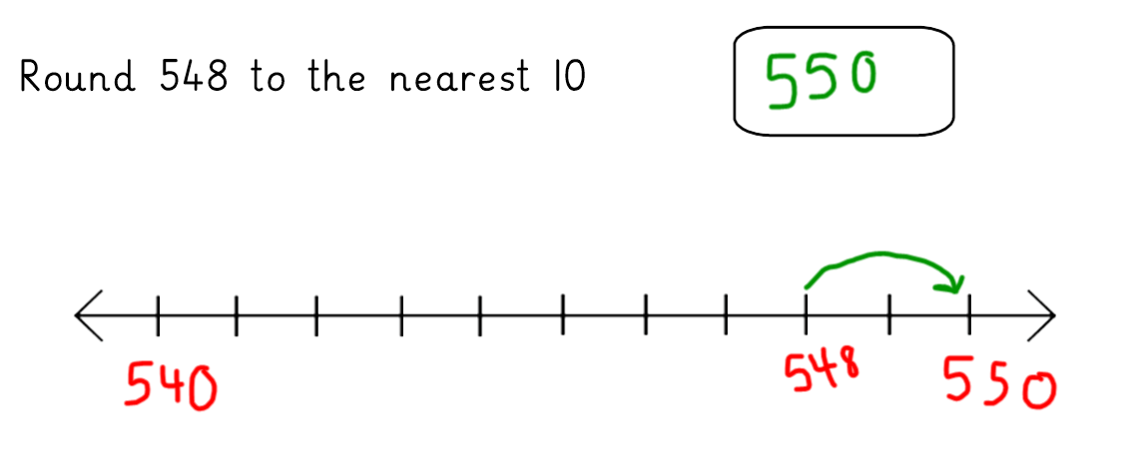
Day Two - Rounding any number
Let’s recap rounding a number to the nearest 10

Slide 14
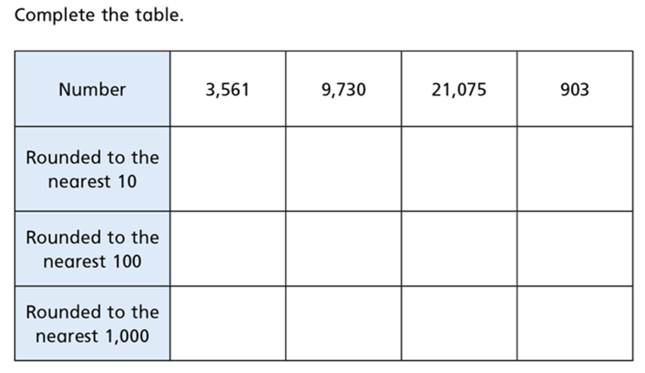

Slide 15
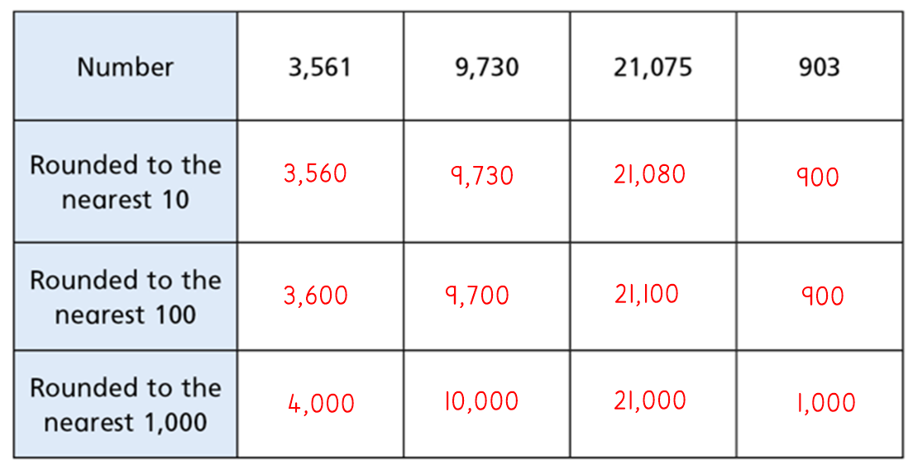
Check your answers

Slide 17
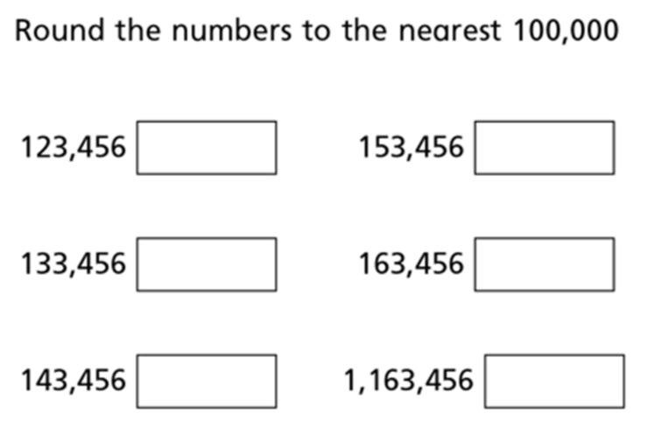

Slide 18
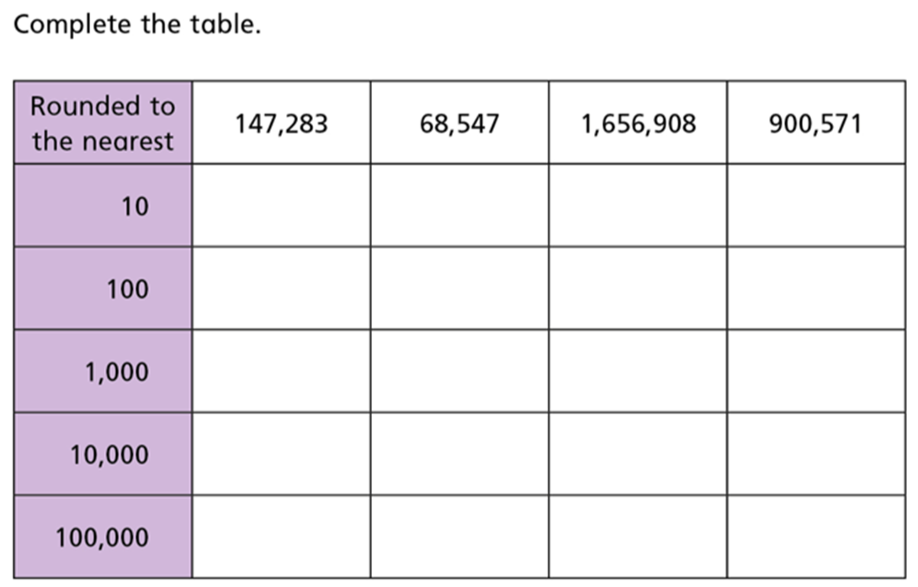

Slide 19
Day 3 – Rounding decimal numbers

Slide 23
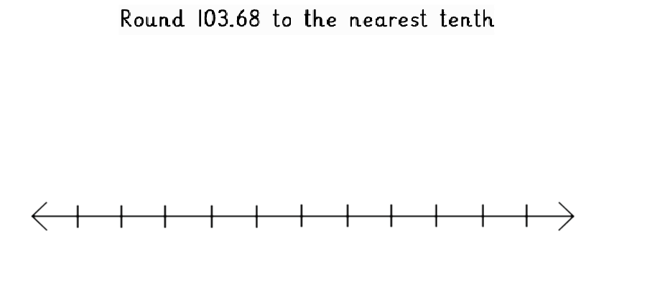

Slide 24
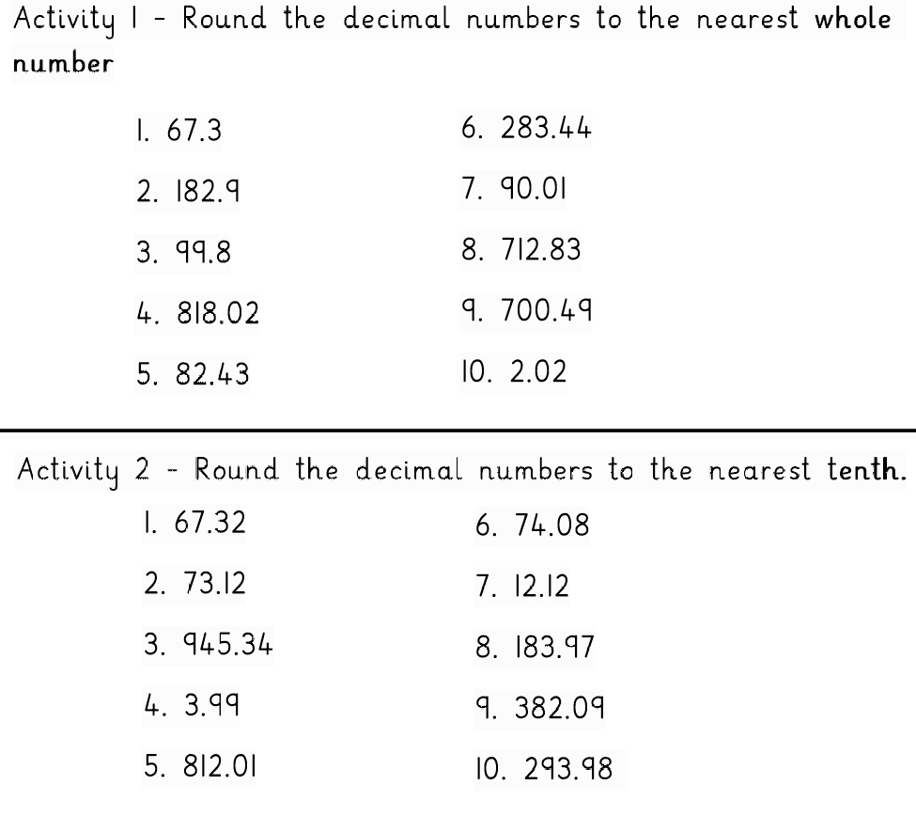

Slide 25
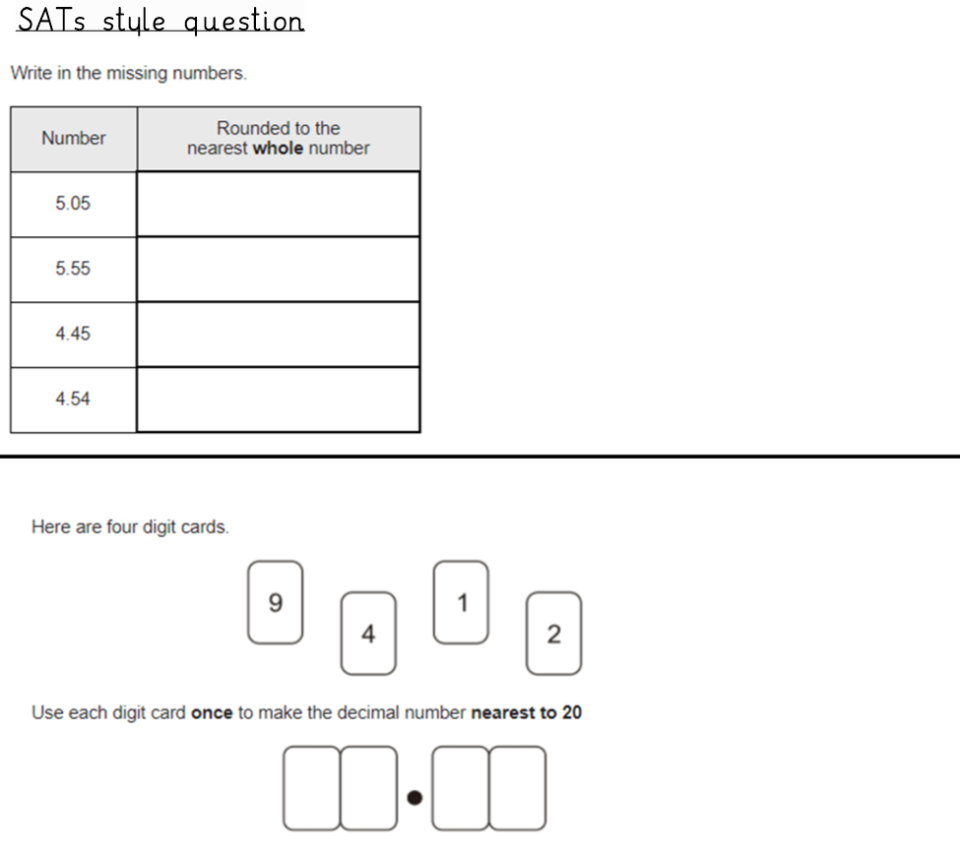

Slide 26
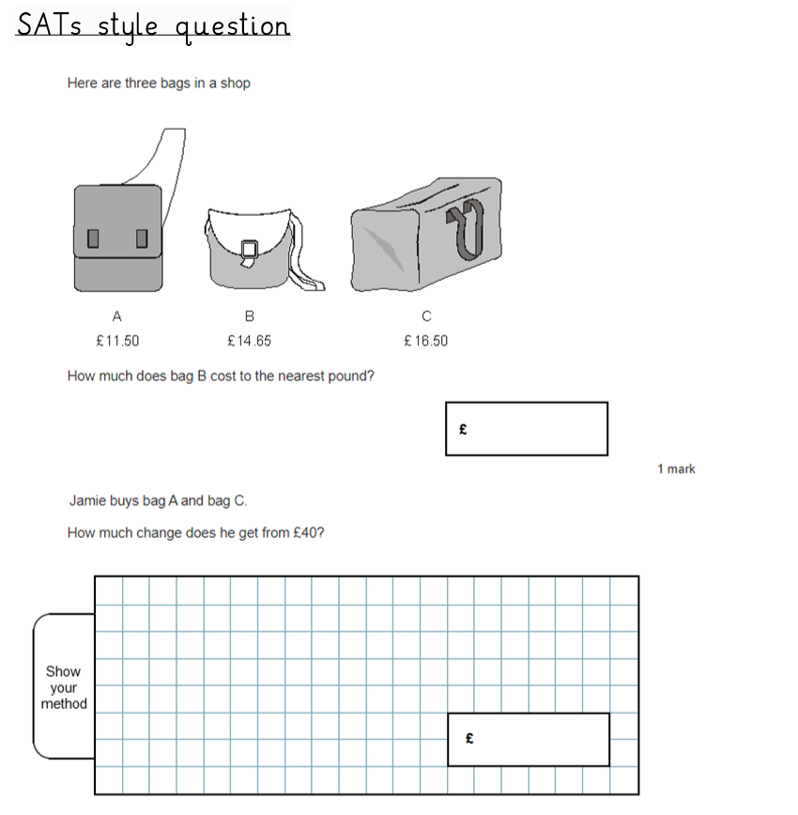

Slide 27
Day 4 – Equivalent Fractions

Slide 29
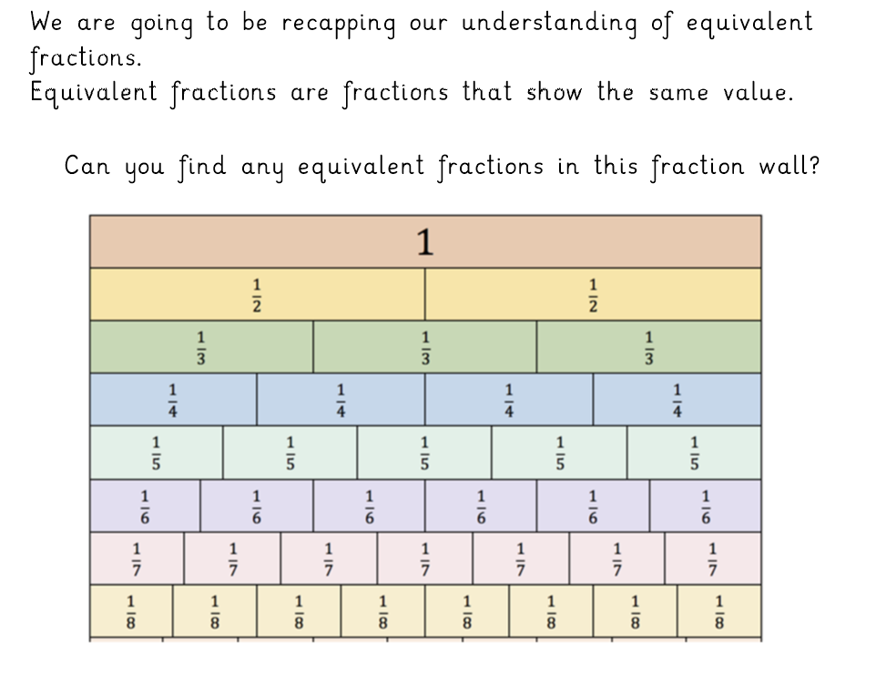

Slide 30
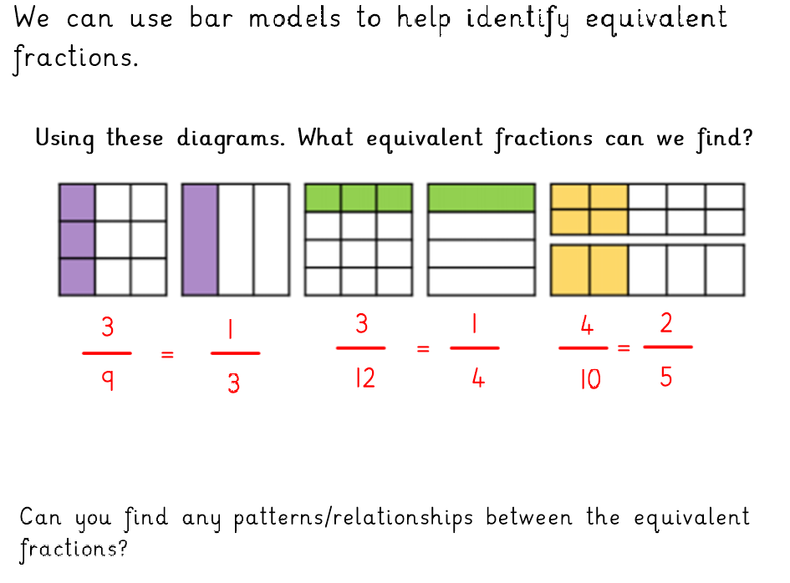

Slide 31
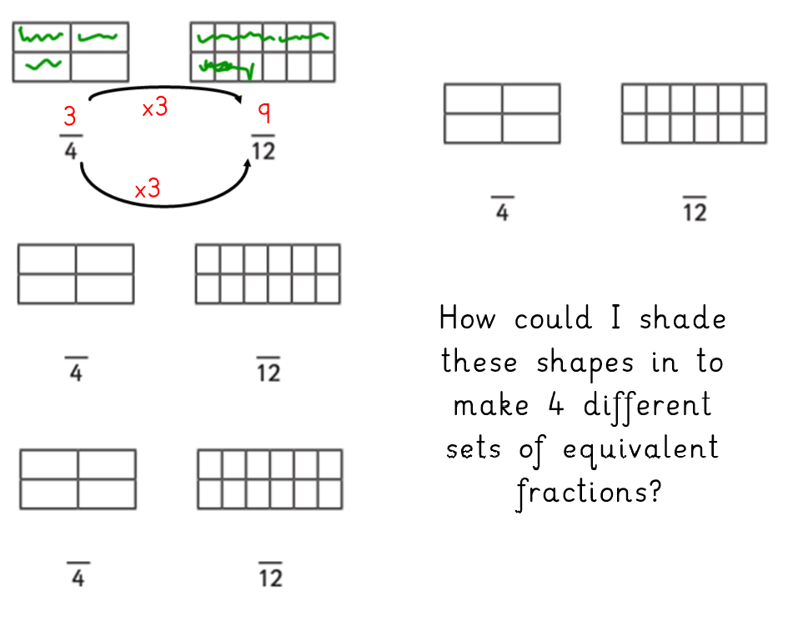

Slide 34
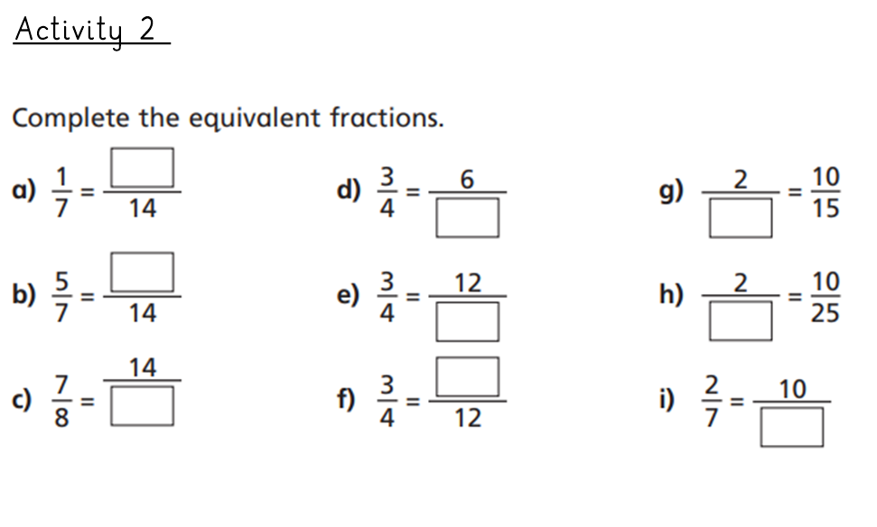

Slide 35
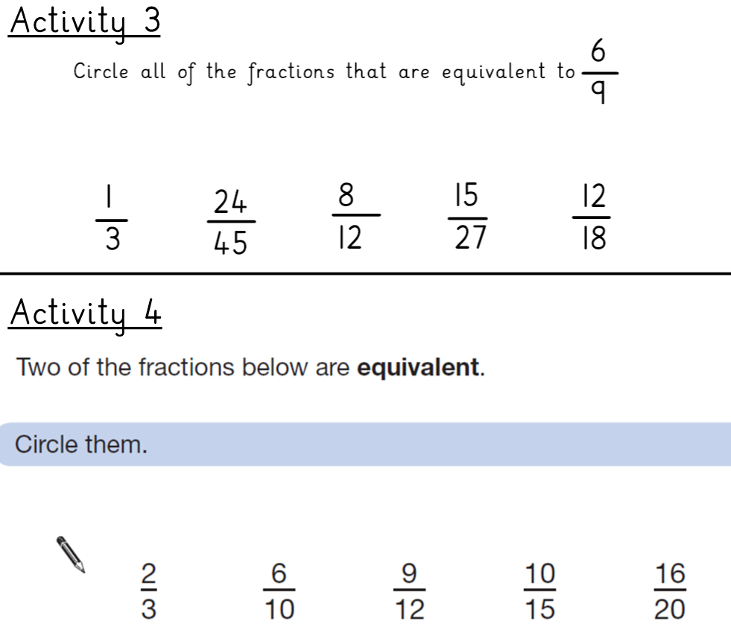

Slide 36
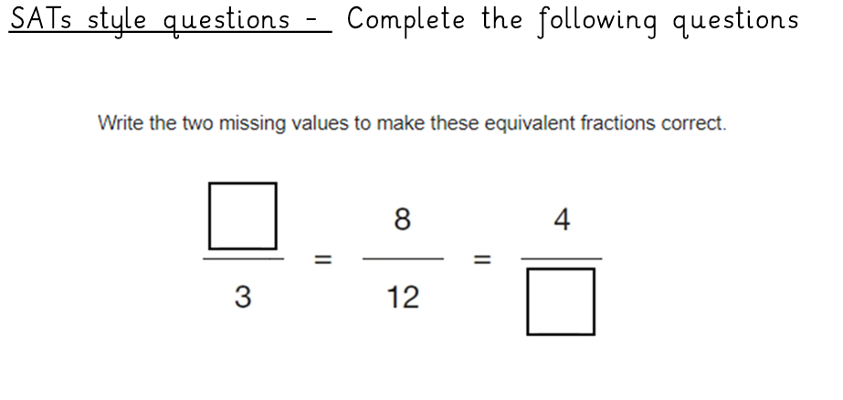
Day 5 – Equivalent Fractions (SATs style questions)

Slide 37
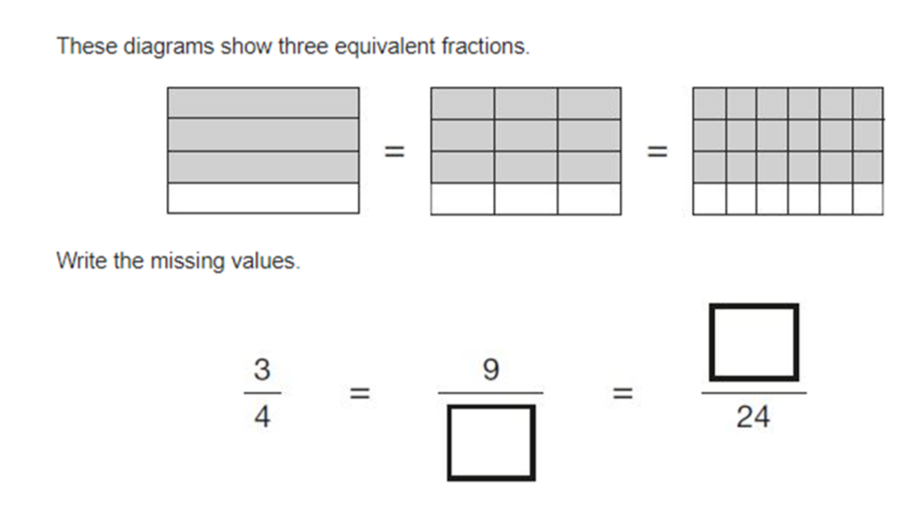

Slide 40
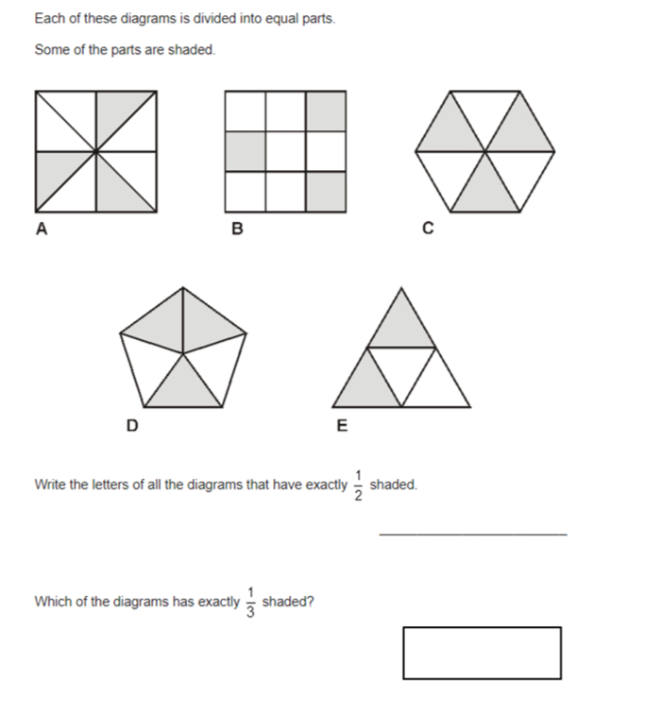

Slide 41
