Slide 1
Maths Home Learning – Set 1
Week Beginning 23.11.20

Slide 2
This week…
Monday – Arithmetic – long division
Tuesday – Adding and subtracting fractions
Wednesday – Simplifying fractions
Thursday – Mixed addition and subtraction of fractions
Friday – Multiplying fractions with whole numbers

Slide 3
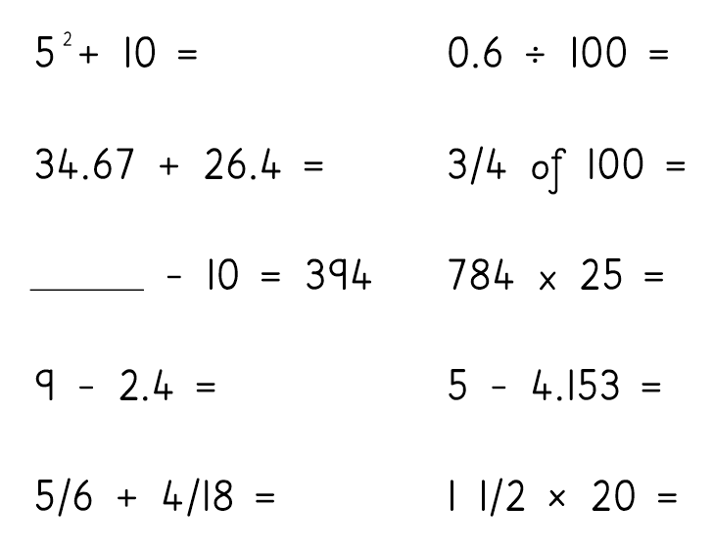
Monday – Arithmetic – Long division
Complete the following arithmetic test in 7 minutes. Then check the answers on the next page.

Slide 4
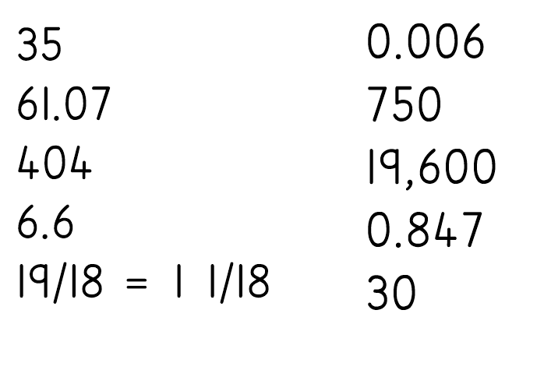
Answers

Slide 5
Example

Slide 6
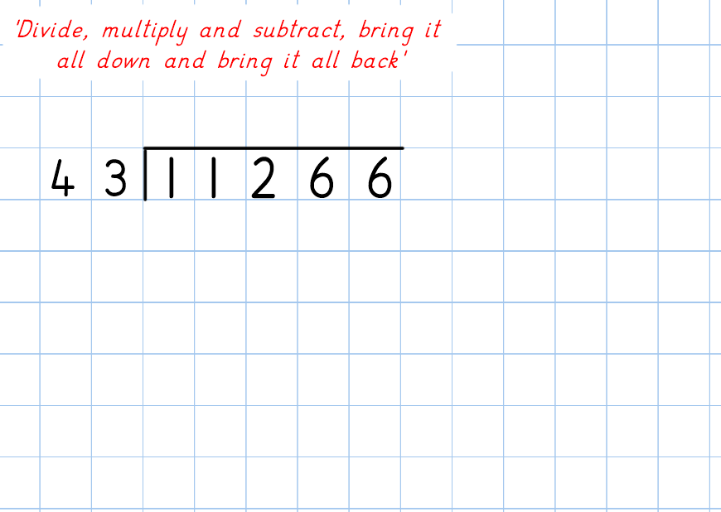
Now you have a go…

Slide 8
Now try this one…

Slide 10
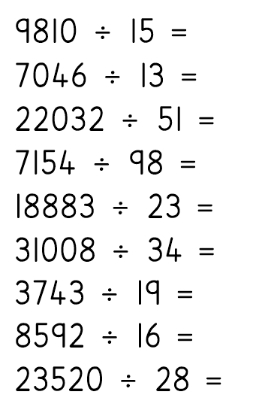
Complete these in your book. Check the method carefully then check with the answers.

Slide 11
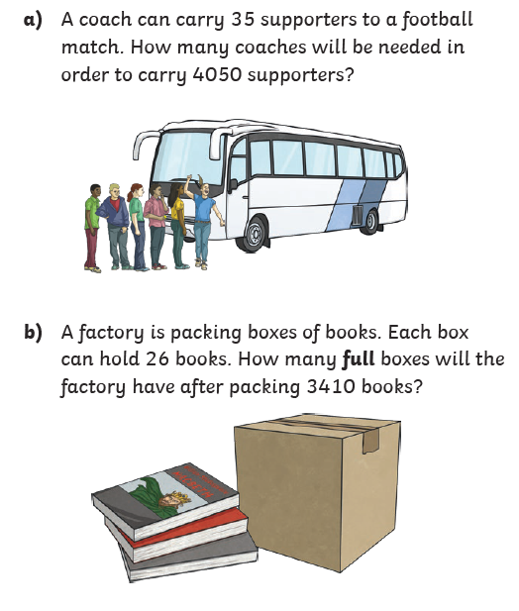
Challenge

Slide 12
Tuesday – Adding and subtracting fractions

Slide 13
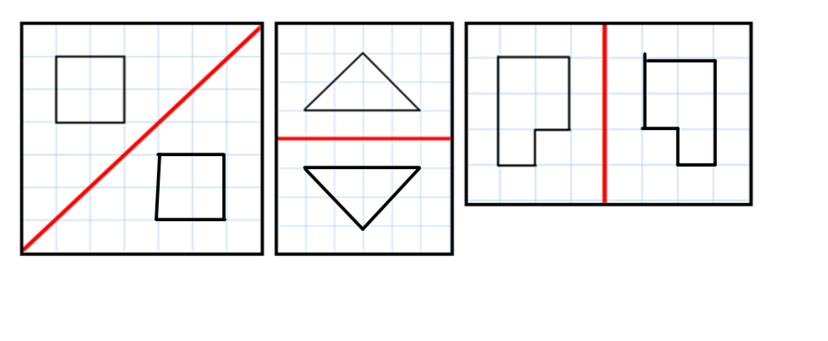
OMS answer

Slide 14
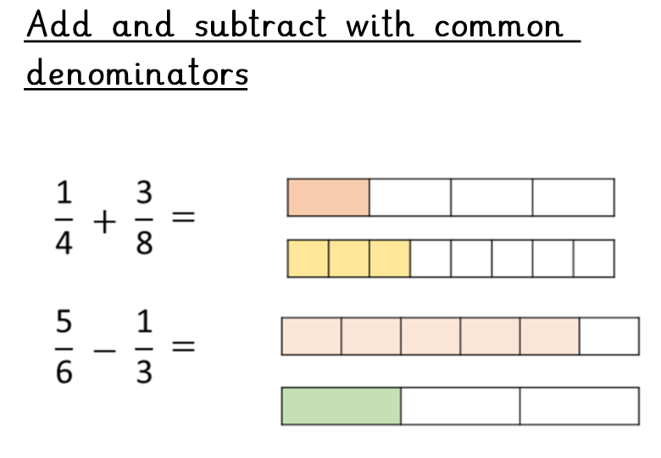
Today we are going to be adding and subtracting fractions, including putting in missing fractions to make whole numbers.

Slide 15
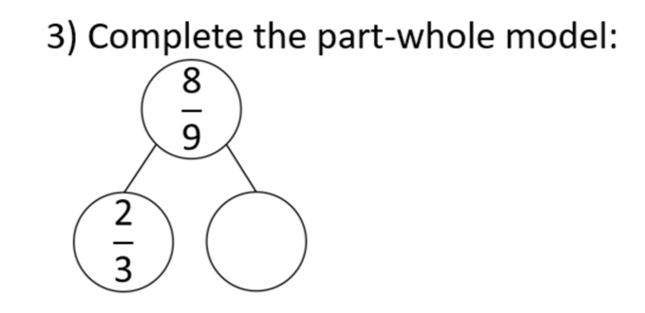
We can use equivalent fractions to find common denominators and complete addition and subtraction sums.

Slide 16
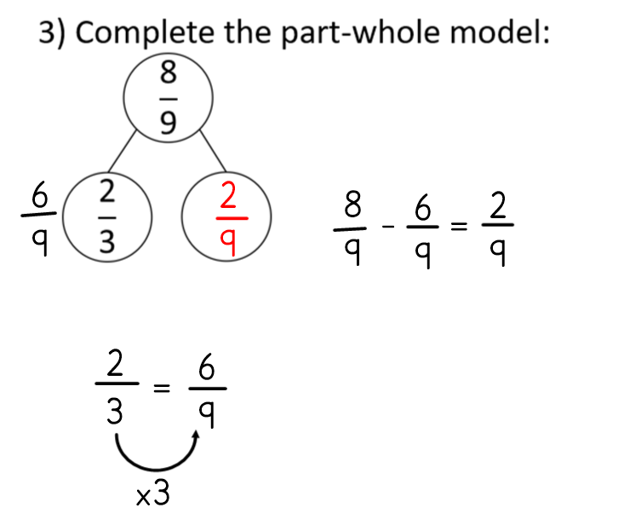
Answer

Slide 17
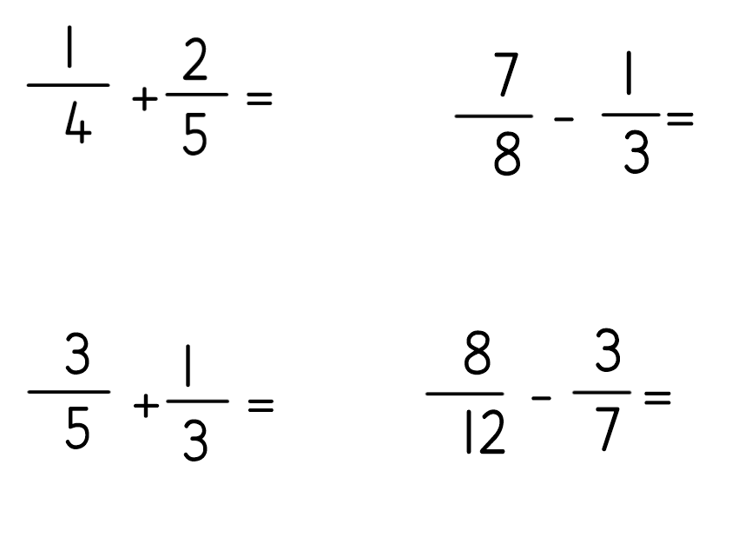
Complete the following questions in your home learning book.

Slide 18
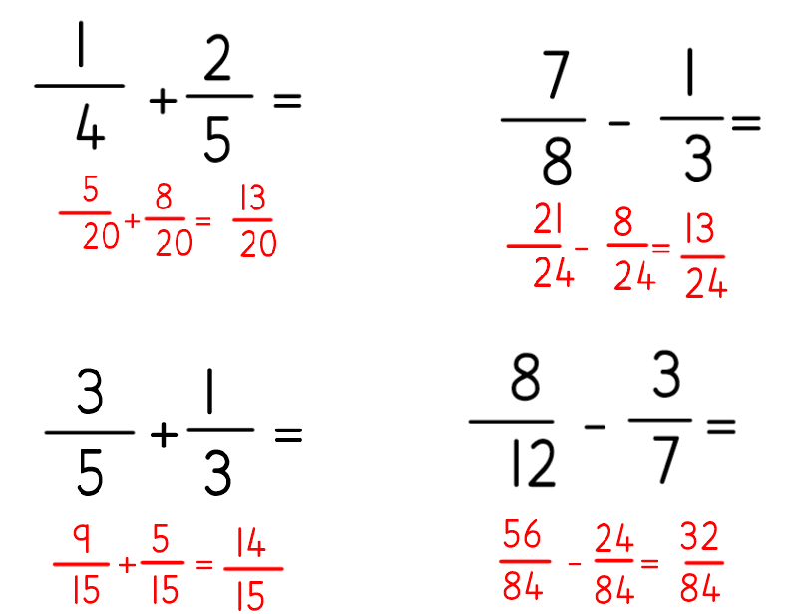
Answers

Slide 22
Answer

Slide 24
Answer

Slide 25
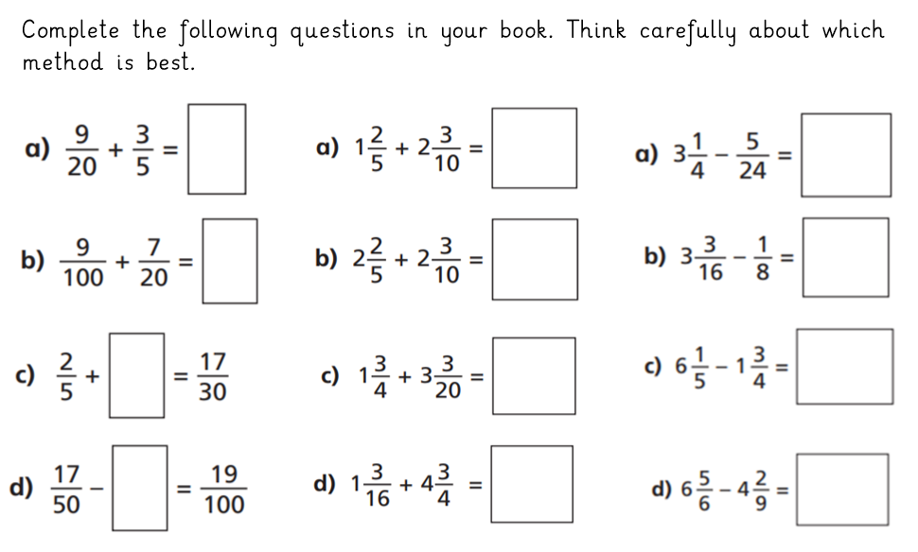

Slide 26
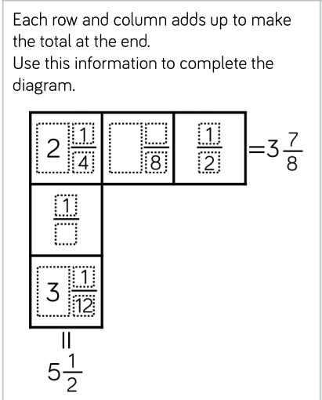
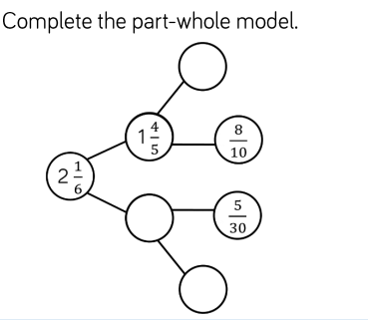
Challenge questions

Slide 27
Wednesday – Simplifying fractions

Slide 28
OMS - Answers

Slide 29
Today we are going to learn how to simplify fractions.

Slide 32
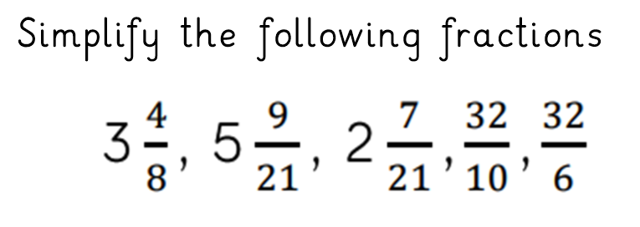

Slide 33
Complete the following online activity to practise simplifying fractions.
https://www.mathplayground.com/fractions_reduce.html

Slide 34
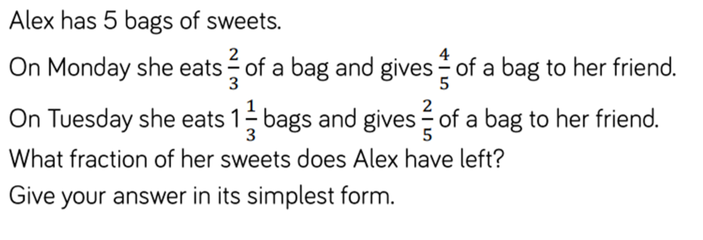
Thursday – mixed addition and subtraction of fractions

Slide 35
Answer

Slide 37
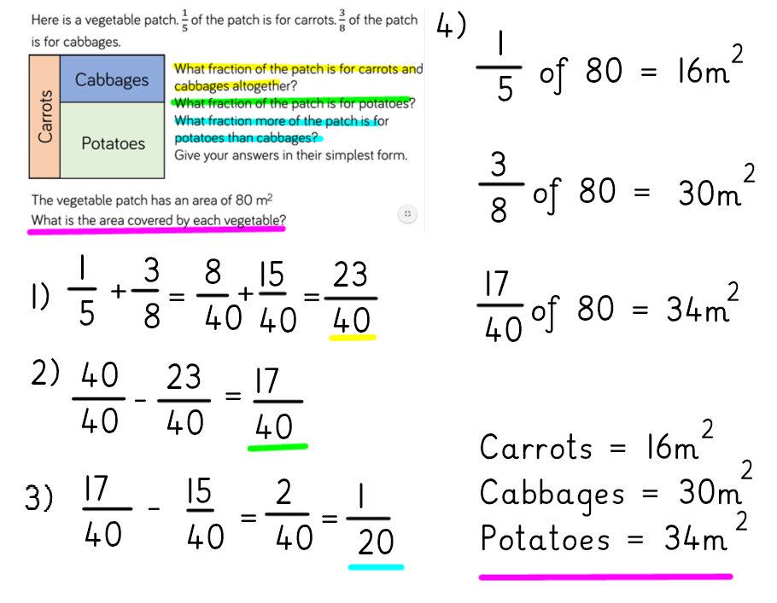
Answer

Slide 38
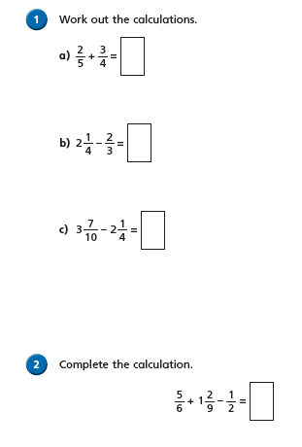
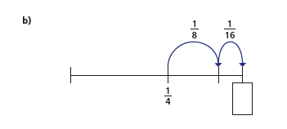
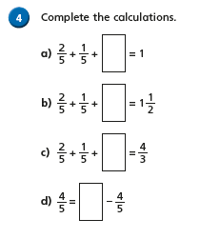
Questions to complete

Slide 39
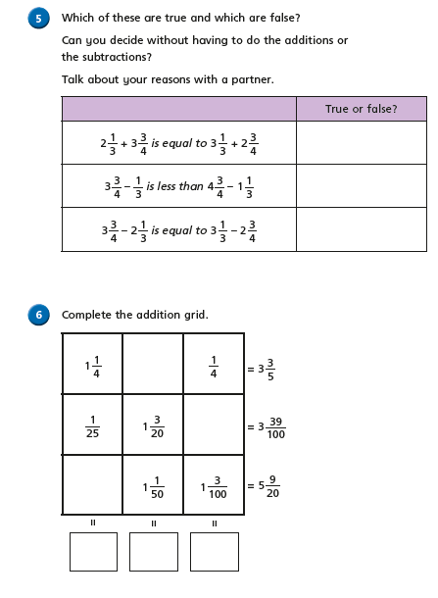
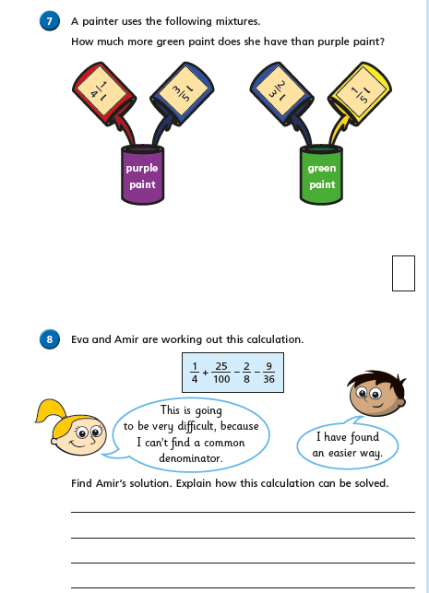

Slide 40
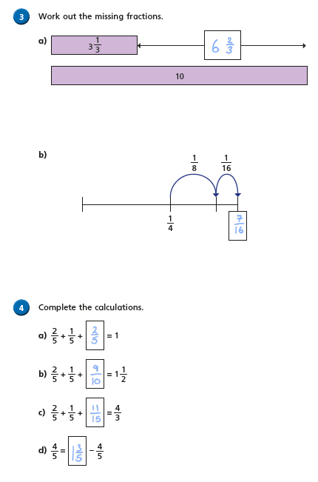
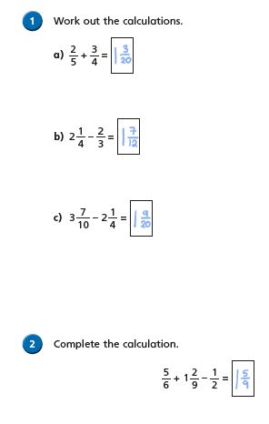
Answers

Slide 41
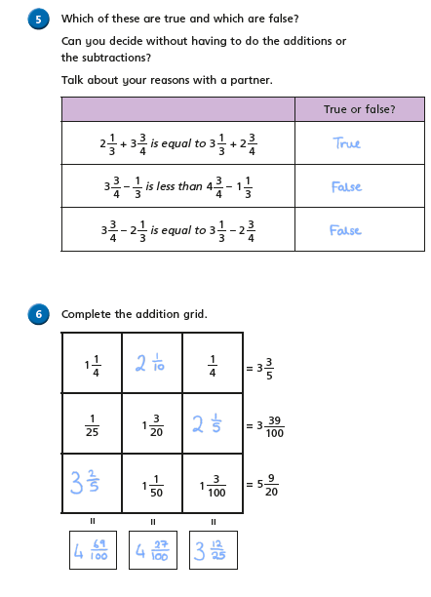

Slide 42
Friday – multiplying fractions by whole numbers

Slide 43
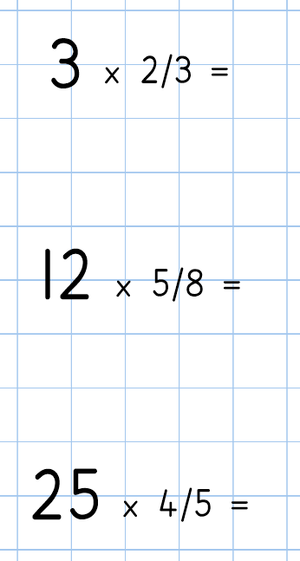

Slide 44
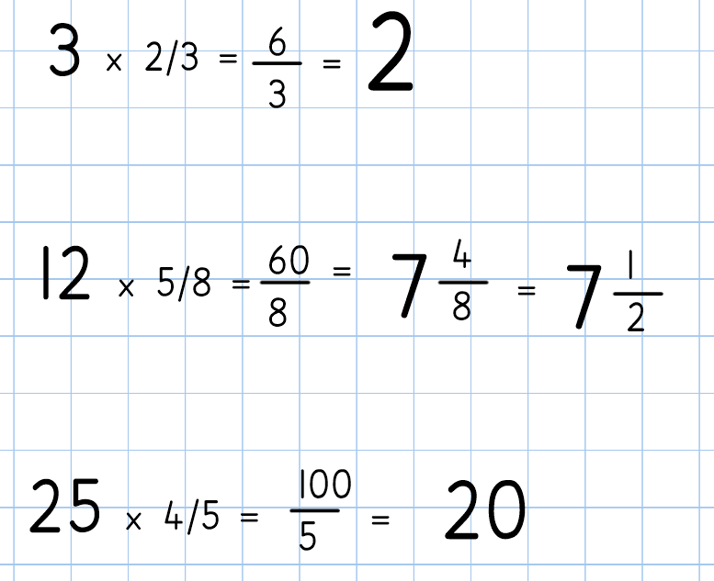
Answers

Slide 45
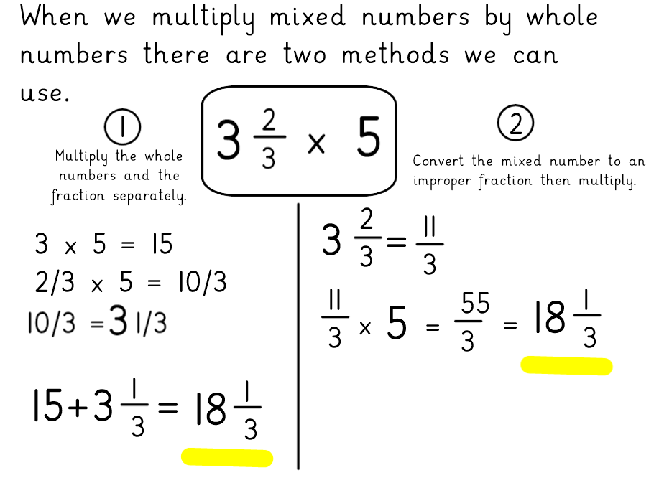

Slide 46
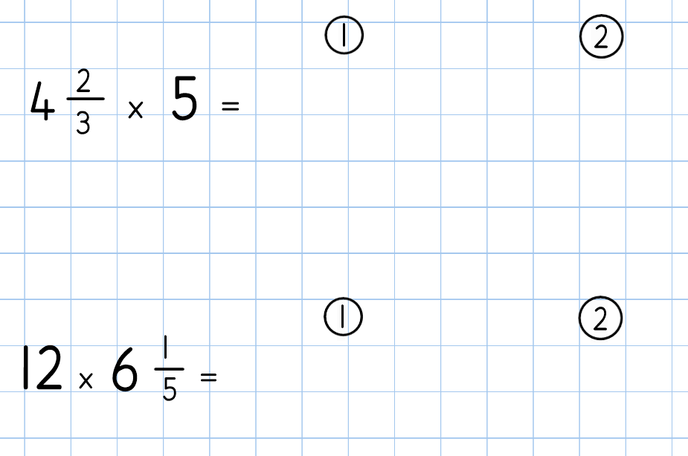

Slide 47
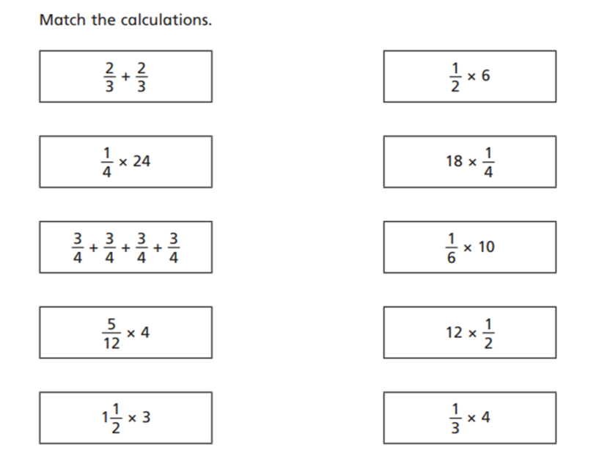

Slide 48
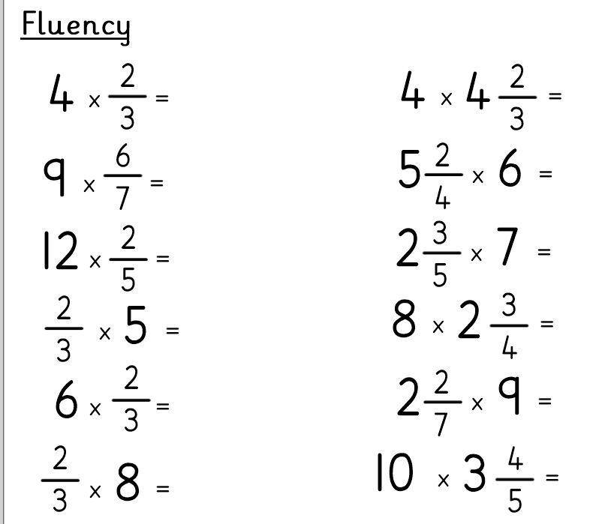

Slide 49
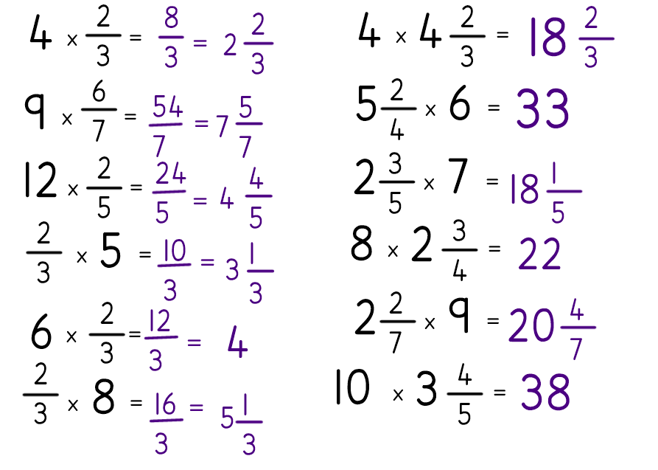
Answers

Slide 50
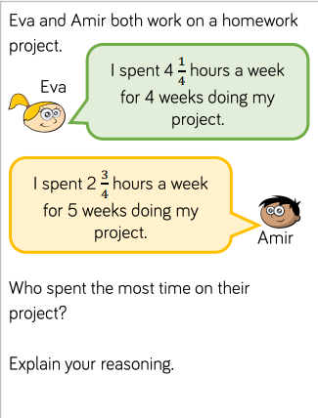
Challenge questions

