Slide 1
English Home Learning
Week Beginning 16.11.20

Slide 2
This week…
Day 1 – Grammar: Modal verbs
Day 2 – Reading comprehension
Day 3 – Writing: Features of a newspaper
Day 4 – Writing: Features of a newspaper
Day 5 – Spellings
Spelling practice website

Slide 3
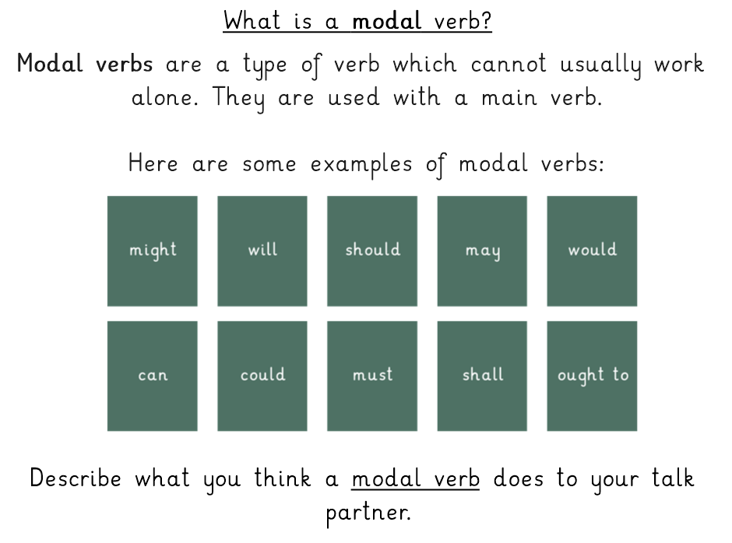
Day 1 – Grammar – Modal verbs

Slide 4
https://www.youtube.com/watch?v=5bREQcdMYBA&feature=emb_logo

Slide 6
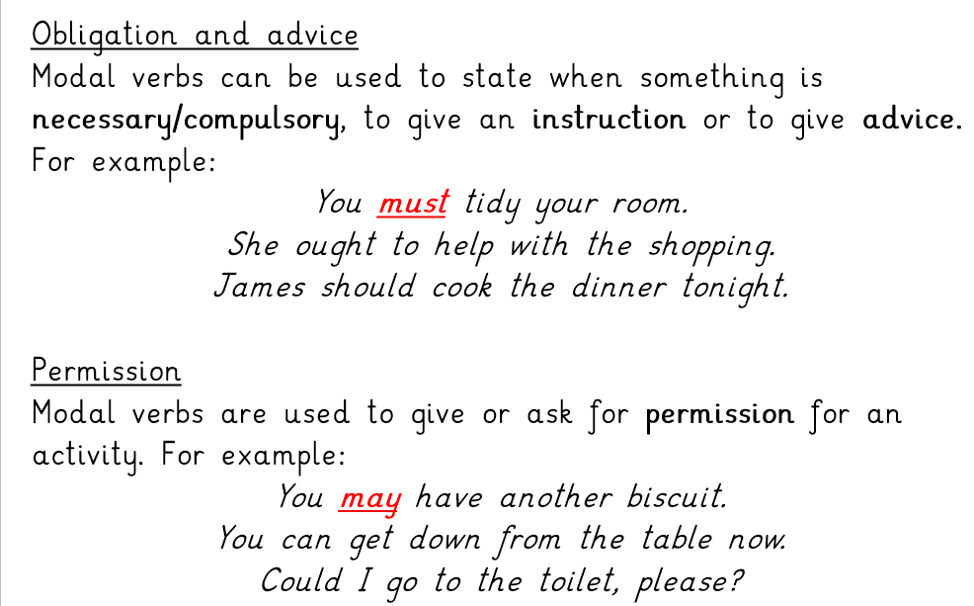

Slide 7
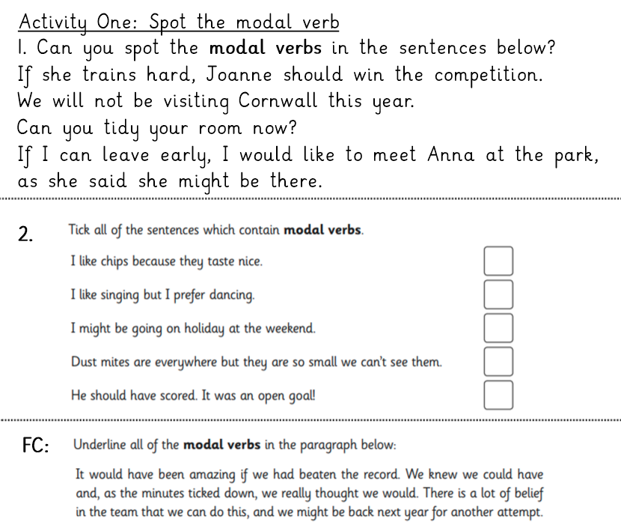

Slide 8
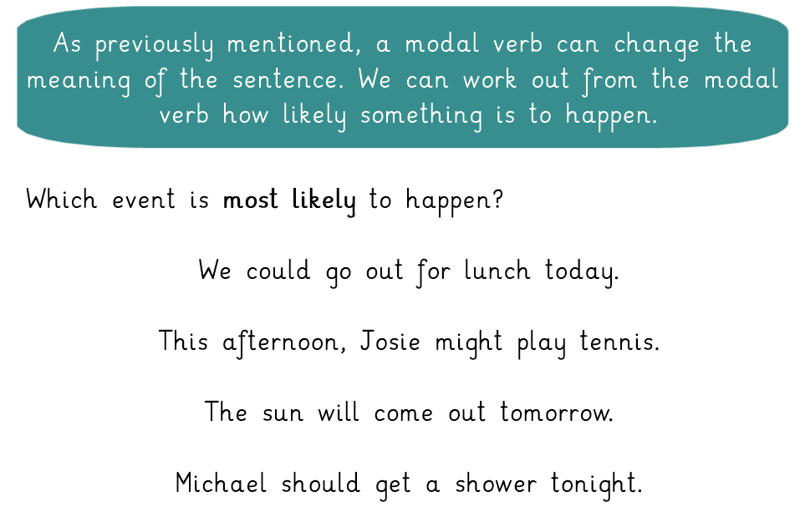

Slide 9
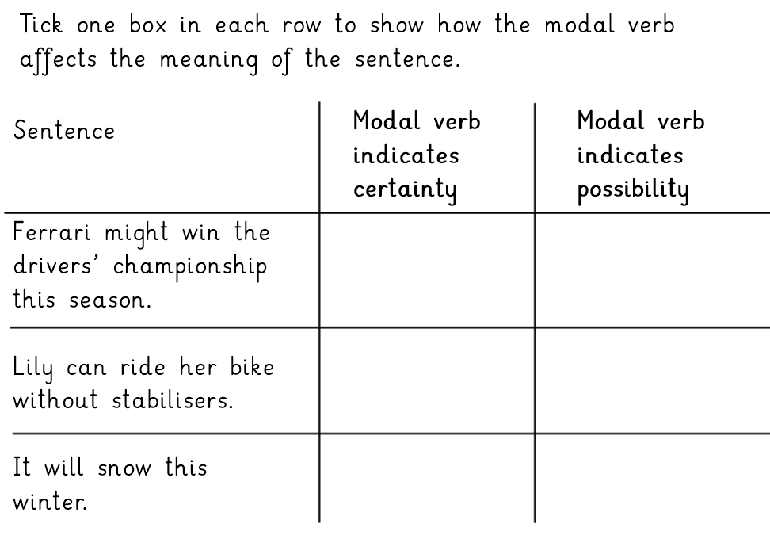

Slide 10
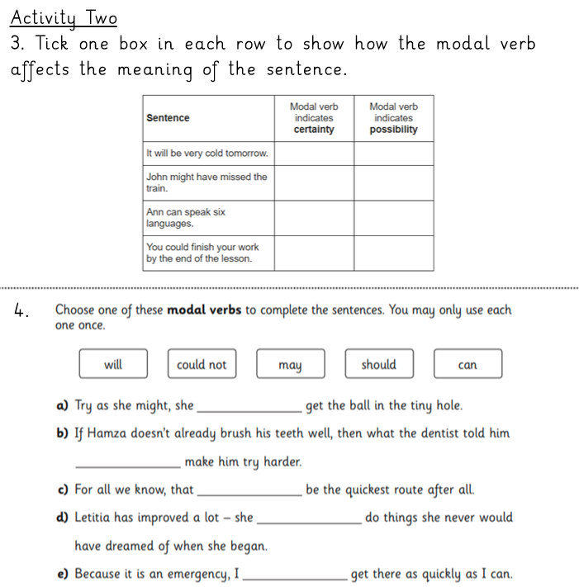

Slide 11
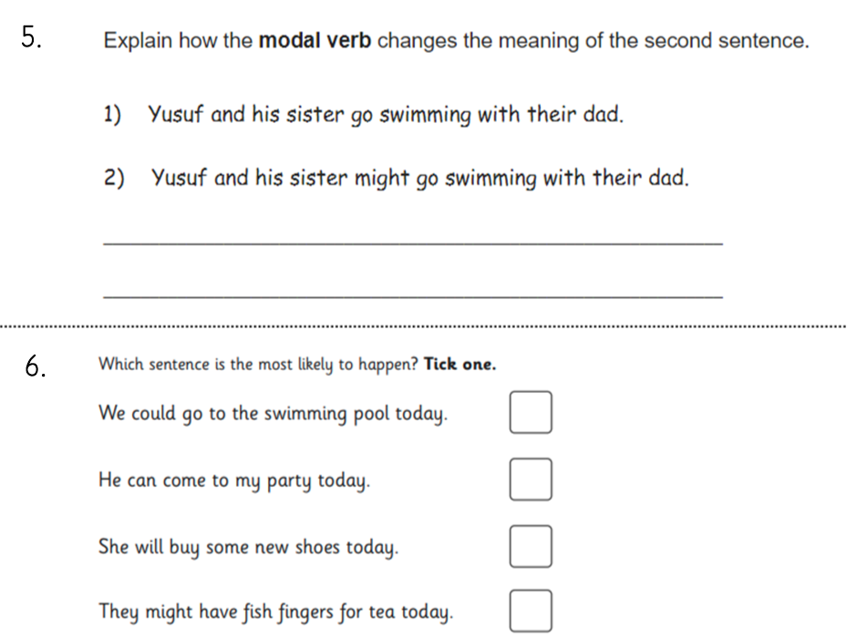

Slide 12
Day 2 – Reading comprehension

Slide 13
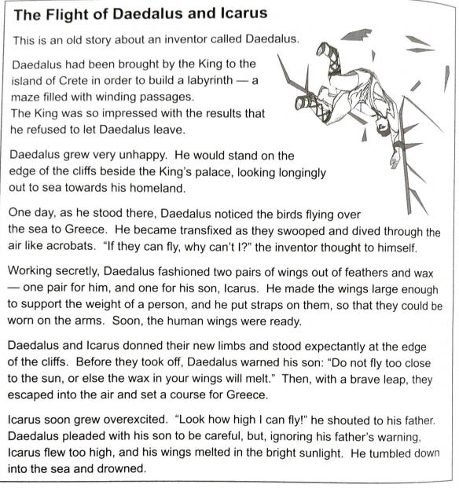
Read through the text carefully.
Think about any words you don’t know.

Slide 14
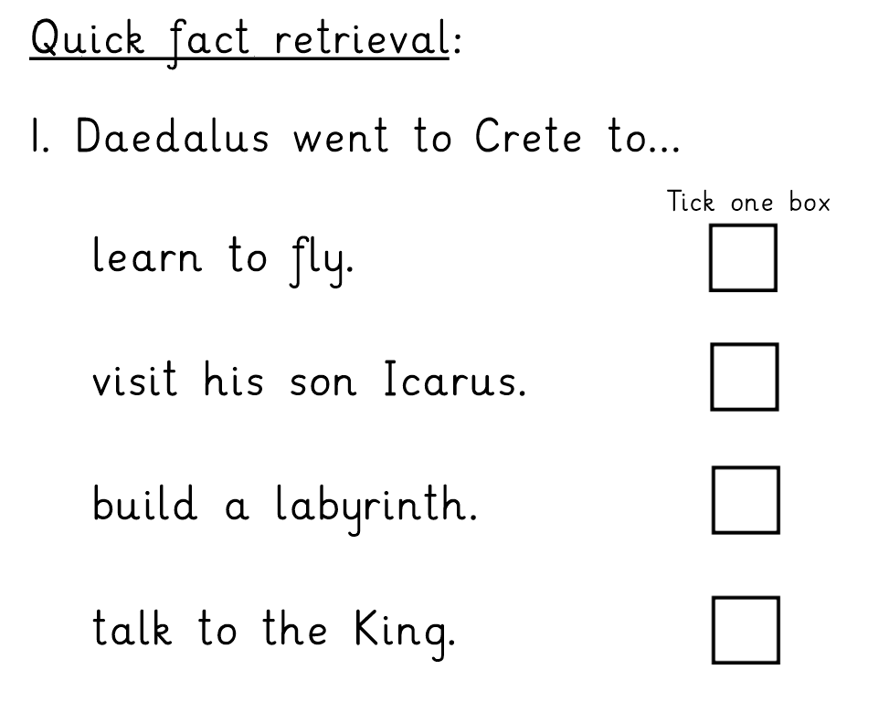
Answer the following questions in your home learning book.
Keep referring back to the text and use quotes where appropriate.

Slide 19
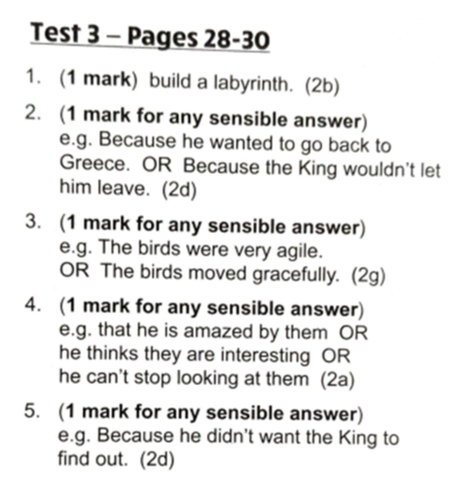
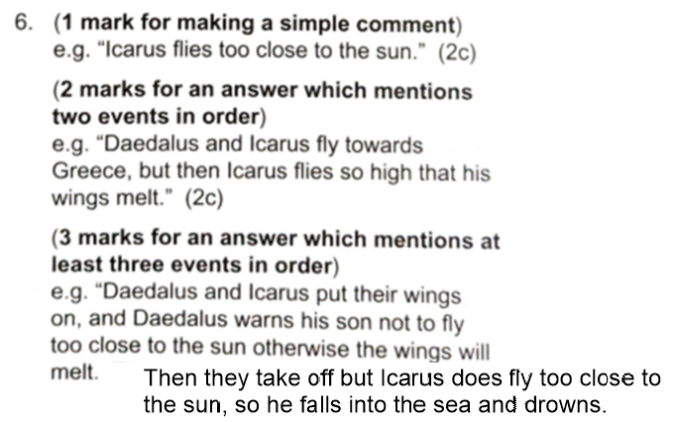
Answers

Slide 20
Day 3 – Features of a newspaper
https://www.dictionary.com/

Slide 21
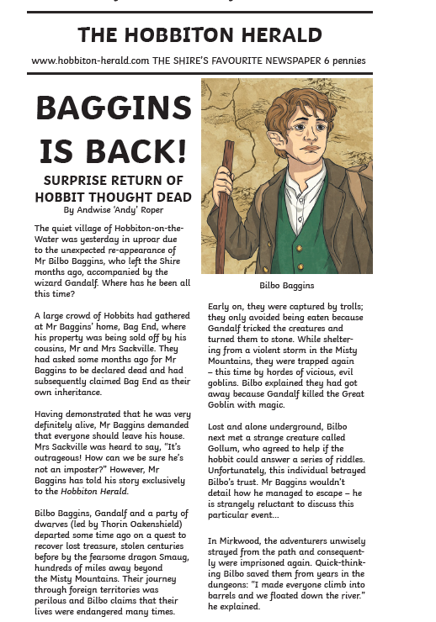
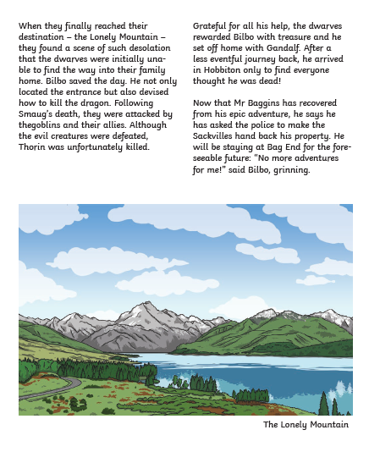

Slide 22
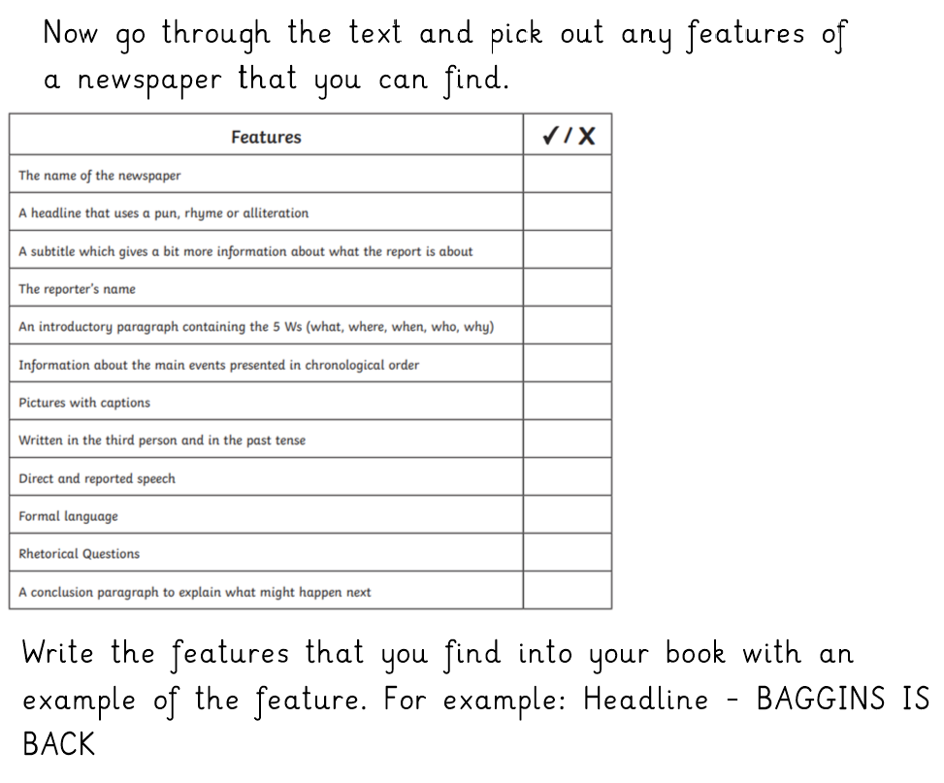

Slide 23
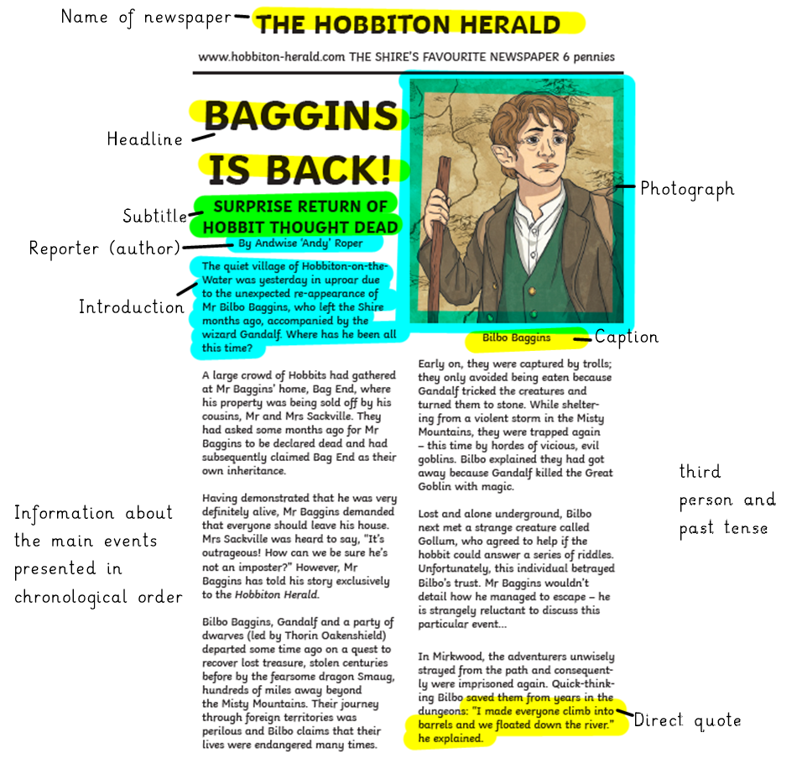
Answers

Slide 24
Day 4 – Features of a newspaper

Slide 25
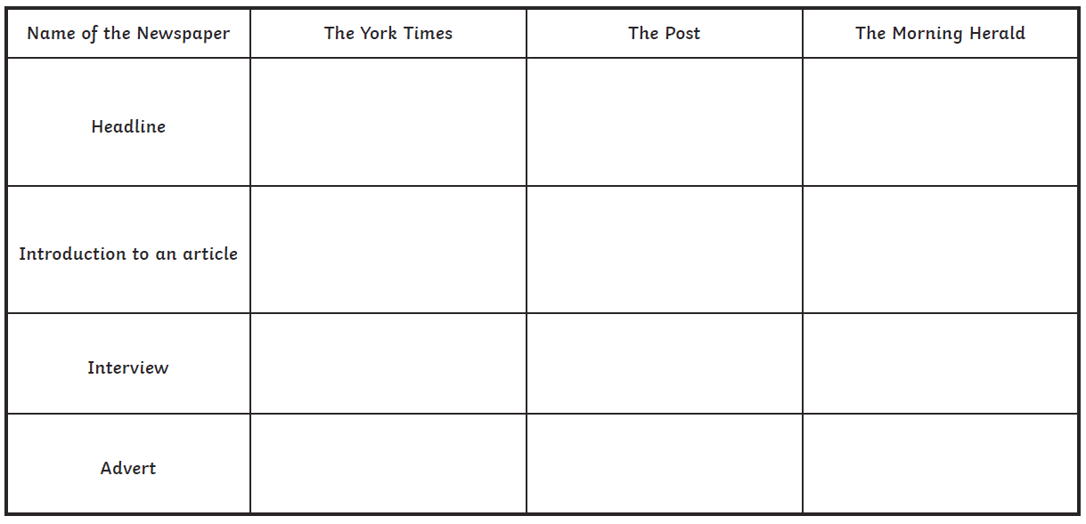
Table to be completed. You can draw this table in your book or print off a copy.

Slide 26
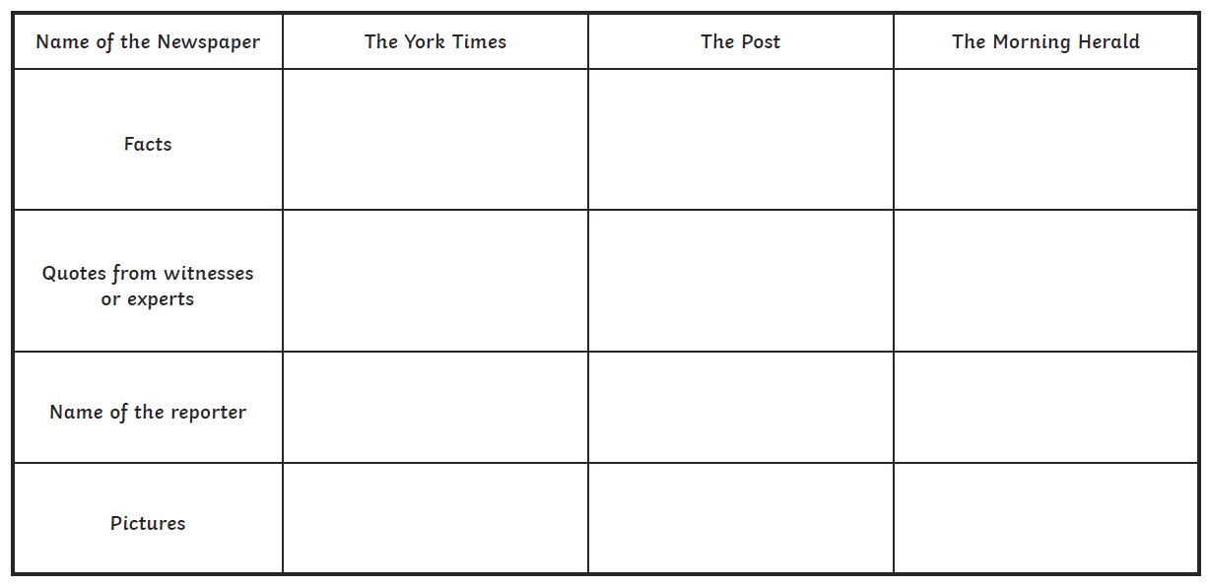

Slide 27
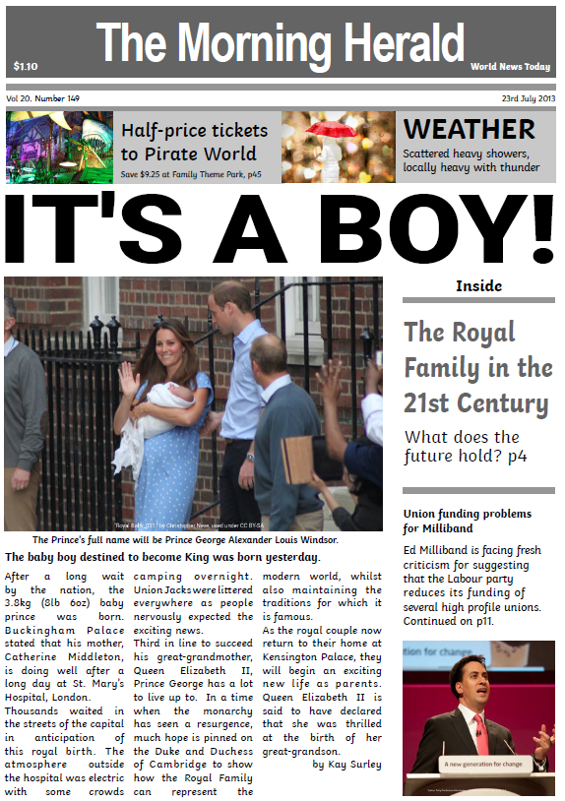

Slide 28
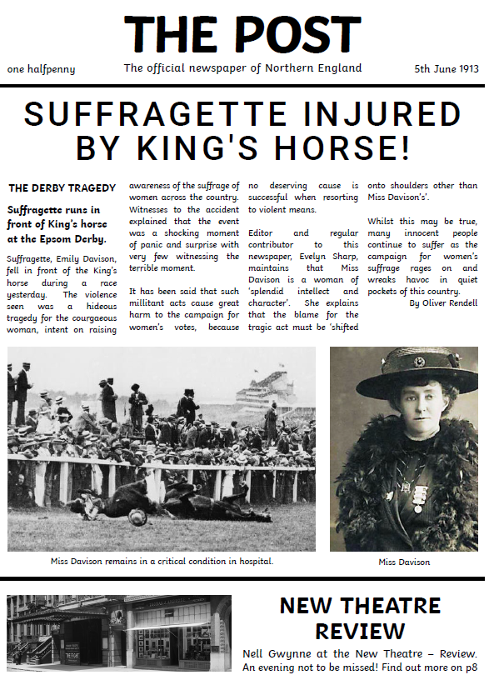

Slide 29
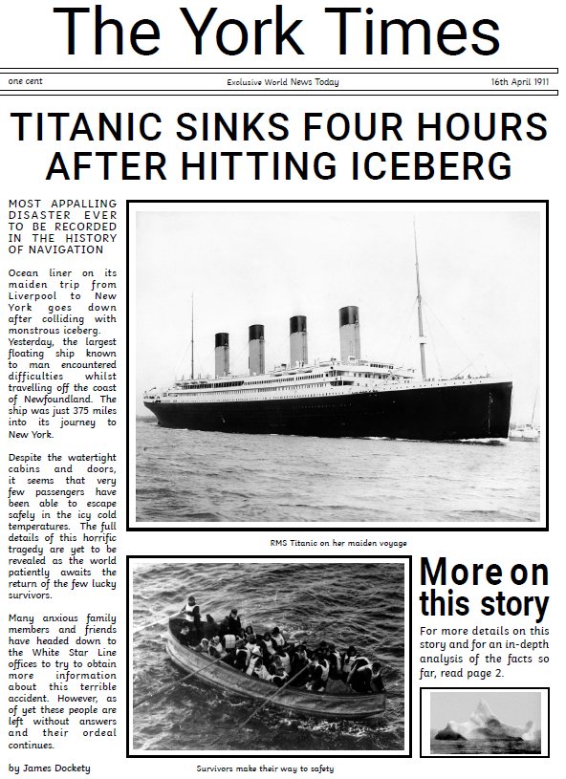

Slide 30
Now complete a table of similarities and differences between the three newspaper articles. Draw this into your book.
Similarities
Differences

Slide 31
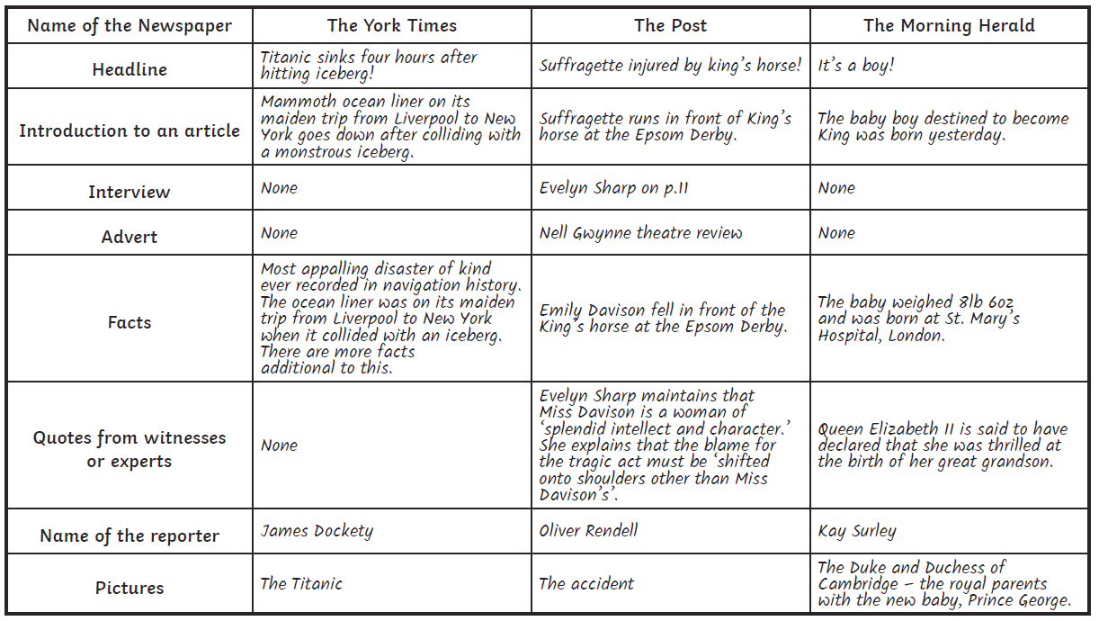
Answers

Slide 32
Day 5 – Spelling

Slide 34
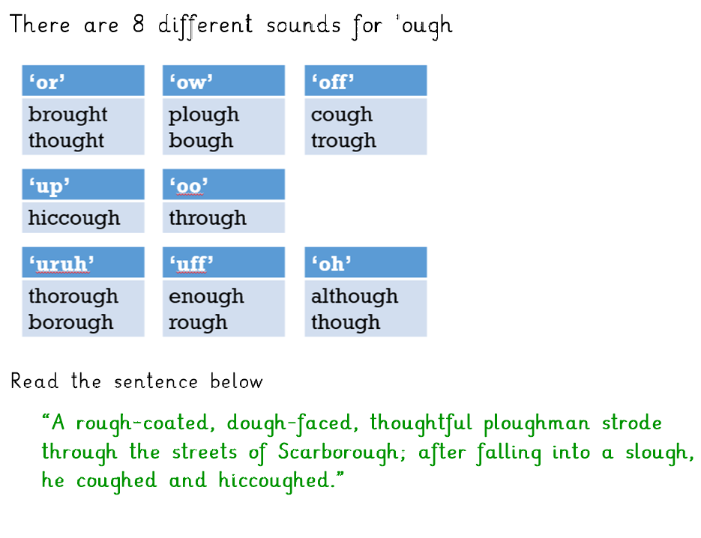

Slide 35
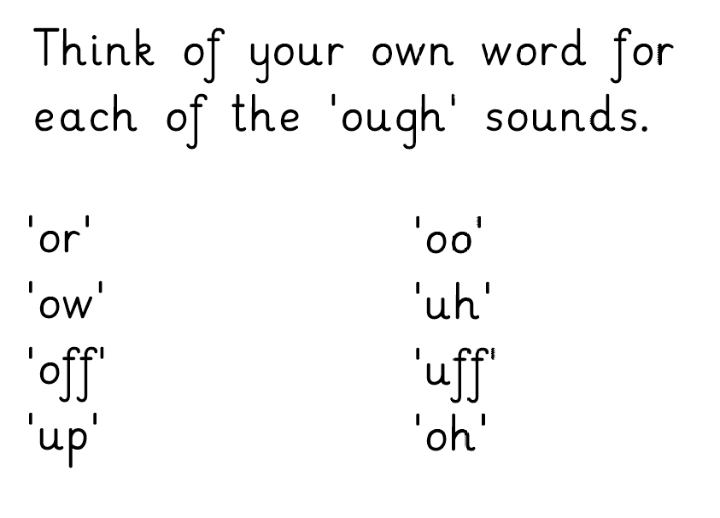
Write these words into your book.

Slide 37
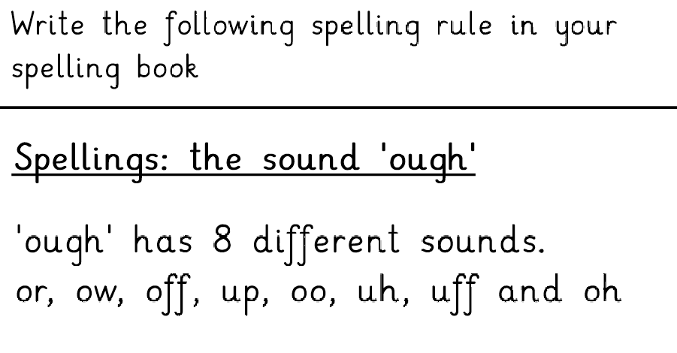

Slide 39
Spelling list
Spelling words to learn:
bought
thought
brought
fought
rough
tough
enough
through
thorough
borough
plough
though

