Slide 1
English Home Learning
Week Beginning 09.11.20

Slide 2
This week…
Day 1 – Grammar: Expanded Noun Phrases
Day 2 – Reading: Petronas
Day 3 – Writing: Power of Reading - Clockwork
Day 4 – Writing: Power of Reading - Clockwork
Day 5 – Writing: Power of Reading – Clockwork
Spelling practise website

Slide 3
Day 1 – Grammar: Expanded Noun Phrases

Slide 4
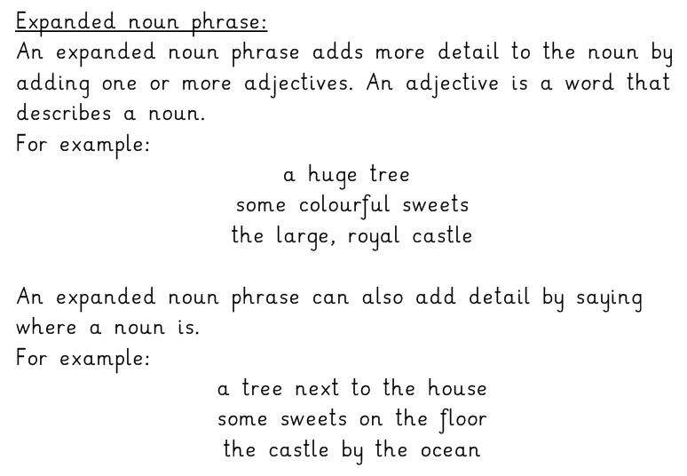

Slide 7
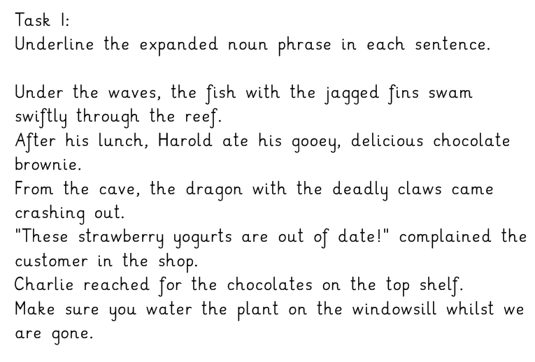

Slide 8
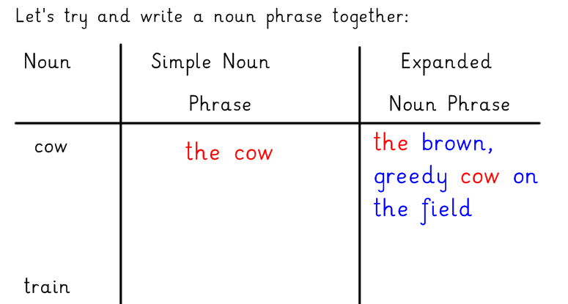
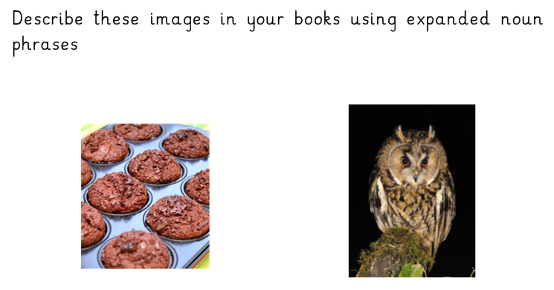

Slide 9
Day 2 – Reading comprehension
Using your bugclub login follow the link and read to page 106
Click here If the link doesn’t work, search for Petronas in your library.
Answer the bug questions as you go. Look for this symbol.
Your answers will be saved for your teacher to see.
(If the link doesn’t work straight away you may need to login first then find the book in your library)

Slide 10
Day 3 – Clockwork

Slide 12
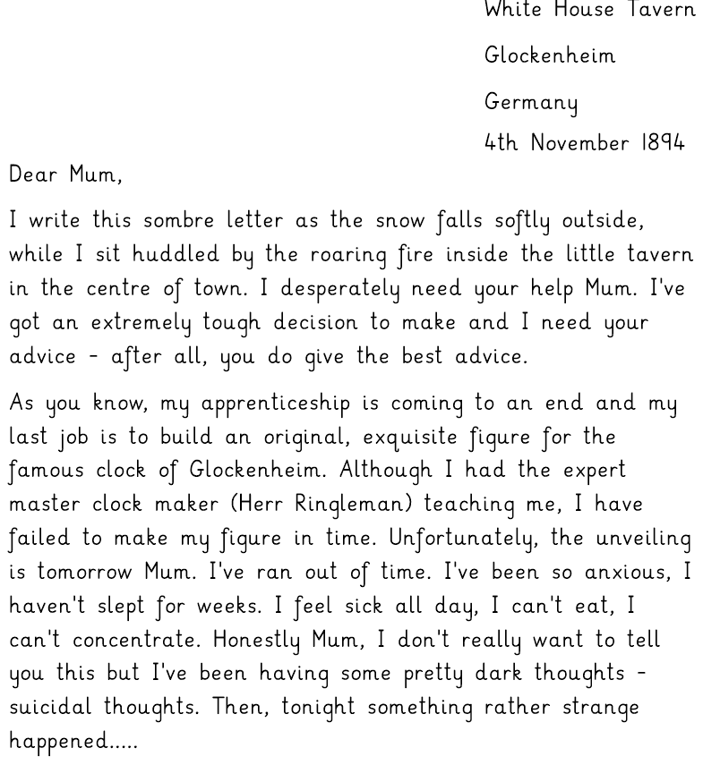

Slide 14
Day 4 – Clockwork
Write paragraph 2

Slide 15
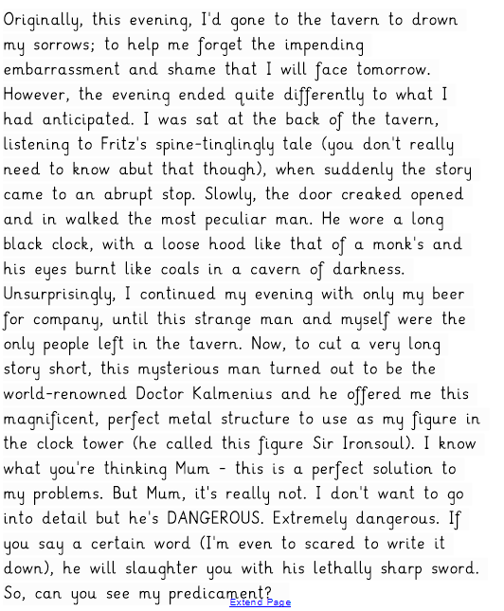
WAGOLL

Slide 16
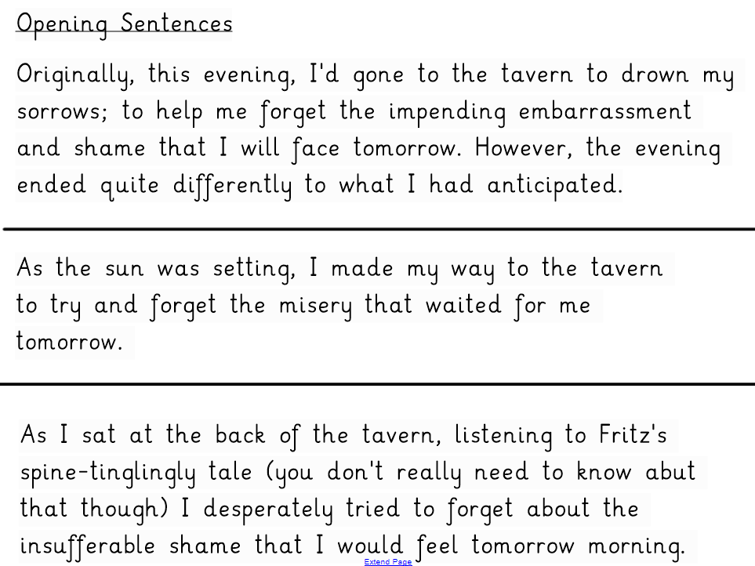

Slide 17
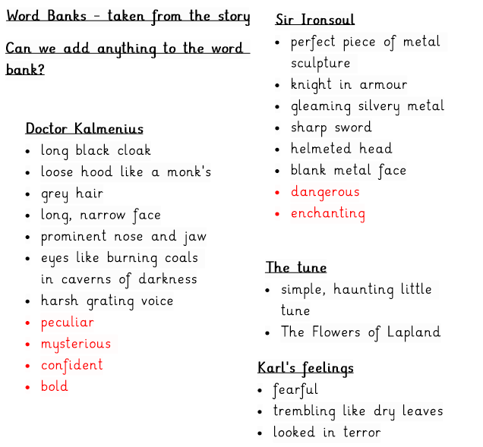
Let me tell you all about it.
The strangest thing happened to me earlier tonight.
It all started when...
I was in the tavern drinking solemnly when...
It was during Fritz's story when...

Slide 18
Day 5 - Clockwork
Write your third paragraph
Paragraph 3 – Your reaction to what has happened.
In this paragraph you need to show how frantic Karl's thoughts are and the predicament that he is in.
To do this you should include;
Reasons to make Sir Ironsoul and use him in the clock
Reasons NOT to take Sir Ironsoul

Slide 19
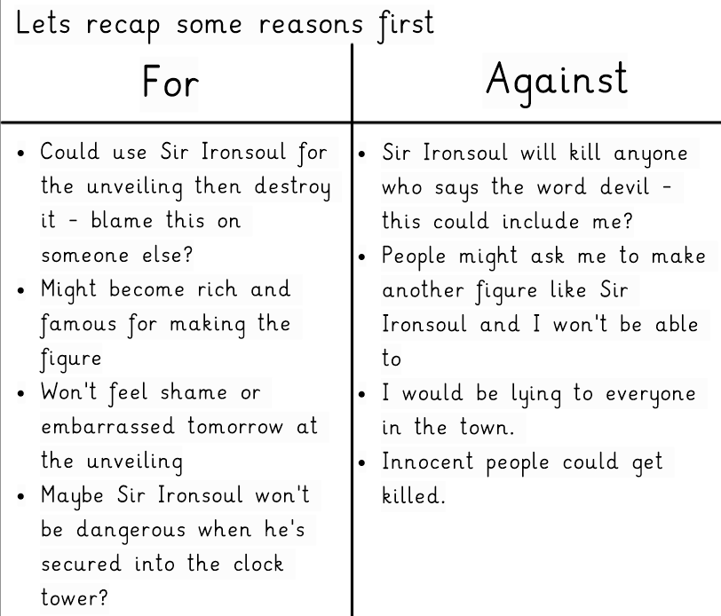

Slide 20
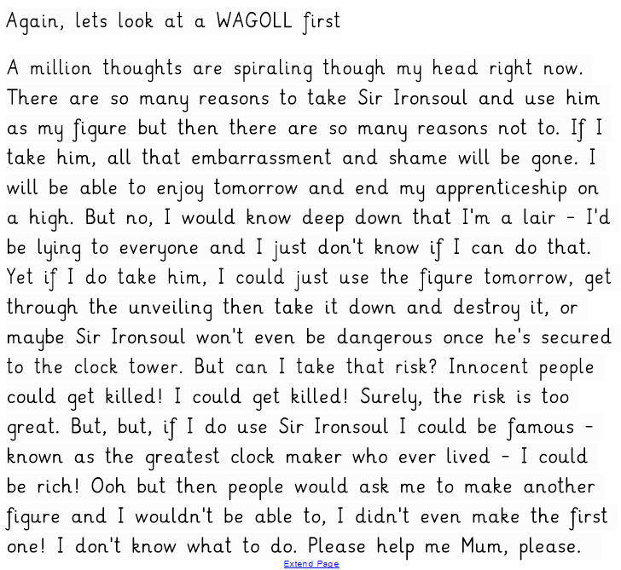

Slide 21
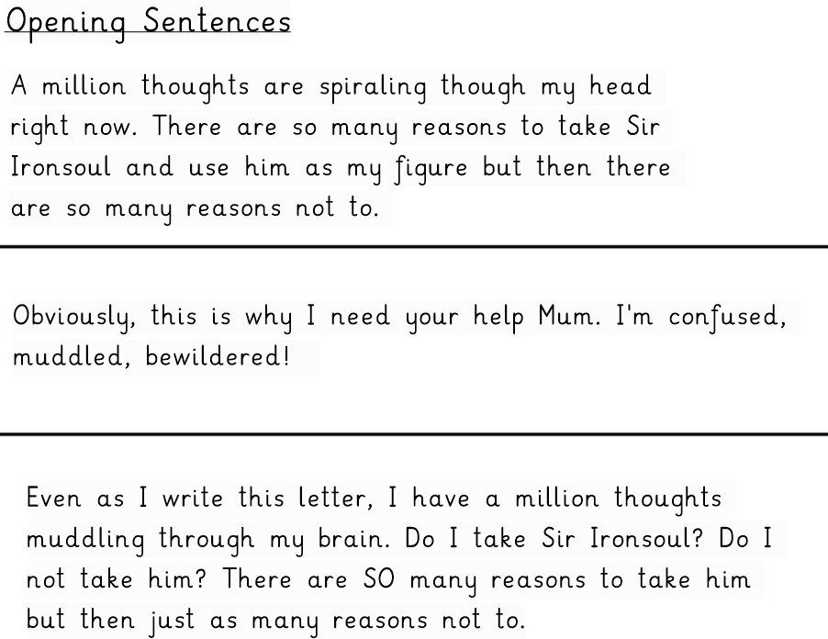

Slide 22
Spelling list and practice
Spelling words to learn:
deceive
conceive
weight
receive
weird
perceive
ceiling
conceit
friend
receipt
deceit
ancient
Go onto the website spellingshed.com to practise some of these words!

