Slide 1
English Home Learning
Week Beginning 02.11.20

Slide 2
This week…
Day 1 – Grammar: Informal/formal language
Day 2 – Reading: Petronas
Day 3 – Writing: Power of Reading - Clockwork
Day 4 – Writing: Power of Reading - Clockwork
Day 5 – Writing: Power of Reading – Clockwork
Spelling practice website

Slide 3
Day 1 – Grammar: Informal/formal language

Slide 6
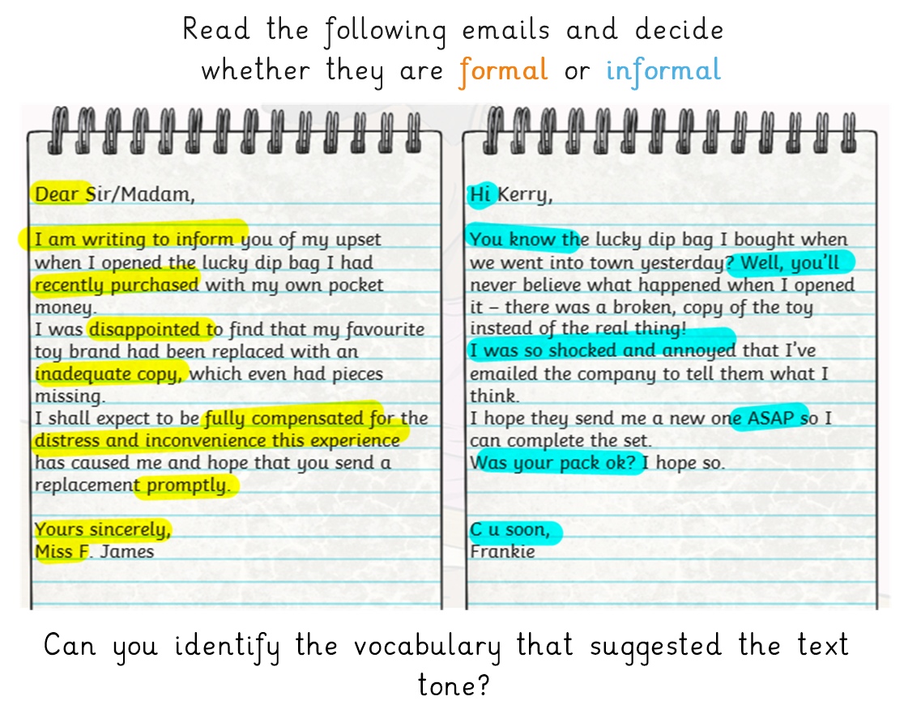

Slide 7
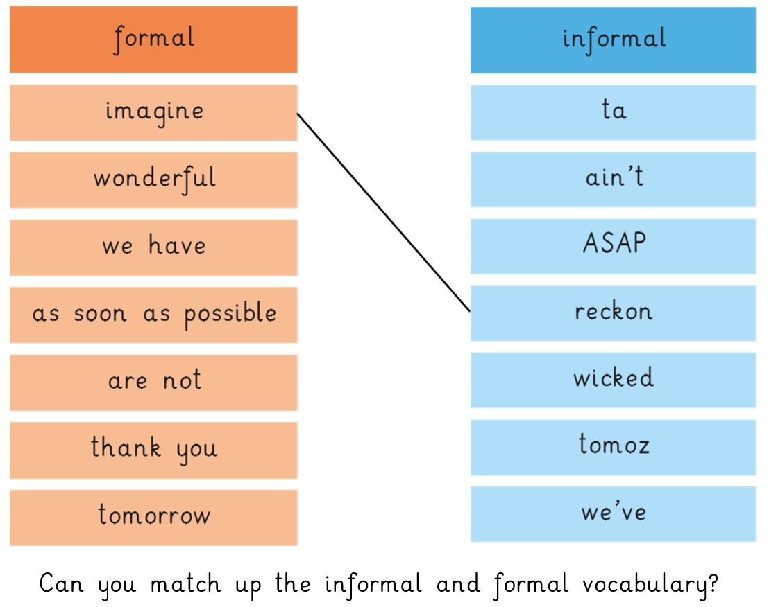

Slide 9
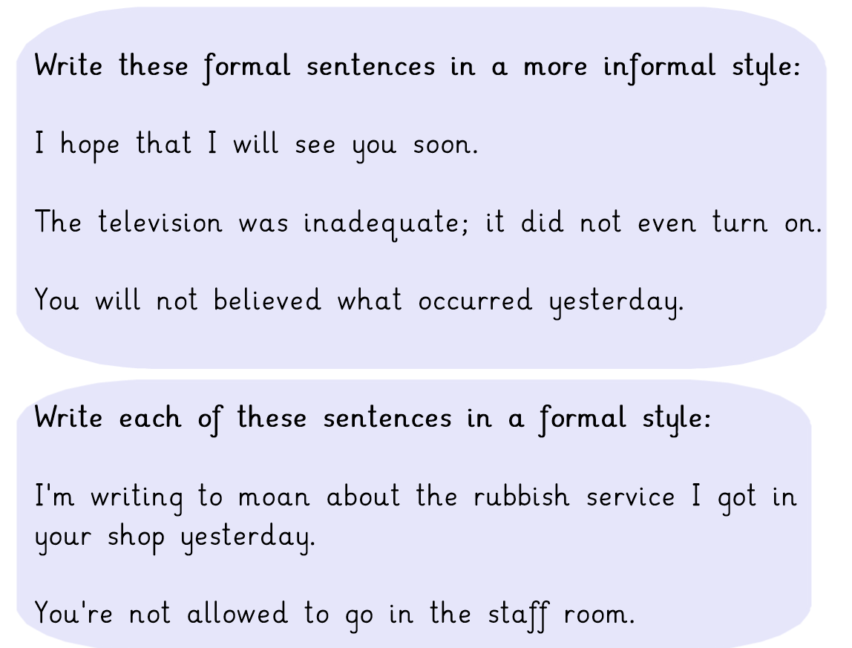

Slide 10
Further challenge:

Slide 11
Day 2 – Reading comprehension
Using your bugclub login follow the link and read to page 64
Click here If the link doesn’t work, search for Petronas in your library.
Answer the bug questions as you go. Look for this symbol.
Your answers will be saved for your teacher to see.
(If the link doesn’t work straight away you may need to login first then find the book in your library)

Slide 12
Day 3 – Clockwork
Recap the story - watch the following videos in order. This should take you up to the end of part one.
https://www.youtube.com/watch?v=6EZMbIrLuAs
https://www.youtube.com/watch?v=6EZMbIrLuAs
https://www.youtube.com/watch?v=dP-q_8CetBg
https://www.youtube.com/watch?v=RZMSfRE3VaM
https://www.youtube.com/watch?v=Ik8-oV_axqE
https://www.youtube.com/watch?v=cH4oB4NNNKw
https://www.youtube.com/watch?v=JHhxTfqMrG4
https://www.youtube.com/watch?v=rtayrF7ErtE
https://www.youtube.com/watch?v=31tlLI5Ly_M

Slide 13
Day 4 – Clockwork

Slide 15
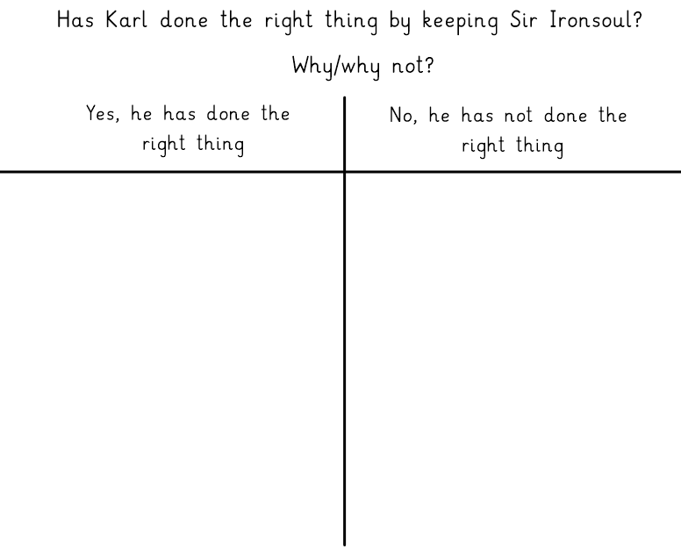

Slide 16
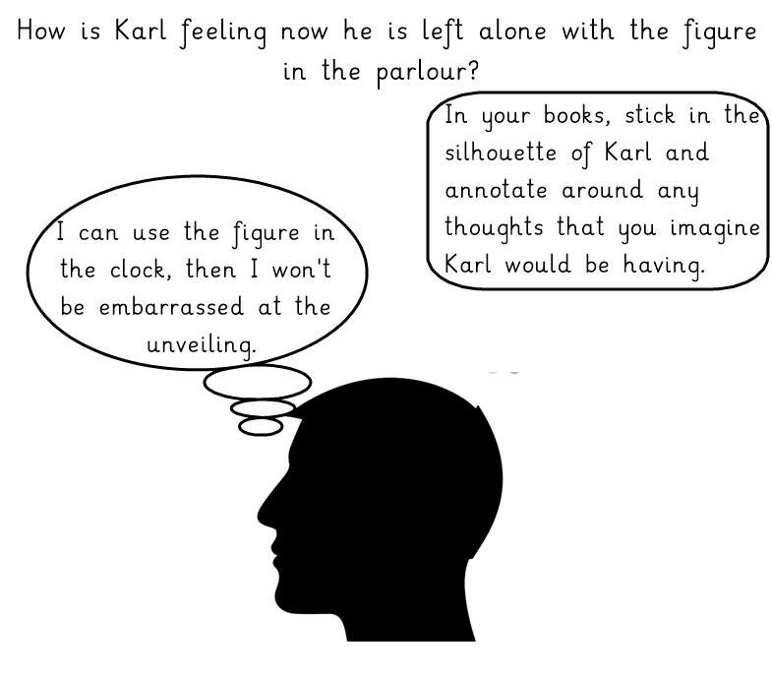

Slide 19
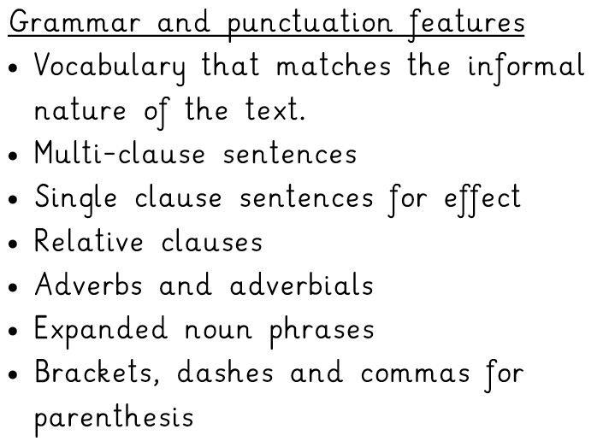

Slide 20
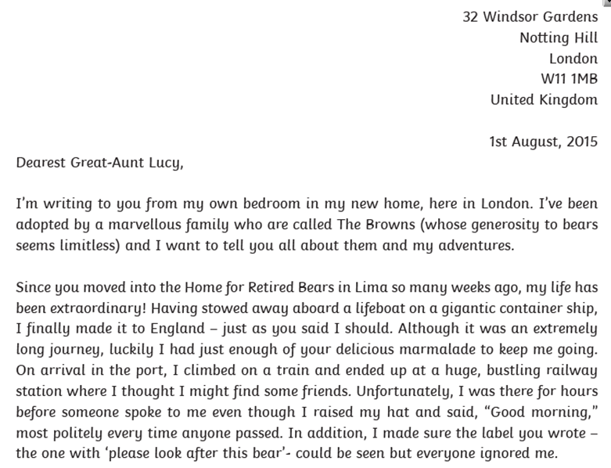

Slide 21
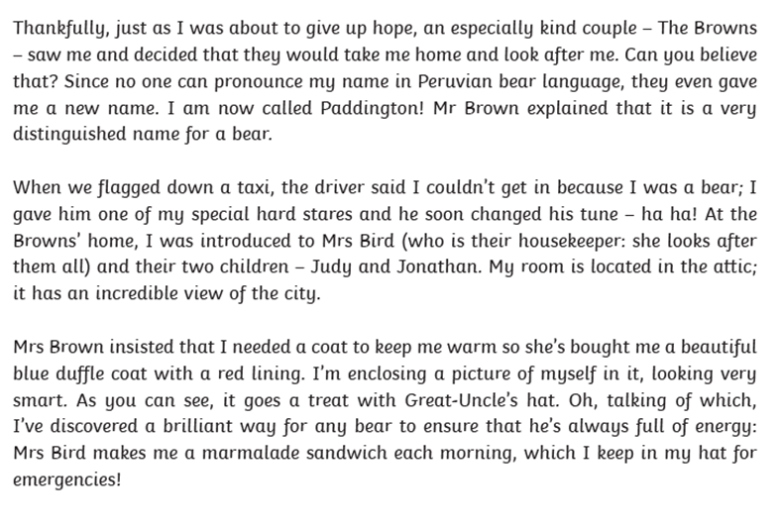

Slide 22
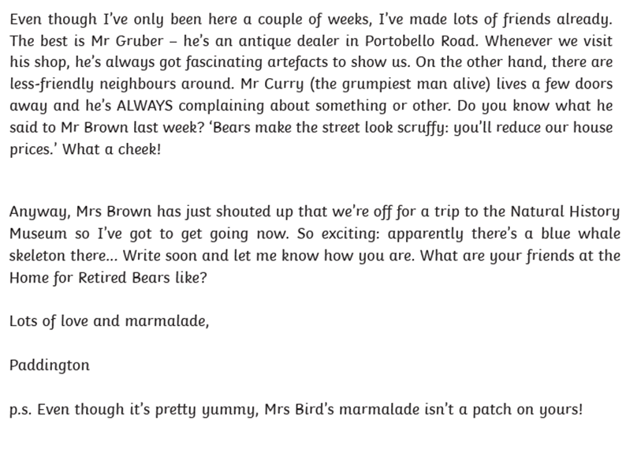

Slide 23
Day 5 - Clockwork

Slide 26
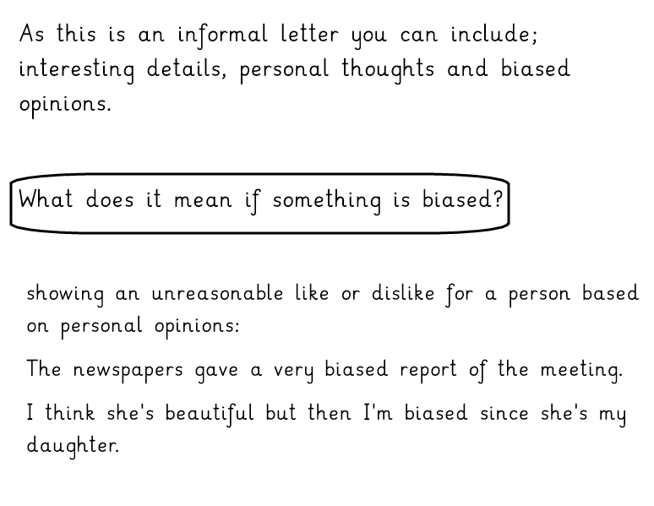

Slide 27
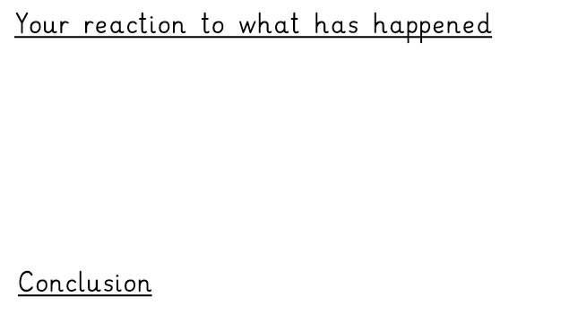
Plan your writing, use the following subheadings to organise your notes

Slide 28
Spelling list and practice
Spelling words to learn:
co-operate
co-ordinate
co-own
re-enter
re-elect
re-educate
re-evaluate
pre-election
semi-detached
non-existent
Follow the link to practise using words with the same spelling rule.
Use the begin practice section. https://spellingframe.co.uk/spelling-rule/37/44-Use-of-the-hyphen

