Slide 1
Curriculum Home Learning
Week beginning 16.11.2020

Slide 2
This Week…
Day 1 – R.E
Day 2 – History
Day 3 – P.E.
Day 4 – P.S.H.E
Day 5 - Spanish

Slide 3
Day 1 - RE
I understand the Islamic concept about God.

Slide 5
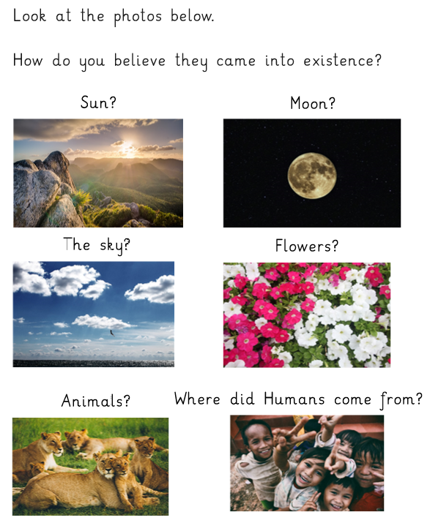

Slide 7
Today we will be looking at the Islamic concept of God. Islam is the religion of people called Muslims.
Muslims believe that someone is more important than themselves and they obey them. Muslims believe this 'being' is God, whom they call Allah.
Muslims believe that there is one God and he is eternal.

Slide 10
What Muslims believe about Allah. Watch:
https://www.youtube.com/watch?v=-3nCzuH2txo

Slide 11
Listen to this video. What does this video tell you about what Muslims believe about Allah? List it down.
https://www.youtube.com/watch?v=0lbo_9fB7XY

Slide 12
Islamic concept of God: Allah Is Unique
Muslims believe Allah is only One God. There is no God but Allah. He does not look like anyone and there is nothing that looks like Allah. He created everything and He does not look like any of the creatures He created. Allah is unique.
Muslims hold strongly to the belief that no representation of Allah should be allowed.

Slide 14
Complete this fact sheet about Allah:
Who is Allah?
Write some qualities of Allah
Draw a picture of Allah’s creations
How many names does Allah have?
Write 3 things you are grateful for

Slide 15
Day 2 - History

Slide 16
https://www.bbc.co.uk/newsround/news/watch_newsround
Using our sources of evidence from last week to support us we are going to write a script for a news script about the Anglo Saxons coming over to Britain.
You can make it as funny or as engaging as you like.

Slide 17
In your report it's important to include: Who, where, when, what and why
Who - Anglo-Saxons and Britons
Where - From Denmark, Germany and the Netherland to Britain
When - 450AD
What - Anglo-Saxons invasion
Why - List the reasons we found

Slide 18
Examples:
Reporter: Good evening and welcome to HG News.
Today our top story is the news that vicious and angry new tribes called Anglo-Saxons have invaded our country. And the main question on every bodies lips is why?
Reporter: We'll be hearing from a monk in Briton who says that the Anglo-Saxons were invited to Britain by the King to help with the invasion from the Picts and Scots.
Reporter: According to reports the Anglo-Saxons were

Slide 19
Lights, camera, action!
Try to record your news reports and watch them back once you have written out your script in your work book!

Slide 20
Day 3 – P.E.

Slide 21
Warm up:
https://www.youtube.com/watch?v=H1zuAsoGpl4

Slide 22
Recap…
What can you remember about a Haka?
What qualities should you show in your performance?
What does unison mean?

Slide 23
Watch the video. https://www.youtube.com/watch?v=SXEzldBHZoU

Slide 24
Recap - Have a go at the war dance until your actions are fluent and strong!

Slide 25
Today you will be performing the Haka with three additional movements.
What does repetition mean?
It is the same movement being repeated.
What does the word canon mean?
Demonstrate cannon using the idea of a Mexican wave.
You must perform the Haka they learnt last week and then add your own 3 new parts:
1. Repetitions
2. Cannon
3. A new movement in unison

Slide 26
Cool down…
https://www.youtube.com/watch?v=9rOQKt6z0d4

Slide 27
Day 4 – P.S.H.E

Slide 28
What would happen if we didn't have any rules at school, on the roads, in supermarkets, in the swimming pool etc?

Slide 30
Task 1:
Write down 5 reasons as to why we have rules in place?
1.
2.
3.
4.
5.

Slide 31
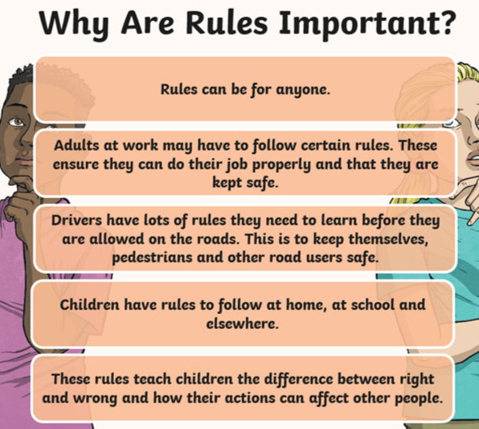

Slide 32
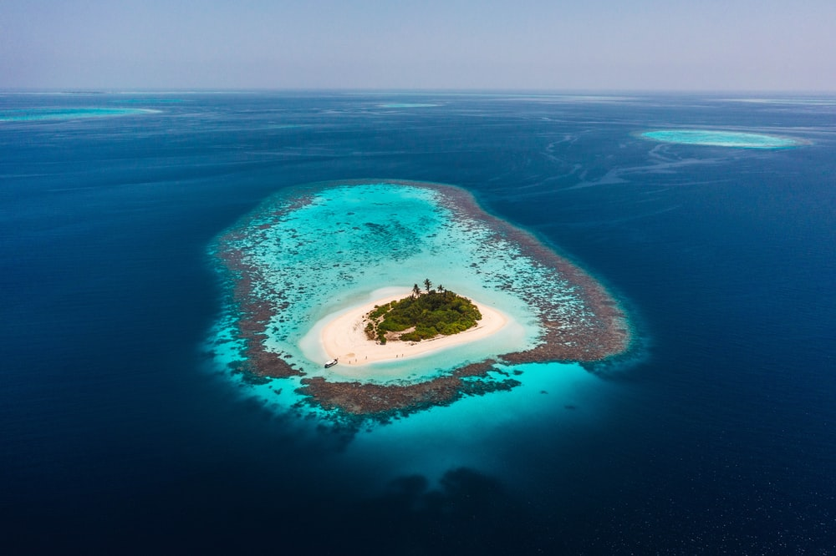
Independent Task…
Write 10 rules that you would need on your own deserted island.
Think about:
-Food
-Security
Religion
-Democracy
-Education

Slide 33
Day 5 - Spanish

Slide 34
Los pasatiempos - hobbies
Viernes 20 Novembre

Slide 35
Practise saying these phrases out loud from last week, what do they mean?
Hola
¿Cómo estas?
Estoy muy bien gracias, ¿y tú?
Estoy un poco mal.
¿Cómo te llamas?
Me llamo ___________.
Cuántos años tienes?
Tengo __________años.
Hello.
How are you?
I am very good thank you, and you?
I’m not feeling well.
What is your name?
My name is _______.
How old are you?
I am _________ years old.

Slide 36
RECAP
In your table complete the puzzle with the key phrases that we learnt last week.
Teacher to then throw around a beanbag/ball and get children to translate a key phrase or respond to your question appropriately.

Slide 37
This week we are going to learn some key vocabulary for hobbies. We are going to learn all of the verbs in the infinitive. This means the whole verb like when we say ‘to play’ or ‘to drink’ in English. We are going to begin by repeating the vocabulary. We will then complete some match up activities and a game.

Slide 38
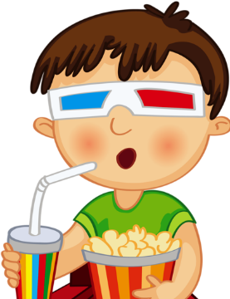
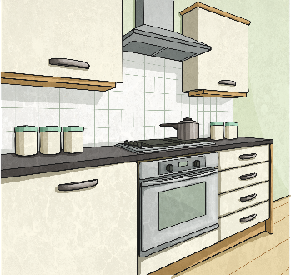
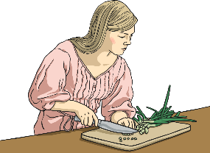
Ir al cine Go to the cinema
Cocinar to cook
Escuchar la música To listen to music

Slide 39
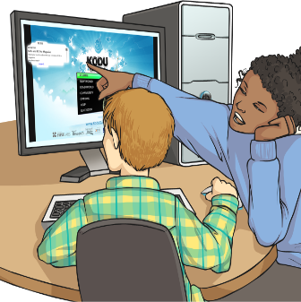
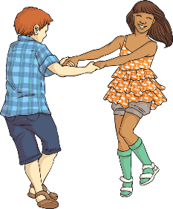
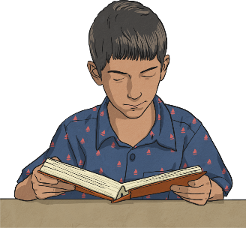
Jugar en el ordenador
To play on the computer
Bailar to dance
Leer to read

Slide 40
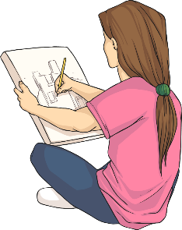
Ver televisión
to watch TV
Dibujar to draw
Cantar to sing

Slide 41
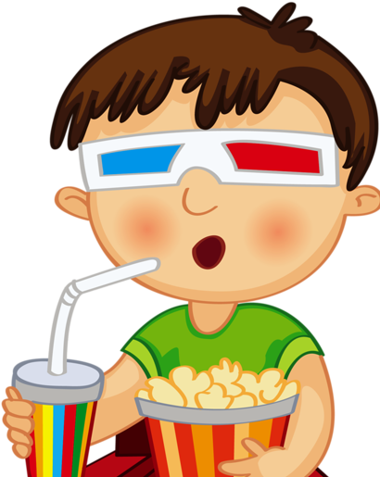
Match the picture to the correct vocabulary. Click on the sound clip to check your answers!
Ir al cine
Dibujar
Cantar
Cocinar

Slide 42
Match the picture to the correct vocabulary. Click on the sound clip to check your answers!
Ver televisión
Leer
Bailar
Jugar en el ordenador
Escuchar la música

Slide 43
Independent Task- Translate the following Spanish phrases into English and copy them into your book. Then draw a picture to go with each. Further Challenge: Think of 3 more things you like to do in your spare time. Use the dictionaries to find the Spanish vocabulary.
Ir al cine
Dibujar
Cantar
Cocinar
Ver televisión
Leer
Bailar
Jugar en el ordenador
Escuchar la música

