Slide 1
English Home Learning
Week Beginning 30.11.20

Slide 2
This week…
Day 1 – Noun Phrases
Day 2 – Features of a letter
Day 3 – Responding to a letter
Day 4 – Planning your letter
Day 5 – Reading text and answer questions

Slide 3
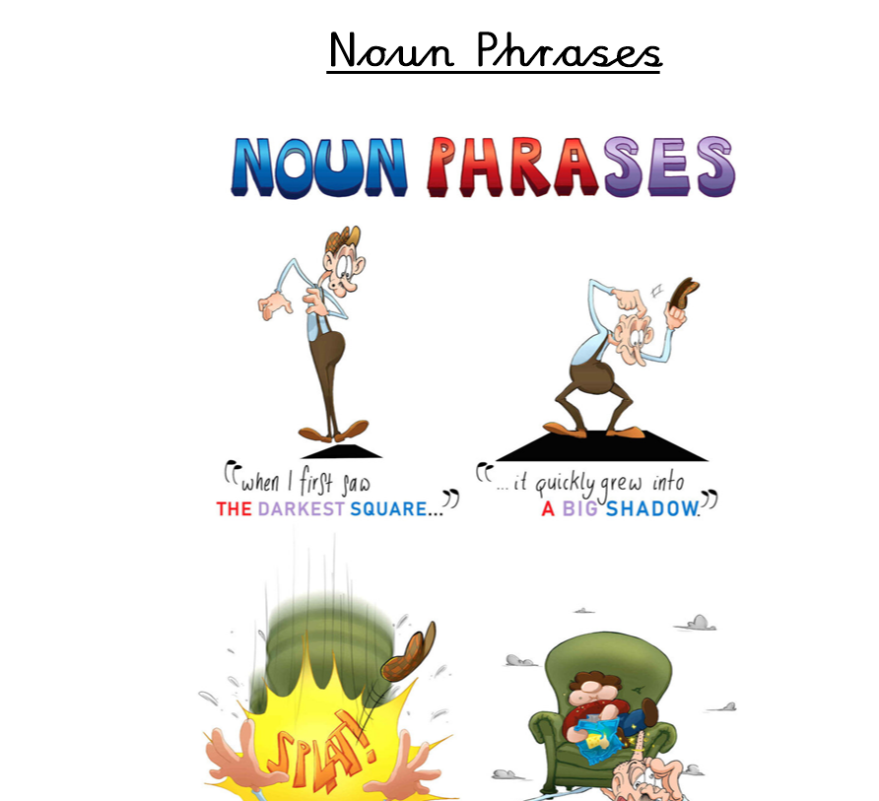
Day 1 – Grammar

Slide 5
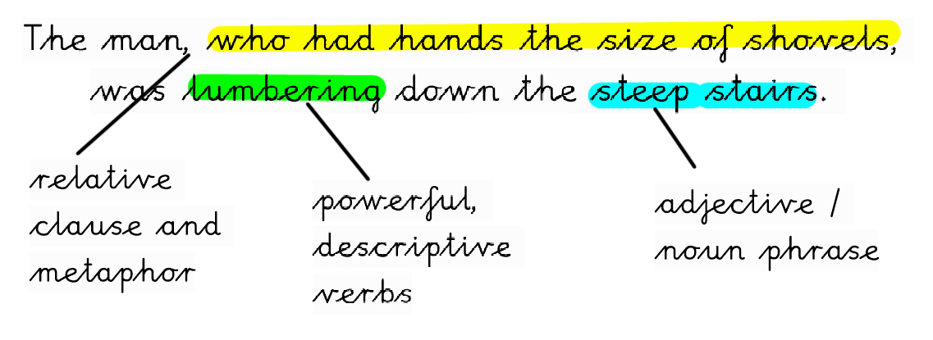

Slide 8
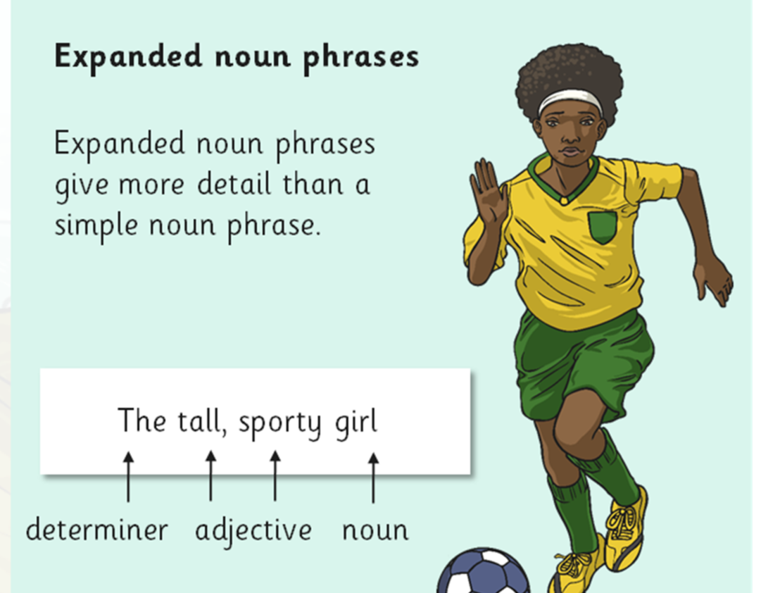

Slide 13
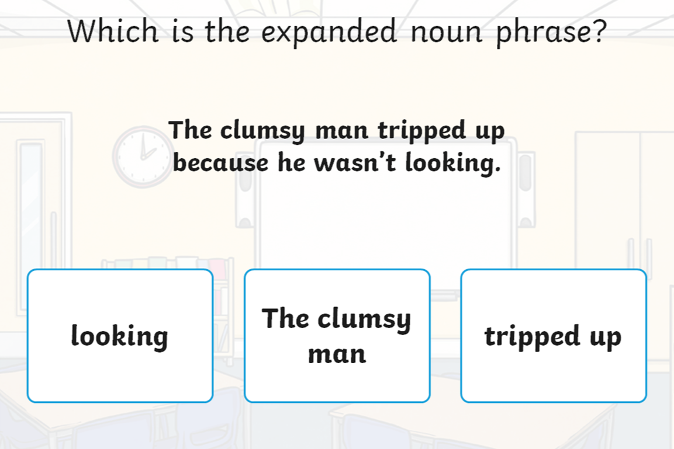

Slide 14
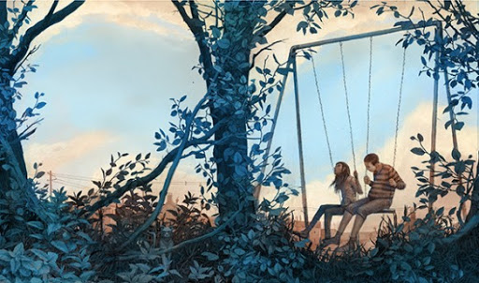
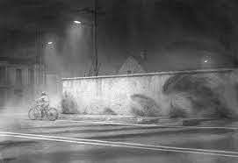
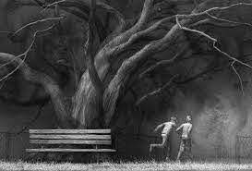
As part of your independent work, can you annotate the pictures below from ‘The Song from Somewhere Else’ and add as many appropriate Expanded Noun Phrases as you can think of.

Slide 15
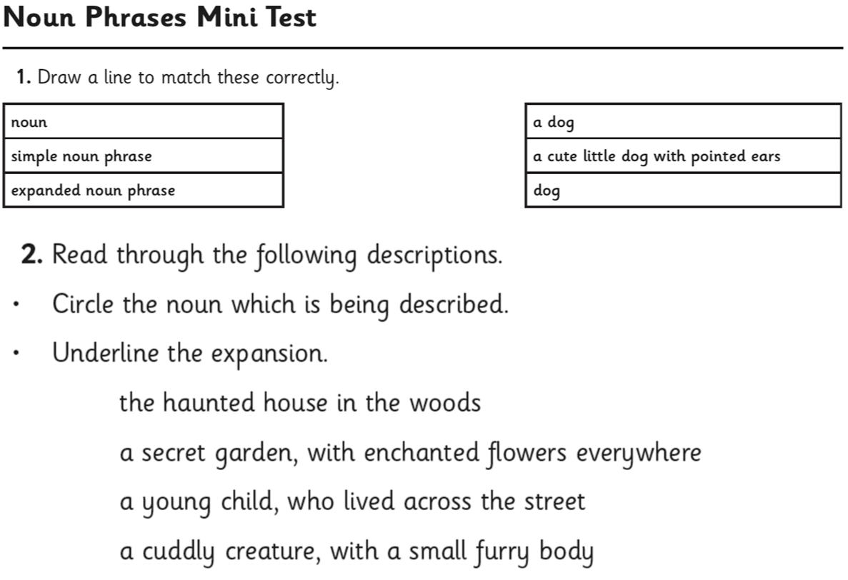

Slide 16
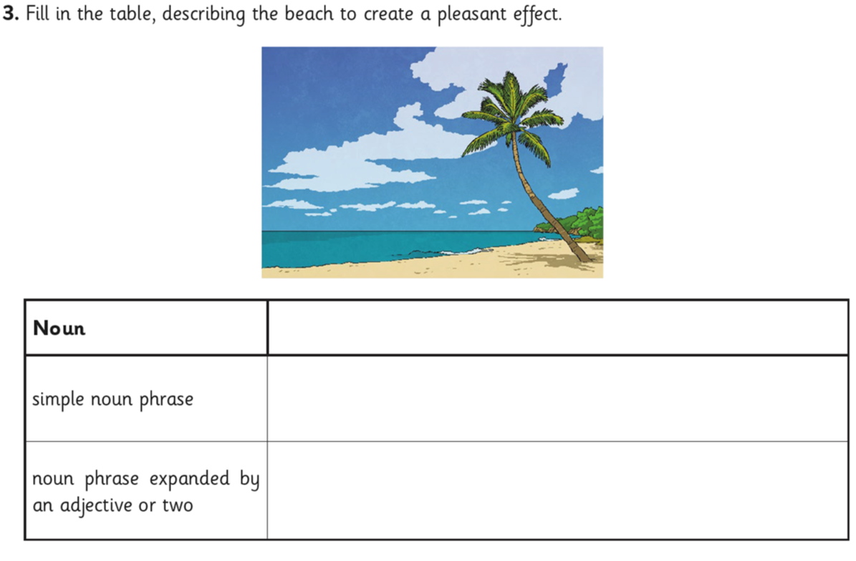

Slide 18
Day 2 – Features of a letter

Slide 20
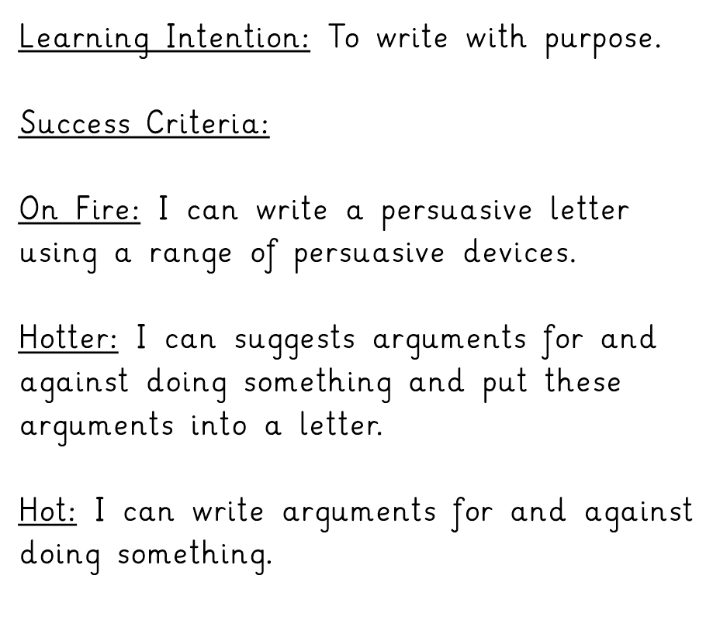

Slide 30
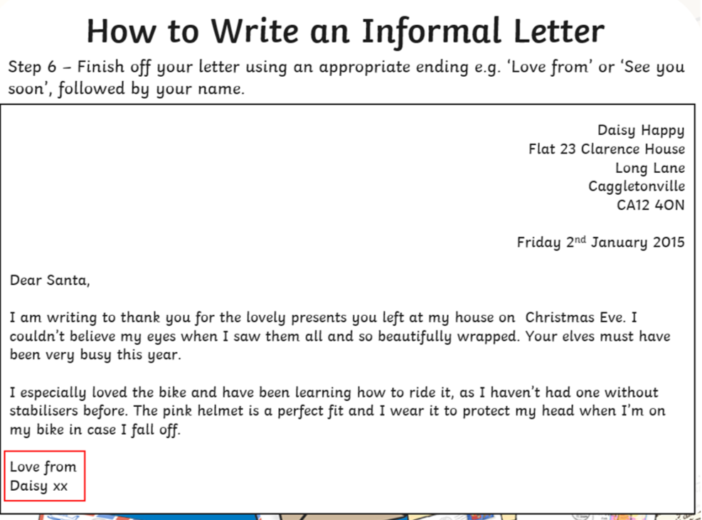

Slide 31
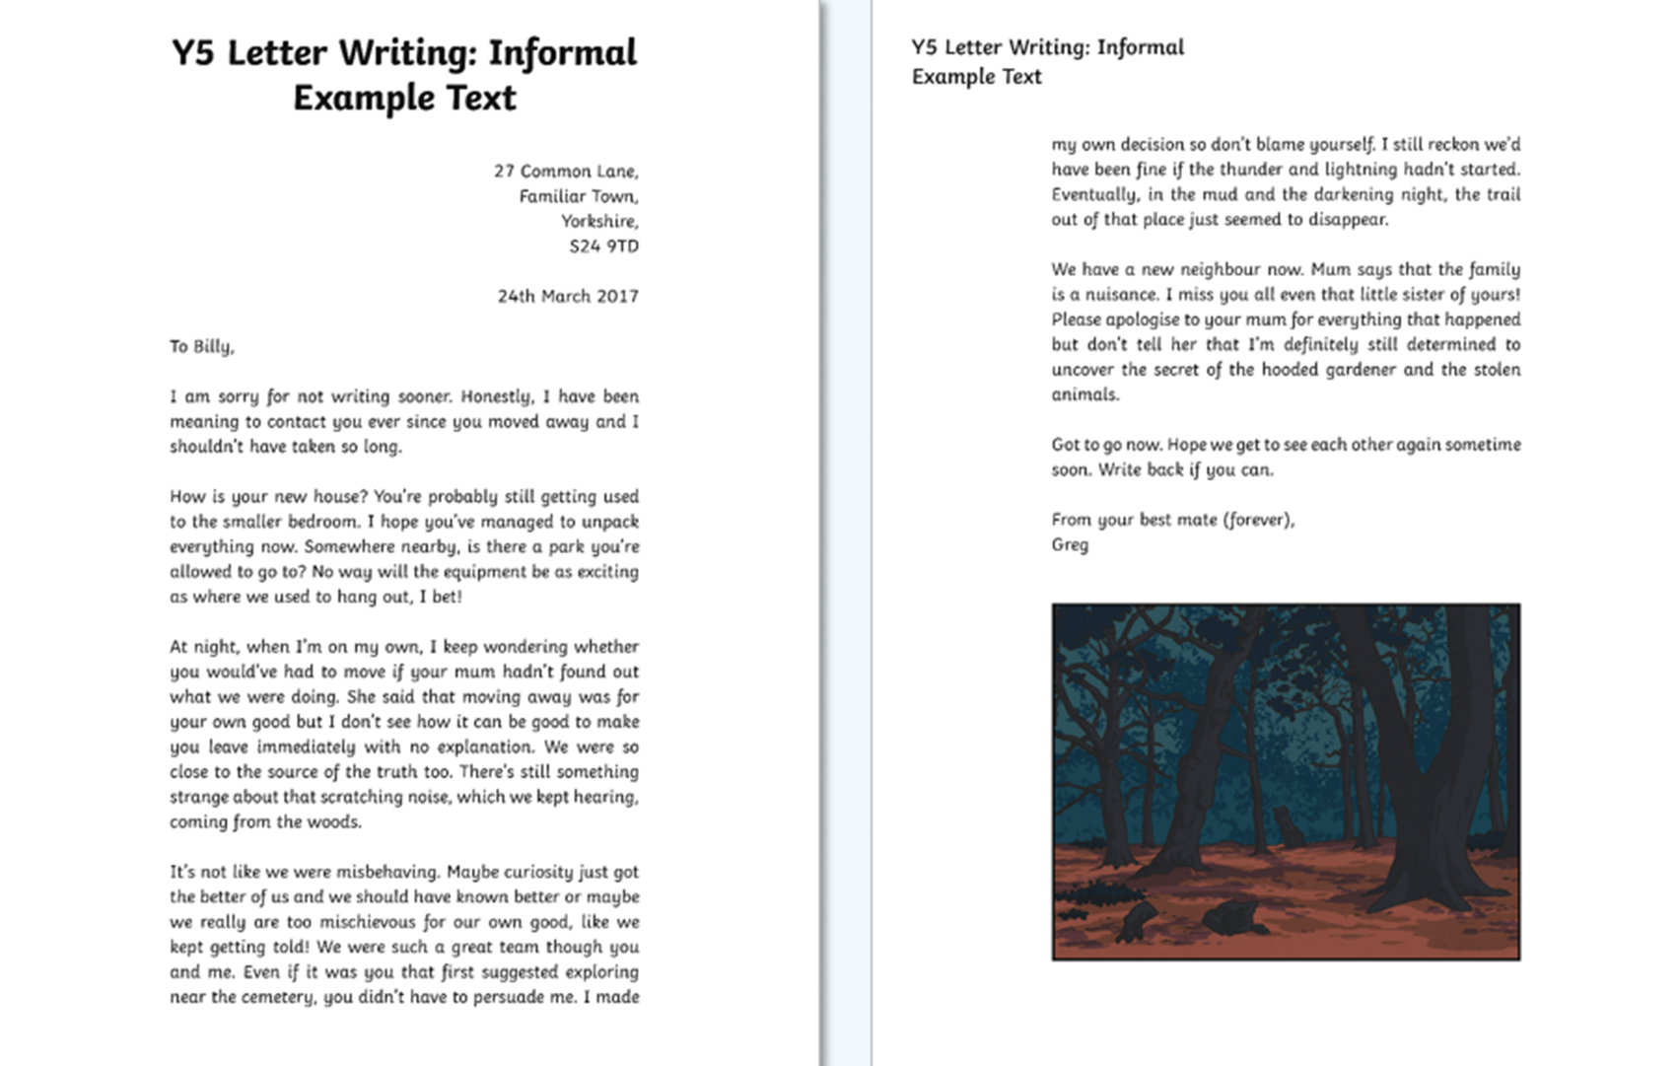
Independent Task - Annotate the features of a letter on the letter template.

Slide 32
Day 3 – Responding to a letter

Slide 33
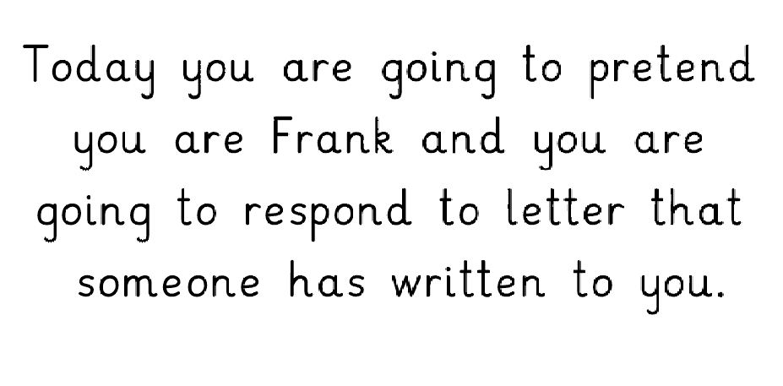

Slide 34
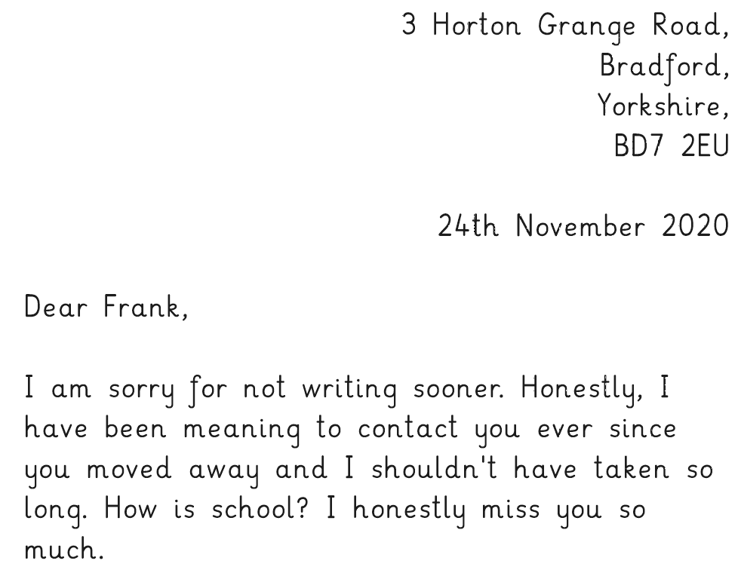

Slide 35
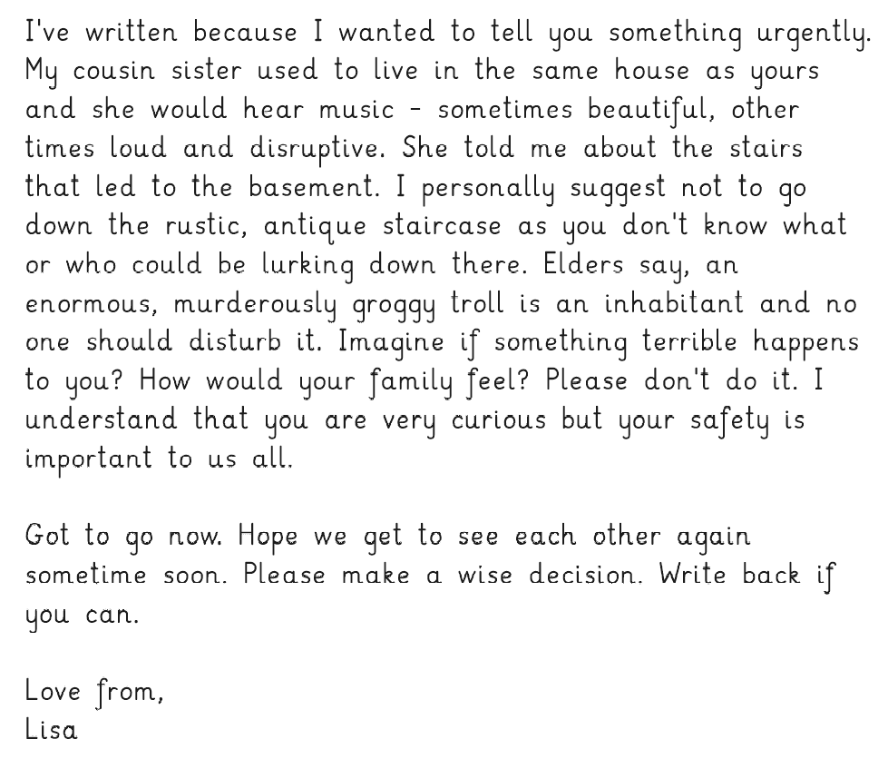

Slide 36
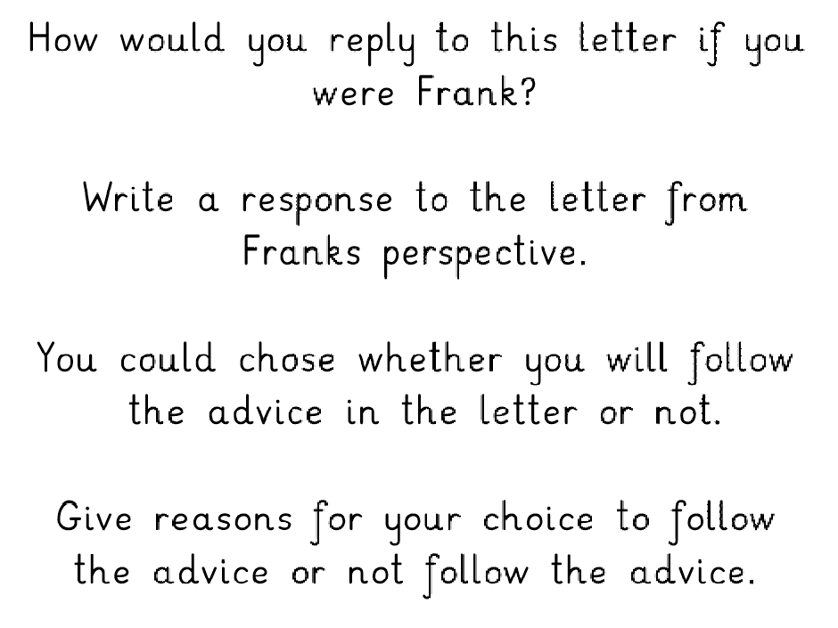

Slide 37
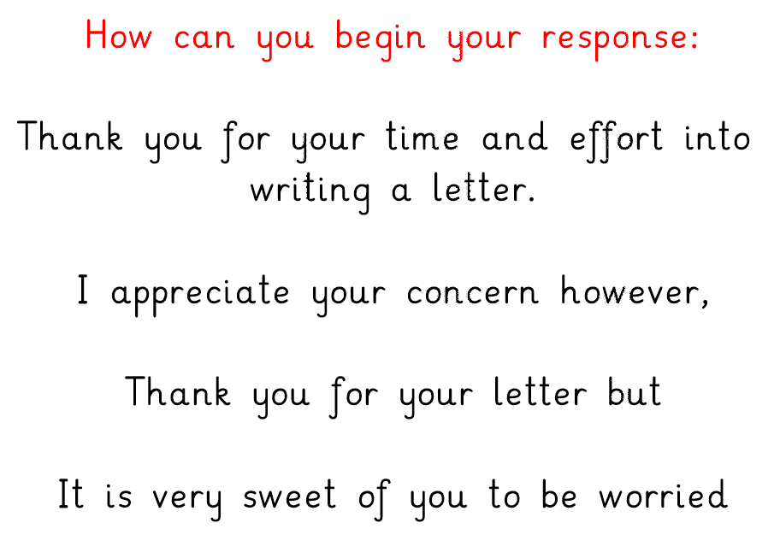

Slide 38
Day 4 – Planning your letter

Slide 39
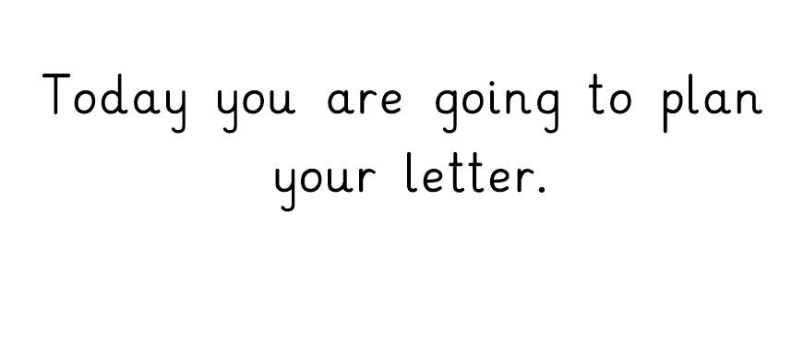

Slide 41
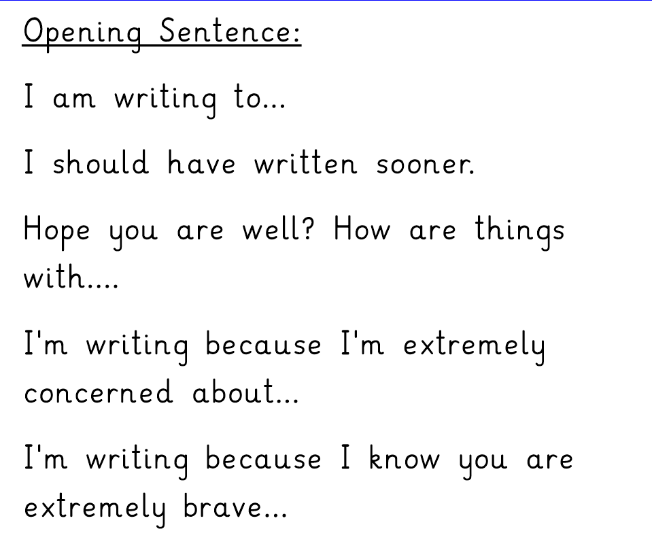

Slide 43
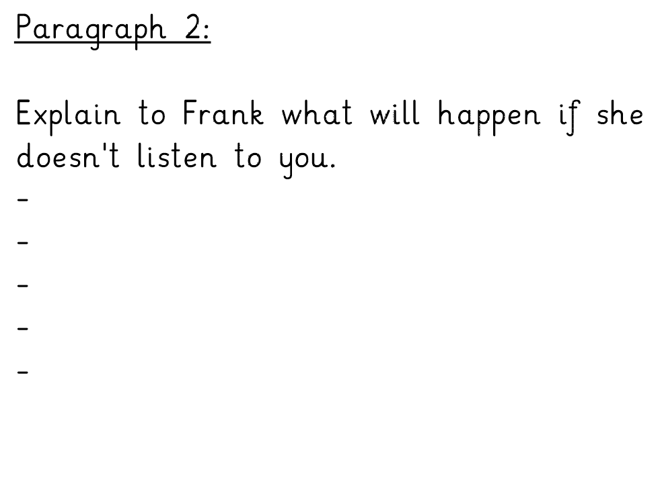

Slide 44
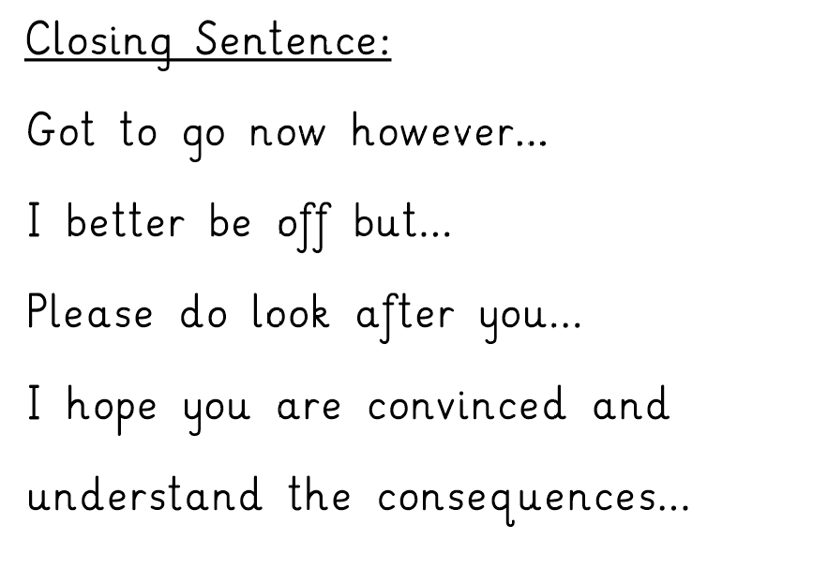

Slide 45
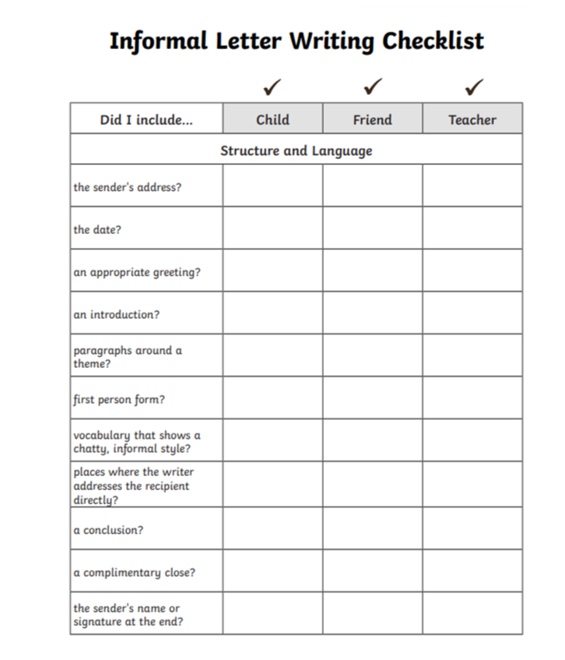

Slide 46
Day 5 – Reading Comprehension

Slide 49
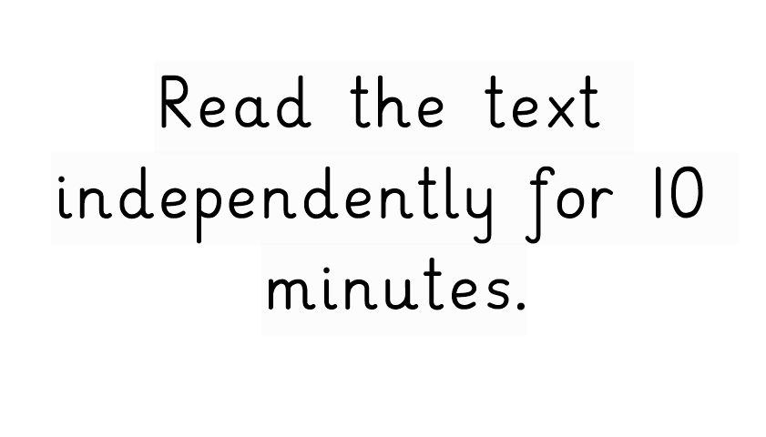

Slide 50
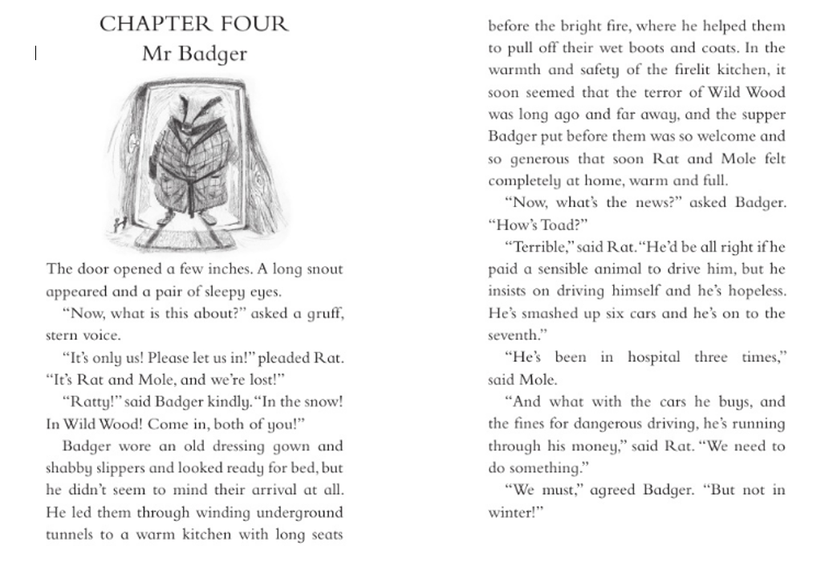

Slide 51
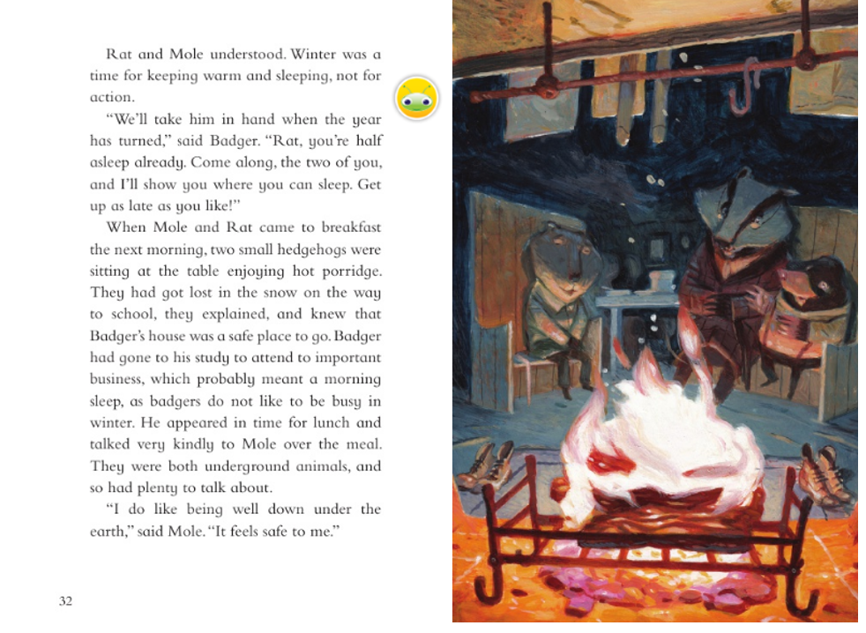

Slide 52
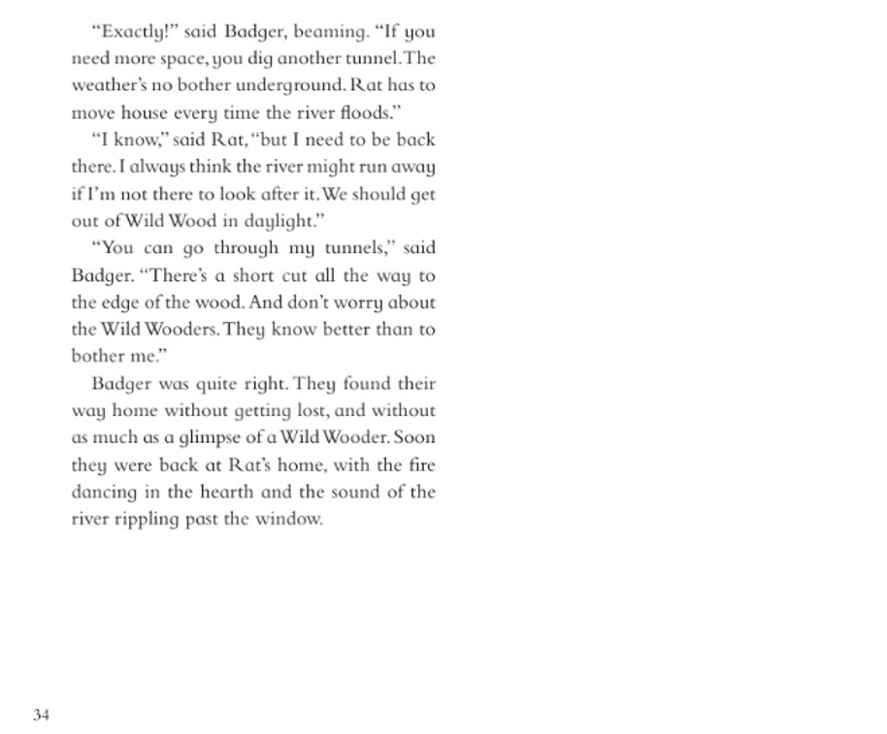

Slide 57
