Slide 1
Maths Home Learning
Week Beginning 16.11.2020

Slide 2
This week…
Day 1- Lines of Symmetry.
Day 2 – Lines of Symmetry
Day 3 – Recognising turns
Day 4 – Turns
Day 5 – Angles as turns

Slide 3
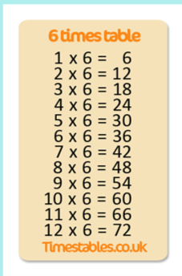
Arithmetic
Let’s learn our x 6 tables
Play the game below
https://www.topmarks.co.uk/maths-games/hit-the-button

Slide 4
Day 1 – Recap

Slide 5
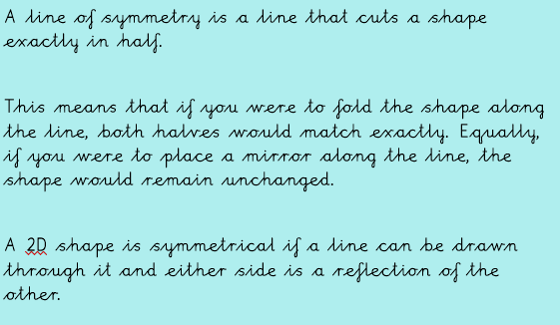
Day 1
Watch the video below
https://www.bbc.co.uk/bitesize/topics/zrhp34j/articles/z8t72p3#:~:text=a%20shape%20symmetrical%3F-,Symmetry,would%20show%20the%20whole%20shape.

Slide 6
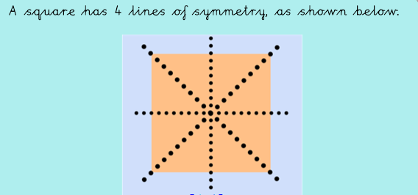
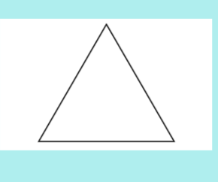
Day 1- I do

Slide 7
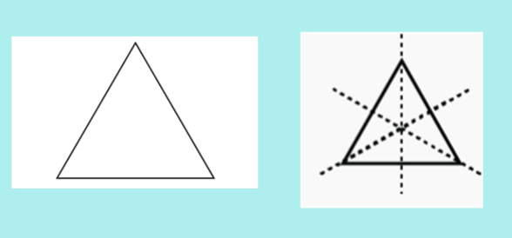
I do
It has 3 lines of symmetry!

Slide 8
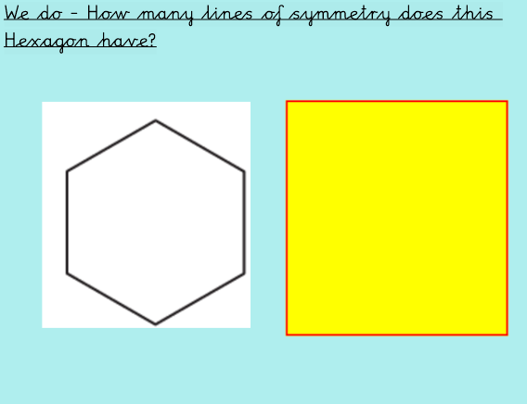
We do

Slide 9
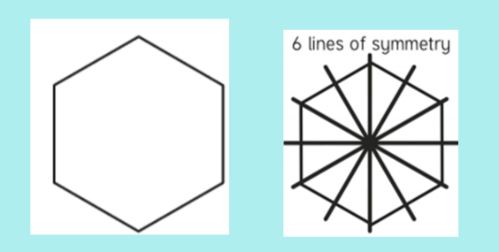
We do - Answers

Slide 10
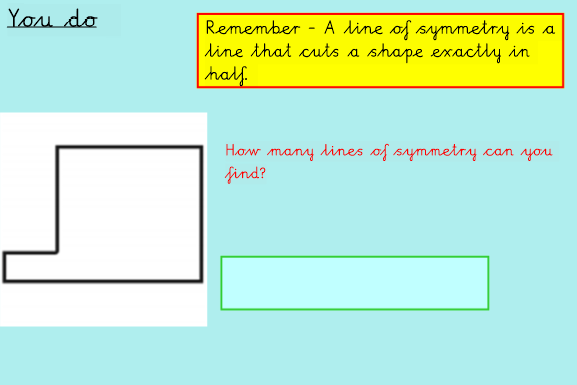
You Do…

Slide 11
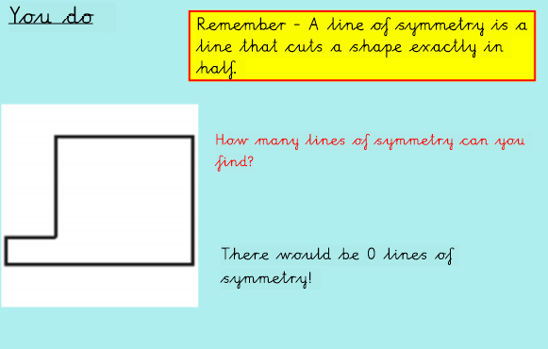
You Do…Answers

Slide 12
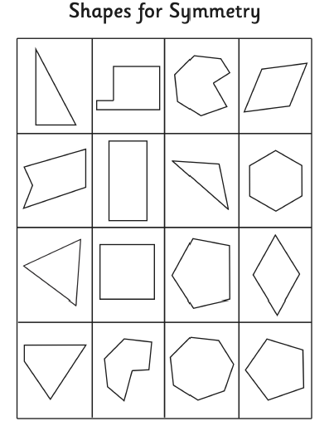
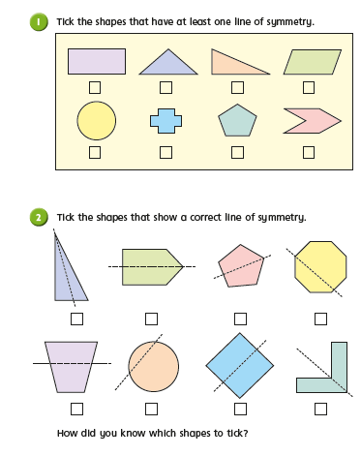
Main Task
Find the lines of symmetry in the shapes below
Challenge

Slide 13
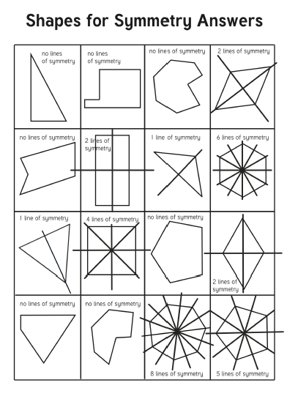
Answers

Slide 14
Day 2 Chant your 6 x tables
Write down your answers in your books, how long did it take you?
Can you write down the inverse?
Remember the inverse of mulitiplication is division!
Example: 18÷6=3

Slide 15
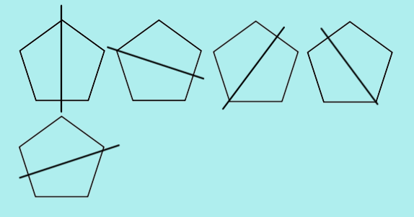
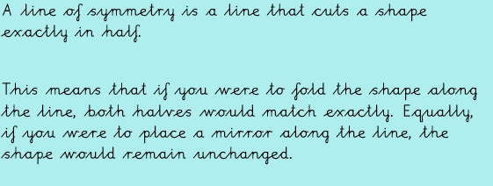
Day 2
Are these lines of symmetry?
Discuss.

Slide 16
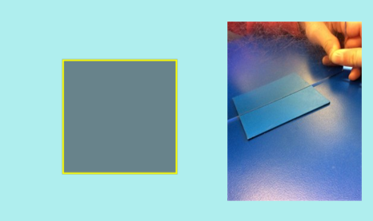
We Do..
What shape is this?
How many lines of symmetry does it have?

Slide 17
You Do
What is this shape?
How many lines of symmetry does it have?

Slide 18
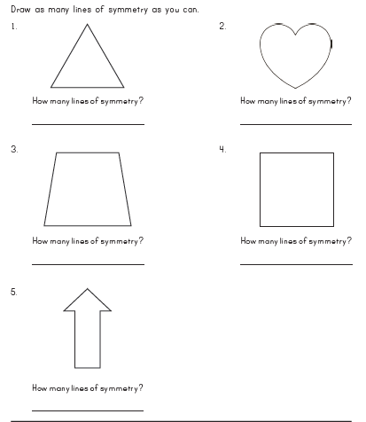
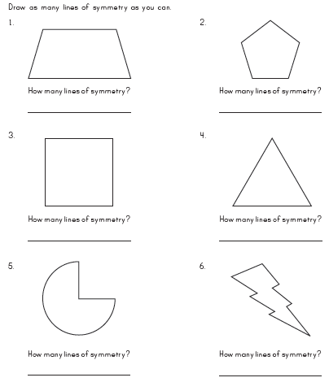
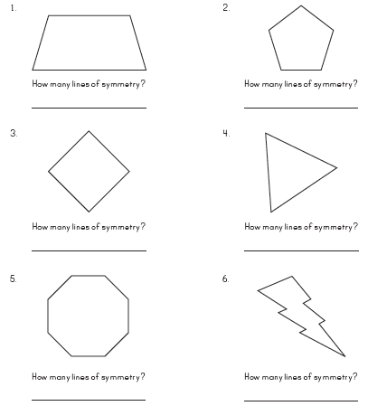
Day 2 Main Task –
Storms Black Panthers Hulks

Slide 19
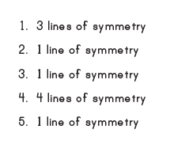
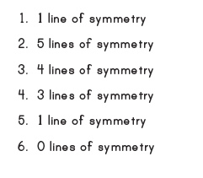
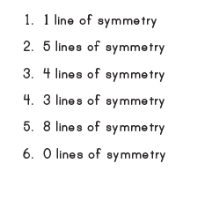
Day 2 Main Task – Answers
Storms Black Panthers Hulks

Slide 20
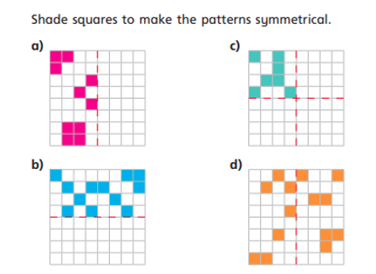
Day 2 Challenge

Slide 21
Day 3 Arithmetic
Use the link below to play hit the button for your 9 and 8 times table practice.
https://www.topmarks.co.uk/maths-games/hit-the-button

Slide 23
Re-Cap

Slide 24
I Do – Identifying turns
Watch the video below to learn what clockwise and anti-clockwise means?
https://www.bbc.co.uk/bitesize/clips/zjyb9j6#:~:text=If%20you%20move%20in%20a,%2C%20this%20is%20anti%2Dclockwise.

Slide 25
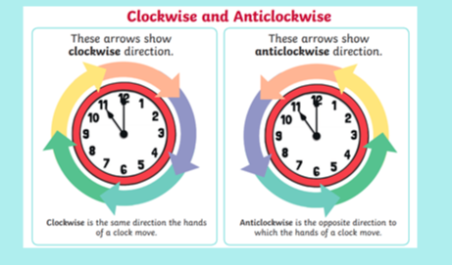
I Do – Identifying turns

Slide 26
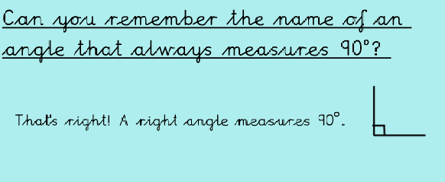
We Do

Slide 27
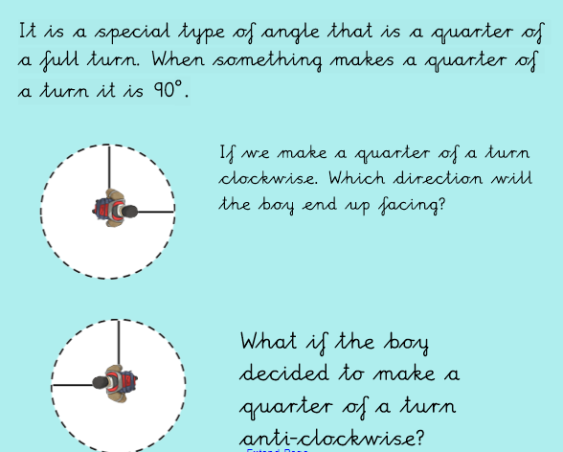
We Do –

Slide 28
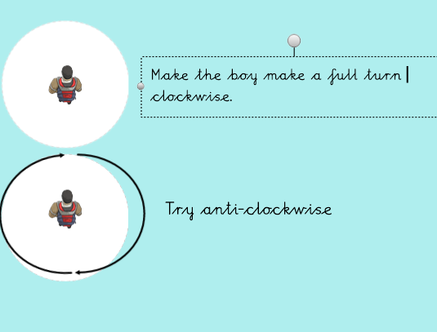
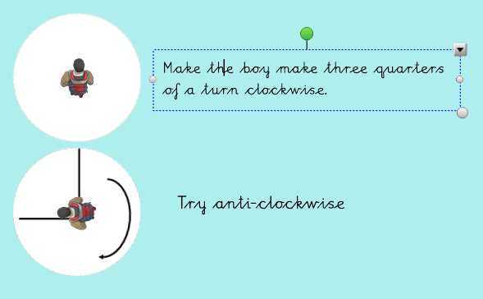
We Do

Slide 29
You Do

Slide 30
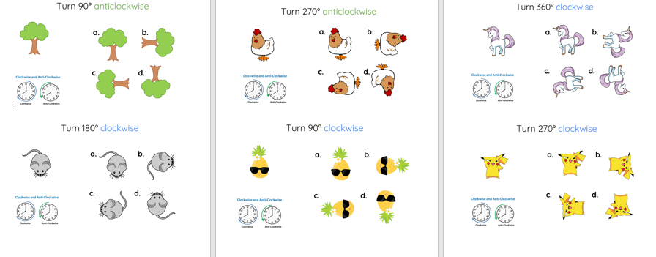
Day 3 Main Task – Storms

Slide 31
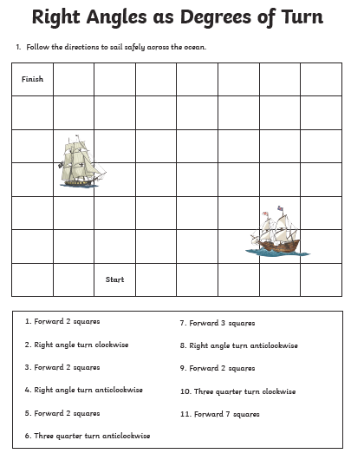
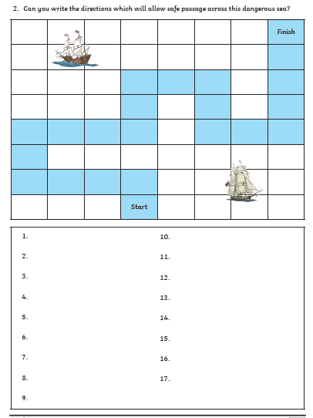
Day 3 Main Task – BP and Hulks

Slide 32
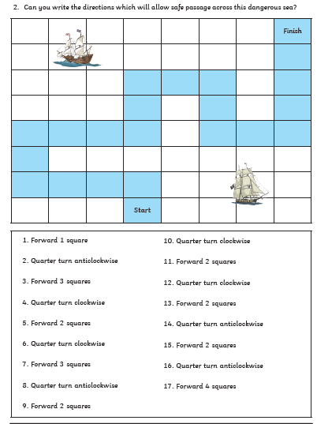
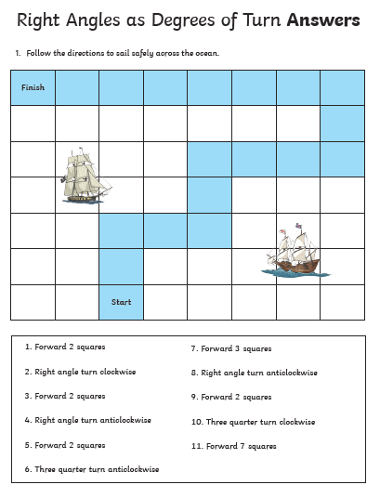
Day 3 Answers

Slide 33
Day 4
Use the link below to play hit the button for your 6 and 7 times table practice.
https://www.topmarks.co.uk/maths-games/hit-the-button

Slide 34
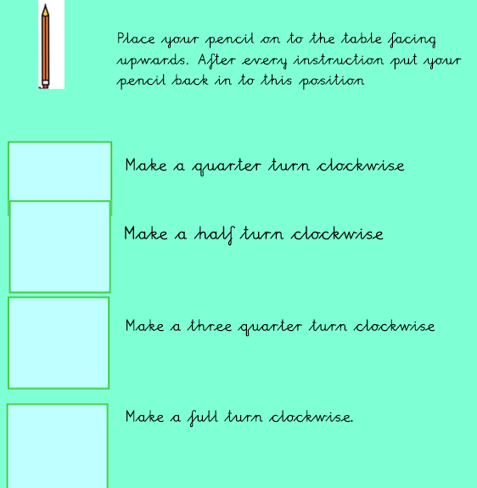
Day 4

Slide 35
Day 4 Answers

Slide 36
I Do….

Slide 37
I Do…. Answer

Slide 38
We Do….

Slide 39
We Do…. Answers

Slide 40
You do..

Slide 41
You do.. Answers

Slide 42
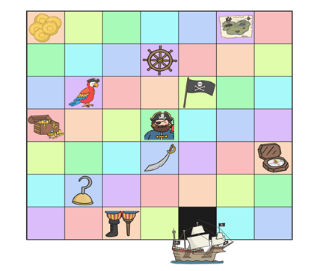
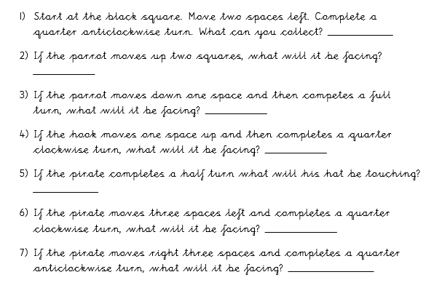
Day 4 - Main Task Hulks and BP

Slide 43
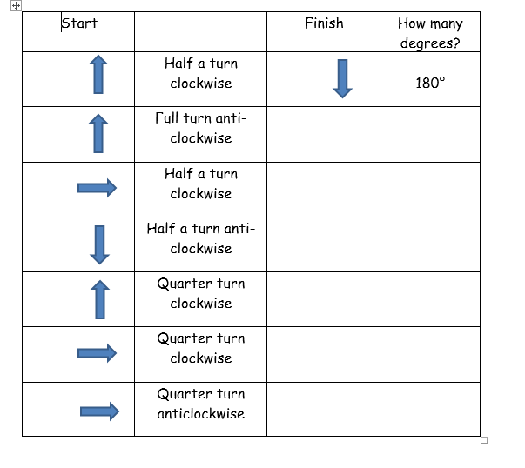
Day 4 - Main Task Storms

Slide 44
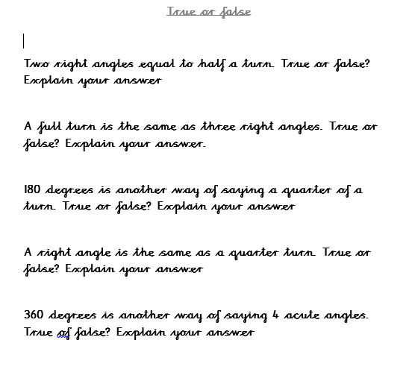
Day 4 – Challenge

Slide 45
Day 5 Arithmetic
Test yourself on your 6 times tables.
4 X 6=
6 X 6=
8 X 6=
1 X 6=
9 X 6=
2 X 6=
10 X 6=
4 X 6=

Slide 48
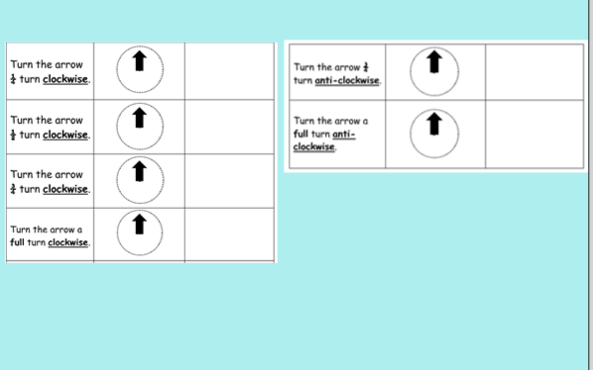
Clockwise and Anti-clockwise

Slide 49
I Do….
If the coins moved 2 squares down and turned a quarter anti-clockwise. What would they be facing?

Slide 50
I Do…. Answers
Parrot
If the coins moved 2 squares down and turned a quarter clockwise. What would they be facing?

Slide 51
We Do…..
If the pirate moved one square to the right and did a full turn anti-clockwise. Who would he be facing?

Slide 52
We Do….. Answers
Flag
If the pirate moved one square to the right and did a full turn anti-clockwise. Who would he be facing?

Slide 53
You Do

Slide 54
You Do- Answers
Nothing

Slide 55
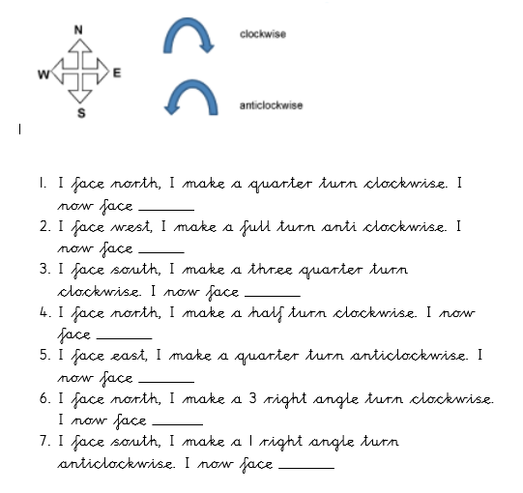
Day 5-Main task Hulks and BP

Slide 56
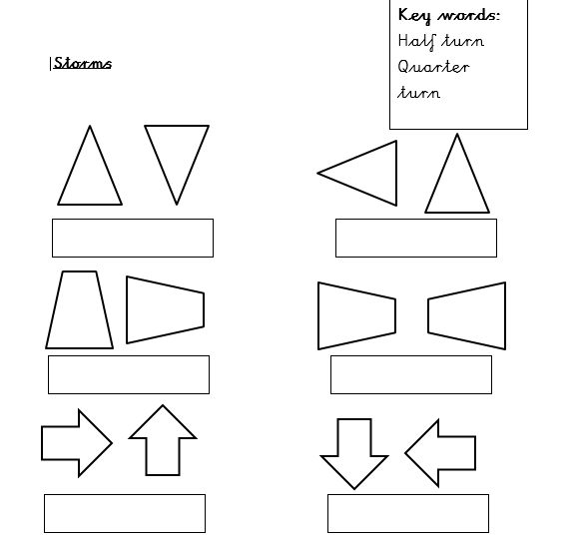
Day 5-Main task Storms

Slide 57
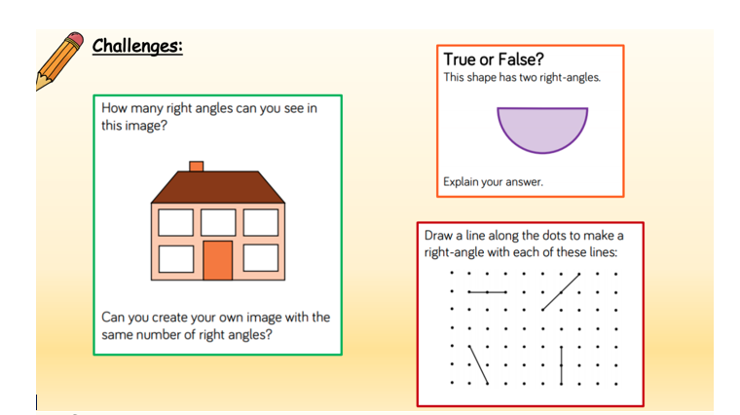
Day 5- Further Challenge

