Slide 1
Maths Home Learning
Week Beginning 09.11.2020

Slide 2
This week…
Day 1- 2D and 3D Shapes
Day 2 – Understanding angles.
Day 3 – Identifying angles in 2D shapes
Day 4 – Horizontal and vertical lines
Day 5 – Perpendicular and parallel lines.

Slide 3
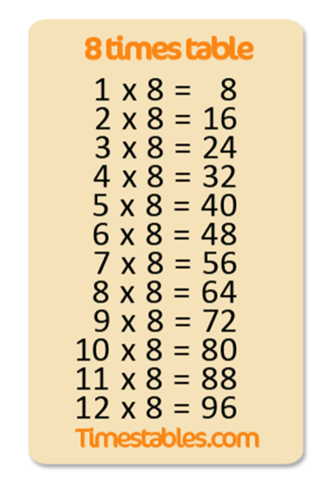
Arithmetic
Let’s learn our x 8 tables
Sing along!
https://www.youtube.com/watch?v=EvUO_d8Uzf0

Slide 4
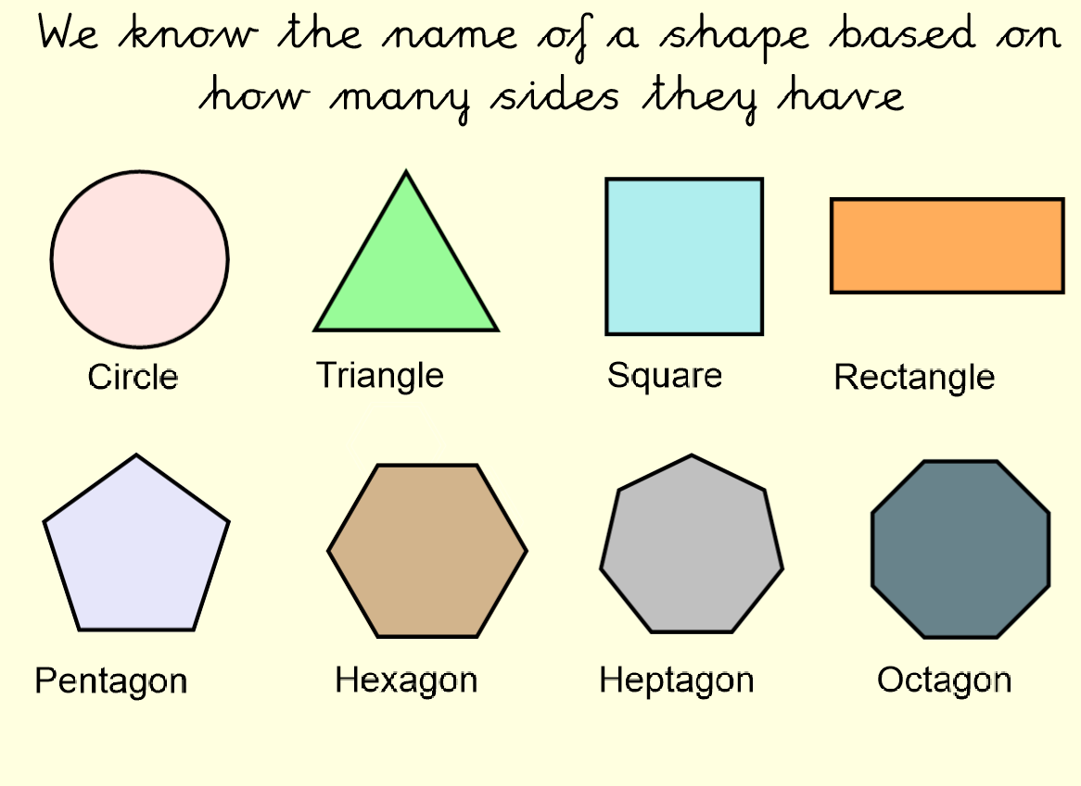
Day 1 – Recap
Last week we introduced 2D shapes – how many can you remember?

Slide 5
Day 1
There are more 2D shapes, here’s one we didn’t look at.
What do you notice about these shapes? Write down your ideas in your home learning book.

Slide 6
Day 1

Slide 7
Day 1
Let’s start to compare 2D and 3D shapes, what do you notice?

Slide 8
Day 1
Much like 2D shapes, 3D shapes have properties, what is similar/different?

Slide 9
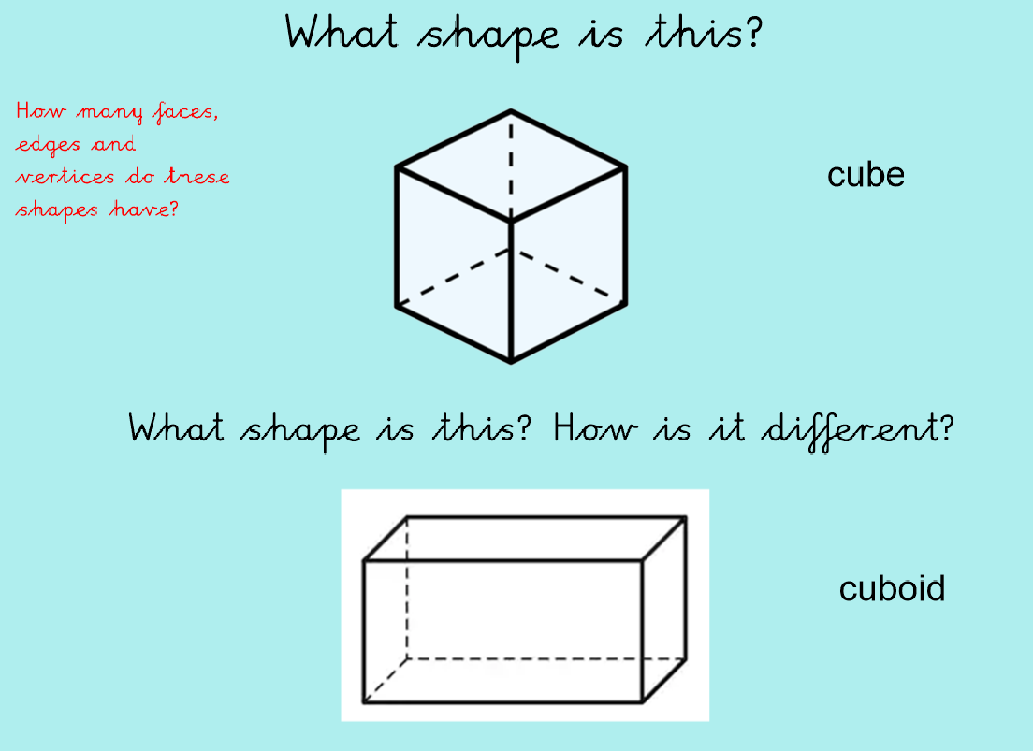
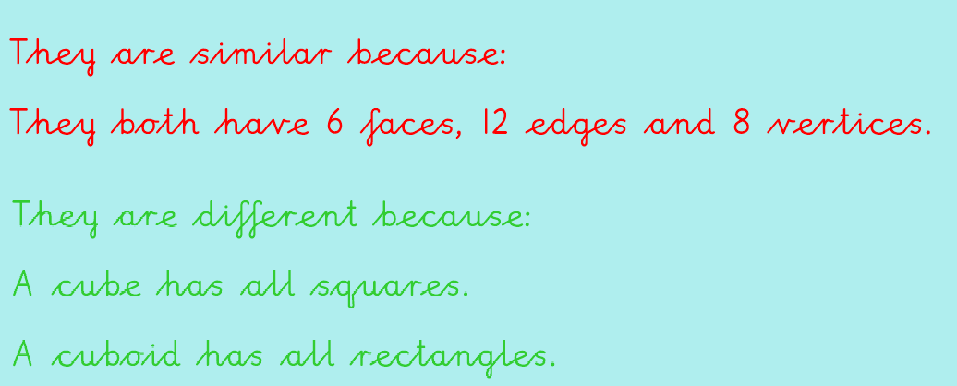
I do

Slide 10
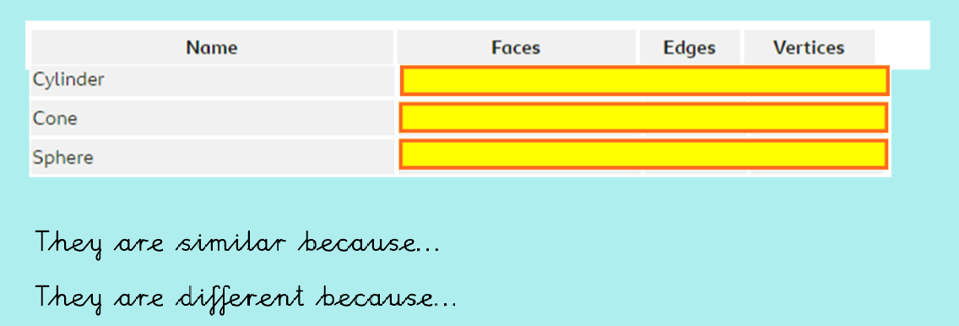
We do
Look at the shapes and name the properties, remember to count the faces!

Slide 11
We do - Answers
How did you do?
They are similar because they all have curved edges
They are different because they have different numbers of faces.

Slide 12
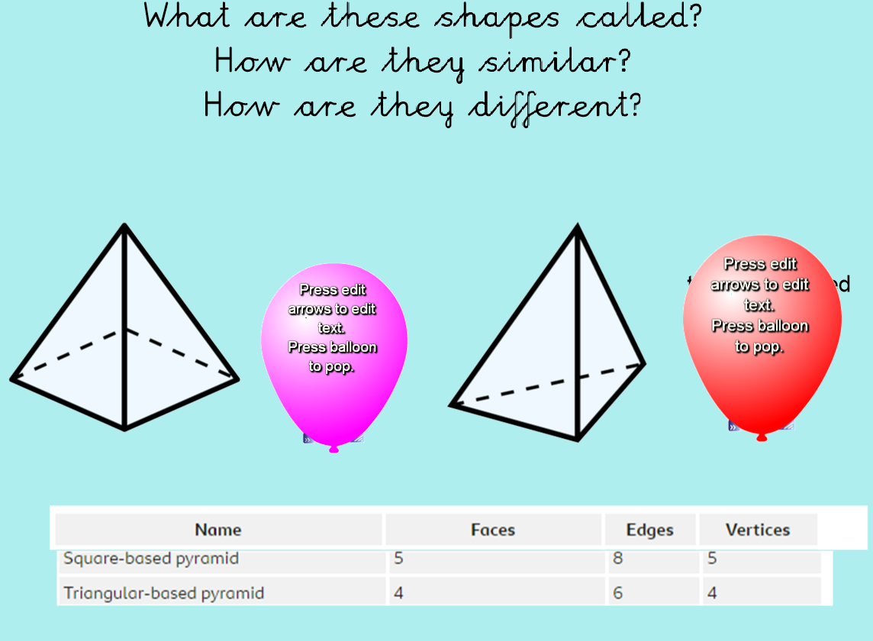
You Do…

Slide 13
You Do…Answers
They are similar because they both have flat edges
They are different because they have different numbers of vertices and faces.

Slide 14
More 3D Shapes…What do you notice?

Slide 15
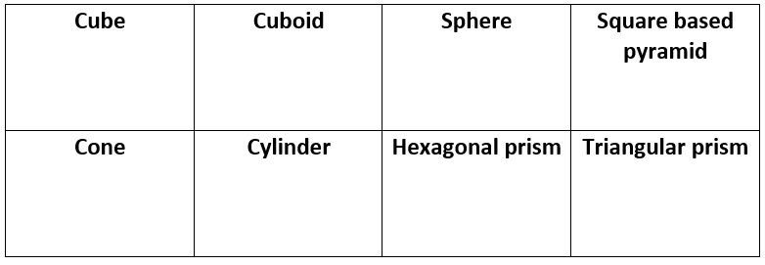
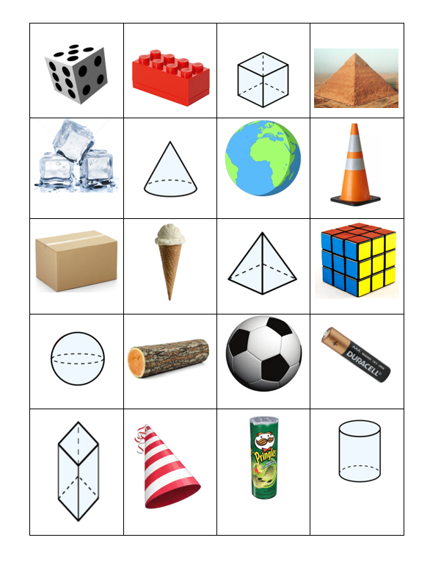
Main Task
Match each picture with the name, can you think of any of your own 3D objects and name them.
Draw a table and write:
Name of shape:
Number of faces:
Number of edges:
Number or vertices:

Slide 16
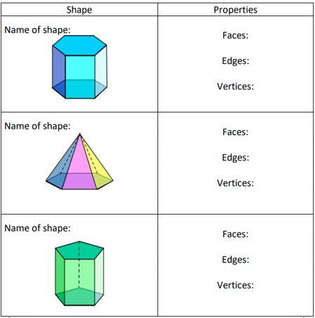
Challenge
Identify the shapes and their properties.
Can you say what is different and similar?
Write down the sentences in your home
Learning books.

Slide 17
Day 2 Chant your 8 x tables
Write down your answers in your books, how long did it take you?
Can you write down the inverse?
Remember the inverse of mulitiplication is division!
Example: 16÷8=2

Slide 18
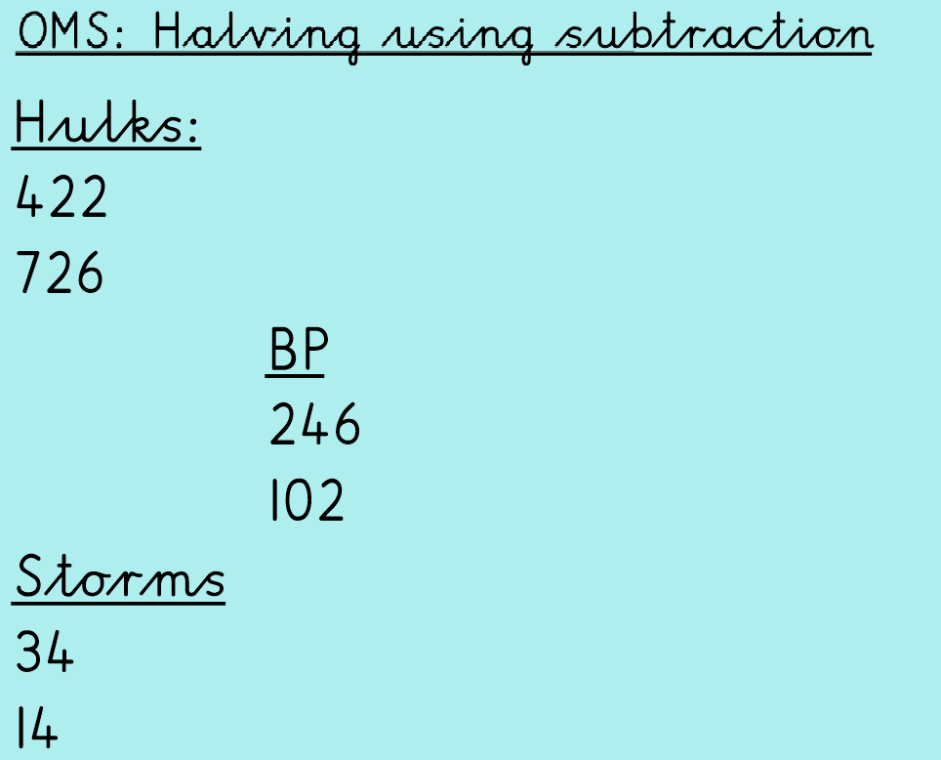
Day 2
For example, to find a half of a number using subtraction, you would label the digits HTO and use partition to find half of each number.

Slide 19
Day 2

Slide 20
Different angles
https://www.bbc.co.uk/bitesize/topics/zb6tyrd/articles/zg68k7h

Slide 21
I Do …Different angles
The angle at 89 degrees is acute because it is smaller than 90 degrees.

Slide 22
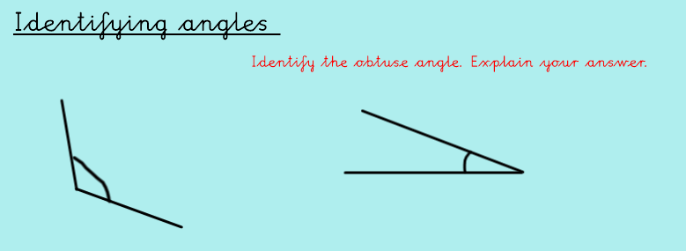
We Do …Different angles
Remember the properties of an obtuse angle, check the previous slides if you need a re-cap!

Slide 23
We Do …Answers
The obtuse angle is the angle on the left hand side because it is larger than 90 degrees and less than 180 degrees.

Slide 24
You Do

Slide 25
You Do….Answers
The right angle is on the left and measures 90 degrees. I know this because a right angle is always at a corner and has straight edges.

Slide 26
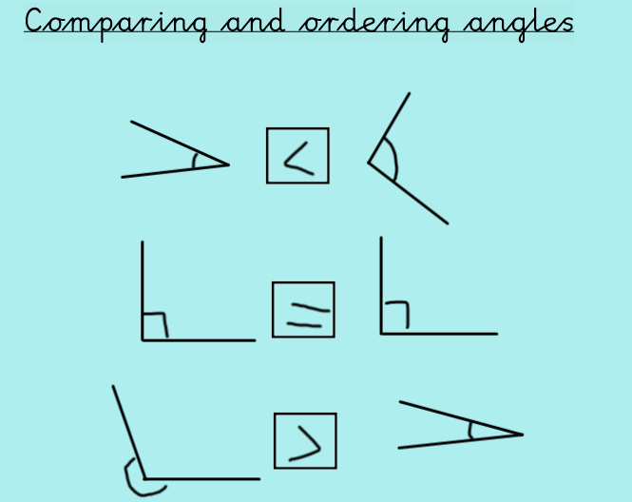
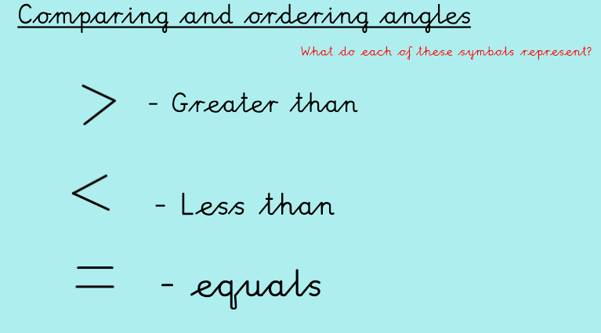
Comparing angles
We can use the greater than, less than and equal to signs to compare fractions

Slide 27
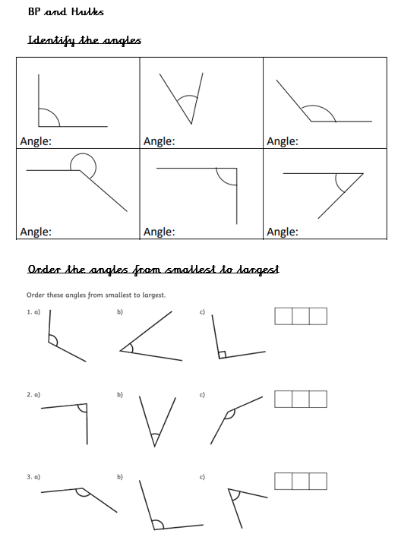
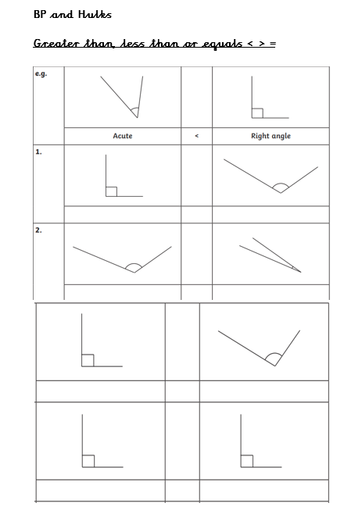
Day 2 Main Task – Hulks and BP

Slide 28
Day 2 Main Task – Storms

Slide 29
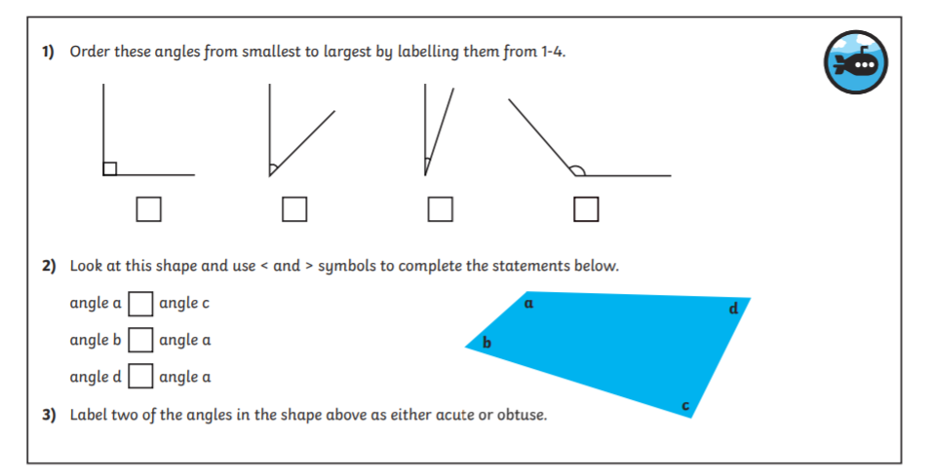
Day 2 Challenge

Slide 30
Day 3
Today we will look at angles in 3D shapes
- Can you remember the angles we learned yesterday?

Slide 31
Arithmetic
Use the link below to play hit the button for your 9 and 8 times table practice.
https://www.topmarks.co.uk/maths-games/hit-the-button

Slide 32
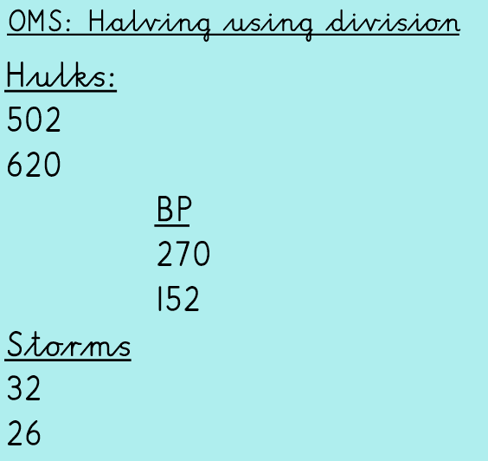

Slide 33
Re-Cap

Slide 34
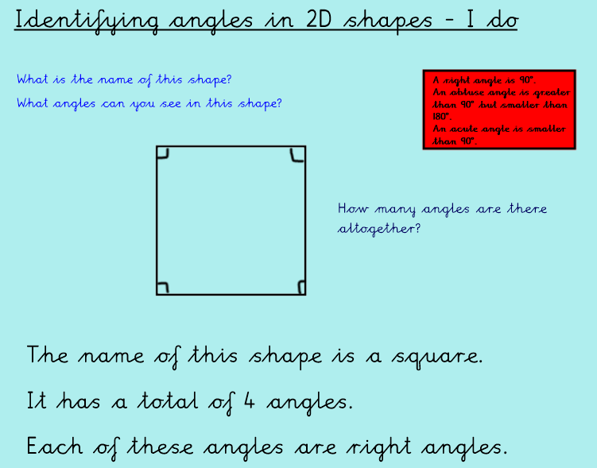
I Do – Identifying angles in 2D shapes

Slide 35
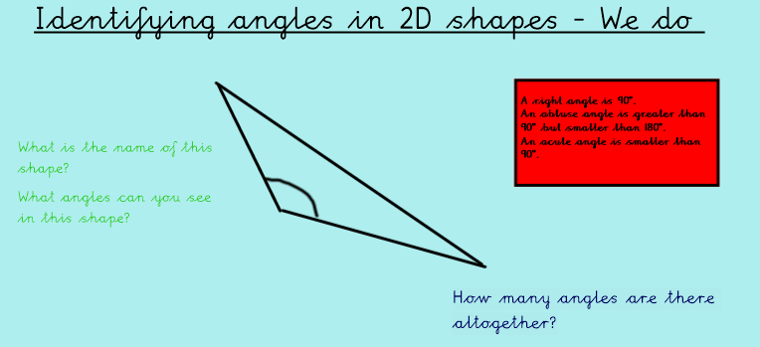
We Do – Identifying angles in 2D shapes

Slide 36
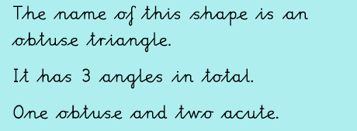
We Do – Identifying angles in 2D shapes - Answers

Slide 37
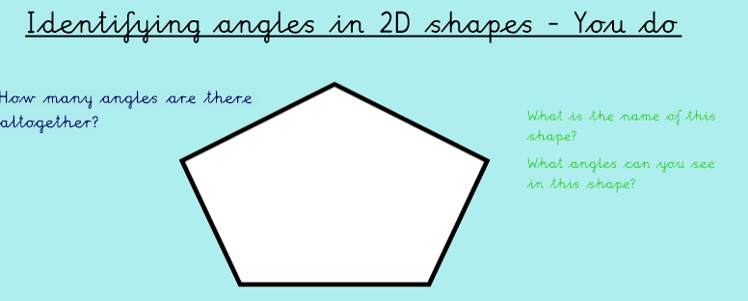
You Do – Identifying angles in 2D shapes
Write your answers in your home learning book.

Slide 38
You Do – Identifying angles in 2D shapes - Answers

Slide 39
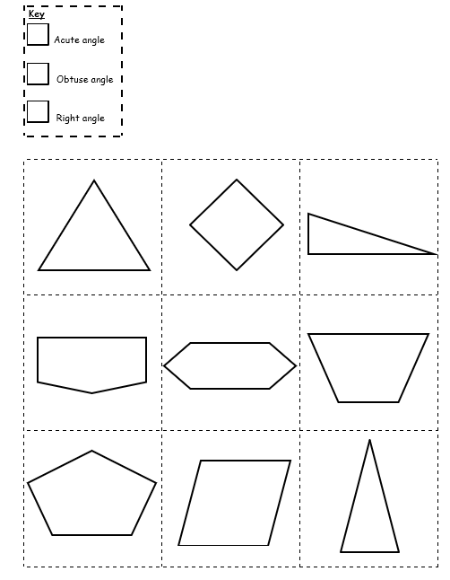
Day 3 Main Task – Hulks and BP
Draw each shape in your book and colour in each of the following angles using a different colour:
Right angle
Acute angle
Obtuse angle

Slide 40
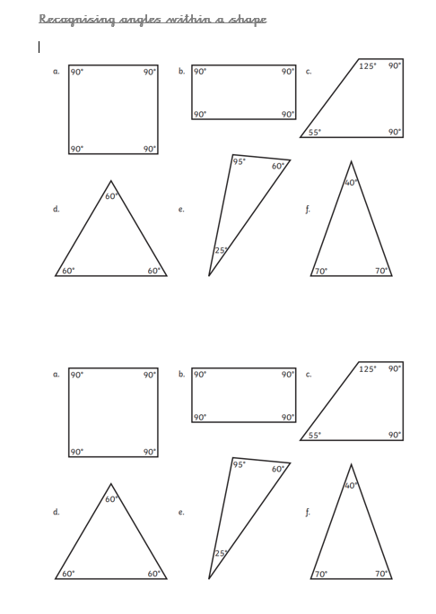
Day 3 Main Task – Storms
Write the name of the angles you can see in each shape
Right angle
Acute angle
Obtuse angle

Slide 41
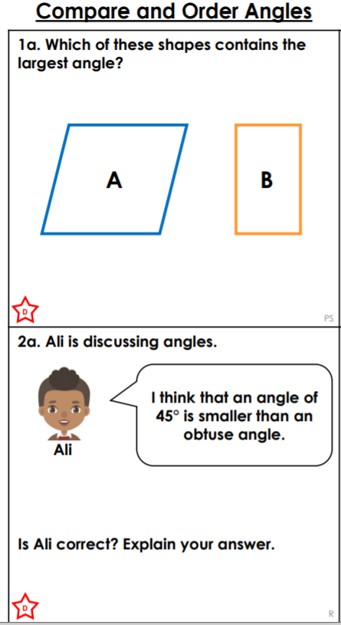
Day 3 Challenges

Slide 42
Day 4
Today we will look at the different types of lines we see in mathematical questions, we will use our knowledge of shapes and their properties to help us.

Slide 43
Day 4
Use the link below to play hit the button for your 6 and 7 times table practice.
https://www.topmarks.co.uk/maths-games/hit-the-button

Slide 44
Day 4

Slide 45
Re Cap

Slide 46
Re Cap – we know that all 2D shapes have angles within them…
Right angle
Right angle

Slide 47
Lines

Slide 48
Lines
Can you find any examples in your home? Write them down in your home learning book!

Slide 49
Lines

Slide 50
I Do….Lines
What lines can we see in this letter?
Horizontal
Vertical
Diagonal

Slide 51
We Do….Lines
What lines can we see in this letter?

Slide 52
We Do….Lines…Answers
What lines can we see in this letter?
Horizontal
Vertical

Slide 53
You Do….Lines
What lines can we see in this letter?
?
?

Slide 54
You Do….Lines…Answers
What lines can we see in this letter?
Horizontal
Vertical

Slide 55
Lines

Slide 56
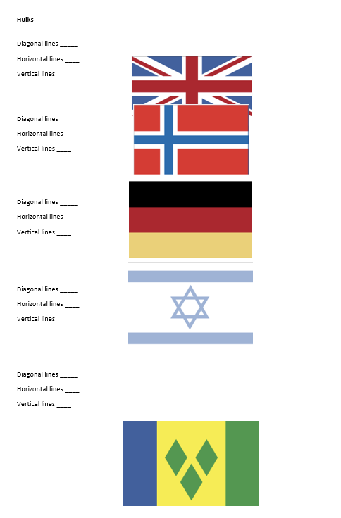
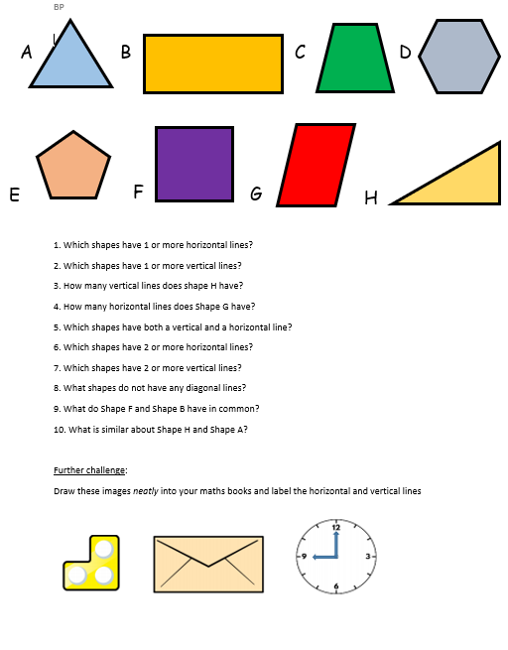
Day 4 - Main Task Hulks and BP

Slide 57
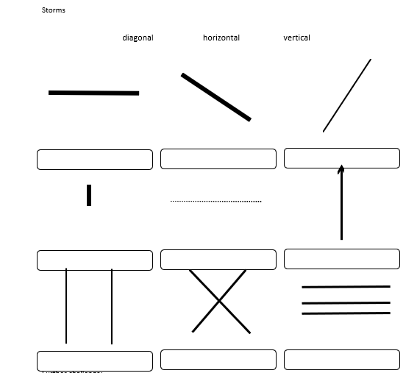
Day 4 - Main Task Storms
Write the name of the line into your home learning book.

Slide 58
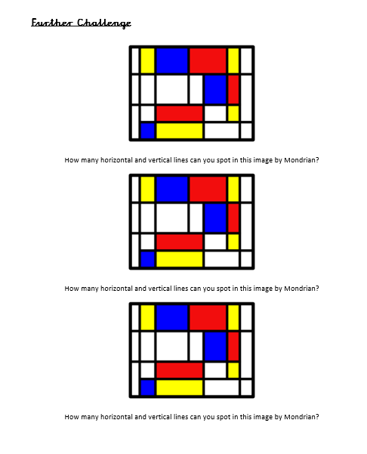
Day 4 – Challenge

Slide 59
Day 5
Today we will focus on different sorts of lines and their properties
Which lines did we learn about yesterday?

Slide 60
Arithmetic
Test yourself on your 6 times tables.
4 X 6=
6 X 6=
8 X 6=
1 X 6=
9 X 6=
2 X 6=
10 X 6=
4 X 6=

Slide 61
Lines

Slide 62
Lines- Parallel

Slide 63
Lines- Perpendicular

Slide 64
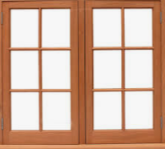
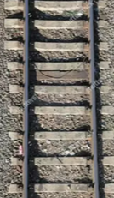
I Do…..Lines
What lines can we see in this picture?
Perpendicular AND parallel
What lines can we see in this picture?
Parallel

Slide 65
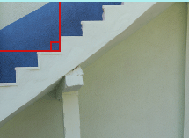
We Do…..Lines
What lines can we see in this picture?
What lines can we see in this picture?

Slide 66
We Do…..Lines….Answers
What lines can we see in this picture?
Parallel
What lines can we see in this picture?
Perpendicular

Slide 67
You Do

Slide 68
You Do….Answers

Slide 69
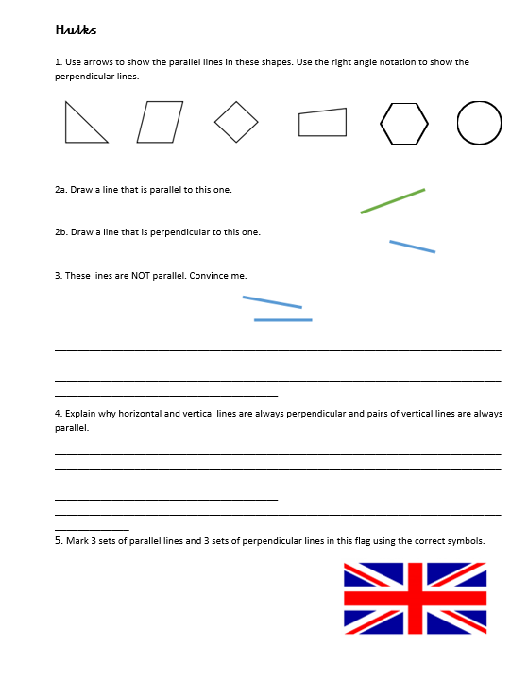
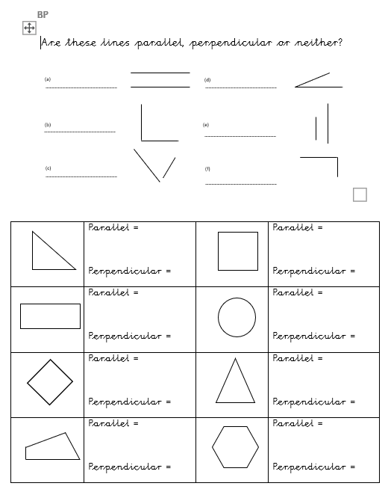
Day 5-Main task Hulks and BP

Slide 70
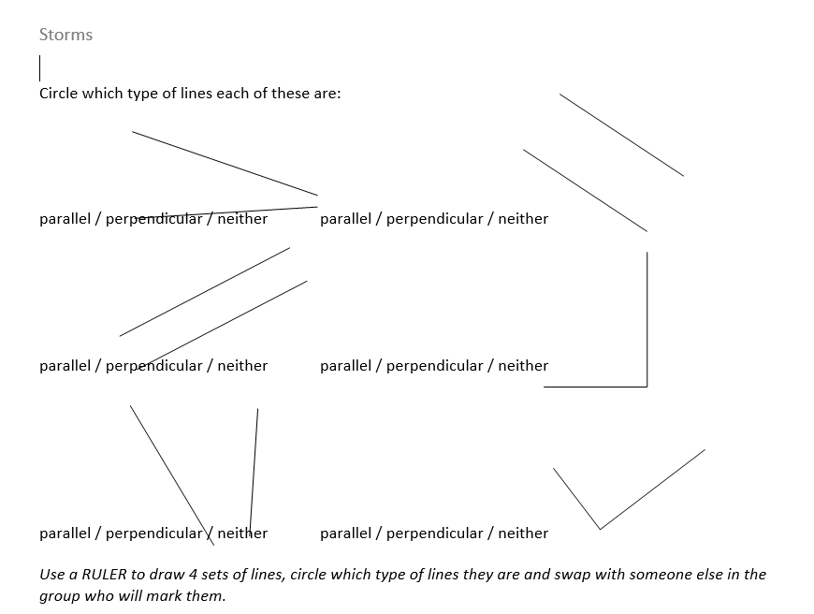
Day 5-Main task Storms

Slide 71
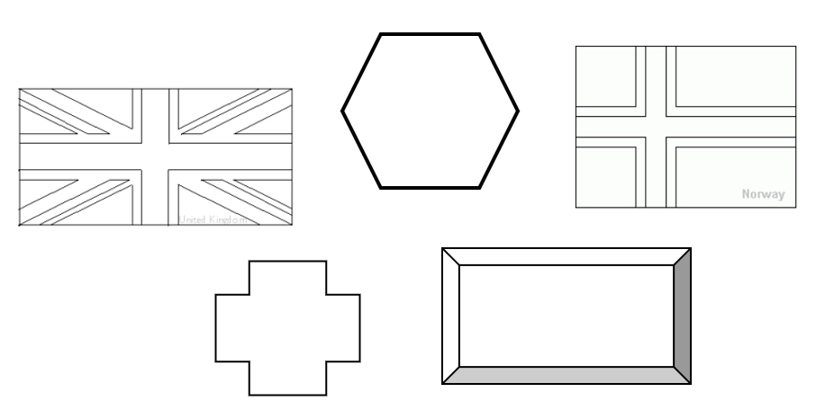
Day 5- Further Challenge
Draw each shape in your book and describe how many different sets of lines each has.

