Slide 1
Maths Home Learning
Week Beginning 02.11.2020

Slide 2
This week…
Day 1- Equivalent Fractions – Using diagrams
Day 2 – Fraction wall (practical session).
Day 3 – Finding equivalent fractions using a fraction wall (problem solving).
Day 4 – Reasoning
Day 5 – Recognizing 2D shapes and identifying properties.

Slide 3
Arithmetic
Let’s learn our x 7 tables
Sing along!
https://www.youtube.com/watch?v=LcSwgZ48ph8

Slide 4
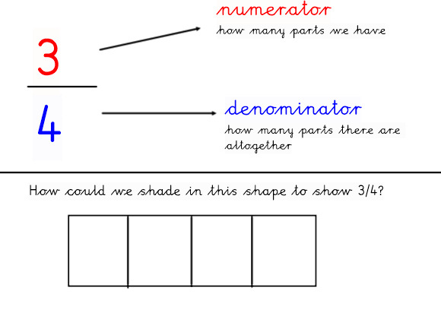
Day 1 – Recap
The top number is the numerator.
The bottom number is the denominator.

Slide 5
Day 1
A unit fraction always has a numerator of 1.
All other numerators that are above 1 are called non-unit fractions.
Can you think of examples for each type of fraction?

Slide 6
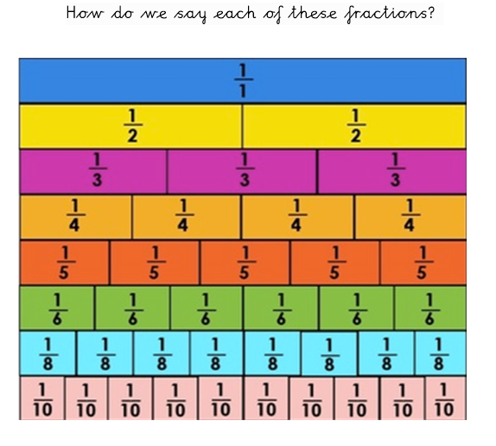
Day 1
Match the correct ones:
One Third
One Tenth
One Sixth
One fifth
One eighth
One Quarter

Slide 7
Day 1
What is an equivalent fraction?
Have a think!

Slide 8
Day 1
Can you think of your own equivalent fractions?
Remember! Equivalent means the same as.

Slide 9
I do
2/4 is the equivalent to ½

Slide 10
We do – Equivalent fractions using diagrams
Remember to follow each of the steps

Slide 11
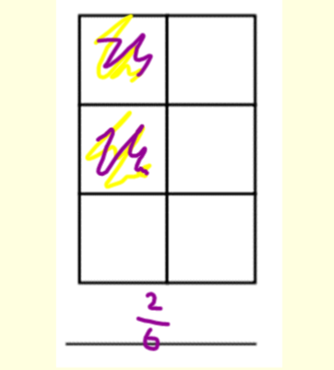
We do - Answers
Answer 2/6.
Why is this my answer?
Firstly, I counted the squares = 6
Secondly, I found 1/3 of my total number of squares. 1/3 of 6 = 2
Lastly, I shades 2 squares. I had a total of 2 squares shaded in out of 6.
This gave me an equivalent fraction of 2/6

Slide 12
You Do…
Remember to follow each of the steps

Slide 13
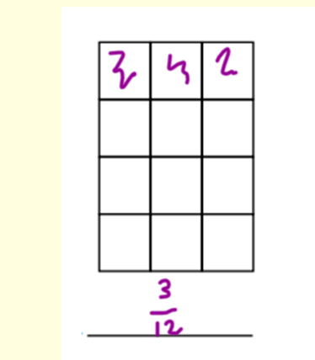
You do - Answers
Answer 3/12.
Why is this my answer?
Firstly, I counted the squares = 12
Secondly, I found 1/4 of my total number of squares. 1/4 of 12 = 3
Lastly, I shades 3 squares. I had a total of 3 squares shaded in out of 12.
This gave me an equivalent fraction of 3/12.

Slide 14
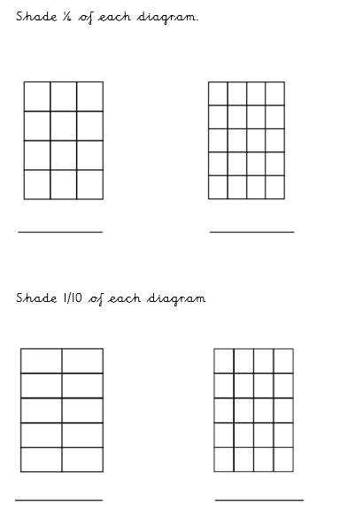
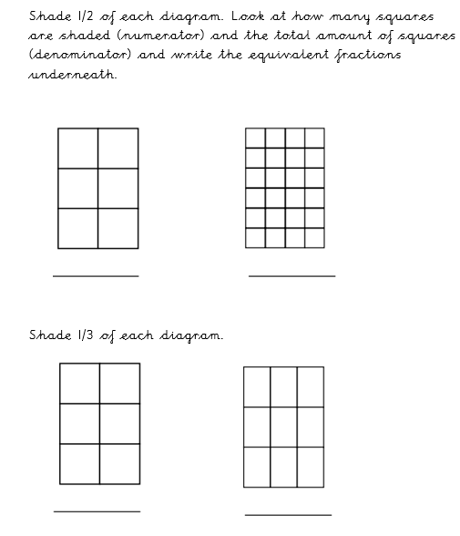
Main Task

Slide 15
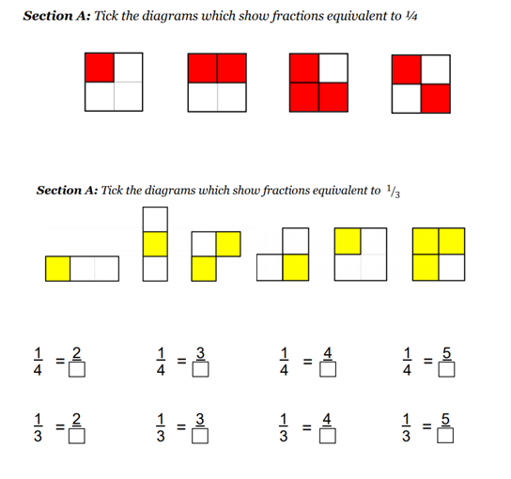
Challenge
What equivalent fractions can we find?
http://www.visnos.com/demos/fraction-wall

Slide 16
Day 2
Fraction Wall Practical session
Today we will use a fraction wall to find equivalent fractions.
What is a fraction wall?

Slide 17
Arithmetic
Let’s practise our x7 tables.
How quickly can you answer these questions. Time yourself
1 x 7=
2x 7 =
3 x 7=
4 x 7=
5 x 7=
6 x 7=
7 x 7=
8x 7 =
9 x 7 =
10 x 7 =
11 x 7 =
12 x 7 =
Check if you can beat your time the second time.

Slide 18
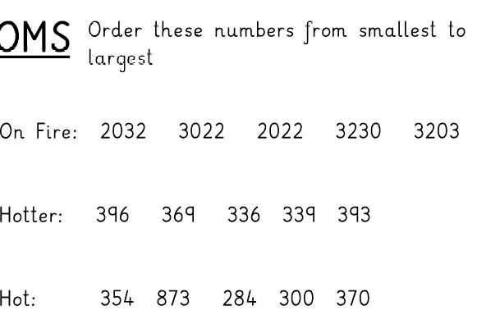

Slide 19
I do
This is what a fraction wall looks like

Slide 20
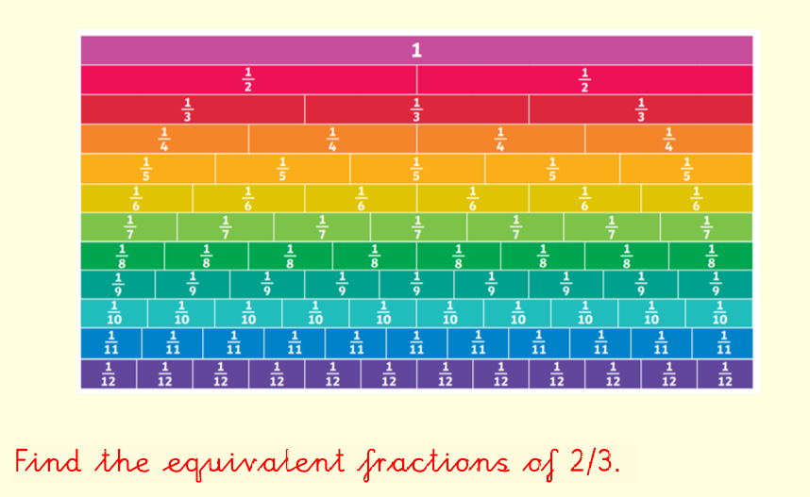
We do

Slide 21
We do- Answers
Can you spot the pattern?
Which equivalent fraction would come next?
Use a ruler to help you find the answer. As you can see once a line is drawn on. The fraction equivalents for:
2/3 = 4/6 = 6/9 = 8/12

Slide 22
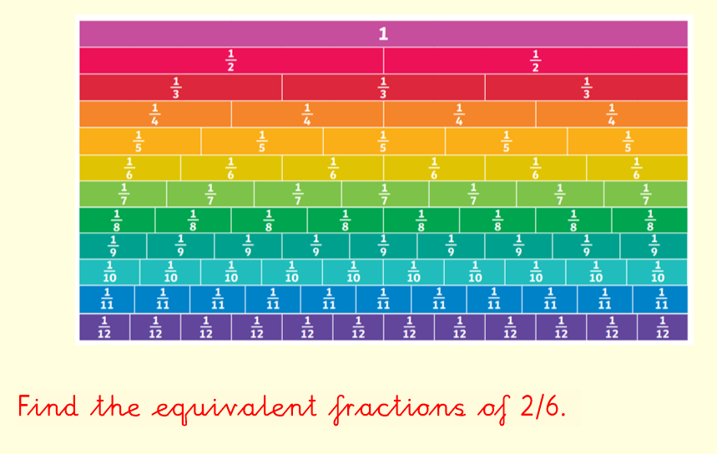
I do

Slide 23
I do- Answers
Can you spot the pattern?
Which equivalent fraction would come next?
What do you notice?
Use a ruler to help you find the answer. As you can see once a line is drawn on. The fraction equivalents for:
2/6 = 1/3 = 3/9 = 4/12

Slide 24
Day 2 Main Task
Find the equivalent fractions for:
½ =
¾ =
1/3 =
4/8 =
3/5 =
1/12 =
6/8 =

Slide 25
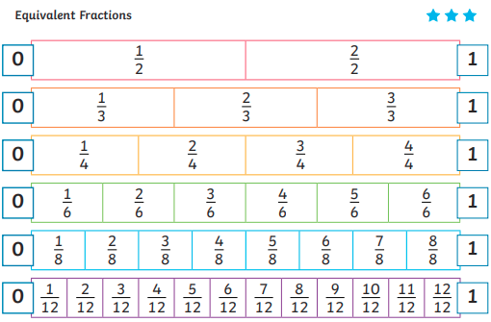
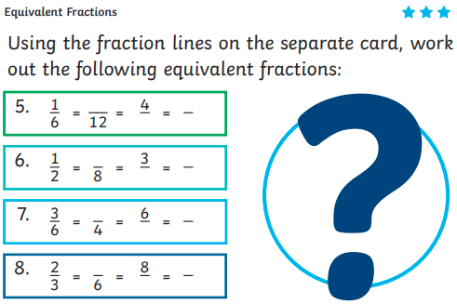
Day 2 Challenge

Slide 26
Day 3
Today we will find equivalent fractions using a fraction wall (problem solving).
- Can you remember what we did the previous session?

Slide 27
Arithmetic
Use the link below to play hit the button for your 7 times table practice.
https://www.topmarks.co.uk/maths-games/hit-the-button

Slide 28
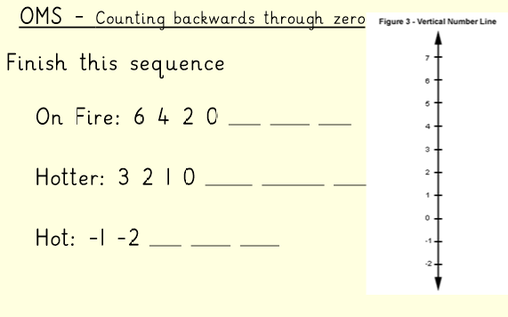

Slide 29
I do
Remember to follow the lines.
Equivalent means the same as.
Follow the lines downwards and upwards to find your answers.

Slide 30
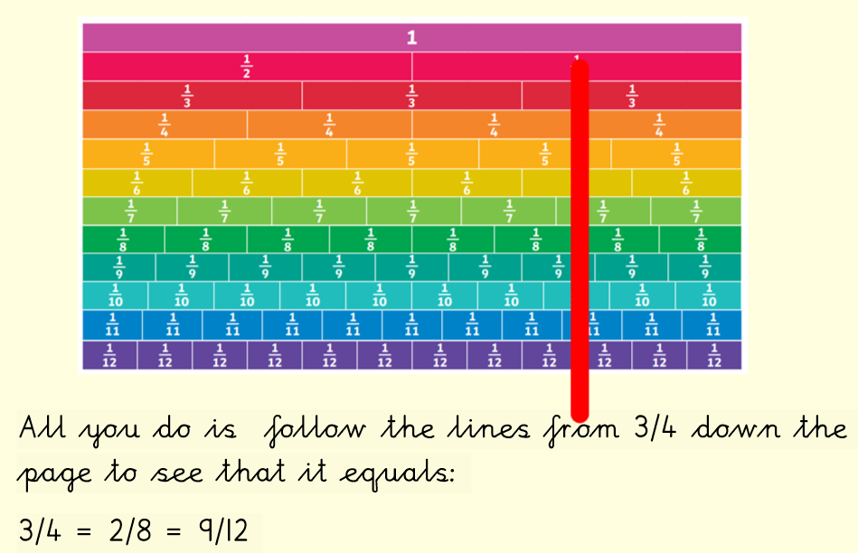
Answer
As you see. When we draw a line, we can visually see the equivalent fractions.
Can you think of the next equivalent fraction?

Slide 31
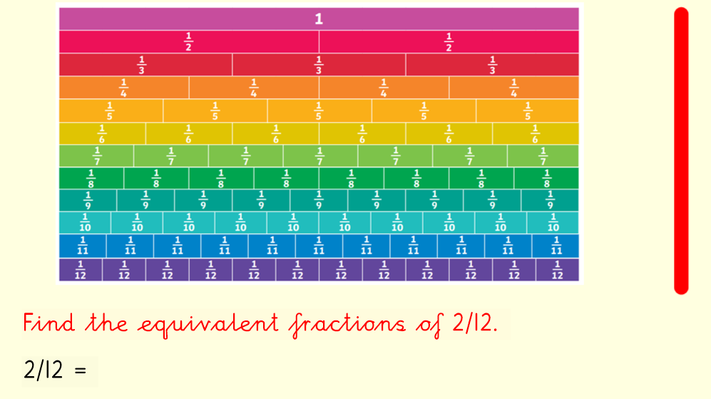
We do
Remember! All you do is follow the lines up from the fraction wall to find your answer.
2/12
What is different about this question?

Slide 32
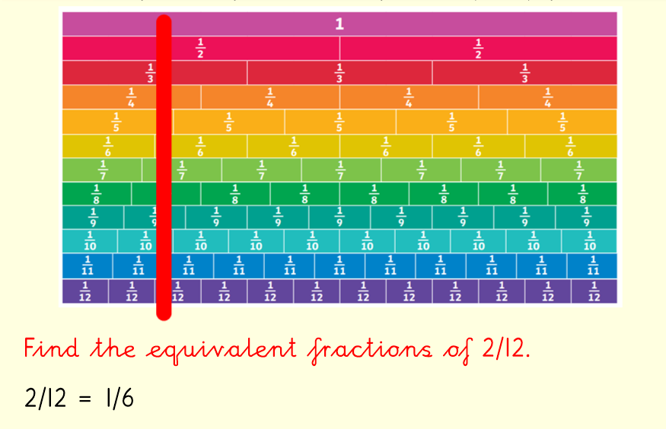
Answer
As you see. When we draw a line, we can visually see the equivalent fractions.
Can you think of the next equivalent fraction?

Slide 33
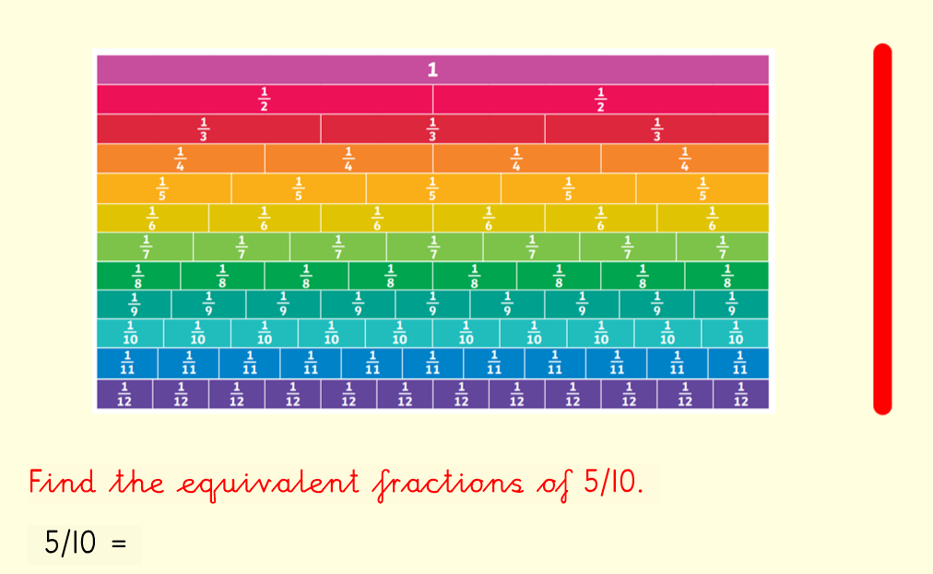
You do
Remember to follow the lines.
Equivalent means the same as.
Follow the lines downwards and upwards to find your answers.

Slide 34
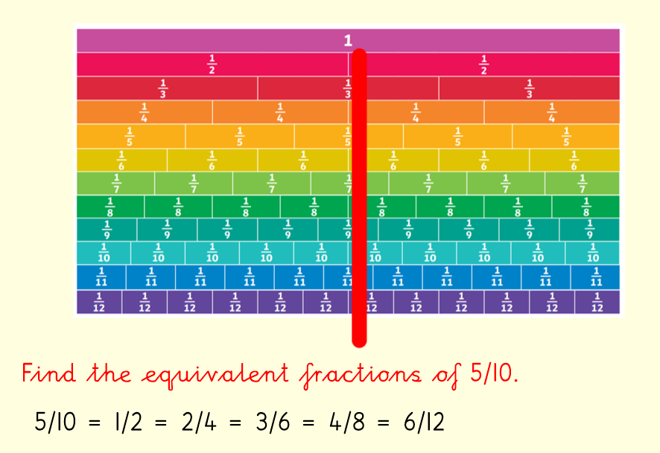
Answer
As you see. When we draw a line, we can visually see the equivalent fractions.
Can you think of the next equivalent fraction?

Slide 35
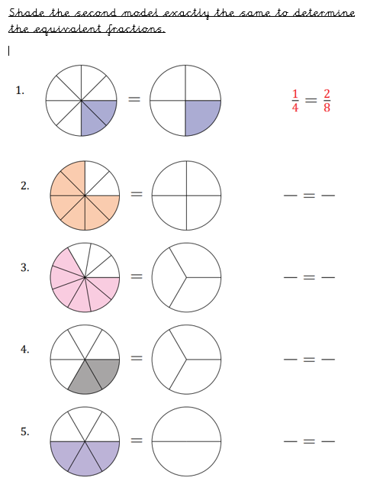
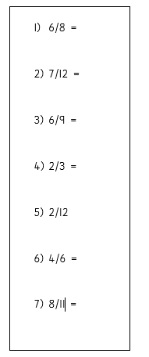
Day 3 Main Task
Find the equivalent fractions using a fraction wall

Slide 36
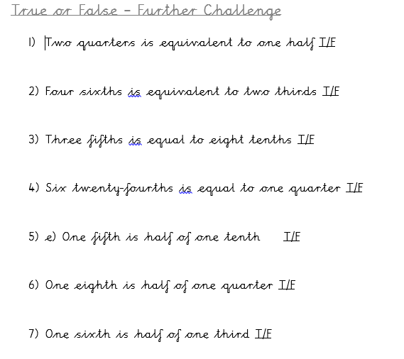
Day 3 Challenges

Slide 37
Day 4
Today we will continue to look at equivalent fractions.
This lesson will focus on reasoning.

Slide 38
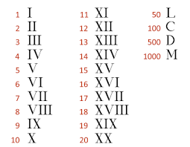
Starter
Use the help sheet below for support if required.

Slide 39
I do
Step 1 – count how many parts each diagram has
Step 2 – find ¼ of the total number of parts.
Step 3 – shade ¼ of each diagram to find the equivalent fraction.

Slide 40
Answers
Step 1 – count how many parts each diagram has.
4 And 8
Step 2 – find ¼ of the total number of parts.
1 And 2
Step 3 – shade ¼ of each diagram to find the equivalent fraction.
What do you notice? Is there another way we could answer this question?

Slide 41
We do
Use the fraction wall to support you!
Remember – equivalent means the same as

Slide 42
We do – Answers
The statement Ellie has made is false. Using the fraction wall I can visibly see that 1/3 is in fact equivalent to 2/6 and not 3/6/

Slide 43
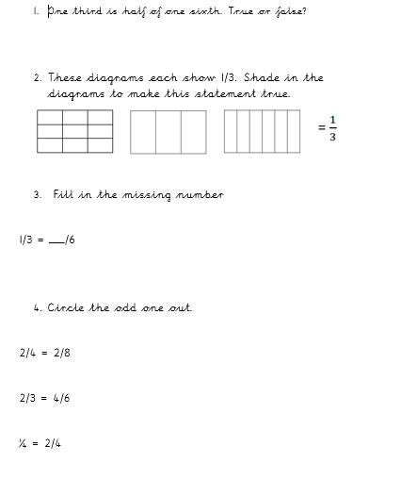
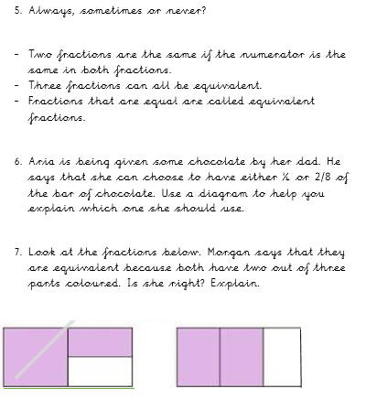
Day 4 - Main Task

Slide 44
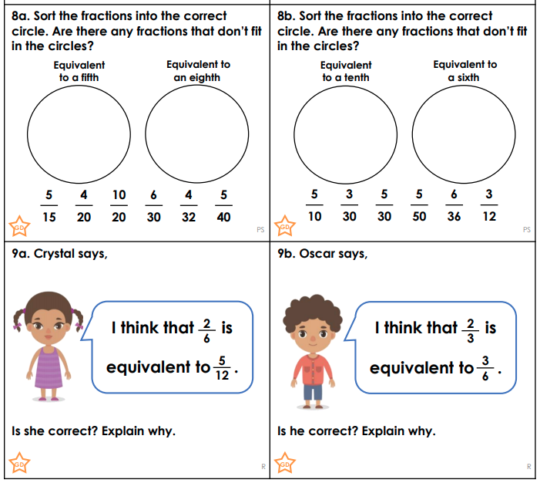
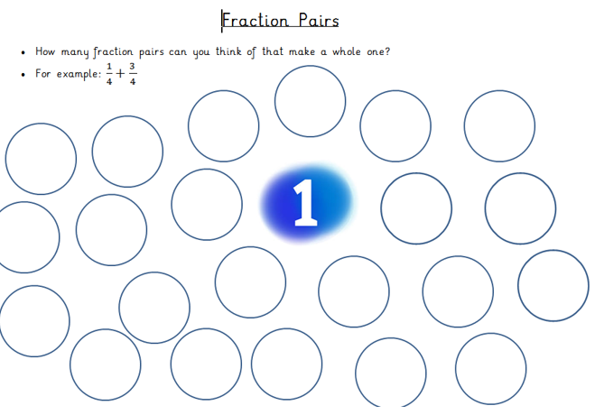
Day 4 – Challenge

Slide 45
Day 5
Today we will focus on recognizing 2D shapes and identifying properties.
What are properties?
What are 2D shapes?
How many 2D shapes can you think of in 30 seconds?

Slide 46
Arithmetic
Test yourself on your 7 times tables.
4 X 7=
6 X 7=
8 X 7=
1 X 7=
9 X 7=
2 X 7=
10 X 7=
4 X 7=

Slide 48
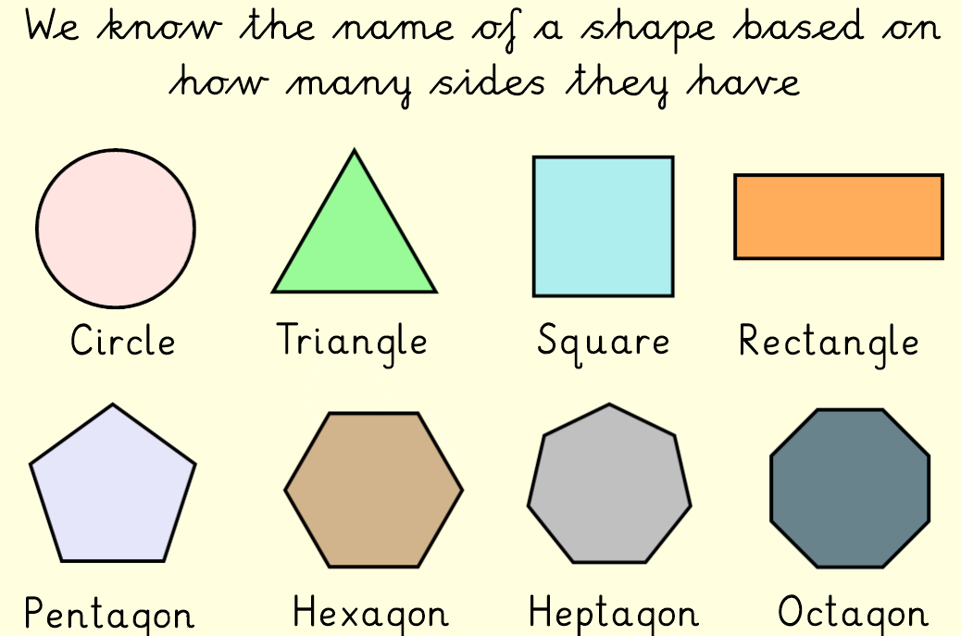

Slide 49
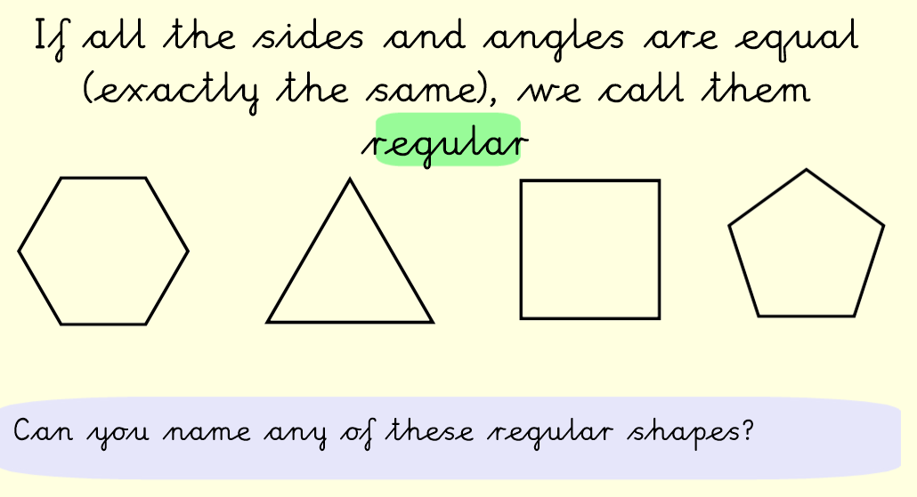

Slide 50
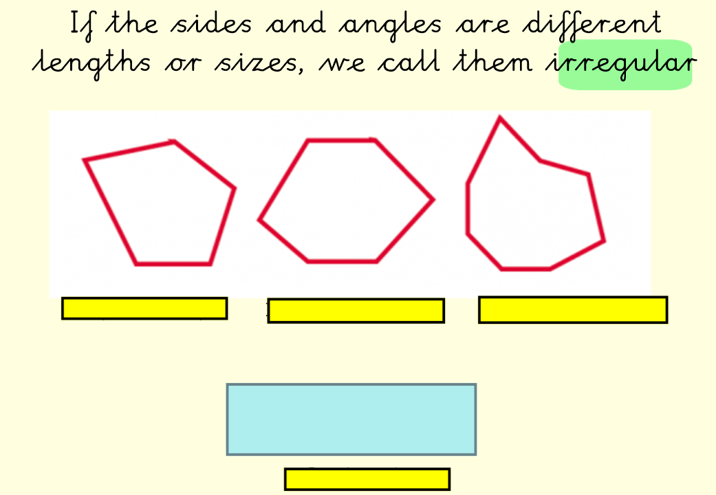

Slide 51
I do
We can see that this shape is a square.
It has 4 equal sides.
It has 4 vertices (corners).
It has 4 straight sides.
It has 0 curved sides

Slide 52
We do
Remember vertices means - A vertex (vertices) is a mathematical word for a corner.
Why is this shape regular or irregular?

Slide 53
We do
We can see that this shape is an irregular pentagon.
It has 5 vertices (corners).
It has 5 sides in total.
It has 0 curved sides

Slide 54
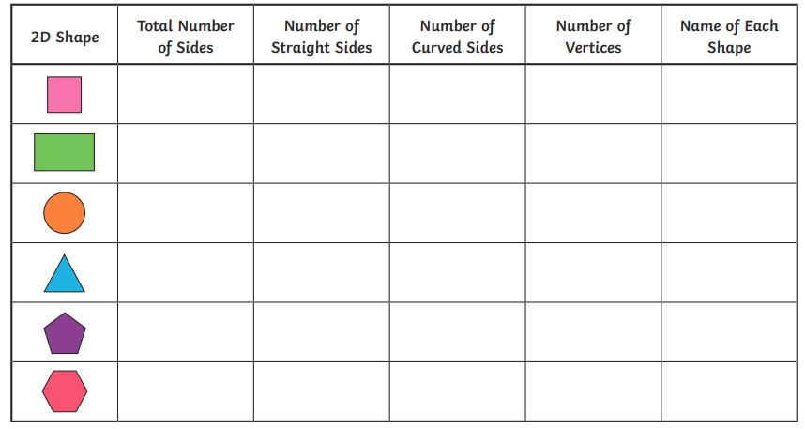
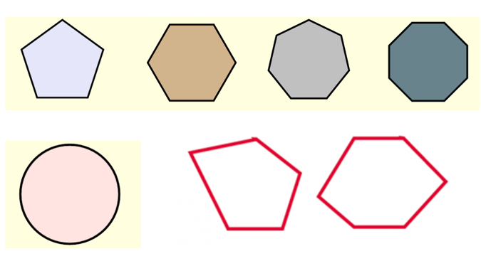
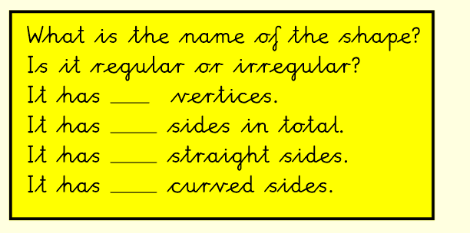
Day 5-Main task
Complete the table
Then move on to the challenge - Answer the questions from the yellow box.
Challenge

Slide 55
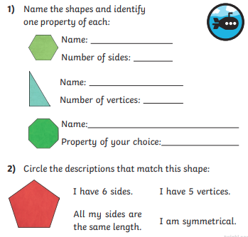
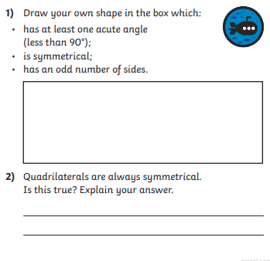
Day 5- Further Challenge

