Slide 1
Year 1
Maths Home Learning
Week Beginning 30.11.2020

Slide 2
This Week………
Day 1: Slide 3-10: Maths Practical: 2D Shapes.
Day 2: Slides 11-25: Maths Abstract: 2D Shapes.
Day 3: Slides 26-30: Maths Practical: Number formation.
Day 4: Slides 31-39: Maths Abstract: Addition.
Day 5: Slides 40-51: Maths Abstract: Subtraction.

Slide 3
Day 1

Slide 4
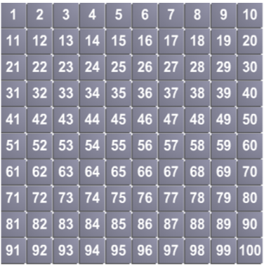
Day 1:
Maths Practical lesson
Pick a number at random.
Count on forwards in ones until your adult tells you to stop. Write this number down.
Pick a number at random.
Count backwards in ones until your adult tells you to stop. Write this number down.

Slide 5

Sing along with the song
https://www.youtube.com/watch?v=OEbRDtCAFdU

Slide 6
Day 1: Maths Practical Lesson
Today we want you to work for the shape police!
You will need to have those eagle eyes ready, a pencil, a clipboard and the attached table.

Slide 7
We want you to do a tour of your house and garden and count up how many circles, triangles, squares and rectangles you can find. If you know the names of other shapes you can add extra rows to your table.
Your grown-up will tell you when you have searched in enough places.

Slide 8
When you find a shape you need to put a tally next to the appropriate shape in the table.
There is a blank space for any other shapes you might find like oval, star etc.
For example, on your rectangle page you could put a tally for the following: door, TV, books, windows etc.

Slide 9
What shapes can you see in the picture?
How many circles, triangles, squares and rectangles will this police officer be recording on his clipboard?

Slide 10
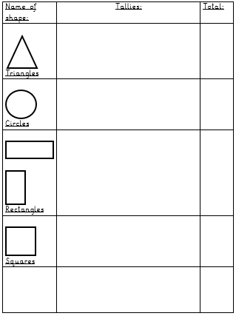

Slide 11
Day 2

Slide 12
Sing along with the song
https://www.youtube.com/watch?v=OEbRDtCAFdU

Slide 13
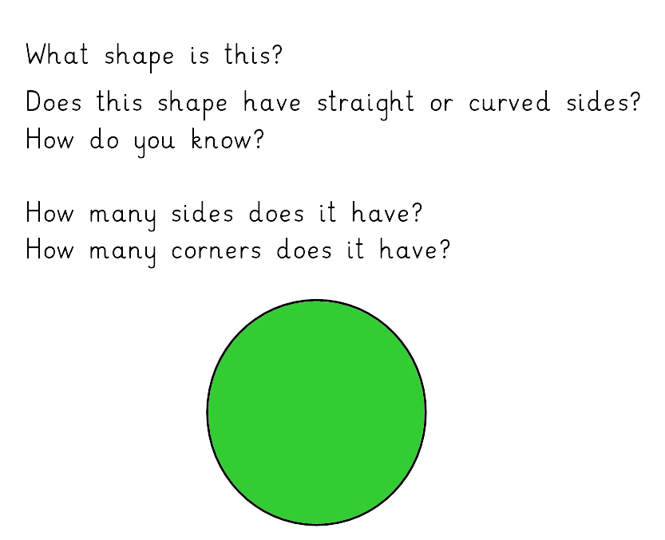

Slide 14
Circle
Curved
One
Zero

Slide 15
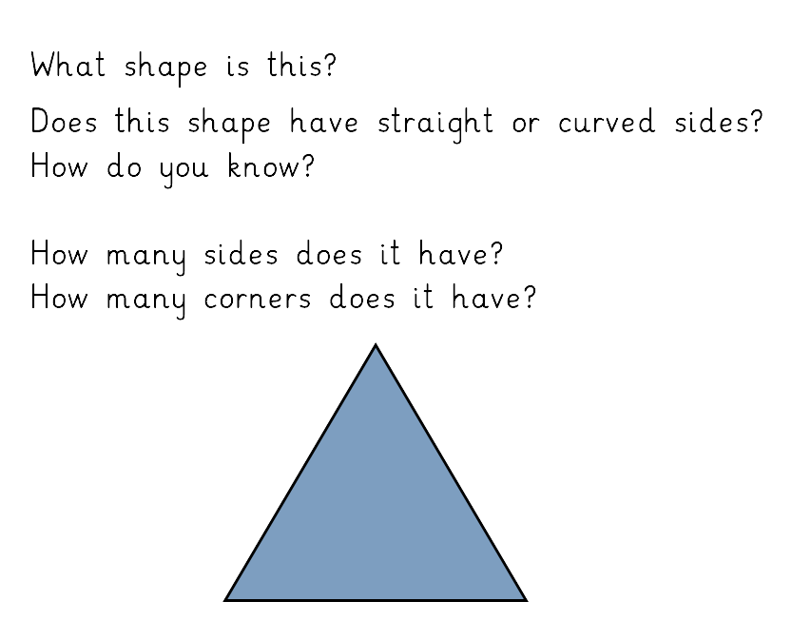

Slide 16
Triangle
Straight
Three
Three

Slide 17
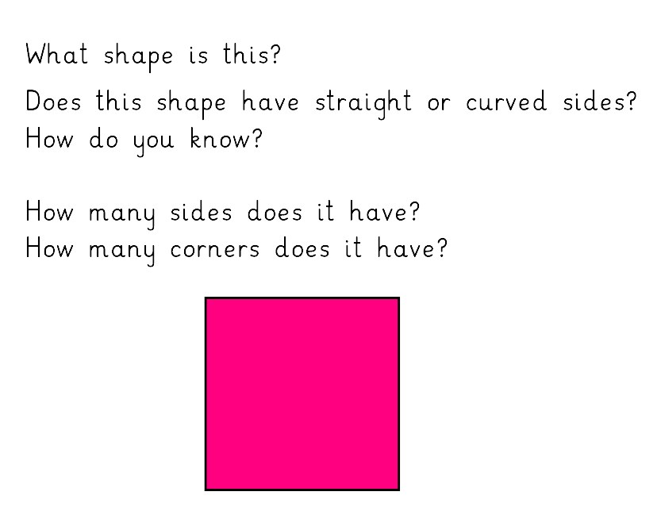

Slide 18
Square
Straight
Four
Four

Slide 19
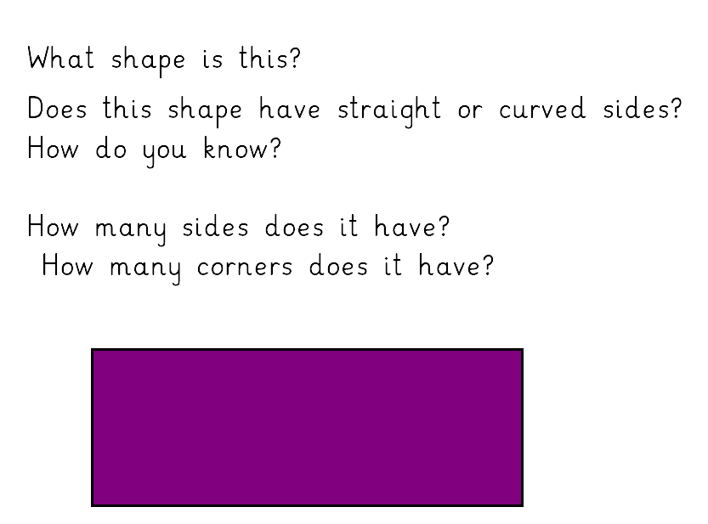

Slide 20
Rectangle
Straight
Four
Four

Slide 21
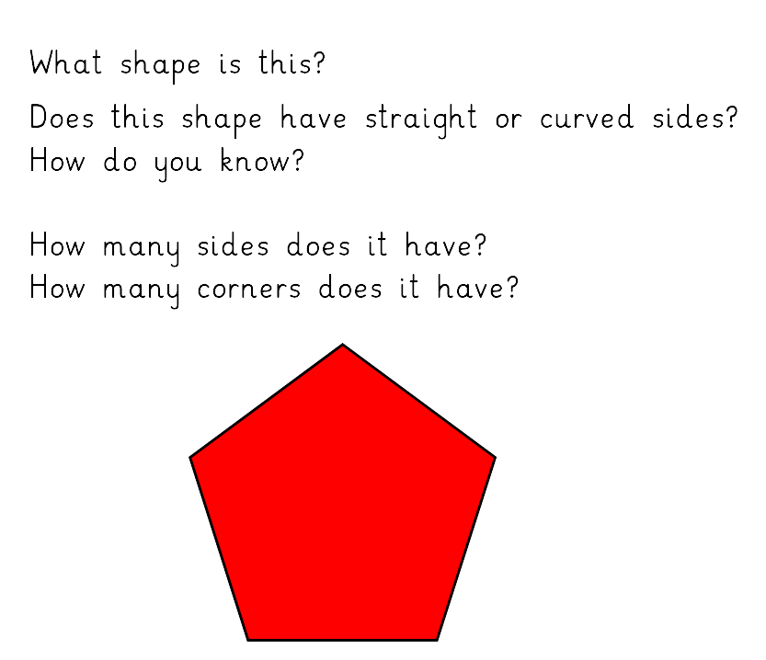

Slide 22
Pentagon
Straight
Five
Five

Slide 23
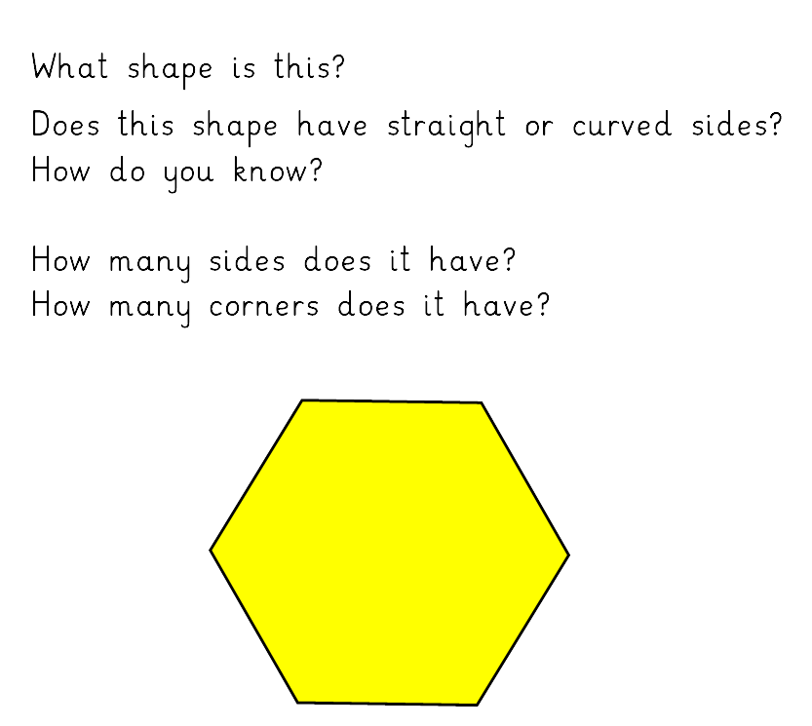

Slide 24
Hexagon
Straight
Six
Six

Slide 25
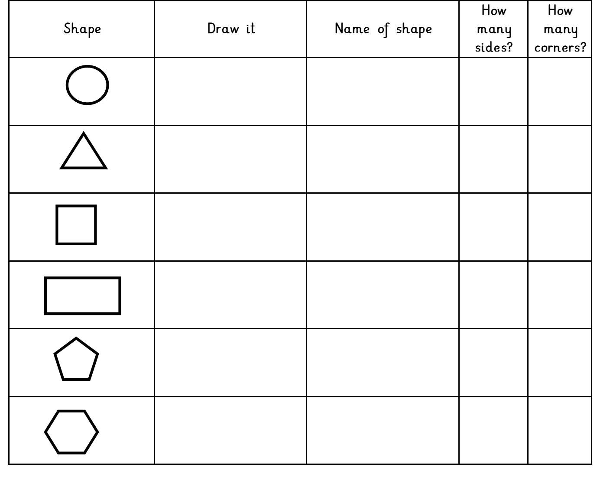
Complete the table using the information from the previous slides

Slide 26
Day 3

Slide 27
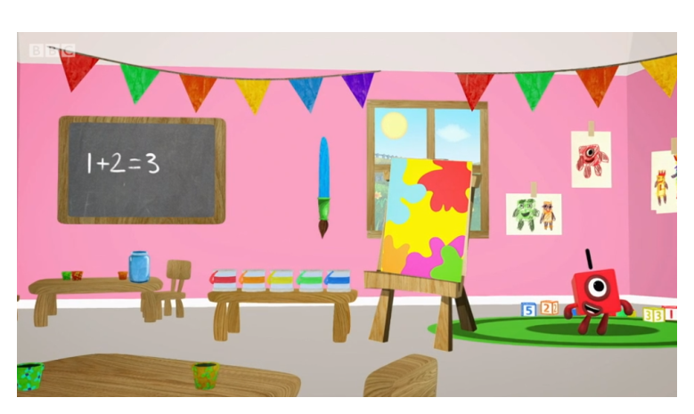
Day 3:
Trace the numbers with your finger.
https://www.bbc.co.uk/iplayer/episode/p077rk5n/numbersongs-lets-all-draw-numbers

Slide 28
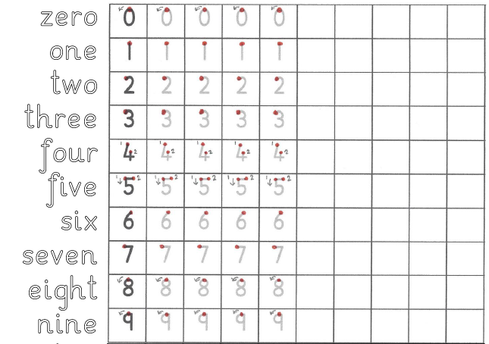
Day 3
Maths Practical Lesson.
Practise forming the numbers and words zero to nine.

Slide 29
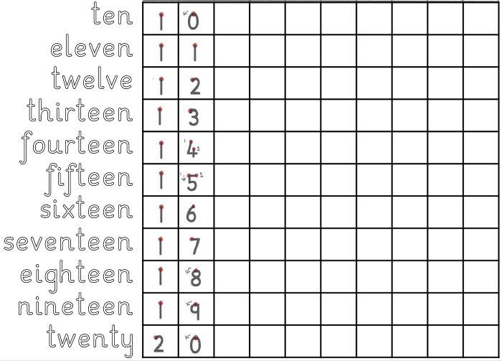
Day 3
Maths Practical Lesson.
Practise forming the numbers and words ten to twenty.

Slide 30
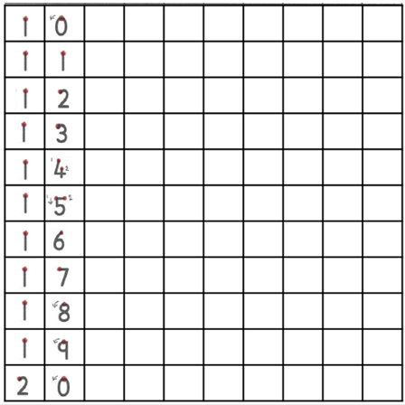

Day 3
Maths Practical Lesson.
Practise forming the numbers from twenty to thirty.

Slide 31
Day 4

Slide 32
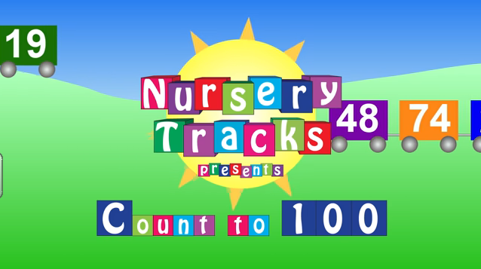
Day 4: Maths Abstract Lesson
How far can you count?
https://www.youtube.com/watch?v=CyYh1raLGBs

Slide 33
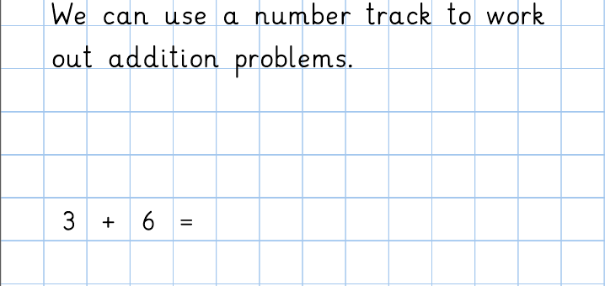
Day 4: Maths Abstract lesson
Adding up

Slide 34
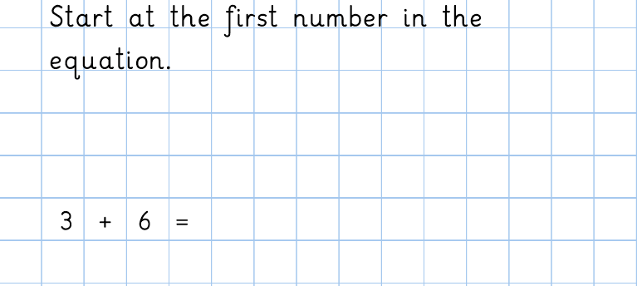

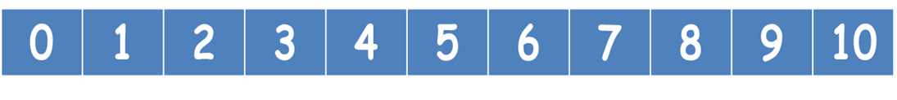
Day 4: Maths Abstract lesson
Adding up

Slide 35
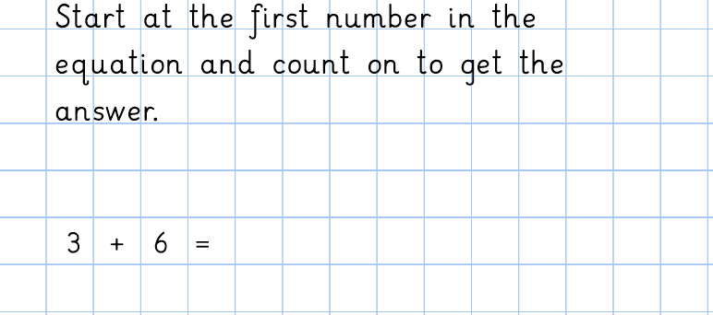
Day 4: Maths Abstract lesson
Adding up

Slide 36
Day 4: Maths Abstract lesson
Adding up
9

Slide 37
Day 4 Task: Use the Number Track to answer these questions.
3 + 6 =
2 + 5 =
6 + 4 =
10 + 4 =
8 + 6 =
13 + 7 =
12 + 6 =
7 + 10 =
3 + 6 = 9
2 + 5 = 7
6 + 4 = 10
10 + 4 = 14
8 + 6 = 14
13 + 7 = 20
12 + 6 = 18
7 + 10 = 17
0 | 1 | 2 | 3 | 4 | 5 | 6 | 7 | 8 | 9 | 10 | 11 | 12 | 13 | 14 | 15 | 16 | 17 | 18 | 19 | 20

Slide 38
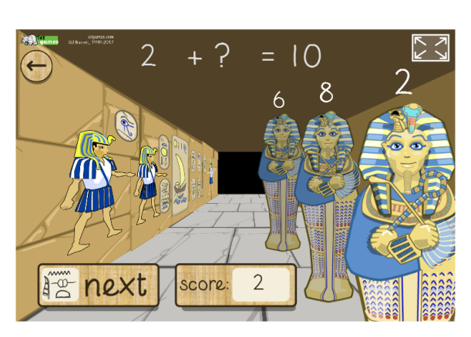
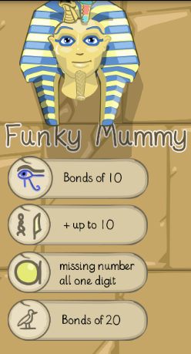
Funky Mummy Addition up to 10
http://www.ictgames.com/mobilePage/funkyMummy/index.html

Slide 39
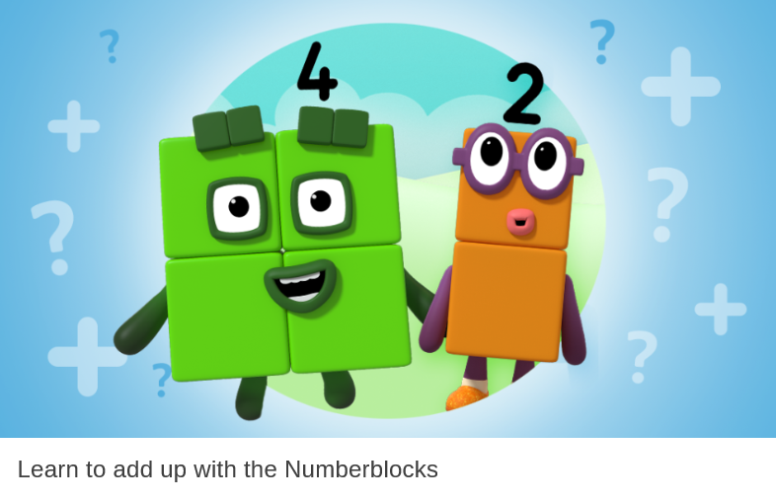
Do the Numberblocks Adding Up Quiz!
https://www.bbc.co.uk/cbeebies/puzzles/numberblocks-adding-up-quiz

Slide 40
Day 5

Slide 41
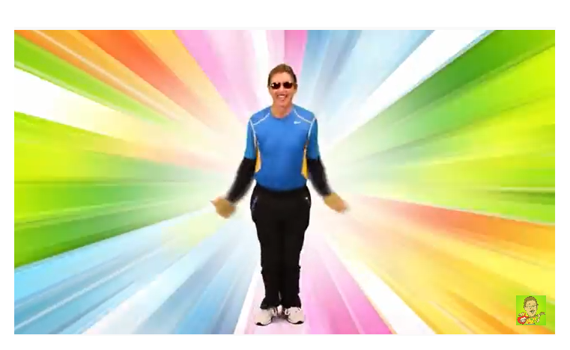
Day 5: Maths Abstract Lesson
Lets count back from 100 and exercise!
https://www.youtube.com/watch?v=v82X6XhsQhs

Slide 42
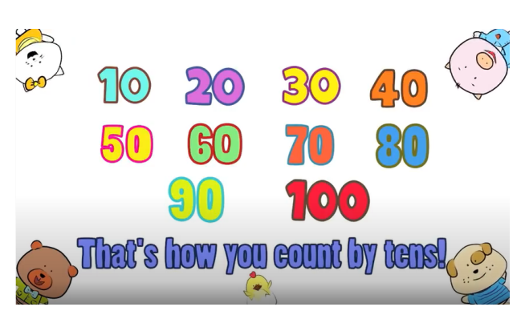
Day 5: Maths Abstract lesson
Watch the counting in 10s video and see if you can write the numbers from 10-100 in order!
https://www.youtube.com/watch?v=-gmEe0-_ex8

Slide 43
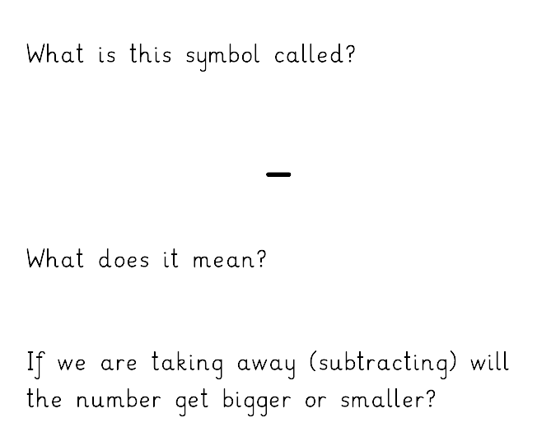
Day 5: Maths Abstract lesson
Today we are learning about Subtraction.
Subtract, minus, take away
Smaller

Slide 44
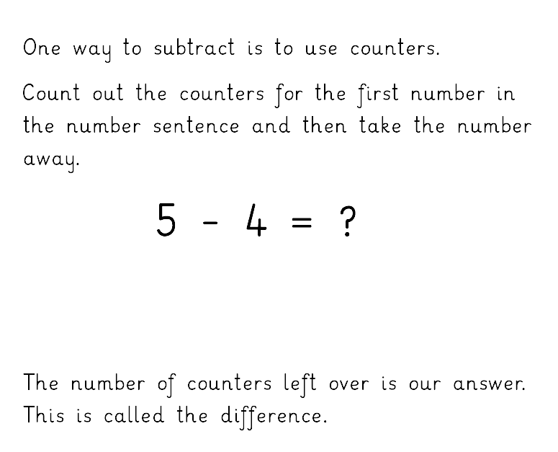

Day 5: Maths Abstract lesson
1

Slide 45
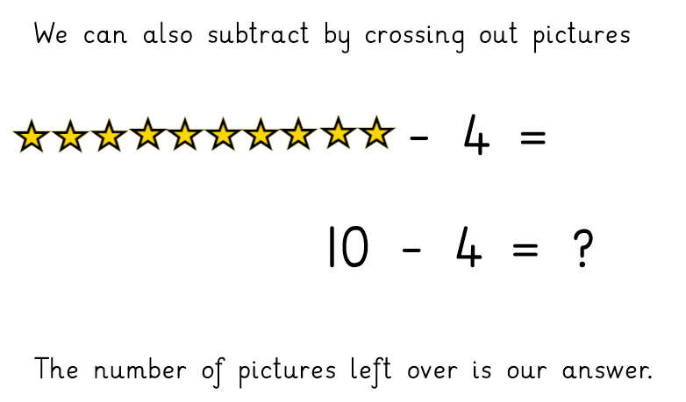

Day 5: Maths Abstract lesson
6
6

Slide 46
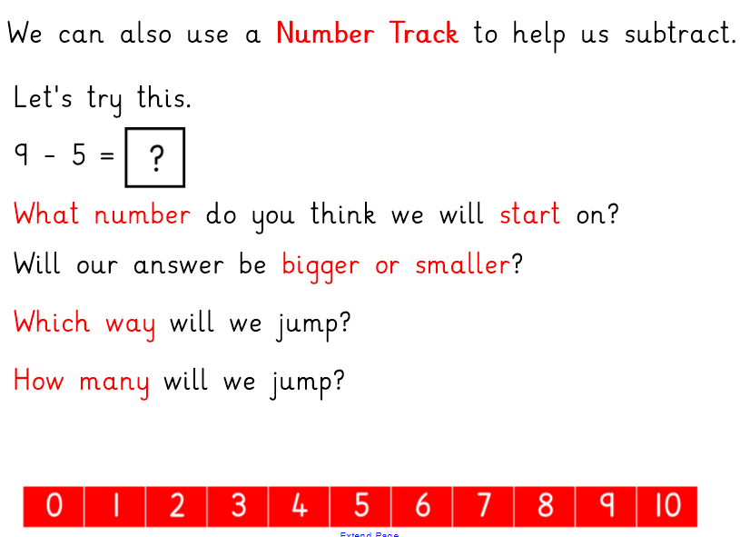

Slide 47
4

Slide 48
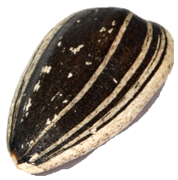
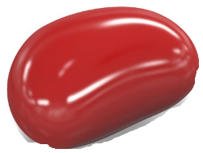
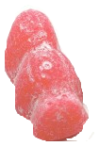

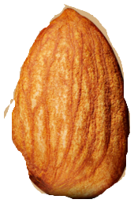

Day 5. Maths Abstract Lesson
Use the three methods (counting objects, crossing out pictures and using a number track) to complete the number sentences on the next page.
Write down the whole number sentences with your answers before checking the answers.

Slide 49
Now try these….
What do you notice?

Slide 50
Check your answers….
Did you spot the pattern?

Slide 51
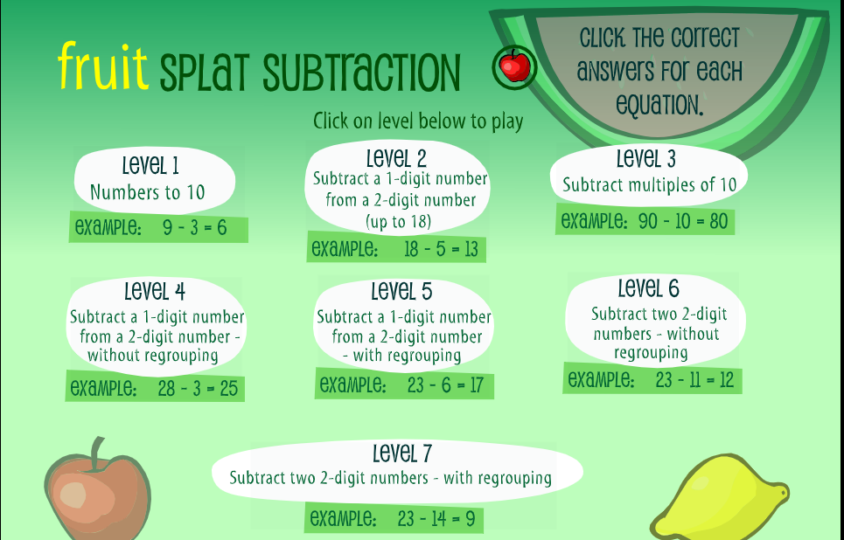
https://www.sheppardsoftware.com/math/subtraction/fruit-splat-game/

