Slide 1
Year 1
Maths Home Learning
Week Beginning 16.11.2020

Slide 2
This Week………
Day 1: Slide 3-8: Maths Practical: Number formation.
Day 2: Slides 9-15: Maths Practical : Subtraction.
Day 3: Slides 16-24: Maths Practical : Subtraction.
Day 4: Slides 25-37: Maths Pictorial: Subtraction.
Day 5: Slides 38-48: Maths Pictorial: Subtraction.

Slide 3
Day 1

Slide 4
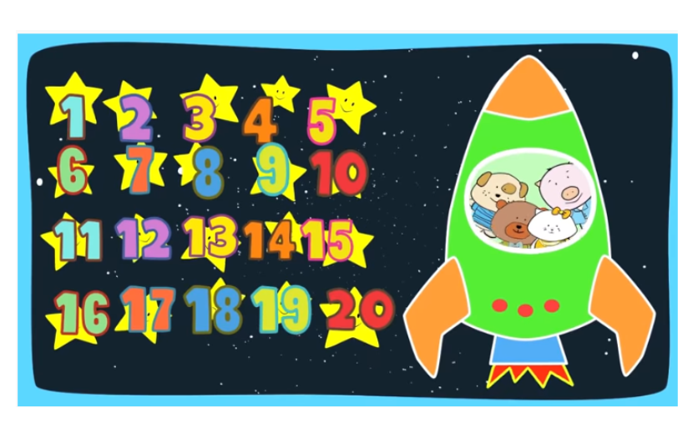
DAY 1:
Let's count to twenty together!
https://www.youtube.com/watch?v=D0Ajq682yrA

Slide 5
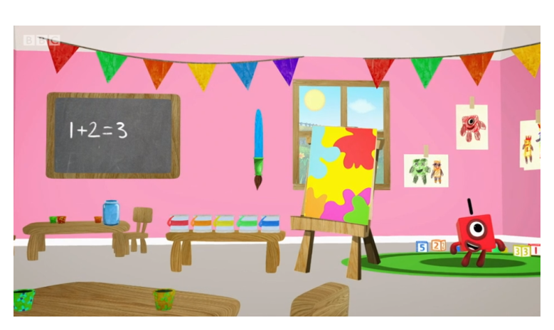
Day 1:
Trace the numbers with your finger.
https://www.bbc.co.uk/iplayer/episode/p077rk5n/numbersongs-lets-all-draw-numbers

Slide 6
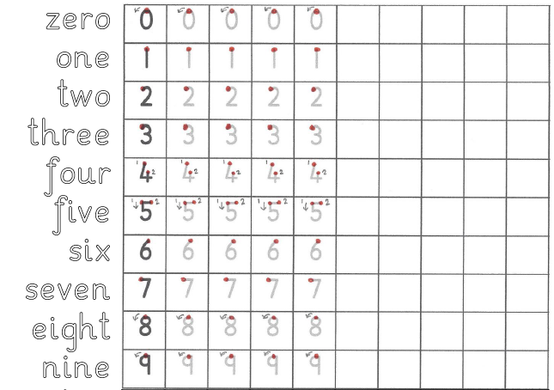
Day 1
Maths Practical Lesson.
Practise forming the numbers and words zero to nine.

Slide 7
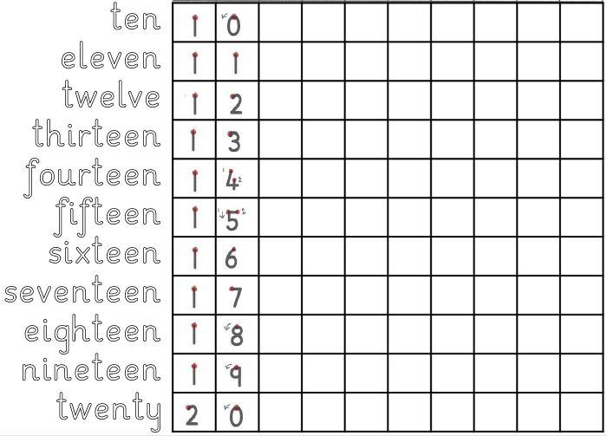
Day 1
Maths Practical Lesson.
Practise forming the numbers and words ten to twenty.

Slide 8
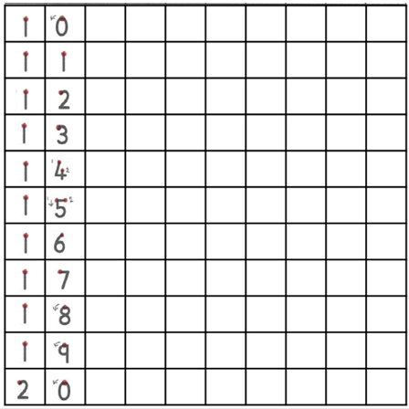

Day 1
Maths Practical Lesson.
Practise forming the numbers from twenty to thirty.

Slide 9
Day 2

Slide 10
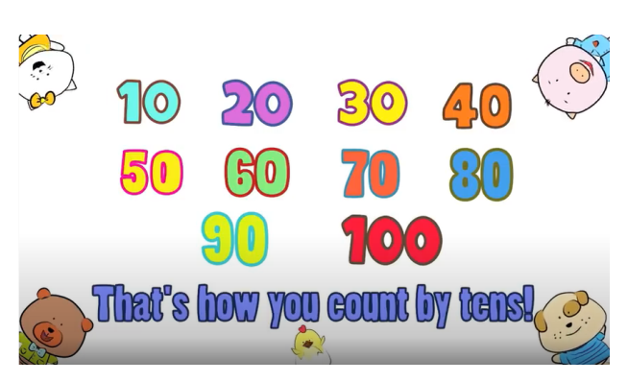
Day 2: Maths Practical lesson
Watch the counting in 10s video and see if you can write the numbers from 10-100 in order!
https://www.youtube.com/watch?v=-gmEe0-_ex8

Slide 11
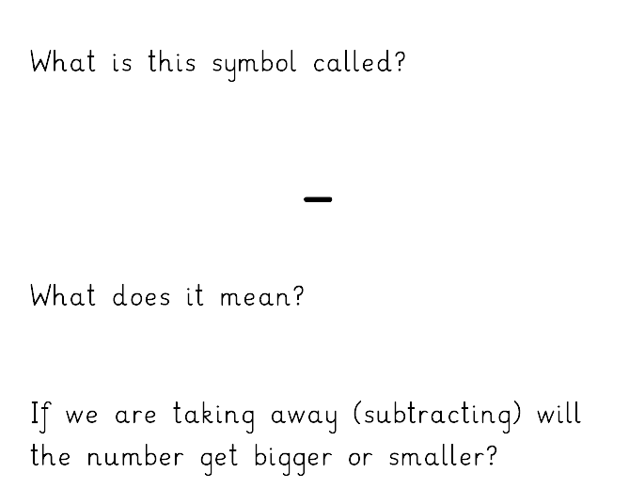
Day 2: Maths Practical lesson
Today we are learning about Subtraction.
Subtract, minus, take away
Smaller

Slide 12
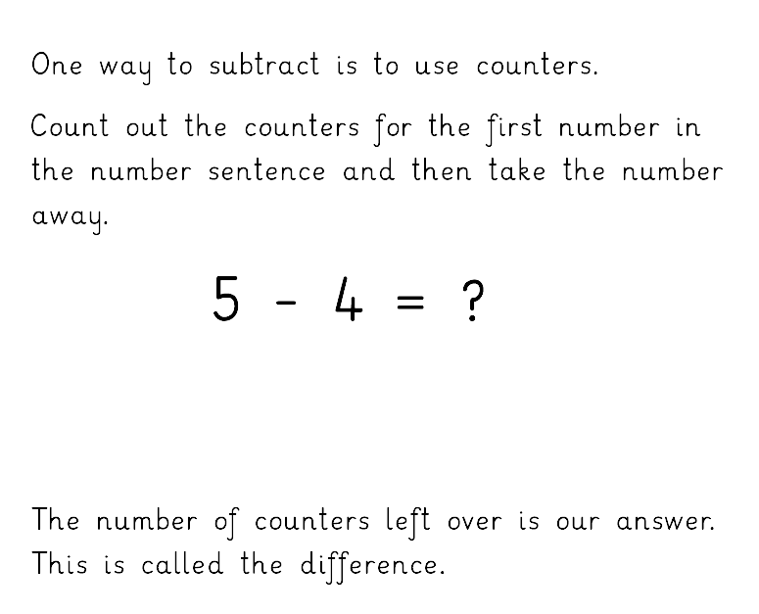

Day 2: Maths Practical lesson
1

Slide 13
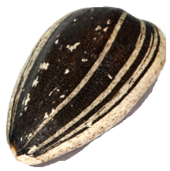
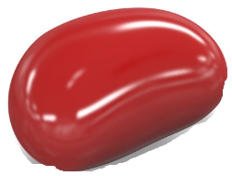


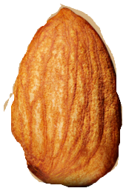

Day 2. Maths Practical Lesson
Count out objects and take them away to solve the subtraction questions on the next slide.
Write down the whole number sentences with your answers before checking the answers.
You can use the number line to help.

Slide 14


Now let’s try these
5 – 2 = 3
4 – 2 = 2
6 – 1 = 5
8 – 7 = 1
10 – 6 = 4

Slide 15
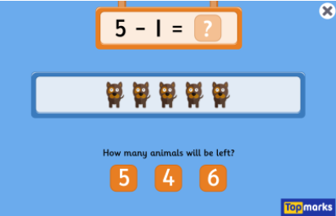
Subtraction to 10 game
https://www.topmarks.co.uk/subtraction/subtraction-to-10

Slide 16
Day 3

Slide 17
Day 3: Maths Pictorial lesson
Watch the counting in 10s video and see if you can write the numbers from 10-100 in order!
https://www.youtube.com/watch?v=-gmEe0-_ex8

Slide 18

Day 3: Maths Practical Lesson
How far can you count?
https://www.youtube.com/watch?v=CyYh1raLGBs

Slide 19
Day 3: Maths Practical lesson
Today we are learning about Subtraction.
Subtract, minus, take away
Smaller

Slide 20
Day 3: Maths Practical lesson
1

Slide 21
Day 3. Maths Practical Lesson
Count out objects and take them away to solve the subtraction questions on the next slide.
Write down the whole number sentences with your answers before checking the answers.
You can use the number line to help.

Slide 22
Now try these….

Slide 23
Check your answers….

Slide 24
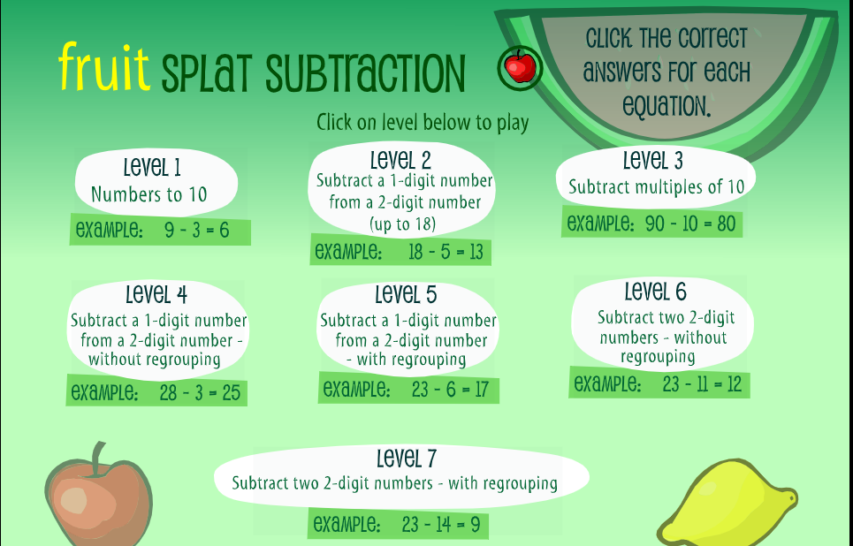
https://www.sheppardsoftware.com/math/subtraction/fruit-splat-game/

Slide 25
Day 4

Slide 26
Day 4: Maths Pictorial lesson
Watch the counting in 10s video and see if you can write the numbers from 10-100 in order!
https://www.youtube.com/watch?v=-gmEe0-_ex8

Slide 27
What is one less than……
?
5 = 6

Slide 28
What is one less than……
?
3 = 4

Slide 29
What is one less than……
?
8 = 9

Slide 30
What is one less than……
?
9 = 10

Slide 31
What is one less than……
?
15 = 16

Slide 32
What is one less than……
?
11 = 12

Slide 33
What is one less than……
?
19 = 20

Slide 34
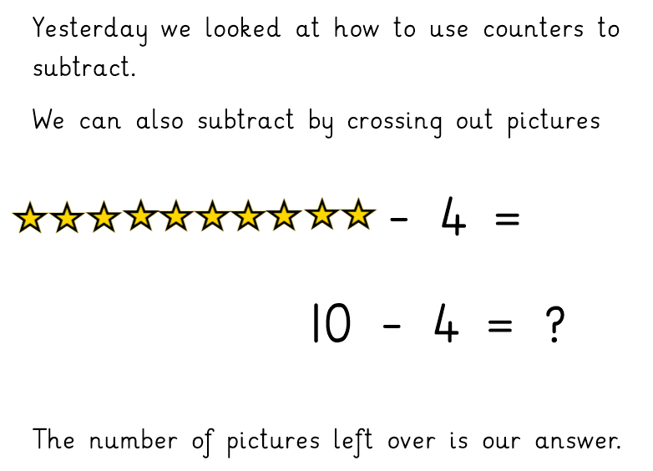

Day 4: Maths Pictorial lesson
6
6

Slide 35
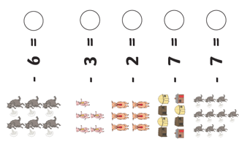
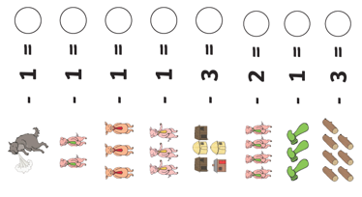
Now try these…

Slide 36
0
Check your answers.
0
0
1
2
2
2
4
2
2
1
2
1
3
4

Slide 37
https://www.sheppardsoftware.com/math/subtraction/fruit-splat-game/

Slide 38
Day 5

Slide 39
Day 5: Maths Pictorial lesson
Watch the counting in 10s video and see if you can write the numbers from 10-100 in order!
https://www.youtube.com/watch?v=-gmEe0-_ex8

Slide 40

Day 5: Maths Pictorial Lesson
Lets count back from 100 and exercise!
https://www.youtube.com/watch?v=v82X6XhsQhs

Slide 41
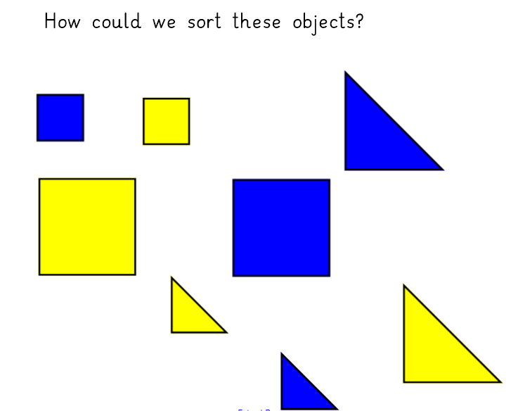

Slide 42
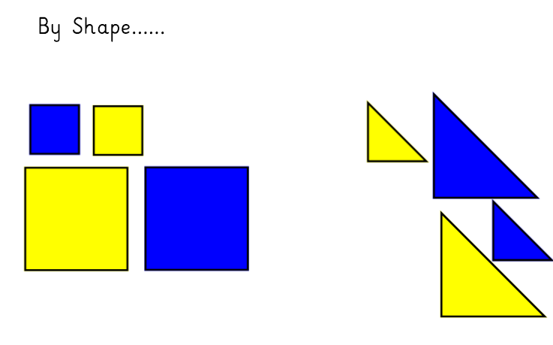

Slide 43
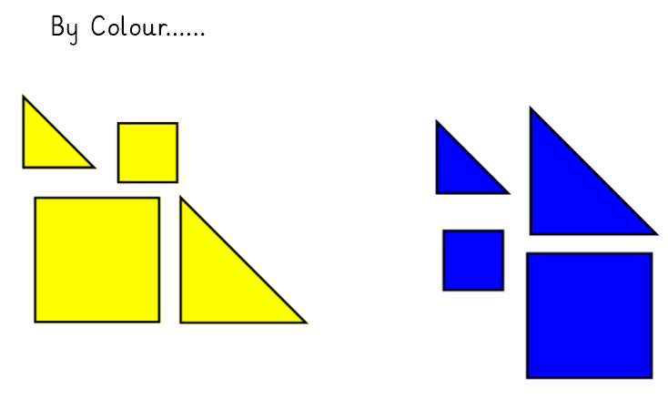

Slide 44
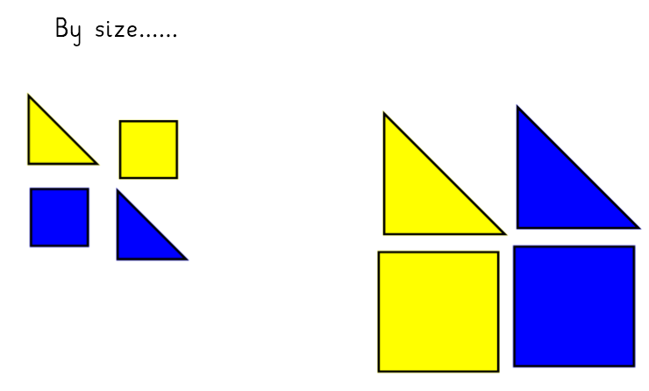

Slide 45
Day 5: Maths Pictorial lesson
6
6

Slide 46
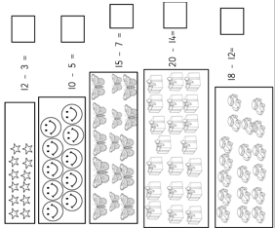
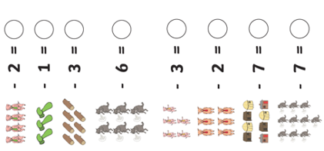
Now try these…

Slide 47
2
9
Check your answers.
2
4
5
0
8
2
6
4
1
6
3

Slide 48
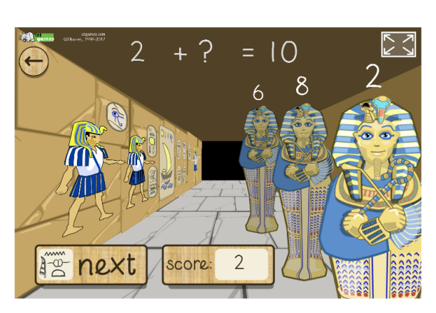
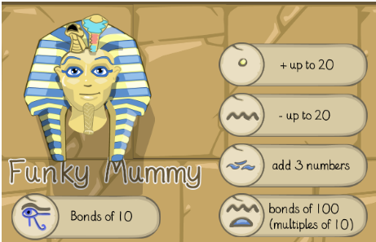
Day 5: Funky Mummy Subtraction up to 20
http://www.ictgames.com/mobilePage/funkyMummy/index.html

